Slide 1
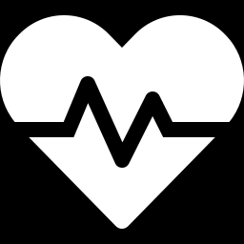
ER TRIAGE
PRIORITY QUEUE
Using a Max-Heap in C++
Topic 13: Medicine and Public Health (SDG 3)
Group Members
Vyshnavi | Rashmi | Varshini | Meghana
Arrive
Insert
Treat
Discharge
Notes:
Topic 13, SDG 3. Emergency-room triage as a priority queue implemented with a max-heap in C++.

Slide 2
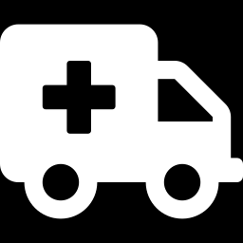
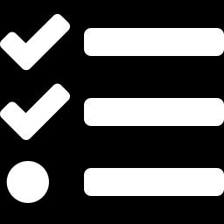
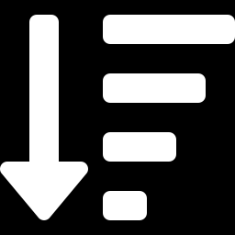
ABSTRACT
The Problem
Core Operations
Always treat the most urgent patient next, while respecting arrival time.
Insert, peek, extract-max and update severity on a max-heap in C++.
Priority Rule
SDG 3 Impact
Higher severity (1 to 5) goes first; ties go to the earlier arrival.
Fast, fair triage supports good health and well-being for all.

Slide 3
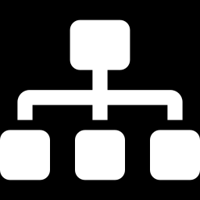
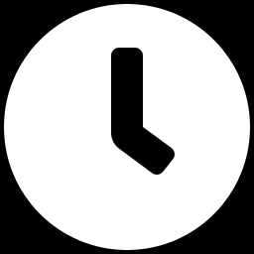
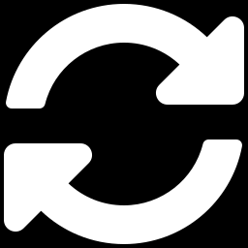
INTRODUCTION
ER patients arrive at random times
Array-based heap: Patient heap[100]
heap[0] = root = next patient
Each patient has a severity from 1 to 5
parent(i) = (i - 1) / 2
A max-heap keeps the most urgent at the root
left(i) = 2i + 1
Ties are broken by the earlier arrival time
right(i) = 2i + 2
Menu-driven loop runs until the user exits

Slide 4
ALGORITHM
Start
Display Menu
1
2
Create an empty max-heap and set the arrival counter to 0
Add, View Next, Treat, Update, Display and Exit
Take Choice
Insert / Update
3
4
Read the option; reject a severity outside 1 to 5
Insert at the end and sift up; update re-heapifies
Peek / Treat
Repeat / Stop
5
6
Peek reads the root; treat removes it and sifts down
Loop until Exit (6), then print the thank-you message

Slide 5
FLOWCHART
START
Operations in the loop
Create empty max-heap
1 Add patient: O(log n)
2 View next: O(1)
3 Treat: O(log n)
4 Update severity: O(n)
5 Display order
Display menu
Read choice
Repeat
choice == 6?
YES
END
NO
Run selected operation

Slide 6
METHODOLOGY
Heap Array
bool higherPriority(Patient a, Patient b) {
if (a.severity != b.severity)
return a.severity > b.severity;
return a.arrivalTime < b.arrivalTime;
}
// insert: sift up O(log n)
heap[size] = p; i = size++;
while (i > 0 && higherPriority(
heap[i], heap[(i-1)/2]))
swap(heap[i], heap[(i-1)/2]);
// treat: sift down O(log n)
heap[0] = heap[--size];
heapify(0);
Patient heap[100] stores name, severity and arrivalTime.
Priority Rule
higherPriority() compares severity, then arrival time.
Insert: Sift Up
New patient goes to the end and swaps up past weaker parents.
Treat: Heapify
Last patient moves to the root, then heapify() sifts it down.

Slide 7
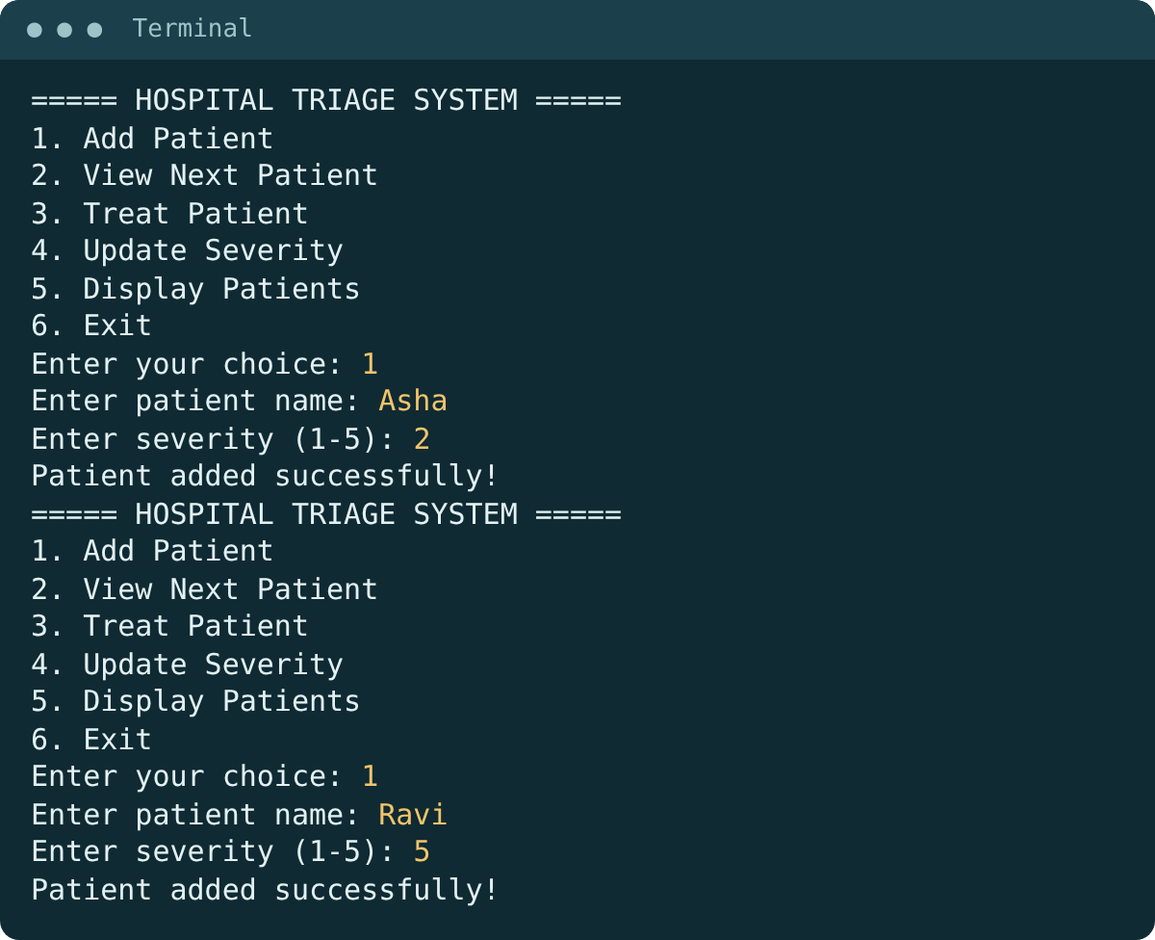
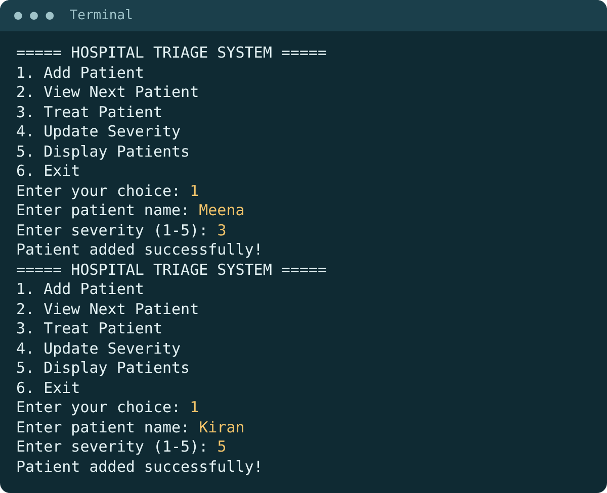
RESULTS (1 OF 3)
Add Asha (severity 2), then Ravi (severity 5)
Add Meena (3) and Kiran (5)

Slide 8
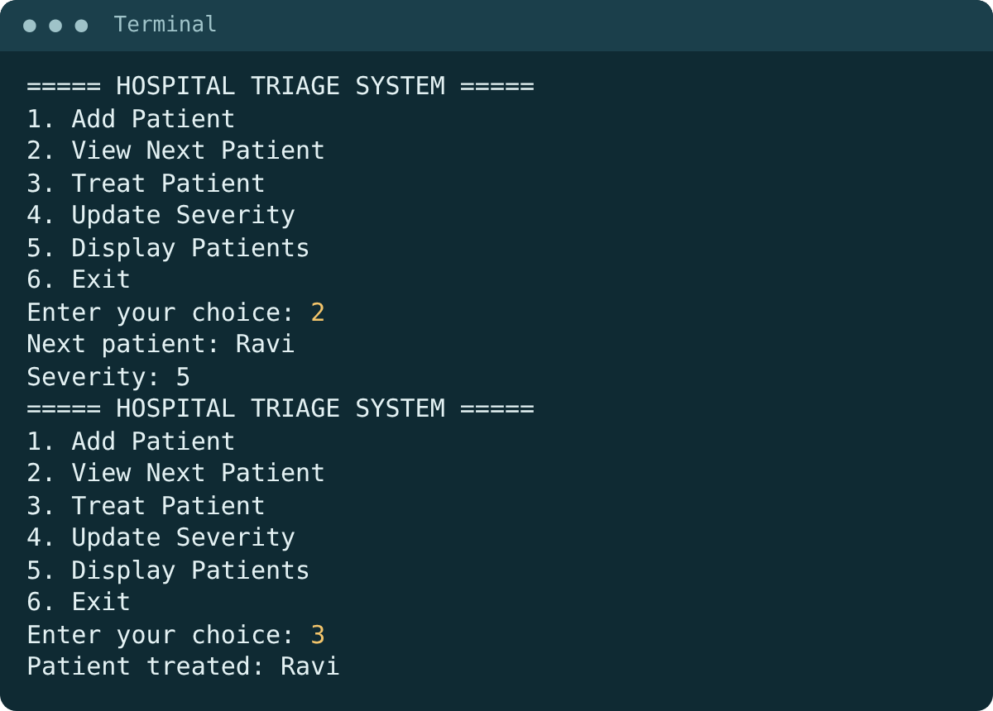
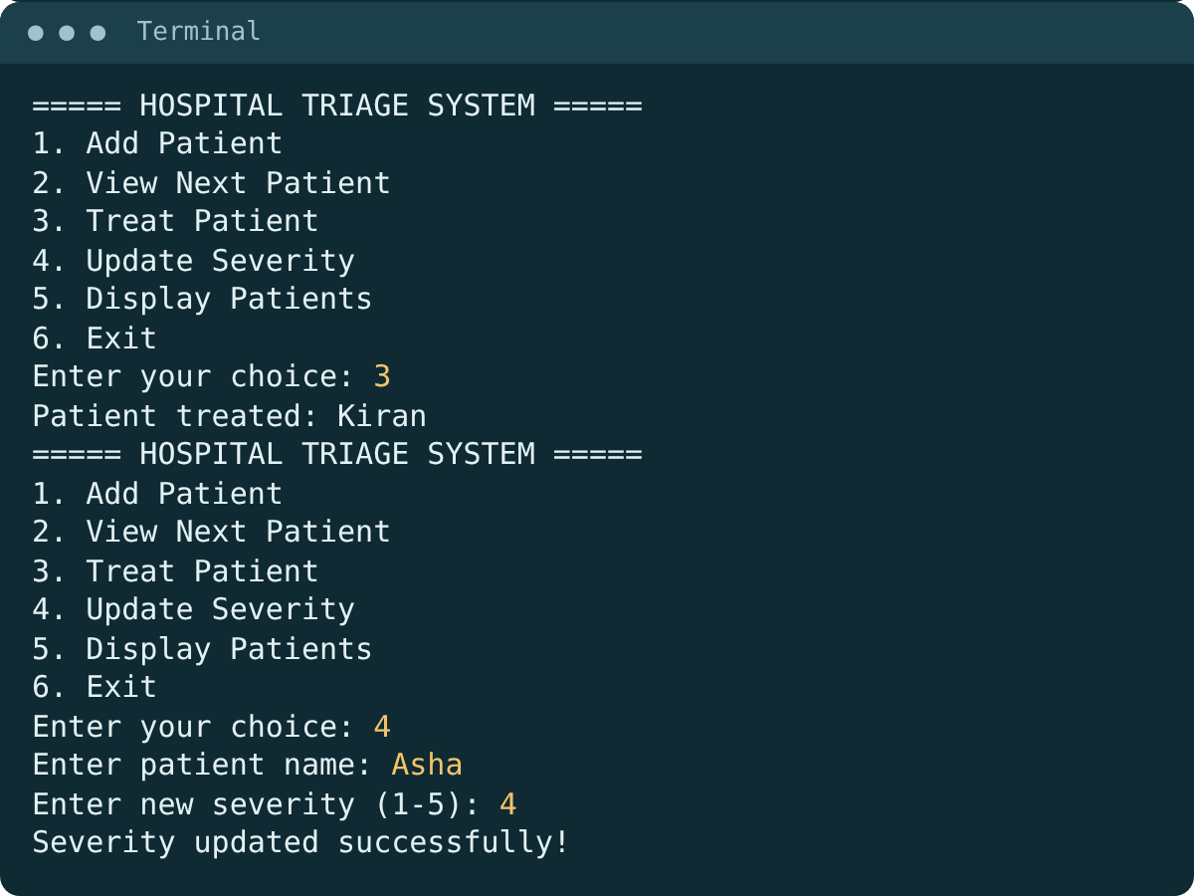
RESULTS (2 OF 3)
View next: Ravi wins the severity-5 tie by arriving first
Treat Kiran, then update Asha to severity 4

Slide 9
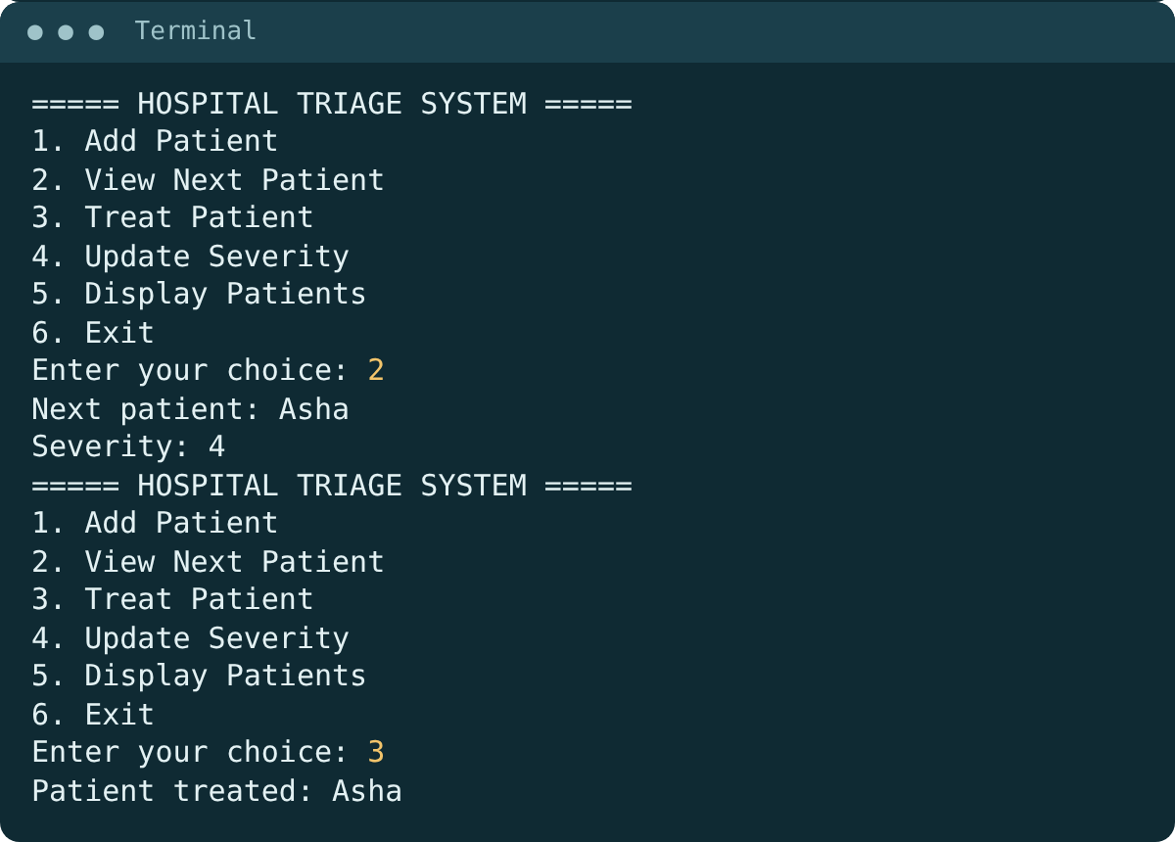
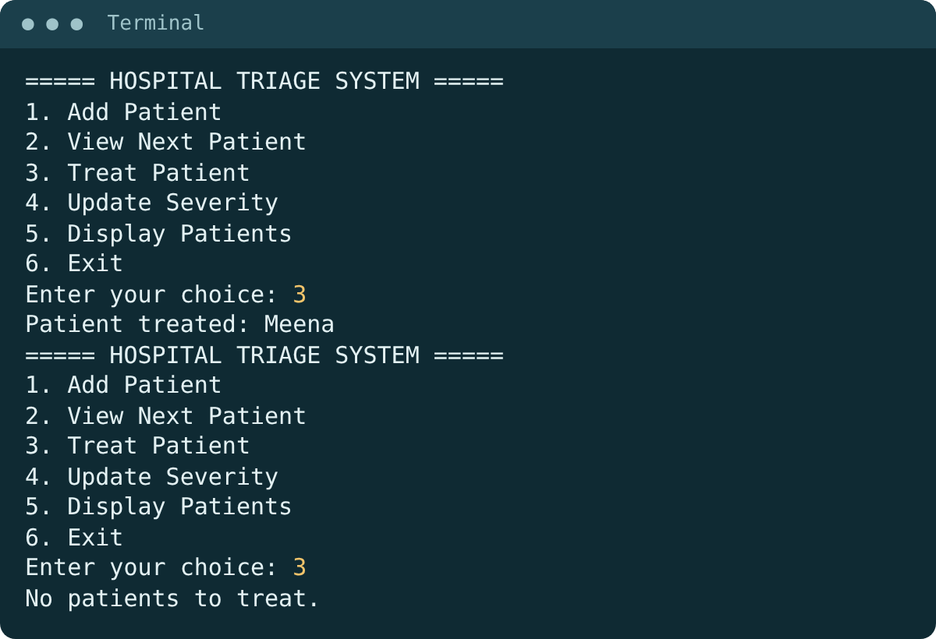
RESULTS (3 OF 3)
View next: Asha, now severity 4, then treat her
Treat Meena, then treat on an empty queue

Slide 10
SIMULATION: ORDER AND WAITING TIMES
Order | Patient | Severity | Arrived | Start | Wait
1 | Asha | 2 | 0 | 0 | 0
2 | Ravi | 5 | 2 | 10 | 8
3 | Kiran | 5 | 6 | 20 | 14
4 | Sita | 4 | 12 | 30 | 18
5 | Meena | 3 | 4 | 40 | 36
6 | Omar | 3 | 10 | 50 | 40
7 | Latha | 1 | 8 | 60 | 52
24 min
average wait
52 min
longest wait (Latha, sev 1)
Arrivals at minutes 0 to 12. Each treatment takes 10 min. Wait = start - arrival (min).

Slide 11
TESTING: TIES AND EMPTY QUEUE
Test case | Scenario | Expected | Result
Empty treat | Treat with no patients | No patients to treat. | PASS
Empty peek | View next with no patients | No patients available. | PASS
Tie on severity | Ravi (5, t=2) vs Kiran (5, t=4) | Ravi first | PASS
Update severity | Asha 2 -> 4 | Asha becomes next | PASS
Drain queue | Treat after the last patient | Empty message again | PASS
Equal severity is served in arrival order, and an empty queue never crashes.

Slide 12
COMPLEXITY: HEAP VS LINEAR SEARCH
Operation | Max-heap | Linear search
Insert | O(log n) | O(1)
Peek | O(1) | O(n)
Extract-max | O(log n) | O(n)
Update severity | O(n) as coded* | O(n)
Treat n patients | O(n log n) | O(n^2)
Why O(log n)?
A heap is a complete binary tree of height log2(n). Sift up and sift down move one level per swap, so each does at most log n swaps.
* Scan to find the name, then rebuild the heap. An id-to-index map makes it O(log n).

Slide 13
BENCHMARK: INSERT N, THEN TREAT N
~1,500x
faster than linear search at 100,000 patients
Heap grows as n log n; linear scan grows as n squared. C++ -O2, same input.

Slide 14



TRIAGE FAIRNESS
What is fair
The risk
Safeguards
Clinical need sets the order
Equal severity: first come, first served
Same rule for every patient
Starvation: Latha (sev 1) waited 52 min
A stream of severe cases can delay mild ones
Severity may be mis-scored
Aging: raise priority as wait grows
Re-triage with Update Severity
Maximum-wait alerts and audit logs
Strict priority serves urgency fairly, but needs aging to protect mild cases.

Slide 15


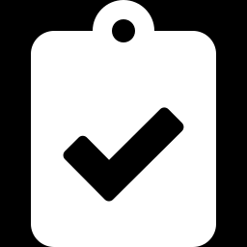
CONCLUSION
A max-heap keyed by severity, then arrival time, always serves the most urgent patient next
Insert and treat run in O(log n) and peek in O(1); linear search needs O(n) per treatment
Benchmark: about 1,500x faster than linear search at 100,000 patients
Ties, updates and the empty queue behave correctly; waiting times are simulated
Future scope: O(log n) update with an id-to-index map, aging for fairness, dynamic queue size, live dashboard

