Slide 1
DATA STRUCTURES AND ALGORITHMS PROJECT
Emergency Room Triage
Priority Queue Using Max Heap
A C++-based simulation for severity-driven patient prioritization
TEAM:
1.SURESHMA KOPPISETTI
2.HARSHA VARDHAN PANDRANGI
3.BHAVYA SRUTHI MUNJETI
4.ANUSHA DEVI SAPIREDDY

Slide 2
Abstract
Emergency departments must prioritize patients according to urgency rather than relying only on arrival order. This project presents a C++-based triage simulation using a custom Max Heap.
Approach
Implementation
Outcome
Patients are prioritized by severity, with arrival time used to resolve equal-severity cases.
A custom Max Heap, vector, and unordered map support queue management and severity updates.
The simulation displays treatment order and calculates patient waiting times.
The project demonstrates the practical use of priority queues in patient-queue management.
EMERGENCY ROOM TRIAGE PRIORITY QUEUE | C++
2

Slide 3
Introduction
Background
Proposed System
Emergency rooms receive patients with different levels of medical urgency. Treating strictly by arrival order may not reflect the seriousness of each case.
A priority queue selects the most urgent waiting patient. Higher severity receives higher priority; earlier arrival breaks severity ties.
Project objectives
• Prioritize patients according to severity.
• Maintain fair ordering for patients with equal severity.
• Support insertion, removal, inspection, and severity updates.
• Simulate treatment scheduling and calculate waiting times.
EMERGENCY ROOM TRIAGE PRIORITY QUEUE | C++
3

Slide 4
Algorithm
1
Initialize an empty Custom Max Heap and patient index map.
2
Sort incoming patients by arrival time.
3
Insert all patients who have arrived by the current simulation time.
4
Select and remove the highest-priority patient using Extract-Max.
5
Calculate waiting time as treatment start time minus arrival time.
6
Advance the simulation clock by the patient's treatment duration.
7
If the queue is empty, move time to the next patient arrival.
8
Repeat until all patients are treated; display treatment order and waiting times.
EMERGENCY ROOM TRIAGE PRIORITY QUEUE | C++
4

Slide 5
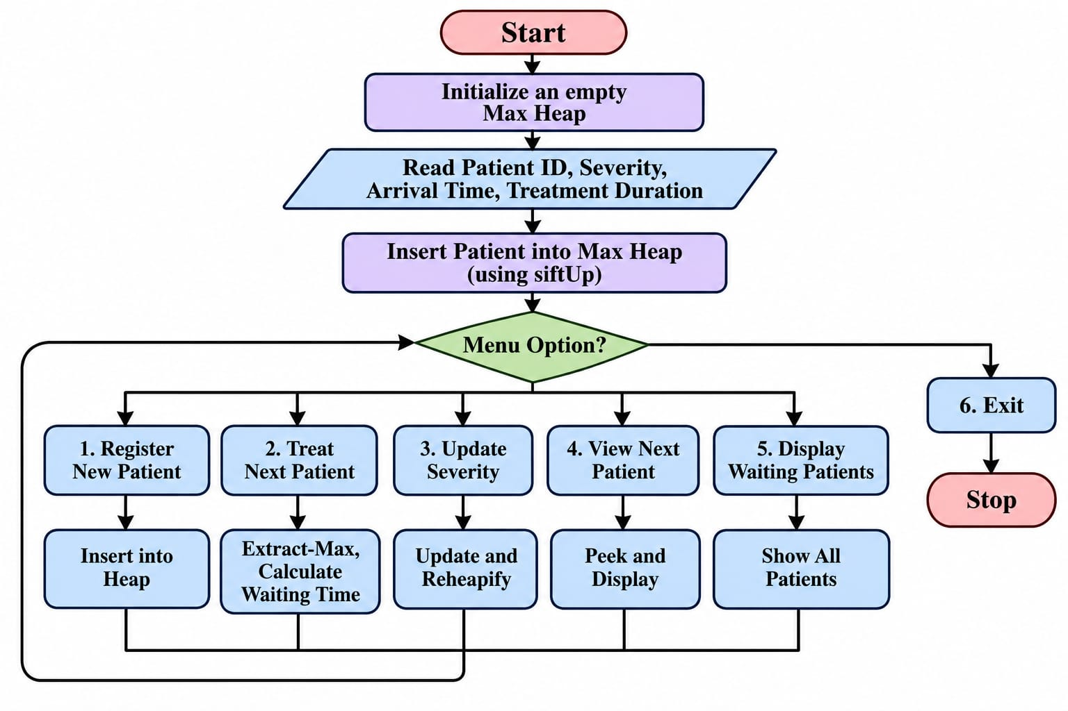
Flowchart
EMERGENCY ROOM TRIAGE PRIORITY QUEUE | C++
5

Slide 6
Methodology
Patient Data
Priority Management
Each patient stores ID, severity, arrival time, and treatment duration.
A Custom Max Heap orders patients by severity and arrival time.
Tie-Breaking
Heap Operations
A sequence number preserves insertion order when severity and arrival time are identical.
Insert, Extract-Max, Peek, and Update Severity maintain the priority queue.
Index Tracking
Simulation & Analysis
An unordered map tracks patient IDs and their current heap positions.
Treatment start times and waiting times are recorded; heap performance is reviewed.
EMERGENCY ROOM TRIAGE PRIORITY QUEUE | C++
6

Slide 7
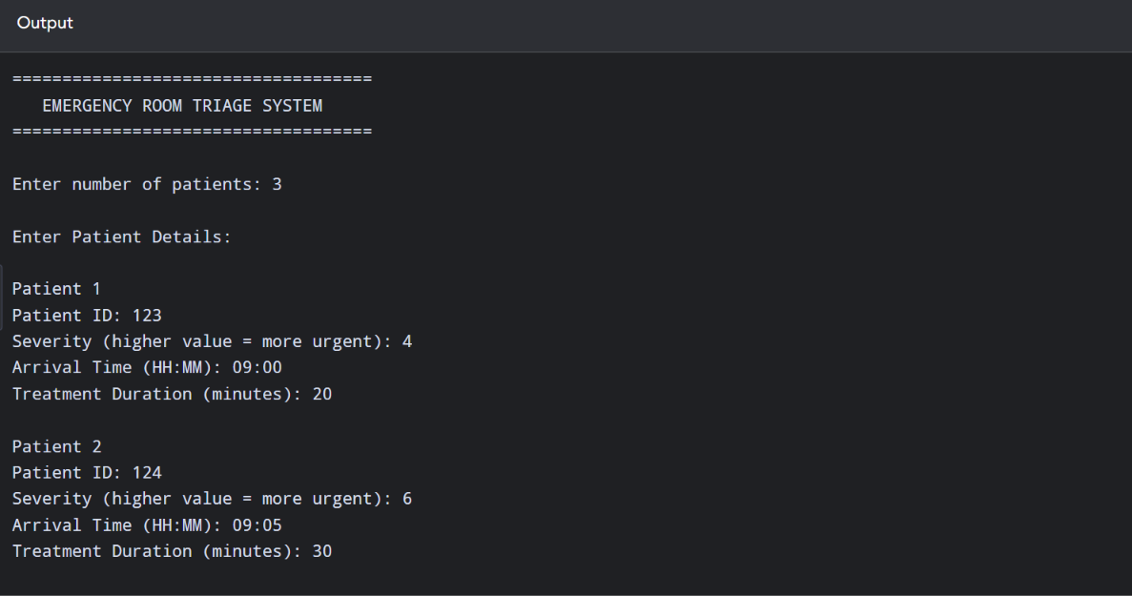
Results and Screenshots
EMERGENCY ROOM TRIAGE PRIORITY QUEUE | C++
7

Slide 8
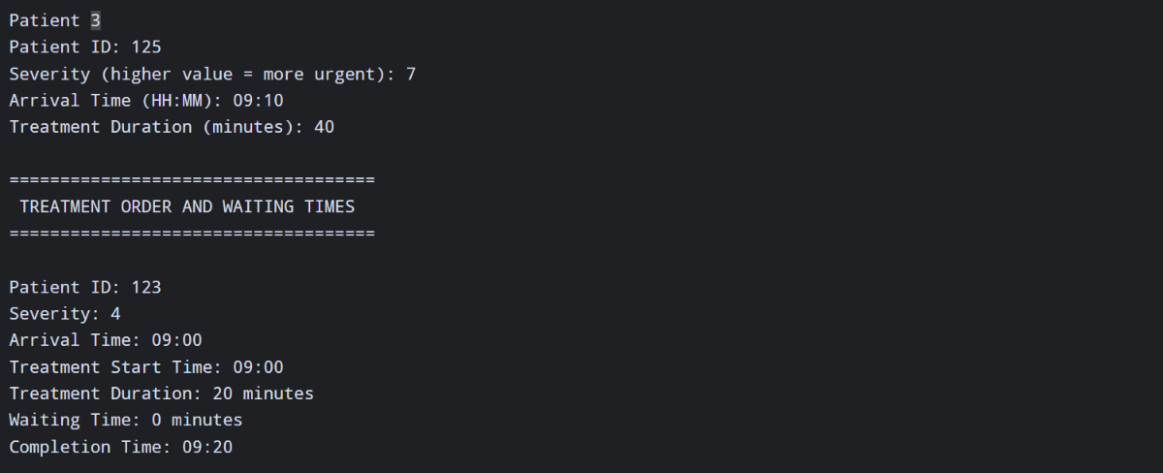

Slide 9
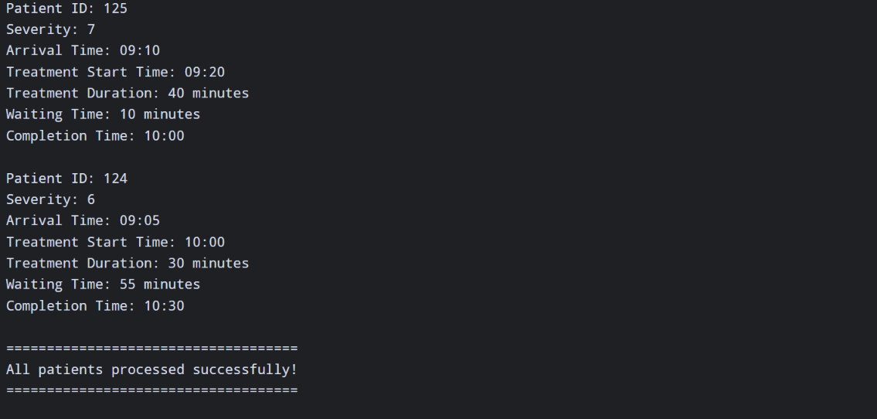

Slide 10
Conclusion
The Emergency Room Triage Priority Queue demonstrates how a Custom Max Heap can organize waiting patients according to urgency.
Efficient
Fair ordering
Useful simulation
Heap operations support efficient insertion and selection of the highest-priority patient.
Arrival time and insertion sequence resolve priority ties consistently.
The program records treatment order and waiting times for analysis.
EMERGENCY ROOM TRIAGE PRIORITY QUEUE | C++
8

Slide 11
THANK YOU
Emergency Room Triage Priority Queue Using Max Heap | C++

