Slide 1
PYTHON MINI PROJECT
SMART LIBRARY BOOK
RESERVATION AND PRIORITY
MANAGEMENT SYSTEM
A simple system to manage books, reservations and priority-based waiting lists.
TEAM:
Harsha Vardhan Pandrangi
Sureshma Koppisetti
Bhavya Sruthi Munjeti
Anusha Devi Sapireddy

Slide 2
ABSTRACT
The Smart Library Book Reservation and Priority Management System is a Python-based application designed to manage library books, student reservations and waiting lists efficiently. It checks book availability, handles reservation requests and places students in a priority-based waiting list when copies are unavailable. When a book is returned, it is allocated to the next eligible student based on priority. The system uses lists, dictionaries, searching, sorting, file handling and object-oriented programming to simplify library operations and reduce manual effort.
BOOK MANAGEMENT
PRIORITY RESERVATION
AUTOMATED ALLOCATION
Maintains book details and available copies.
Organizes requests based on priority.
Assigns returned books to waiting students.
02 | SMART LIBRARY SYSTEM

Slide 3
INTRODUCTION
Libraries need an organized way to track books and handle multiple student requests, especially when a book has no available copies.
• Stores book details such as ID, title, author and number of copies.
• Allows students to search for books and request reservations.
• Maintains a waiting list when all copies are unavailable.
• Uses priority levels to decide which waiting request is served first.
• Updates book availability when a reservation is returned.
Developed using Python and Object-Oriented Programming (OOP).
03 | SMART LIBRARY SYSTEM

Slide 4
ALGORITHM
• Start the application and display the menu.
• Add book details and initialize reservation and waiting-list records.
• Allow users to display or search for books.
• Accept the book ID, student name and priority for a reservation.
• Check book availability; reserve immediately if a copy is available and no request is waiting.
• Otherwise, add the request to the waiting list according to priority.
• When a book is returned, allocate it to the highest-priority waiting student.
• Display notifications and updated reservation details.
• Save book records to a file and exit.
04 | SMART LIBRARY SYSTEM

Slide 5
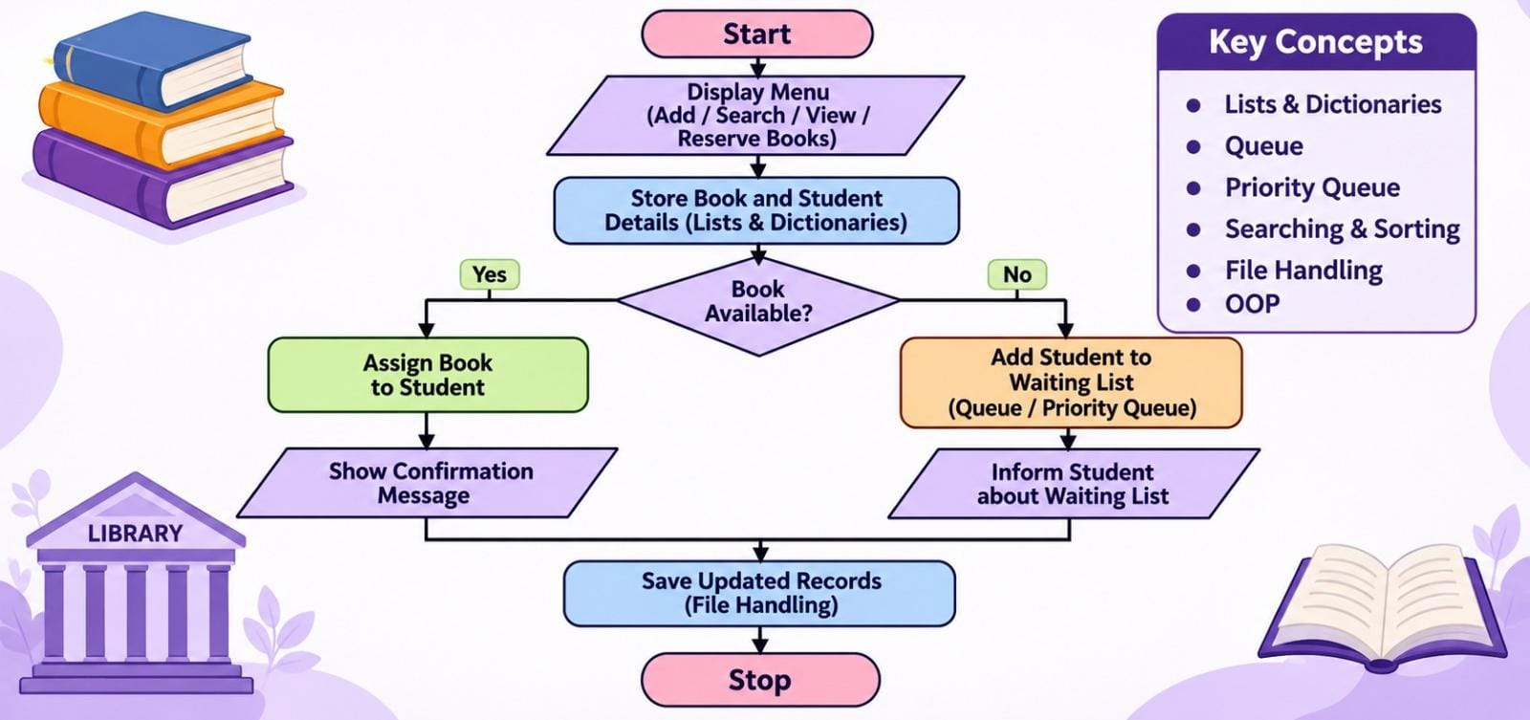
FLOWCHART
05 | SMART LIBRARY SYSTEM

Slide 6
METHODOLOGY
Book management
Book searching
Reservation
Add and maintain book details.
Search books by title or author.
Check availability and process student requests.
Priority management
Book allocation
Notifications
Maintain a priority-based waiting list.
Assign returned books to waiting students.
Display book availability notifications.
Data storage
Display
Save book records using file handling.
Show updated books, reservations and waiting lists.
06 | SMART LIBRARY SYSTEM

Slide 7
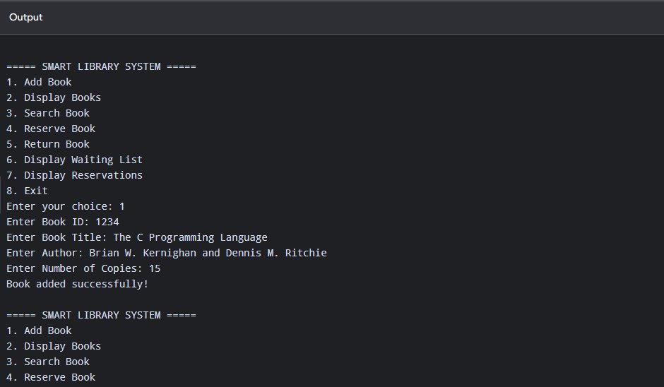
RESULTS – OUTPUT SCREENSHOTS
07 | SMART LIBRARY SYSTEM

Slide 8
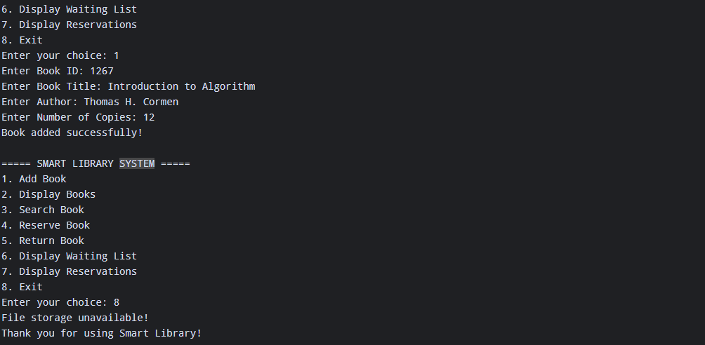
08 | SMART LIBRARY SYSTEM

Slide 9
CONCLUSION
The Smart Library Book Reservation and Priority Management System provides an organized way to manage library books, student reservations and waiting lists. It uses Python data structures, priority-based allocation, searching, sorting and file handling to simplify library operations. The system reduces manual effort and helps ensure that available books are assigned to waiting students in the correct priority order.
ORGANIZED
EFFICIENT
USER-FRIENDLY
Maintains book and reservation details.
Manages priority-based waiting requests.
Simplifies common library operations.
09 | SMART LIBRARY SYSTEM

Slide 10
FUTURE SCOPE
Develop a web-based library management application.
- Integrate barcode or QR code scanning for books.
- Implement email and SMS notifications.
- Add student login and authentication.
Provide advanced search and filtering options.
- Generate reports on book usage and reservations.
- Integrate cloud storage for secure data management.
- Support multiple libraries and branches.
10| SMART LIBRARY SYSTEM

Slide 11
THANK YOU
Smart Library Book Reservation and Priority Management System
Questions & Feedback

