Slide 1
JAVA MINI PROJECT
P
SLOT ALLOCATION &
MANAGEMENT SYSTEM
SMART
PARKING
An automated approach to vehicle entry, parking allocation,
slot tracking and parking fee calculation.
TEAM:
Bhavya Sruthi Munjeti
Sureshma Koppisetti
Harsha Vardhan Pandrangi
Anusha Devi Sapireddy

Slide 2
Abstract
The Smart Parking Slot Allocation and Management System is a Java-based application designed to simplify and automate parking operations. The system manages vehicle entry and exit, automatically allocates available parking slots, maintains parking records, and displays the current availability of parking spaces. It also calculates parking charges based on the duration of vehicle parking. By using object-oriented programming concepts, ArrayList, Queue, exception handling, and file handling, the system provides an organized and efficient approach to parking management. This project aims to reduce manual effort, minimize parking delays, improve space utilization, and provide a reliable solution for managing parking facilities.
02 | SMART PARKING SYSTEM

Slide 3
Introduction
Why smart parking?
01
Automatic slot allocation
Parking management is an important aspect of crowded places such as shopping malls, colleges, hospitals and commercial buildings. Manual allocation and record keeping can cause delays, confusion and inefficient use of available spaces.
This Java application automates the process by assigning vacant slots, recording vehicle entry and exit, tracking availability and calculating parking fees according to the parking duration.
02
Vehicle entry and exit records
03
Live slot availability
04
Duration-based fee calculation
03 | SMART PARKING SYSTEM

Slide 4
Algorithm
1
Start the program and initialize parking slots.
6
On vehicle exit, retrieve its entry record and calculate the parking duration.
2
Display the parking management menu.
7
Calculate the parking fee and release the occupied slot.
3
Accept vehicle details and vehicle type.
8
Allocate the released slot to the next waiting vehicle, if any.
4
Check for an available parking slot.
9
Update and display parking records and slot availability.
5
If a slot is available, allocate it; otherwise add the vehicle to the waiting queue.
10
Repeat until Exit is selected, then Stop.
04 | SMART PARKING SYSTEM

Slide 5
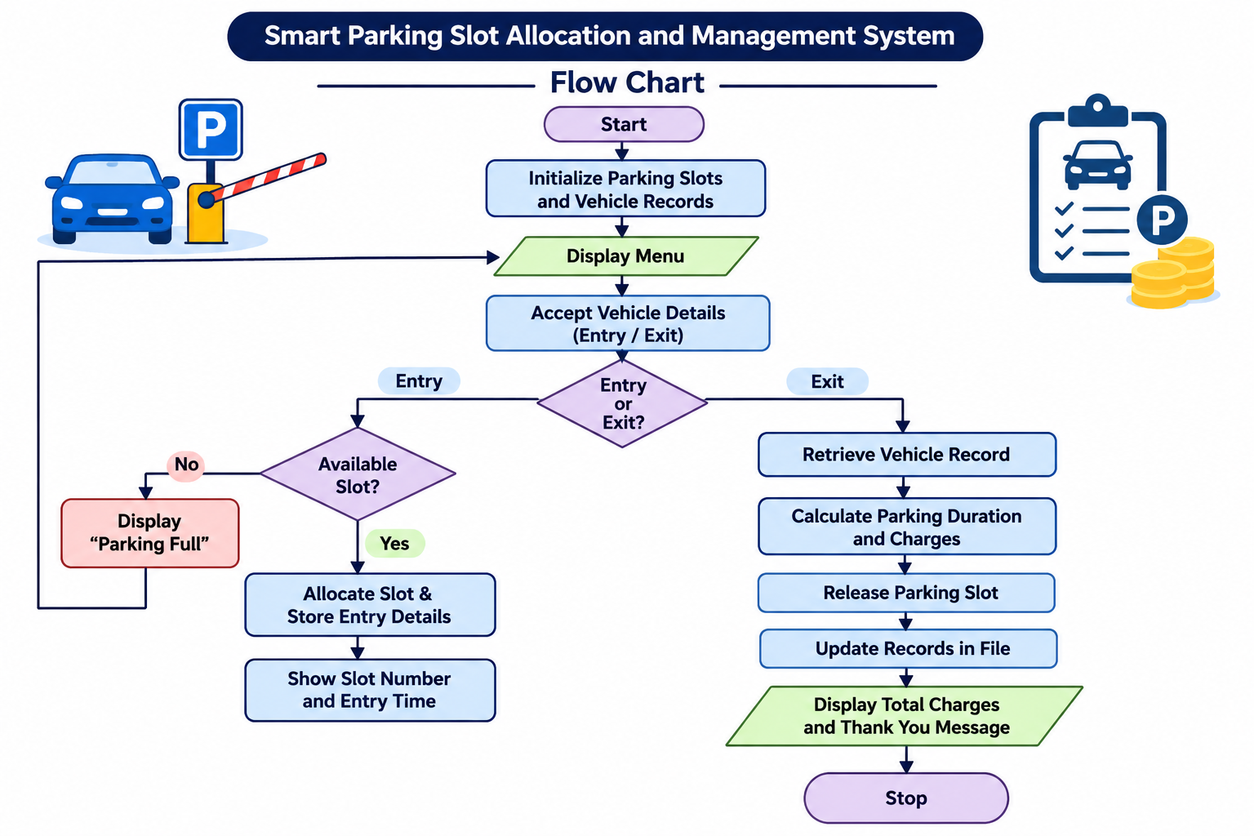
Flowchart
05 | SMART PARKING SYSTEM

Slide 6
Methodology
Object-oriented design
Inheritance & encapsulation
Use classes and objects to represent vehicles, parking slots and the parking system.
Create Car and Bike subclasses; protect vehicle and slot data using private fields and methods.
Data structures
Parking operations
Use ArrayList to manage slots and active vehicles, and Queue to manage waiting vehicles.
Allocate vacant slots, record entry time, process exits and calculate charges.
Exception handling
File handling
Validate menu input and handle file-related errors safely.
Append parking events to a text file and read saved records when requested.
06 | SMART PARKING SYSTEM

Slide 7
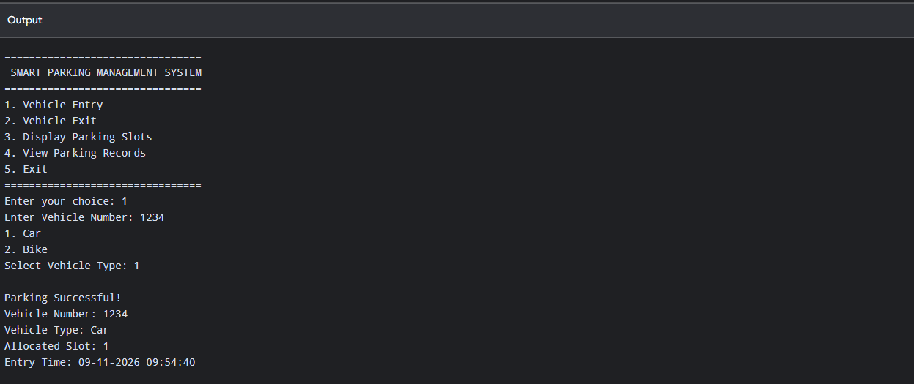
Results – Screenshots
07 | SMART PARKING SYSTEM

Slide 8
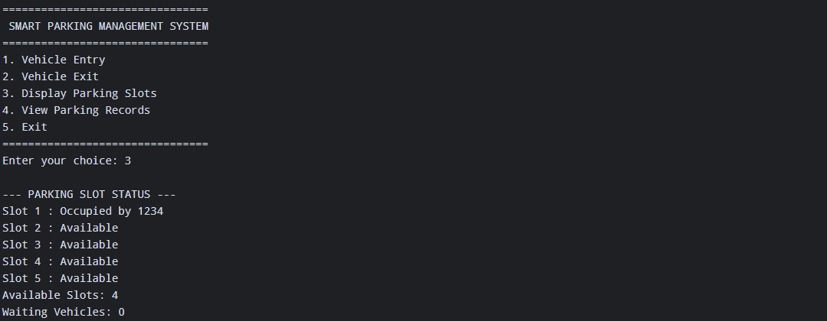
08 | SMART PARKING SYSTEM

Slide 9
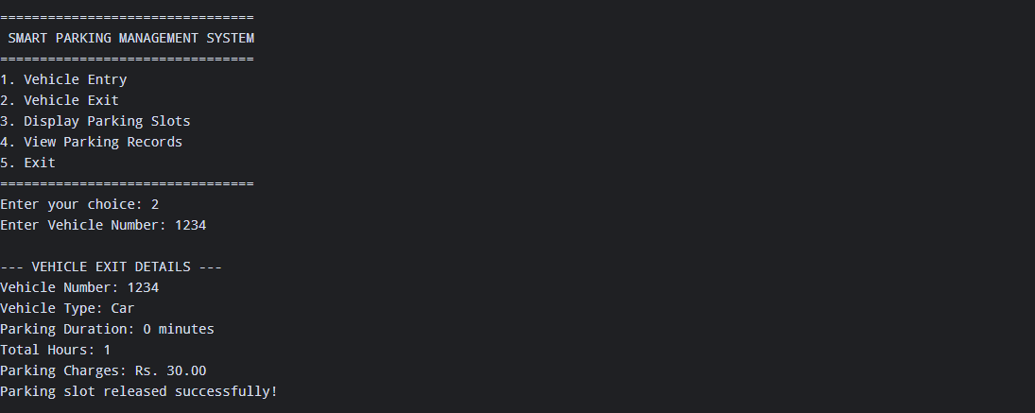
09| SMART PARKING SYSTEM

Slide 10
Conclusion
The Smart Parking Slot Allocation and Management System provides an efficient and automated solution for managing parking facilities. It simplifies vehicle entry and exit, allocates parking slots, maintains records and calculates parking charges based on parking duration. By applying Java concepts such as object-oriented programming, ArrayList, Queue, exception handling and file handling, the system reduces manual effort, saves time and improves parking space utilization.
Outcome: organized parking operations with reduced manual intervention.
10| SMART PARKING SYSTEM

Slide 11
Future Scope
01
Online parking slot booking
02
Real-time parking availability tracking
03
QR code-based vehicle entry and exit
04
Integration of online payment methods
05
Mobile application for users
06
Sensors to detect vacant parking slots
07
Automated reports and parking analytics
08
AI-based vehicle number plate recognition
11| SMART PARKING SYSTEM

Slide 12
P
THANK YOU
Smart Parking Slot Allocation and Management System
Questions?

