Slide 1
DATA STRUCTURES & ALGORITHMS PROJECT
PERISHABLE FOOD
WAREHOUSE DISPATCH SYSTEM
FEFO
Expiry-based inventory management using a Min-Heap and FEFO dispatch
Presented by
Bobbili Jaya Venkata Rayudu
Java | Min-Heap | FEFO | File Handling

Slide 2
Project Overview
INTRODUCTION
A console-based Java application that manages perishable food batches and prioritises dispatch by expiry date.
CORE IDEA
DISPATCH RULE
PROJECT GOAL
Use a Min-Heap so the batch with the earliest expiry date is available at the root.
Follow FEFO: First Expiry, First Out. Earlier-expiring eligible batches are dispatched first.
Support organised inventory handling, expiry monitoring and reduced avoidable food wastage.
Implementation: Java classes • ArrayList • HashMap • LocalDate • Java file I/O
PERISHABLE FOOD WAREHOUSE DISPATCH SYSTEM | JAVA + MIN-HEAP
2

Slide 3
Problem Statement
MOTIVATION
Perishable food items have limited shelf lives. If batches are dispatched without considering expiry dates, older stock may remain in storage and expire.
CHALLENGE 1
CHALLENGE 2
CHALLENGE 3
Tracking several batches with different expiry dates can become difficult.
Repeatedly searching for the earliest-expiring batch can be inefficient.
Expired stock must be identified and excluded from dispatch.
Proposed solution: organise batches by expiry priority using a Min-Heap.
PERISHABLE FOOD WAREHOUSE DISPATCH SYSTEM | JAVA + MIN-HEAP
3

Slide 4
Project Objectives
GOALS
Manage food batches with ID, food name, quantity and expiry date.
Implement a Min-Heap based on expiry date.
Insert, inspect, extract and update batches efficiently.
Dispatch required quantities using FEFO priority.
Identify near-expiry batches and delete expired batches.
Generate warehouse dispatch and wastage summaries.
Save inventory to a text file and load it on the next run.
PERISHABLE FOOD WAREHOUSE DISPATCH SYSTEM | JAVA + MIN-HEAP
4

Slide 5
Data Structure: Min-Heap
CORE CONCEPT
A Min-Heap is a complete binary tree where each parent has priority less than or equal to its children.
In this project:
• Expiry date is the primary key.
• Batch ID breaks expiry-date ties.
• The root holds the earliest batch.
11-10
11-12
11-14
11-15
11-18
11-20
11-22
Illustrative Min-Heap ordering (earliest date at root)
PERISHABLE FOOD WAREHOUSE DISPATCH SYSTEM | JAVA + MIN-HEAP
5

Slide 6
Project Structure & Technologies
IMPLEMENTATION
Batch.java
MinHeap.java
WarehouseDispatchSystem.java
Represents one food batch:
• Batch ID
• Food name
• Quantity
• Expiry date
Maintains priority order:
• ArrayList<Batch>
• HashMap for ID-to-index mapping
• siftUp / siftDown
• insert / peek / extractMin
Application workflow:
• Menu and user input
• FEFO dispatch
• Expiry alerts and reports
• Inventory file storage
Supporting Java APIs: LocalDate, Scanner, BufferedReader, BufferedWriter, Files and Paths.
PERISHABLE FOOD WAREHOUSE DISPATCH SYSTEM | JAVA + MIN-HEAP
6

Slide 7
Working Procedure
APPLICATION FLOW
1
Start
2
Manage
3
Prioritise
Load saved inventory, if present
Add batches or update expiry details
Min-Heap keeps earliest expiry at root
4
Dispatch
5
Monitor
6
Report & Save
Serve eligible batches in FEFO order
Check near-expiry and expired batches
Show totals and save remaining inventory
PERISHABLE FOOD WAREHOUSE DISPATCH SYSTEM | JAVA + MIN-HEAP
7

Slide 8
Key Min-Heap Operations
ALGORITHM
Insert
Add the batch at the end, then sift up.
O(log n)
Peek
Read the root without removing it.
O(1)
Extract Min
Remove the root, move last item to root, then sift down.
O(log n)
Update Expiry
Find index using HashMap, change date, then restore heap order.
O(log n) expected
Delete Expired
Scan and remove batches whose expiry date is before today.
O(n log n) worst case
PERISHABLE FOOD WAREHOUSE DISPATCH SYSTEM | JAVA + MIN-HEAP
8

Slide 9
Application Features
FUNCTIONALITY
Add Food Batch — validate and insert a batch.
View All Batches — display inventory sorted by expiry.
Peek Earliest — inspect the next batch to expire.
Dispatch Quantity — dispatch partial or full quantities.
Update Shelf Life — change an existing batch's expiry date.
Delete Expired — remove batches expired before the current date.
Simulate Dispatch Day — classify batches by a selected date.
Near Expiry Alert — show batches expiring today through the next three days.
Warehouse Report — show dispatch, waste and remaining-stock totals.
PERISHABLE FOOD WAREHOUSE DISPATCH SYSTEM | JAVA + MIN-HEAP
9

Slide 10
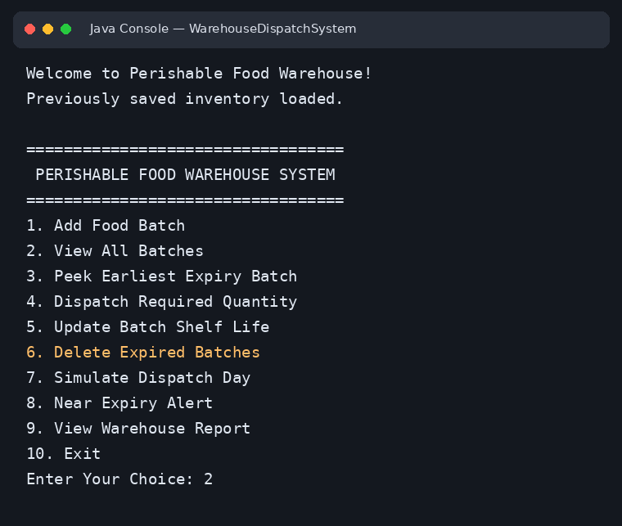
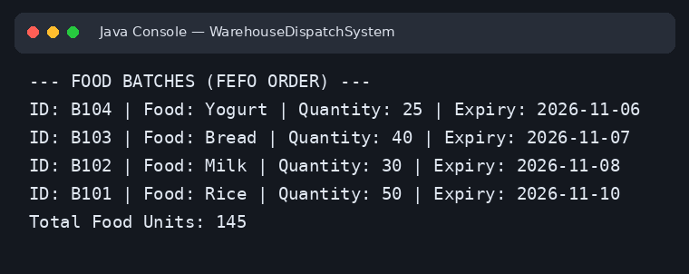
Sample Program Output
SCREENSHOTS
Main menu
Inventory in FEFO order
PERISHABLE FOOD WAREHOUSE DISPATCH SYSTEM | JAVA + MIN-HEAP
10

Slide 11
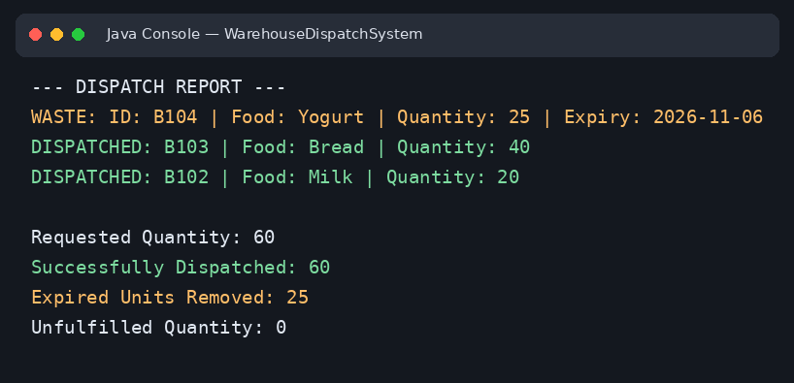
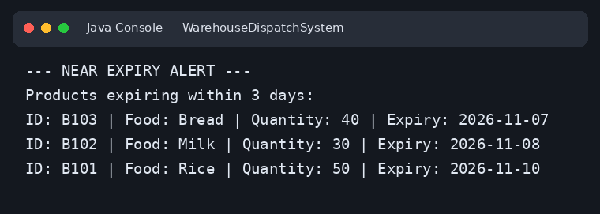
Sample Program Output
SCREENSHOTS
Near-expiry alert
Dispatch report
PERISHABLE FOOD WAREHOUSE DISPATCH SYSTEM | JAVA + MIN-HEAP
11

Slide 12
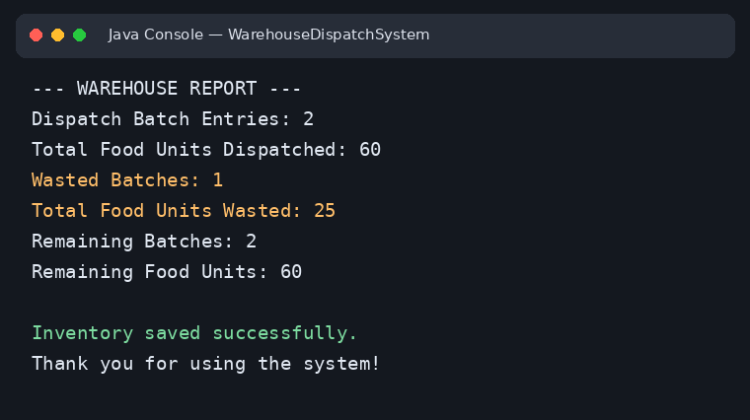
Warehouse Summary
SCREENSHOTS
The report summarises dispatch activity, wasted batches and remaining inventory.
PERISHABLE FOOD WAREHOUSE DISPATCH SYSTEM | JAVA + MIN-HEAP
12

Slide 13
Testing Strategy
VALIDATION
The documentation defines test scenarios. Record Pass/Fail only after executing each test in your environment.
Valid, duplicate and invalid batch insertion
Peek and extraction from non-empty and empty heap
Two or more batches with the same expiry date
Update expiry date and verify heap order
Delete batches expired before the current date
Full and partial dispatch quantity
Near-expiry alert window
Save inventory, restart and load saved batches
PERISHABLE FOOD WAREHOUSE DISPATCH SYSTEM | JAVA + MIN-HEAP
13

Slide 14
Performance Analysis
COMPLEXITY
Operation
Time Complexity
Reason
Insert
O(log n)
Append + sift up
Peek
O(1)
Read root
Extract Min
O(log n)
Replace root + sift down
Update Expiry
O(log n) expected
HashMap lookup + heap adjustment
Display sorted
O(n log n)
Copy and sort batches
Delete expired
O(n log n) worst case
Scan and remove expired entries
Sorting all batches repeatedly costs O(n log n) per sort; a Min-Heap supports O(log n) insertion and extraction.
PERISHABLE FOOD WAREHOUSE DISPATCH SYSTEM | JAVA + MIN-HEAP
14

Slide 15
Future Enhancements
NEXT STEPS
Graphical user interface for easier interaction.
Database integration for structured inventory storage.
Barcode scanning to speed up batch identification.
Multiple-warehouse inventory management.
More detailed dispatch and wastage reports.
Search and filtering by batch ID, food name and expiry date.
CURRENT SCOPE
A Java console application focused on the Min-Heap, FEFO dispatch, expiry monitoring and file-based inventory persistence.
PERISHABLE FOOD WAREHOUSE DISPATCH SYSTEM | JAVA + MIN-HEAP
15

Slide 16
Conclusion
SUMMARY
A Min-Heap provides an efficient way to prioritise perishable food batches by expiry date.
The project demonstrates how core data-structure operations can support a practical warehouse workflow. It combines batch management, FEFO dispatch, expiry alerts, reporting and inventory persistence in a Java console application.
THANK YOU
Questions?
Bobbili Jaya Venkata Rayudu
PERISHABLE FOOD WAREHOUSE DISPATCH SYSTEM | JAVA + MIN-HEAP
16

