Slide 1
Undo/Redo Text Editor
Using Stack Data Structure in C++
Implementation & Analysis

Slide 2
Abstract
A console-based text editor demonstrating Undo and Redo functionality.
Uses two stacks to maintain history.
Efficient state management using STL.

Slide 3
Introduction
Importance of Undo/Redo in software.
Stack: LIFO (Last-In First-Out) principle.
Snapshot-based approach for text recovery.

Slide 4
Algorithm
1. Insertion: Save state to UndoStack, add text, clear RedoStack.
2. Deletion: Save state to UndoStack, remove last word, clear RedoStack.
3. Undo: Push current to RedoStack, pop from UndoStack.
4. Redo: Push current to UndoStack, pop from RedoStack.

Slide 5
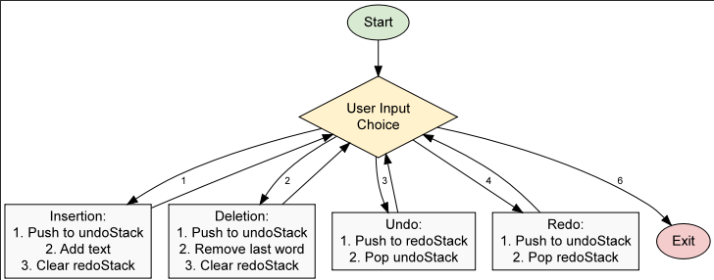
Flowchart Logic
- Start -> User Input Menu
- Action -> Check Stack Capacity -> Update Current State
- Undo/Redo -> Swap states between Stacks
- Loop until Exit signal.

Slide 6
Methodology
- Language: C++
- Library: <stack>, <string>, <iostream>
- Core Logic: Menu-driven interaction
- Data Type: std::stack<std::string>

Slide 7
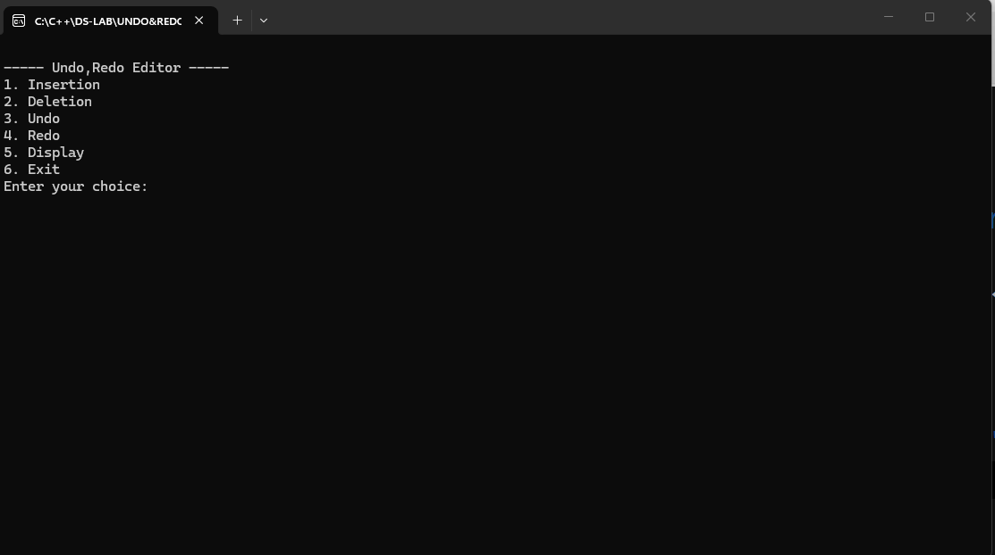
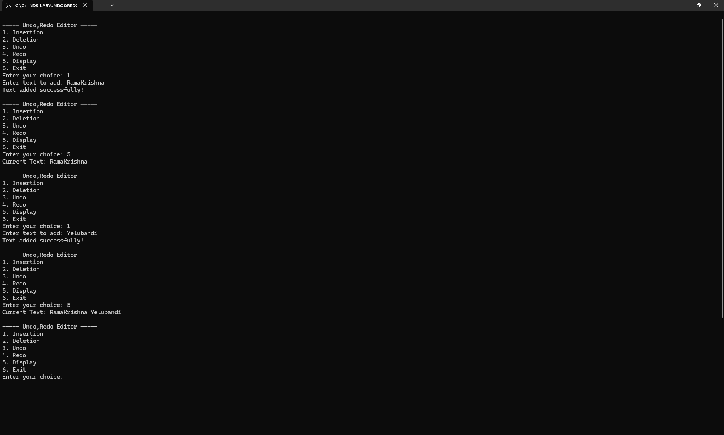
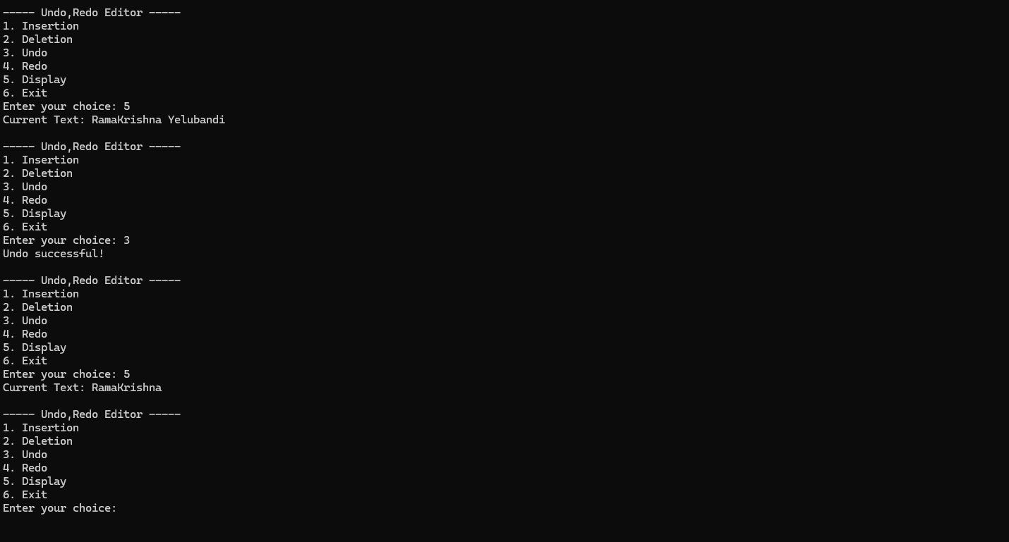
Result Screenshots
1. Main Menu
2. Insertion Test
3. Undo/Redo Flow

Slide 8
Conclusion
Successfully implemented basic text history management.
Demonstrated real-world application of Stacks.
Simple and efficient CLI interface.

Slide 9
THANK YOU!
GROUP DETAILS :
NAME : YELUBANDI HARI DURGA RAMAKRISHNA ROLL NO : 25A31A05LI SECTION : CSE F
NAME : ADABALA DHARMA VEERA SRIKRISHNA KARTHIK ROLL NO : 25A31A05KB SECTION : CSE F
NAME : ANGADA SAI VIGNESH ROLL NO : 25A31A05KD SECTION : CSE F
NAME : CHOLLANGI LAKSHITHA ROLL NO : 25A31A05JB SECTION : CSE F

