Slide 1

Title: Quantum Machine Learning for Pattern Recognition
Subtitle: Leveraging Quantum Advantage for Next-Generation Data Analysis
Presented by: [Your Name/Organization]
Date: March 2026
Sit Dolor Amet

Slide 2
Introduction – Why QML?
The Bottleneck: Classical ML faces "The Curse of Dimensionality" as
datasets grow exponentially.
The Solution: QML combines the predictive power of ML with the
computational speed of quantum mechanics.
Key Value: Ability to process high-dimensional data in "Hilbert Space“,
finding patterns invisible to classical computers.

Slide 3

Fundamental Quantum Concepts
Qubits vs. Bits:
Classical: 0 or 1.
Quantum: Superposition of and
Entanglement: Linking qubits so the state of one instantly influences
another, regardless of distance.
Interference: Manipulating probability amplitudes to amplify the
"correct" pattern and cancel out noise.

Slide 4
Pattern Recognition Workflow in QML
Data Encoding: Converting classical data (pixels/features) into quantum states
(Amplitude or Angle encoding).
Quantum Circuit: Applying quantum gates (Hadamard, CNOT) to process the data.
Measurement: Collapsing the quantum state to get a classical output (classification/label).
Classical Optimization: Using a classical optimizer to tune the quantum circuit parameters (Hybrid Approach).

Slide 5
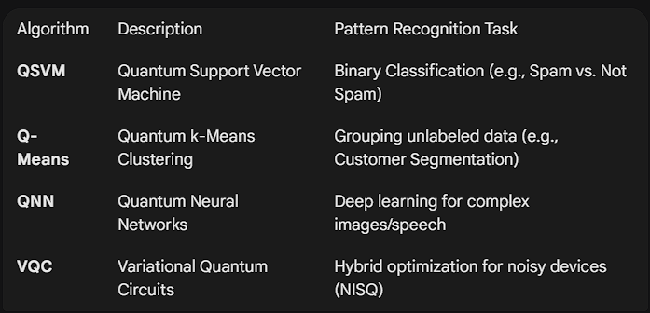
Core QML Algorithms for Pattern Recognition

Slide 6
Quantum Advantage: Feature Mapping
linear vs. non-linear: some patterns are messy and inseparable in 2d or
3d.
the "quantum trick": qml maps data into a massive hilbert space
where non-linear patterns become linearly separable.
efficiency: quantum kernels can handle feature spaces that are
exponentially larger than those handled by classical kernels.

Slide 7
Practical Applications (Industry Use-Cases)
Biomedical Imaging: Identifying early-stage cancer cells
in high-res MRI scans.
Finance: Fraud detection through anomaly recognition in
millions of simultaneous transactions.
Cybersecurity: Detecting sophisticated malware patterns
in encrypted traffic.
Particle Physics: Analyzing billions of collisions (e.g., at
CERN) to identify rare subatomic particles.

Slide 8
Tools & Frameworks (The 2026 Landscape)
IBM Qiskit Machine Learning: The industry standard for
circuit-based QML.
PennyLane (Xanadu): Best for differentiable quantum
programming and hybrid models.
TensorFlow Quantum (Google): Integrating quantum
layers into standard AI workflows.
Amazon Braket: Cloud access to diverse quantum
hardware (IonQ, Rigetti).

Slide 9
Current Challenges (The Reality Check)
Noise (Decoherence): Quantum states are fragile;
errors accumulate quickly in deep circuits.
Data Loading: The "QRAM" bottleneck—it’s still hard
to load massive classical datasets into quantum states
efficiently.
Hardware Scale: We are in the NISQ (Noisy Intermediate
-Scale Quantum) era; full fault-tolerance is still 5–10 years
away.

Slide 10
Conclusion & Future Outlook
Hybrid is King: The immediate future belongs to Quantum-Classical
Hybrids, where quantum handles the "heavy lifting" of high-dimensional
math.
Scalability: As qubit counts reach 1,000+, QML will move from "toy datasets“
to solving real-world global challenges.
Final Thought: QML isn't just about faster math; it's about seeing patterns
we didn't know existed.

