Slide 1
DAE PROJECT: LINKEDIN JOB TRENDS ANALYSIS SYSTEM
TEAM MEMBERS :
Pramodh (25B11CS938)
Kiran (25B11CS595)
Rupa (25B11CS125)
Karishma (25B11CS360)

Slide 2
Introduction:
What is the project about?
A data analytics system that mines LinkedIn (social media) job-posting data to uncover hiring trends, in-demand skills, salary patterns, and industry demand using Python's data science stack.
Application/domain:
Social media analytics applied to the HR-tech / career-intelligence domain.
Why important?
LinkedIn generates massive real-time data on hiring activity; analyzing it reveals what skills, roles, and industries are trending — valuable for job-seekers, recruiters, and policymakers.
Motivation:
Growing gap between skills taught and skills demanded in the market; students and job-seekers lack a data-driven way to see what employers actually want, in real time, from social/professional media.

Slide 3
Problem Definition :
LinkedIn data is scattered/unstructured — trends invisible at a glance.
Problem:
Manual tracking of skills/salaries is slow, unreliable.
Difficulty:
Skill mismatch wastes time; roles stay unfilled.
Impact:
Job seekers, students, recruiters, institutes.
Affected:
Automated pipeline for cleaning, aggregating, visualizing trends.
Need:

Slide 4
Proposed Solution:
Functions:
Cleaning, skill-trend analysis, salary/industry analytics, dashboards.
Users:
Students, job seekers, recruiters.
Flow:
Excel → Pandas/NumPy processing → Charts & insights.
Method:
Load → Clean → Aggregate → Visualize.
Benefit:
Data-backed skill and salary decisions.

Slide 5
Data Used :
Type:
Structured Excel
source:
LinkedIn_Jobs_and_Skills dataset
Format:
CSV (Jan 2025 – Aug 2026)
Records:
50,000 postings
Attributes:
Title, company, location, skills, salary, industry, experience, date

Slide 6
Implementation Pipeline
1 Load
Read the 50,000-row CSV
2 Clean
Trim text, remove duplicates, fix salaries
3 Transform
Add average salary, month, skills list
4 Analyze
NumPy mean, median, std, percentiles
5 Visualize
6 charts and 2 sorted tables
6 Insights
Top skills, salary range, companies hiring
Steps 1 to 4 run in code inside prepare() every time the app starts, and the cleaned file is saved to the cleaned_data folder.
The dashboard only shows the results (numbers, tables, charts), so the user never sees the cleaning steps.
4

Slide 7
Modules Completed
Module | What it does | Status
Data Loading | Reads the 50,000 LinkedIn job postings (14 columns) | Done
Data Cleaning | Trims text, removes duplicate job_ids, fixes salaries, saves to cleaned_data/ | Done
Transformation | Adds average salary, posting month and a skills list | Done
Analysis (NumPy) | Mean, median, std. deviation, 25th/75th percentile of salary | Done
Dashboard (Streamlit) | Level and skill filters, sorted tables, 6 charts | Done
Testing and report | Checking outputs on different filters, writing the final report | Done
5

Slide 8
Module 1: Data Loading
Data loaded
Job title, company, location, industry
Required skills and experience level
Salary minimum and maximum (INR)
Posting date and number of applications
Tools used
Pandas: read_csv loads the 50,000 postings
NumPy: array operations on salaries
Matplotlib: all six charts
Streamlit: dashboard with filters
6

Slide 9
Module 2: Data Cleaning and Preprocessing
Raw data
Standardize
Validate
Clean dataset
Cleaning operations
Remove duplicate job_ids
Fill missing salaries with the median
Replace zero or negative salaries
Swap minimum and maximum if reversed
Standardization
Text columns trimmed of extra spaces
Salary columns converted to numbers
Average salary and posting month added
Result saved in the cleaned_data folder
7

Slide 10
Module 3: Salary Analysis and Comparison
₹3.78L
MIN: lowest average salary
₹35.41L
MAX: highest average salary
₹15.79L
AVG: average salary
₹31.63L
Δ: difference between max and min
Example from project dataset
Median salary by level:
Entry ₹7.1L, Mid ₹11.6L,
Senior ₹18.1L, Lead ₹26.0L
Salary rises steadily with experience
Comparison output
Compare salaries across experience levels
Compare companies by openings and average salary
Filter any result by skill and level
8

Slide 11
Code, Functions and Outputs
Functions and libraries explained
prepare(): load, clean, transform, save
show(): draws every chart
Pandas: cleaning, grouping, sorting
NumPy: salary fixes and statistics
Matplotlib: bar, pie, histogram, boxplot, line, scatter
Streamlit: filters and dashboard
Outputs to demonstrate
Cleaned file in cleaned_data folder
Salary statistics (mean, median, std, percentiles)
Companies recruiting table, sorted
Matching jobs table, sorted by choice
Six charts that update with the filters
9

Slide 12
Code: Load and Clean
df = pd.read_csv(RAW_FILE)
for c in ["job_title", "company", "location",
"industry", "required_skills",
"experience_level"]:
df[c] = df[c].astype(str).str.strip()
df = df.drop_duplicates(subset="job_id")
for c in ["salary_min_inr", "salary_max_inr"]:
df[c] = df[c].astype(float)
df[c] = df[c].fillna(df[c].median())
df.loc[df[c] <= 0, c] = df[c].median()
lo = df["salary_min_inr"].to_numpy()
hi = df["salary_max_inr"].to_numpy()
df["salary_min_inr"] = np.minimum(lo, hi)
df["salary_max_inr"] = np.maximum(lo, hi)
os.makedirs(CLEAN_DIR, exist_ok=True)
df.to_csv(CLEAN_FILE, index=False)
Output: cleaning check
Check | Result
Rows loaded | 50,000
Duplicate job_ids | 0
Missing values | 0
Min > max salary | 0
Cleaned file | Saved
Saved to cleaned_data/cleaned_linkedin_jobs.csv (50,000 rows)
10

Slide 13
Code: Transform and Analyze
df["salary_avg_inr"] = (df["salary_min_inr"]
+ df["salary_max_inr"]) / 2
df["posting_month"] = pd.to_datetime(
df["posting_date"], errors="coerce"
).dt.to_period("M").astype(str)
s = df["salary_avg_inr"].to_numpy()
print(f"Mean {np.mean(s):,.0f} | "
f"Median {np.median(s):,.0f} | "
f"Std {np.std(s):,.0f} | ...")
# 25th / 75th: np.percentile(s, 25), np.percentile(s, 75)
Output (terminal)
Statistic | Salary (INR)
Mean | 1,578,786
Median | 1,404,553
Std deviation | 782,150
25th percentile | 893,208
75th percentile | 2,159,354
Two new columns are created: salary_avg_inr (used by the histogram, boxplot and tables) and posting_month (used by the line chart).
11

Slide 14
Code: Filters and Sorted Tables
if level != "Any":
df = df[df["experience_level"] == level]
if skill.strip():
df = df[df["required_skills"].str.contains(
skill.strip(), case=False)]
companies = df.groupby("company").agg(
openings=("job_id", "count"),
avg_salary=("salary_avg_inr", "mean"),
max_salary=("salary_max_inr", "max")
).round(0).sort_values("openings", ascending=False)
st.dataframe(companies)
st.dataframe(df.sort_values(sort_by,
ascending=not high_first)[cols])
Output: Mid Level + Python (1,328 openings)
Company | Openings | Avg salary
Salesforce | 71 | 1,191,388
Zoho | 71 | 1,175,619
Oracle | 67 | 1,170,901
Tech Mahindra | 65 | 1,174,805
12

Slide 15
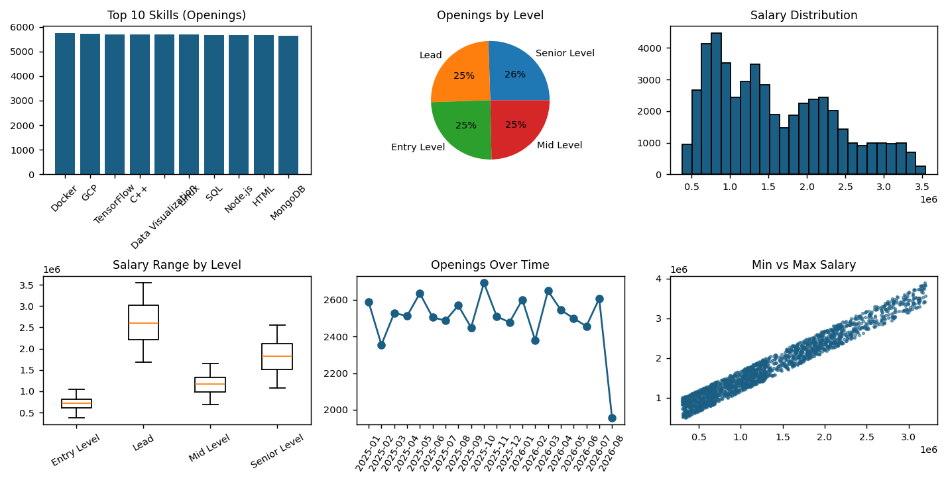
Visualization and Analytical Outputs
Charts included in the project
Bar chart: top skills by openings
Pie chart: openings by experience level
Histogram: salary distribution
Boxplot: salary range by level
Line chart: openings over time
Scatter plot: min vs max salary
Charts reveal in-demand skills, pay gaps, trends and outliers
13

Slide 16
Relevant DAE Concepts
Data Collection
Loading 50,000 LinkedIn job postings
Preprocessing
Cleaning, standardization and validation of salaries
Data Analysis
NumPy statistics and company comparison
Visualization
Six charts reveal skills, levels and salaries
Insight Generation
Top skills, salary range, companies hiring
Trend Analysis
Openings over time, Jan 2025 to Aug 2026
20

Slide 17
Programming Concepts Used
Functions and caching
prepare() and show(), with @st.cache_data to avoid reloading
Lists and comprehensions
Splitting required_skills into a list for each job
NumPy arrays
np.minimum / np.maximum to fix salaries, np.percentile for statistics
Boolean filtering
Pandas masks select rows by level and skill
Lambda functions
Chart-drawing code is passed into show() as a lambda
File handling
os.makedirs and to_csv create the cleaned_data folder
21

Slide 18
Key Points
Show the completed modules: load, clean, transform, analyze, dashboard
1
Show the cleaned data saved in the cleaned_data folder
2
Explain the main functions and libraries used
3
Show salary statistics and company comparison
4
Show the visualization outputs (six charts)
5
Connect each step to a DAE concept
6
LOAD → CLEAN → ANALYZE → VISUALIZE → INSIGHT

Slide 19
Thank You

