Slide 1
FLIPMART SALES DASHBOARD
Power BI Visual Report | Data Visualization and Storytelling Task

Slide 2
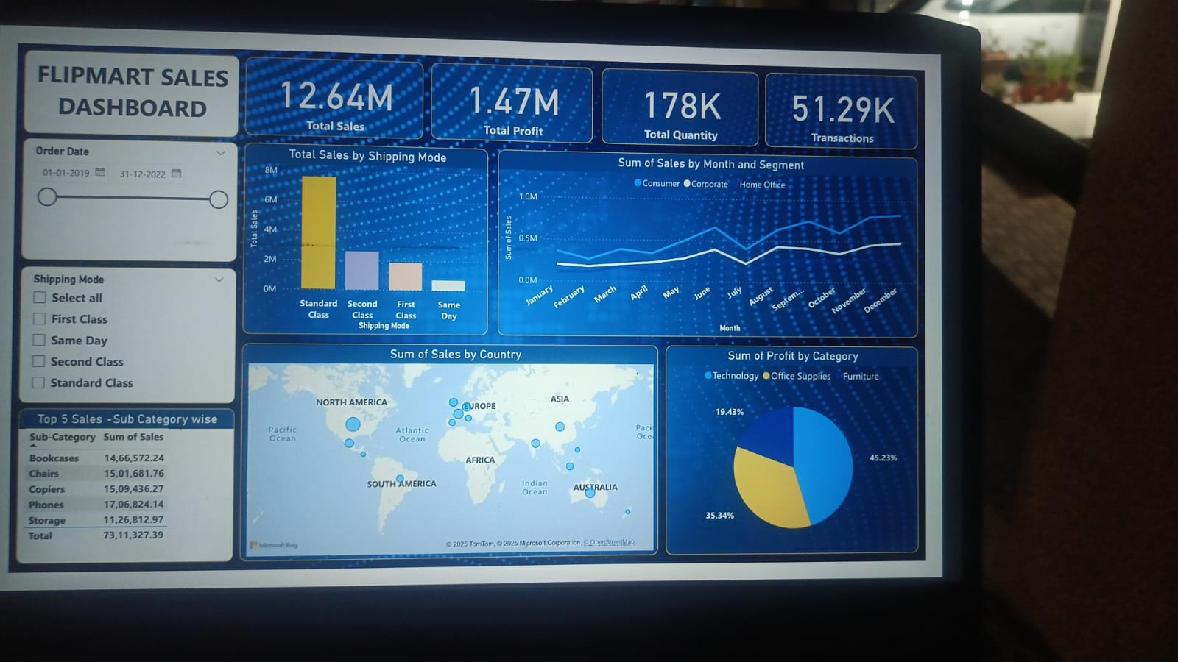
Overall Sales Dashboard

Slide 3
Key Business Insights
Total Sales: ₹12.64M
Total Profit: ₹1.47M
Total Quantity: 178K
Transactions: 51.29K
Standard Class has the highest sales among shipping modes.
Sales peak around July and November–December, indicating festive season impact.
Top 5 Sub-Categories by Sales: Phones, Chairs, Copiers, Bookcases, Storage.
High-performing countries include North America and Europe.
Technology contributes the highest share of profit (45.23%), followed by Office Supplies (35.34%).
Second Class and Same Day modes offer opportunities for profit optimization.

