Slide 1

SUMMER INTERNSHIP PROJECT
Women's Safety System
A fast and reliable emergency response application designed to enhance personal security through instant SOS alerts and real-time location sharing.
Presented by: Nandana Nambiar

Slide 2

The Challenge We Address
Women's safety remains a significant social concern. In emergencies, every second matters — yet existing safety methods often fail to provide quick communication or real-time support, resulting in critically delayed assistance.
This project offers a fast, reliable emergency response system that bridges the gap between danger and help.

Slide 3






Project Objectives
Simple & User-Friendly
One-Tap SOS Alerts
Develop an intuitive safety application accessible to all users.
Enable instant emergency alerts with a single tap.
Live Location Sharing
Faster Response
Share real-time GPS location with trusted contacts.
Improve emergency response time during critical situations.
Confidence & Security
Reliable Support
Enhance women's personal safety and daily confidence.
Ensure dependable assistance when it matters most.

Slide 4
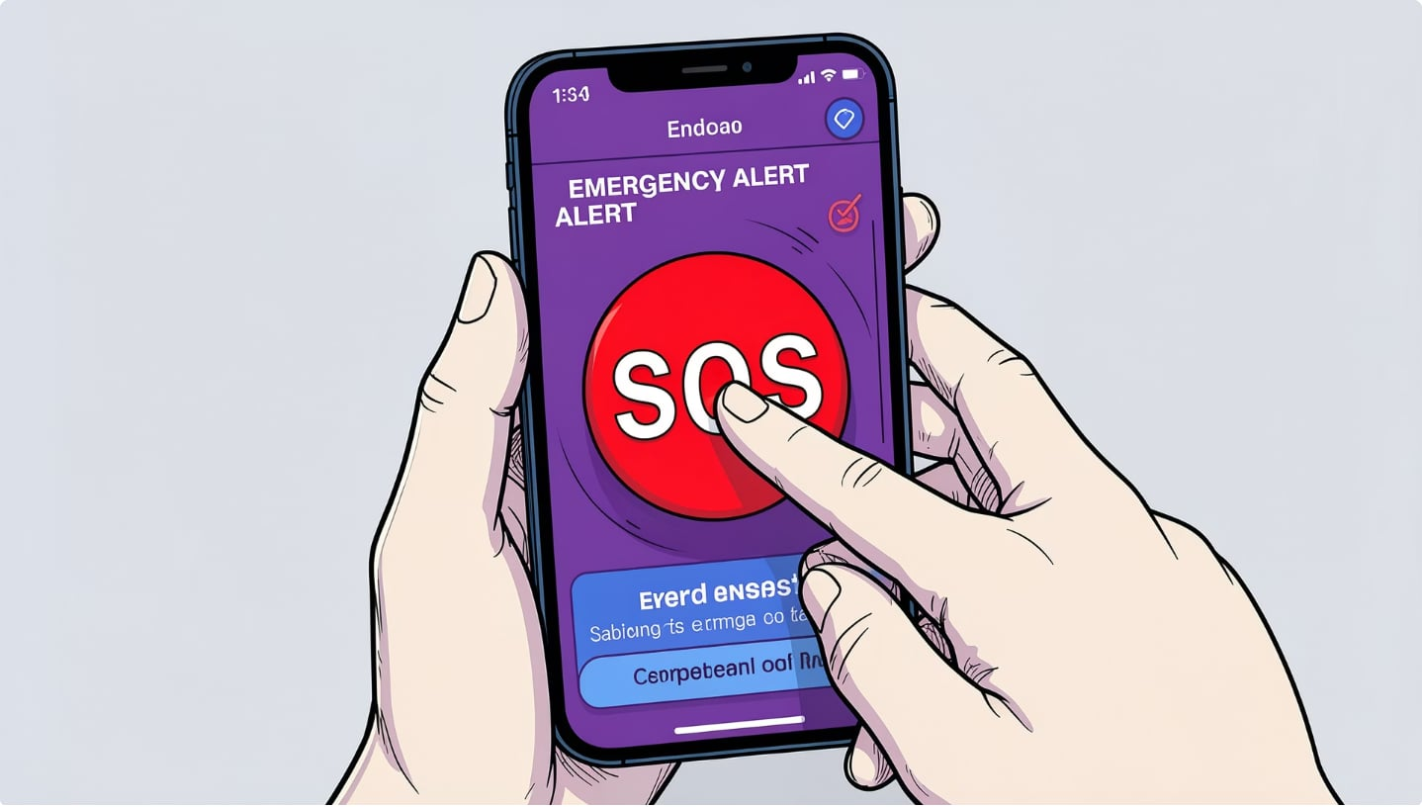

The Proposed Solution
The Women's Safety System empowers users to send an emergency SOS alert with a single tap.
The application instantly shares the user's live location with trusted contacts, enabling swift response during critical moments.
Designed to be simple, reliable, and effortless to use — even under stress.
One tap. Instant help. Real-time location shared.

Slide 5
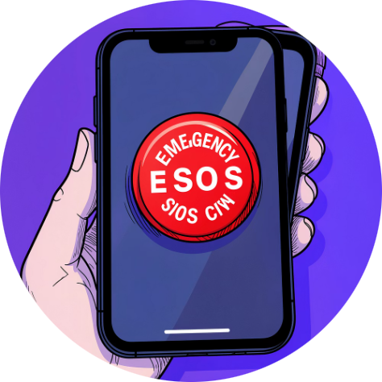
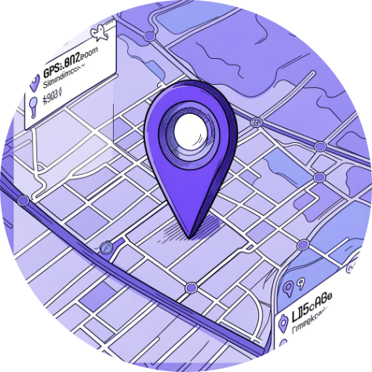
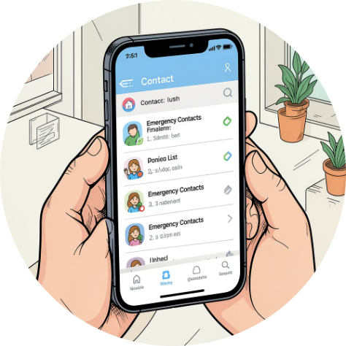
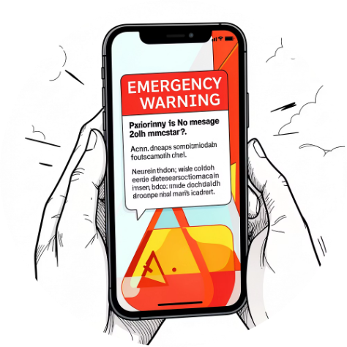
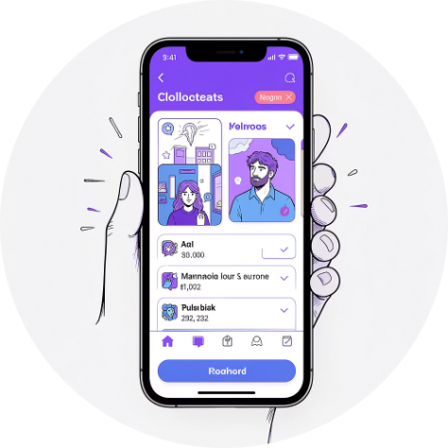
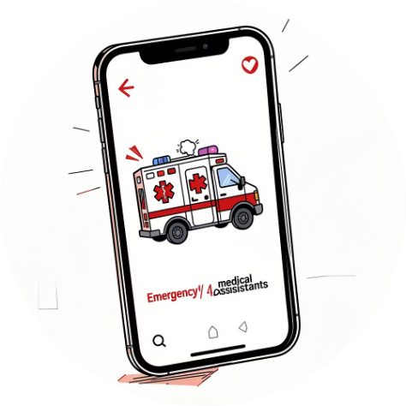
Key Features
One-Tap SOS Button
Live GPS Location Sharing
Emergency Contact Management
Instant Alert Notifications
Trigger an emergency alert instantly with minimal interaction.
Real-time location broadcast to trusted contacts for quick response.
Immediate push notifications sent to all emergency contacts.
Add and manage trusted contacts who will receive your alerts.
User-Friendly Interface
Quick Emergency Assistance
A clean, intuitive design that works even under pressure.
Fast and dependable support when every second counts.

Slide 6
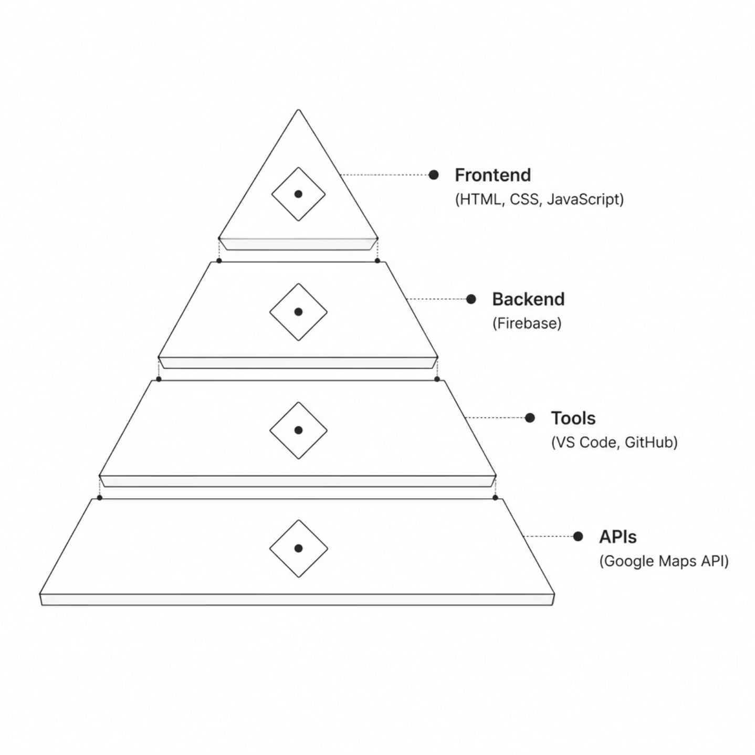
Technology Stack
Built using modern web technologies and cloud infrastructure for reliability and real-time performance.
Frontend: HTML, CSS, JavaScript — responsive and interactive UI
Backend: Firebase — real-time data sync and authentication
Tools: VS Code, GitHub for version control and collaboration
APIs: Google Maps API for live GPS location tracking

Slide 7

System Workflow
Register
Add Contacts
Emergency
Press SOS
From registration to rescue — a seamless flow designed for speed and reliability during critical situations.

Slide 8
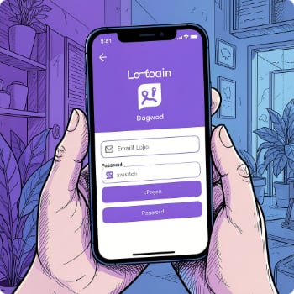
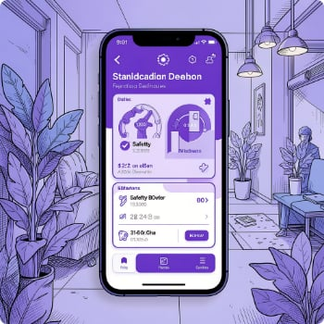
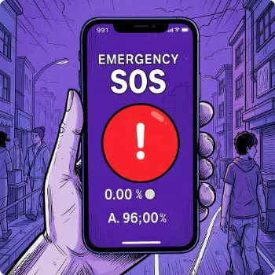
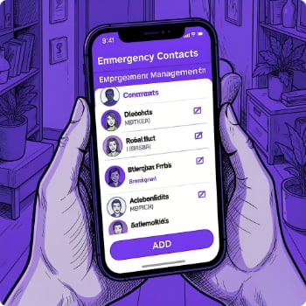
Implementation & Screenshots
01
02
03
Requirement Analysis
UI Design
Development
04
05
Testing
Deployment
Login Screen
Home Screen
SOS Screen
Emergency Contacts
Secure authentication entry point.
Main dashboard with quick access.
One-tap emergency alert trigger.
Manage trusted contact network.

Slide 9


Challenges
Future Scope
Simple Interface
1
2
Building an interface usable under extreme stress.
Voice-Activated SOS
AI Danger Detection
Real-Time Location
Trigger alerts hands-free using voice commands.
Machine learning to detect potential threats.
Implementing accurate live GPS sharing.
3
4
Emergency Testing
Simulating and testing critical alert features.
Smartwatch Integration
Police & Ambulance Link
Extend alerts to wearable devices.
Direct integration with emergency services.

Slide 10

Conclusion
The Women's Safety System provides a practical and effective solution for enhancing women's safety through instant SOS alerts and live location sharing. This project demonstrates how technology can improve emergency response, personal security, and user confidence.
Thank You!
— Nandana Nambiar

