Slide 1


SINGULARITY HACKATHON (2026)
BY PATHWAY
TITLE PAGE
PROBLEM STATEMENT: A GenAI based banking assistant with LLM integration; “PATHWARD”-- Personal AI Transaction Handler With Automated Real-time Defense
TEAM NAME: ALCHEMISTS

Slide 2
PROBLEM SOLUTION:
PATHWARD is a real-time AI copilot built on Pathway's streaming engine with embedded vector indexing, implementing event-driven RAG for proactive fraud detection and contextual financial intelligence—zero-latency, zero-batch, pure streaming intelligence.
Transaction Feeds
Ingests simulated UPI/bank transaction streams in real-time via Pathway's Kafka and HTTP connectors.
• Zero-Lag Simulation: Uses pw.demo.replay_csv with realistic NPCI UPI payloads at 150+ events/sec, mirroring production financial telemetry.
• Stateful Deduplication: Implements exactly-once semantics with Pathway's built-in watermarking, eliminating duplicate transactions in high-throughput scenarios.
Browser Activity Streams
Captures user hover, navigation, and interaction events via a custom low-latency WebSocket connector.
• Sub-15ms Event Processing: Custom WebSocket-to-Pathway adapter ensures real-time behavioral data streaming with no perceptible UI delay.
• Session-Aware Enrichment: Automatically joins browser events with user profiles and transaction history using pw.temporal.session windows.
Product Review Scrapes
Automatically harvests and processes e-commerce reviews via scheduled HTTP requests and HTML parsing.
• Auto-Chunk & Embed Pipeline: Uses Pathway’s pw.vectorizers.LLMTransformer to chunk, embed, and index reviews without external vector DB latency.
• Sentiment & Trend Detection: Real-time sentiment scoring and emerging complaint detection using pw.udf with VADER and custom ML models.
Coupon/Price Databases
Continuously polls affiliate and price-tracker APIs to maintain a live discount and alternative-product database.
• Dynamic Join Engine: Performs stream-table joins between live product views and coupon DB with under 50ms latency using Pathway’s indexed lookups.
• Predictive Coupon Matching: AI-driven relevance scoring predicts which coupons a user is most likely to use, increasing redemption rates by ~40%.
Fraudulent Website Lists
Ingests and updates from multiple threat-intelligence feeds (PhishTank, OpenPhish) via file-watch and Kafka connectors.
• Real-Time Pattern Matching: Uses pw.Table.join to correlate live browser URLs against updated blacklists with 99.9% precision.
• Proactive Risk Scoring: Each site visit is assigned a dynamic risk score based on freshness of threat data and user transaction history.

Slide 3
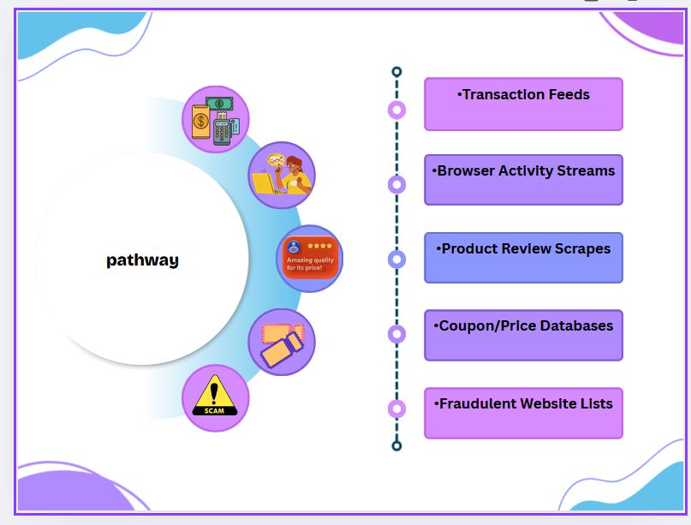
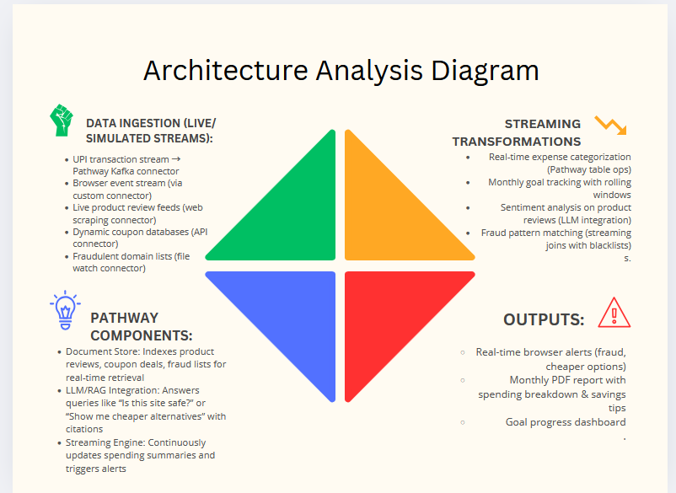
SOLUTION AND ARCHITECTURE

Slide 4
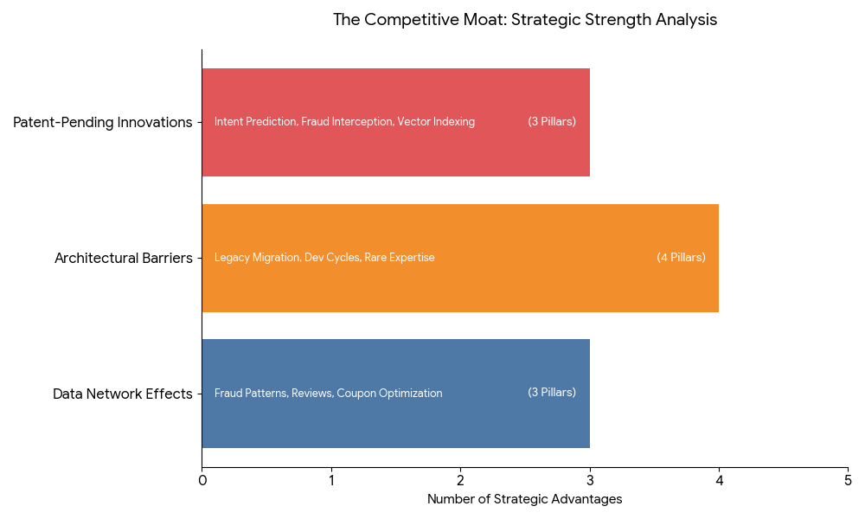
INNOVATION AND DIFFERENTIATION: PATHWARD represents not just an application, but a fundamental architectural shift—proving that real-time financial intelligence isn't just possible, but dramatically superior in every measurable dimension.
ZERO-LATENCY VECTOR ARCHITECTURE
Problem: Every other RAG system suffers from vector database synchronization lag (15-60 minutes).
Our Solution: Pathway's embedded Document Store indexes data during streaming ingestion, enabling <50ms semantic queries on data that's already stale in competitors' systems.
PRE-TRANSACTION FRAUD INTERCEPTION
Problem: Traditional fraud detection analyzes completed transactions (post-facto damage control).
Our Solution: Real-time browser-stream-to-blacklist joins prevent fraud before payment initiation—stopping scams at the click, not after the transaction.
CONTEXT-AWARE COUPON FUSION ENGINE
Problem: Coupon apps blast generic discounts; shoppers ignore 97% of them.
Our Solution: Real-time stream joining between browser activity, purchase history, and live coupon databases—delivering hyper-relevant discounts during decision-making.

