Slide 1
FBLA Desktop Application Programming
By: Innocent Niyibizi

Slide 2
The Problem:
Create a desktop application that does the following:
Keep records for FBLA members
Create reports for seniors and other members
Be able to print and export report to an Excel file

Slide 3



Programming Details:

Slide 4
Planning:
Main Goals:
Program must be efficient
Easy for anyone to use and maintain
Free of as many errors as possible

Slide 5
Design:
Simple
User Friendly
Easy to navigate
Aestheticly pleasing to the eye

Slide 6
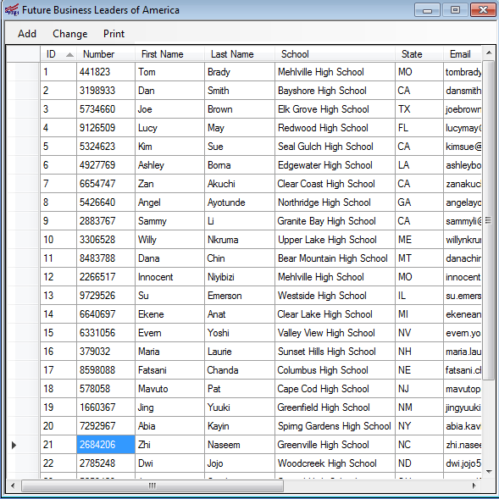
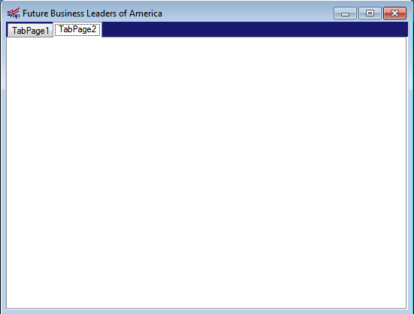
Original Designs:

Slide 7
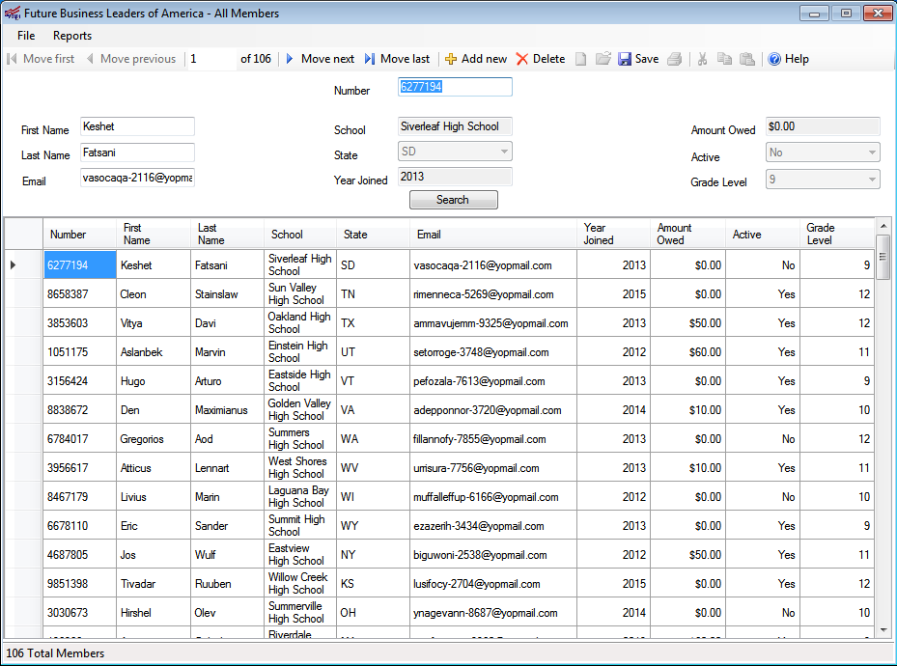
Final Design:

Slide 8
Documentation:
Comments wherever necessary
Regions used
Maintenance log on each page

Slide 9
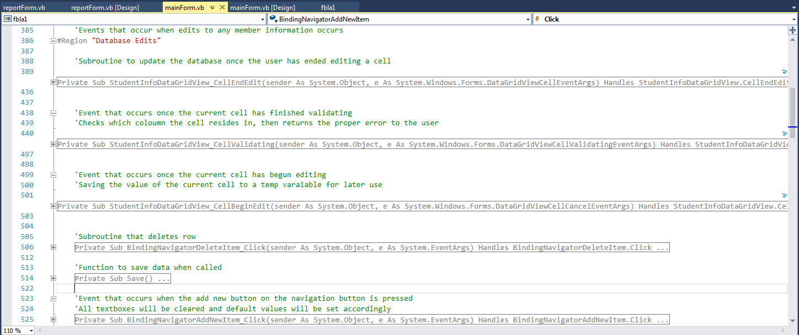

Slide 10
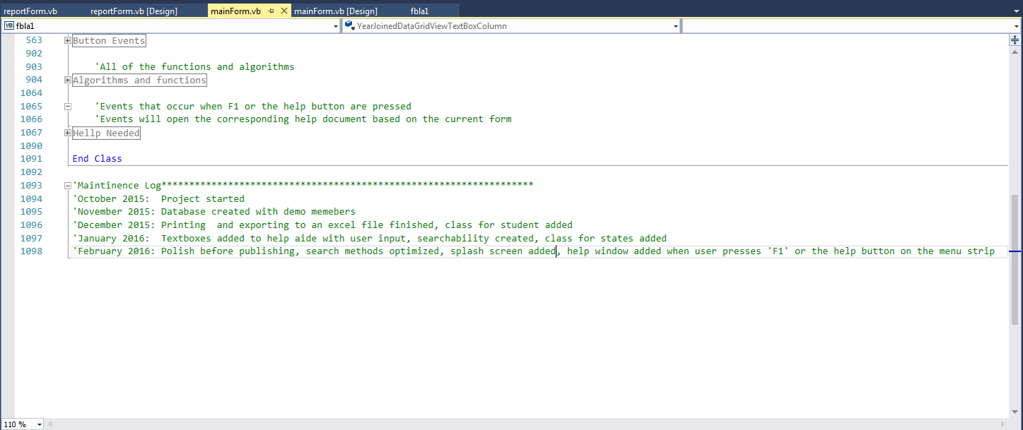

Slide 11
Input & Output:
Input:
Grid boxes for additions
Member changes made in cells
Output:
Paper reports
Excel reports

Slide 12
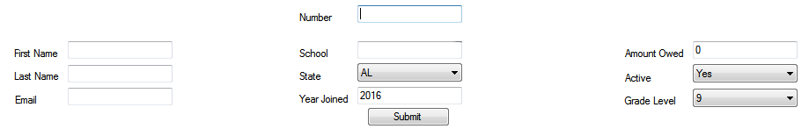
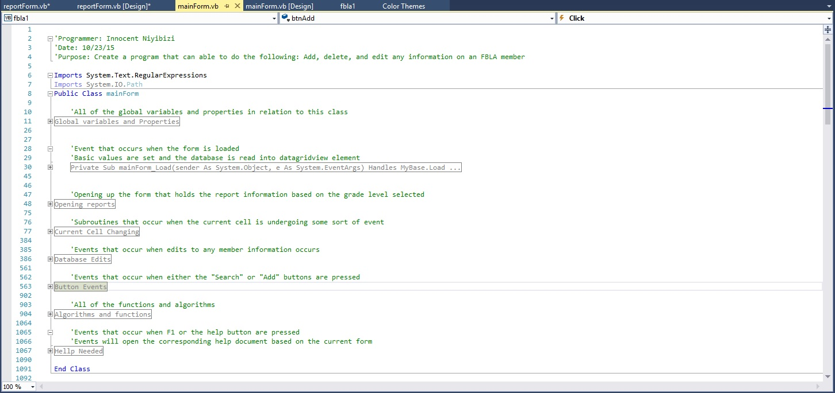

Slide 13
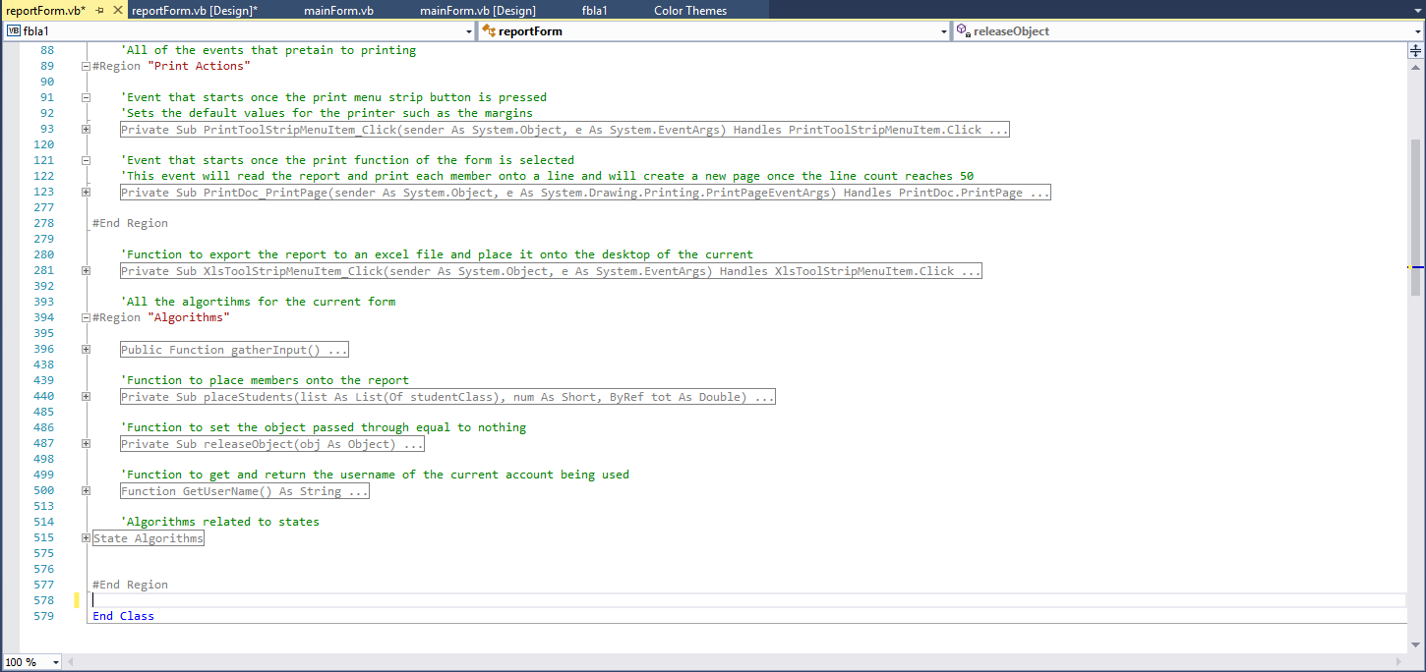

Slide 14
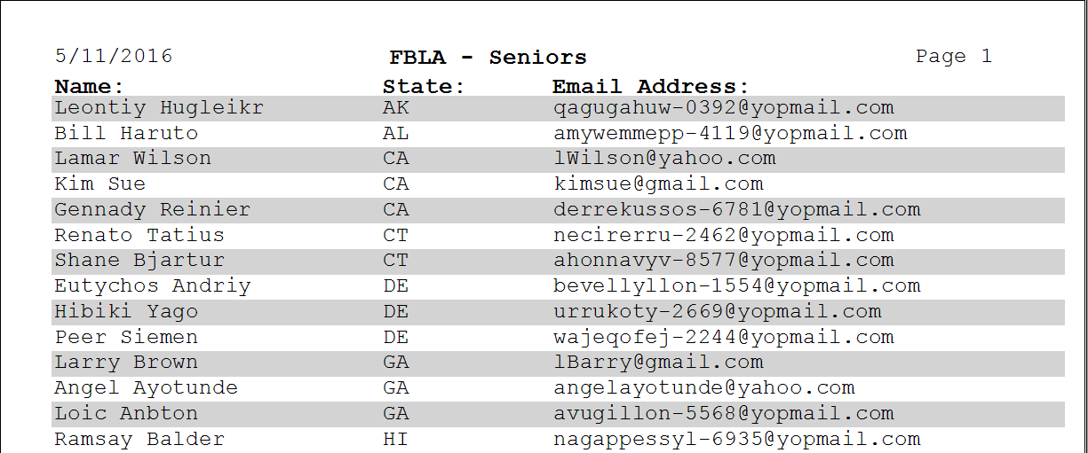
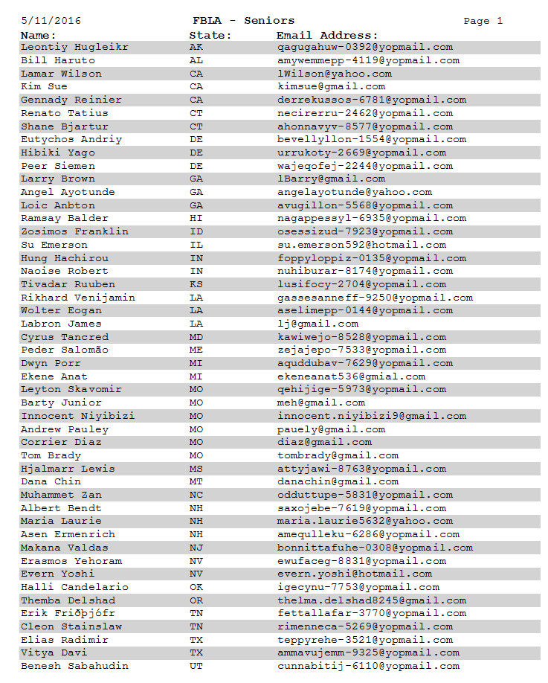

Slide 15
Future Improvements:
More error checking
More efficient processes
Better database modeling

