Slide 1
USER AUTHENTICATION BASED ON KEYSTROKE DATA USING ONE-CLASS SUPPORT VECTOR MACHINE
Group 18
Soumyadeep Kal (20EC65R01)
Krishnendu Ghosh (20EC65R02)
Dishant Satuley (20EC65R03)
Navin Tiwari (20EC65R08)
Chaitanya Hegde (20EC65R23)

Slide 2
Section I
An Approach to User Authentication
Keystrokes Dynamics
Features of Keystrokes Dynamics

Slide 3
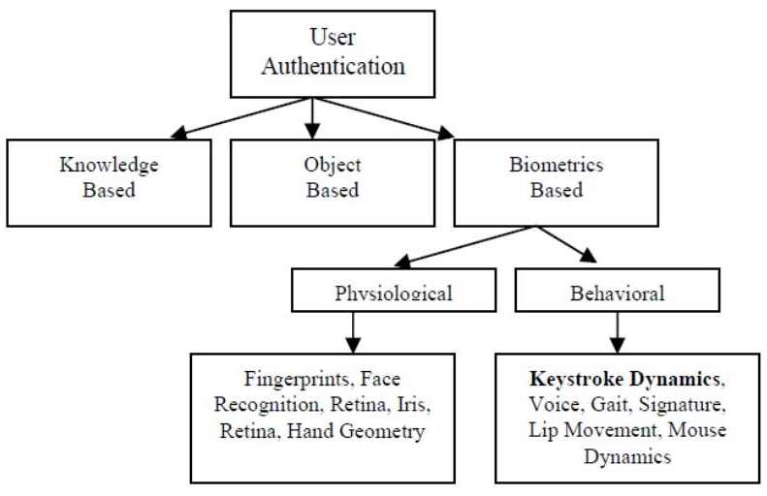
An Approach to User Authentication

Slide 4

Keystrokes Dynamics
A behavioral measurement to identify users based on typing rhythms
An upcoming area of research in biometrics
Used by Coursera for student verification
No additional hardware needed except a keyboard

Slide 5
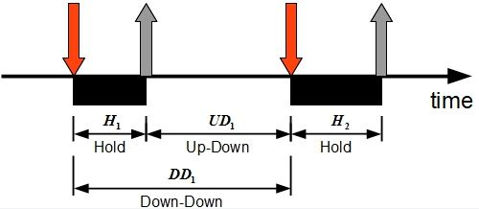
Features of Keystrokes Dynamics
Hold time – time between press and release of a key.
Keydown-Keydown time – time between the pressing of consecutive keys.
Keyup-Keydown time – time between the release of one key and the press of next key.

Slide 6
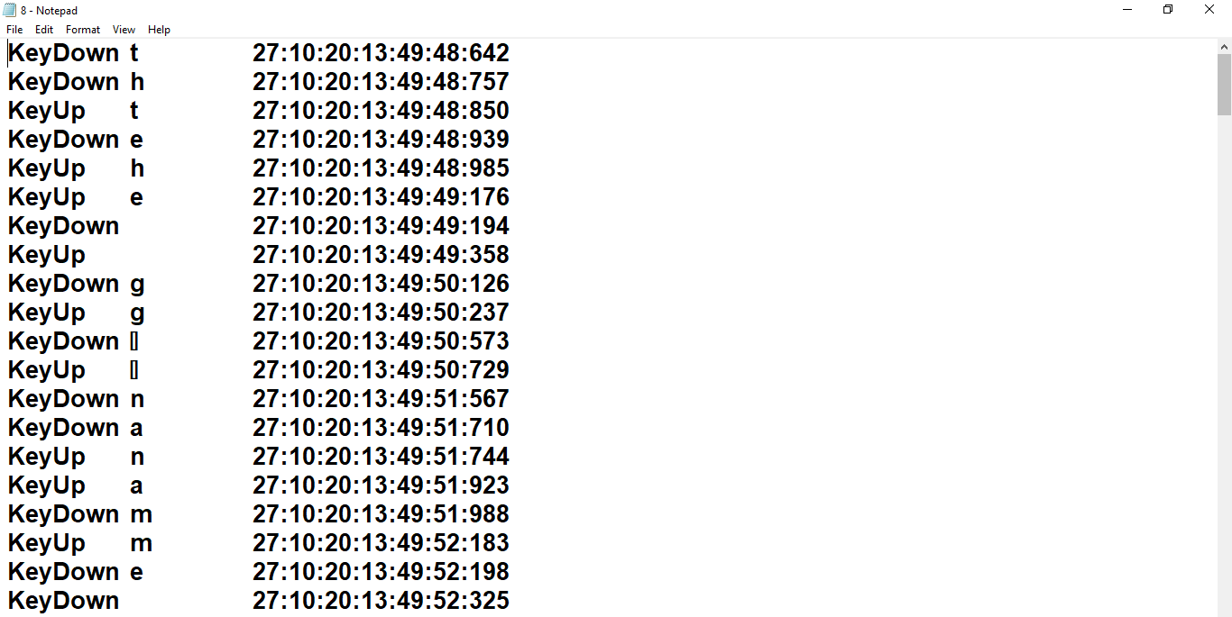
An Example from Data Acquisition

Slide 7
Section II
Classifier
One-Class SVM

Slide 8
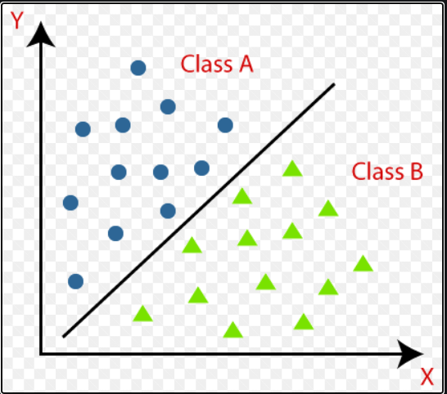
Classifier
A Classifier predicts the class of given set of points .
The classifier tries to predict a mapping function f from input training instances X to discrete output variables Y.

Slide 9
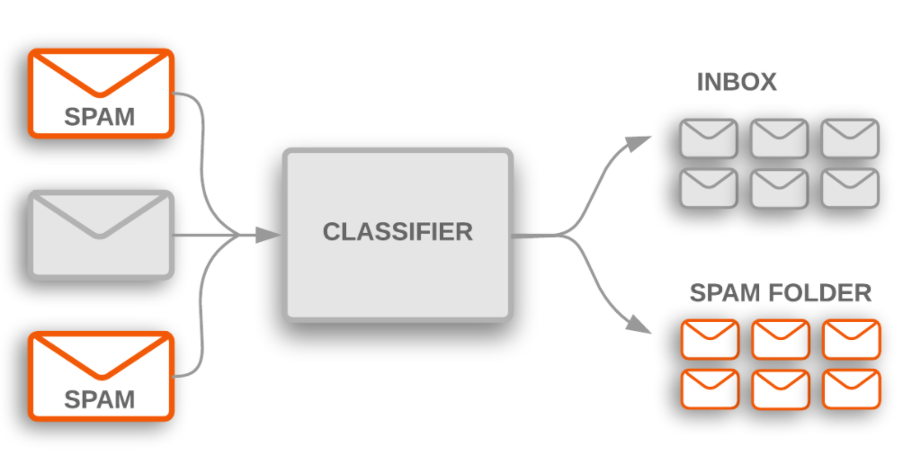
Classification:
Classification is a supervised learning task. Example: Tumour classification - Benign or Malignant Mail classification - Spam or not spam etc.
Binary and multiclass classification
Lazy learners and Eager learners KNN , Artificial Neural Networks

Slide 10
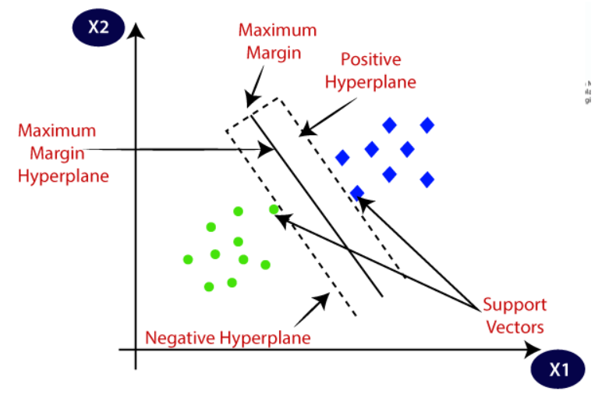
SVM - Support Vector Machine
Some definitions :
Hyperplane: A hyperplane is a decision plane which separates between a set of objects having different class memberships. Support Vectors: Support vectors are the data points, which are closest to the hyperplane. Margin: A margin is a gap between the two lines on the closest class points.

Slide 11
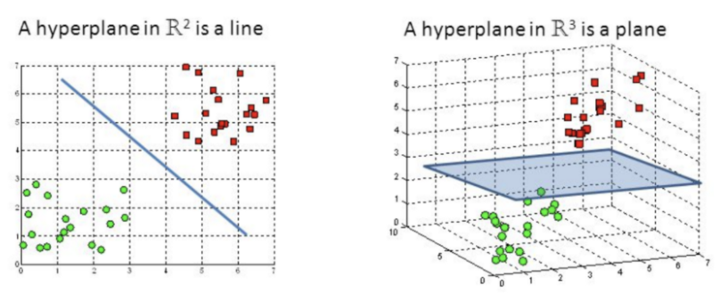
SVM (continued)
Identify the right hyper-plane:
Dimension of a hyperplane depends On the dimensionality of the data. e.g. for input data with two parameters the hyperplane is just a line etc.
The objective of the Support Vector Machine algorithm is to find a hyperplane in a N dimensional space that distinctly classifies the data points.

Slide 12
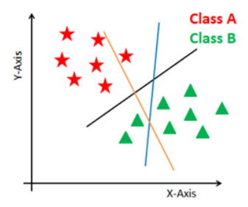
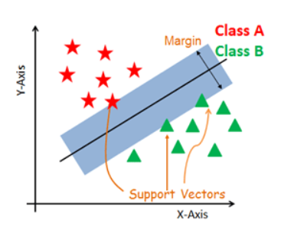
SVM (continued)
Generate hyperplanes which segregates the classes in the best way.
Maximum margin intuition: Select the right hyperplane with the maximum segregation from the either nearest data points as shown in the right-hand side figure.

Slide 13
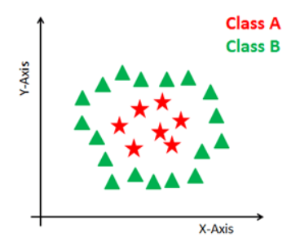
SVM (continued)
What if data not separated linearly? It is easy to have a linear hyper-plane between classes. But what if data cannot be separated by linear hyperplane? The SVM algorithm has a technique called the Kernel trick. The SVM kernel is a function that takes low dimensional input space and transforms it to a higher dimensional space i.e. it converts not separable problem to separable problem.

Slide 14
Section III
A Mathematical Approach to SVM
Advantages of One Class Support Vector Machine

Slide 15
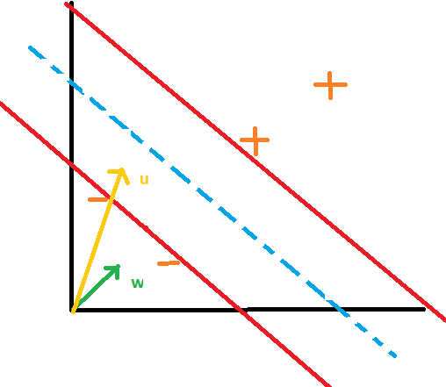
A Mathematical Approach to SVM
w.u >= c
w.u +b >= 0 for positive samples
Decision Rule
w.x₊ + b >= 1
w.x₋ + b >= -1

Slide 16
y_{i}(w.x_{i} + b) >= 1
y_{i}(w.x_{i} + b) - 1 >= 0
For x_{i} exactly on the hyperplanes,
y_{i}(w.x_{i} + b) - 1 = 0
Width = (x₊ - x₋).w^
Width = 2/|w|
Maximize width → Minimize |w|
For Mathematical Convenience,
We minimize (½)|w|² .

Slide 17
L = ½ |w|² - Σα_{i}[y_{i}(x_{i}.w+b)-1]
w = ∑α_{i}y_{i}x_{i}
And,
∑α_{i}y_{i} = 0
Putting back these values in Lagrange’s equation,
L = ∑α_{i} - ½ ∑∑α_{i}α_{j}y_{i}y_{j}x_{i}.x_{j}
Finally, Decision rule becomes
∑α_{i}y_{i}x_{i}.u + b >= 0
for positive sample

Slide 18
Advantages of One Class Support Vector Machine
Works relatively well when there is a clear margin of separation between classes
More effective in high dimensional spaces
Effective in cases where the number of dimensions is greater than the number of samples
Memory efficient

Slide 19
Section IV
Data Acquisition
Approach to the Problem

Slide 20
Data Acquisition
Keystrokes data Collection considering Happy, Sad or Neutral mood of user
Gap of at least a day is maintained
Total 7 users participated in data collection
4 Weeks Collection
Preprocessing of Recorded keystrokes
Generation of hold time and latency time
CSV Files Generation

Slide 21
Feature Extraction
Features from the keystroke data were extracted by running a file feature_extractor.exe
Preprocessed data is created that contains hold time and latencies for all combinations of keystrokes
A CSV is generated with the preprocessed data
This CSV is loaded with pandas in the code

Slide 22
Environment for Data Processing
Hardware Environment
Arch Linux x86_64
RAM 16GB
AMD Ryzen 5
RX 560 GPU
Software Environment
Python 3.8
Numpy 1.19.1
Scikit learn 0.23.2
Pandas 1.1.3

Slide 23
Training the Model
Putting NaN in all the Empty columns
Reducing the unnecessary repetitions
Data is contained in a pandas data framework
One Class Support Vector Machine is trained with 80% of available data.
Rest is used for testing.
5 - fold validation is used.

Slide 24
Training the Model (Continued…)
Model is supplied with unseen examples
SVMs learn a decision function from the data of one class only
sklearn.svm.OneClassSVM sub-module was used
fit() function was used to train a OneClassSVM object
decision_function() function was used to calculate the similarities scores for the test samples

Slide 25
Section V
Figure of Merit
Performance Evaluation
Conclusion

Slide 26
Figure of Merit
False Rejection Rate
False Acceptance Test
Equal Error Rate or Crossover Rate

Slide 27
Performance Evaluation
Model was tested for different users
For each user, Error is calculated
When error is quite small, user is valid
Average Equal Error Rate calculated for the model was 0.03771
Least Average EER among all the classifiers

Slide 28
Drawbacks of Keystrokes Authentication
Dynamic Change in typing pattern
Injury may affect the typing rhythm
Change of the hardware affects the typing speed
Users’ susceptibility to fatigue
Requires adaptive learning
Error rate comparison is difficult

Slide 29
Block Diagram
Hold time and Latencies
Train and Test
SVM
Data Collection
Feature Extraction
Training the Model
Output
Generate CSV
Load CSV
fit() function
decision_fn()

Slide 30
Conclusion
Effective way to verify authorized user
Keystrokes Authentication seems promising but still needs more efforts

Slide 31
THANK YOU!
Any questions?

