Slide 1
Covid-19 Statistics Web app
Devaram Ranjith Reddy
Deepanshi bansal

Slide 2
Introduction
The covid-19 Statistics web app
provides information on covid cases
worldwide and country by country ,
as well as the basic information
about covid symptoms and it’s
preventive measures and vaccination
availability in specific centers by
their pincodes.

Slide 3
About
This website is designed using HTML, CSS and Javascript. The APIs available for public use have been used such as COVID-19 API and the other made available on API Setu by the Indian government. The website needs a stable internet connection to fetch the consumer requests.
the Web application

Slide 4
Objective
Through this application we tried to display the current COVID-19 condition in the different countries in a more interactive way and to display the nearby vaccination centers available just by mentioning the pincode of the area you are residing in.
for the web application

Slide 5
Motivation
With the Indian government taking all necessary measures to ensure its citizens safety against the pandemic one of which is the vaccination programme which has helped our country stand strong against the virus with our own developed vaccines.
for the web application

Slide 6

Navbar can be used to navigate to different parts of the website

Slide 7
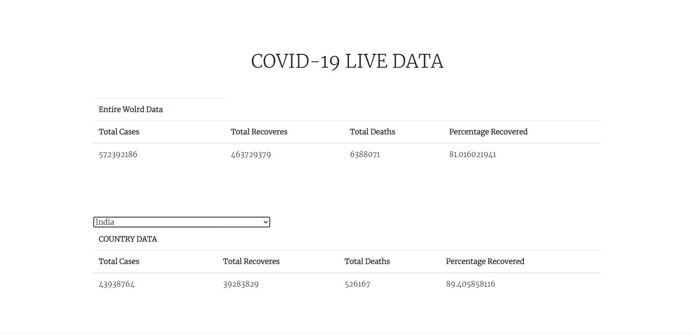
For each country and for the entire world, the total number of cases, recoveries, deaths and percentage recovered are displayed in real-time.

Slide 8
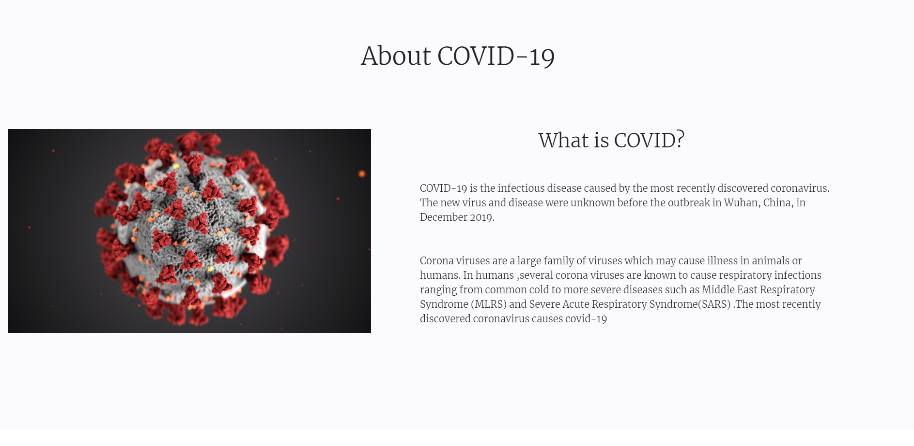
Basic information about covid

Slide 9
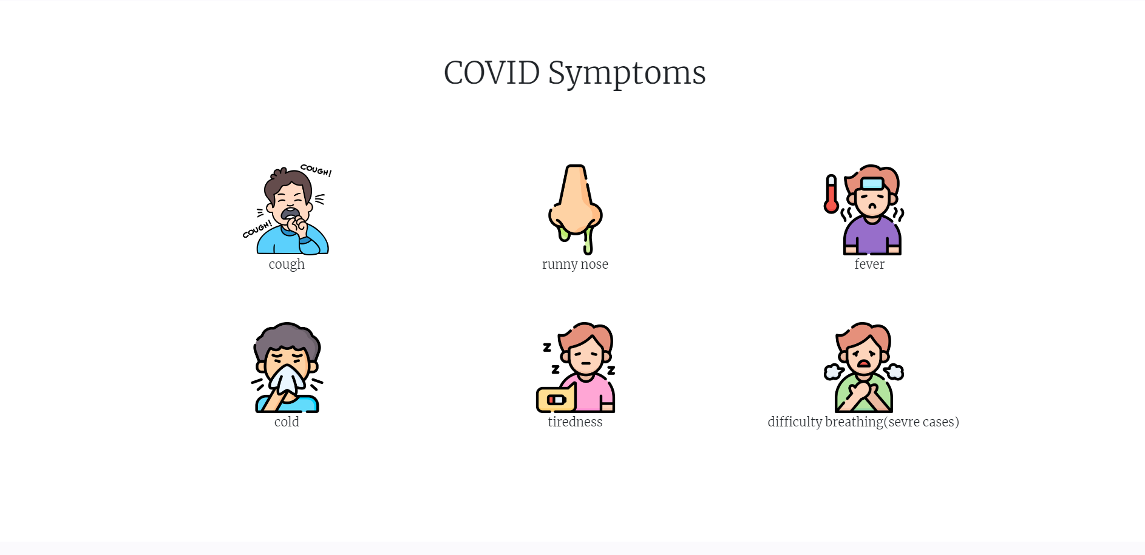
Covid symptoms

Slide 10
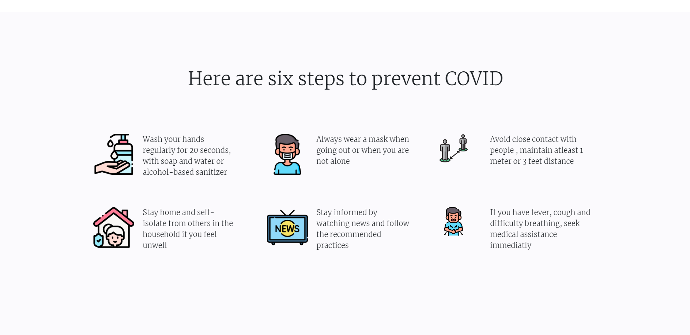
These steps to be followed in order to prevent the infection

Slide 11
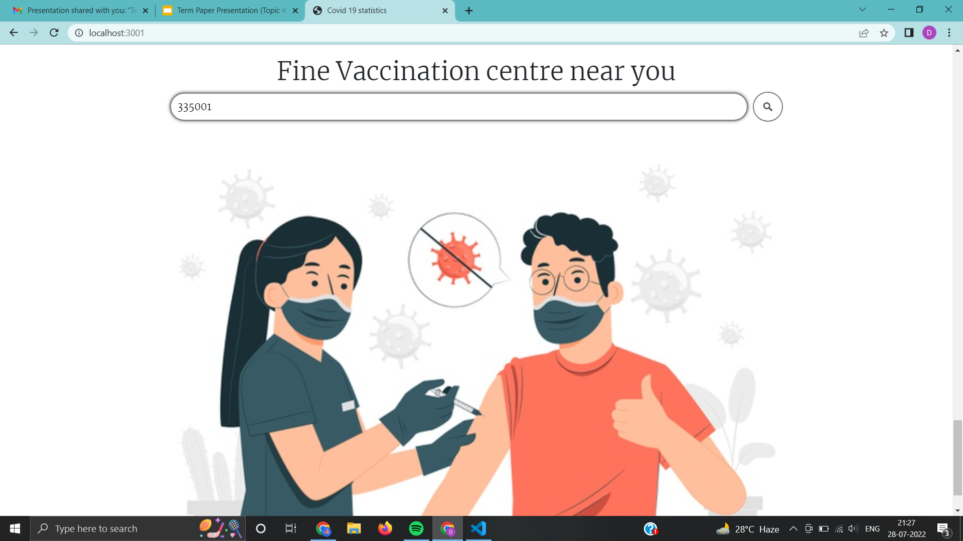
The space provided with the search option can be used to provide the pincode for the particular area to search for the slots availability using either search button or enter key -

Slide 12
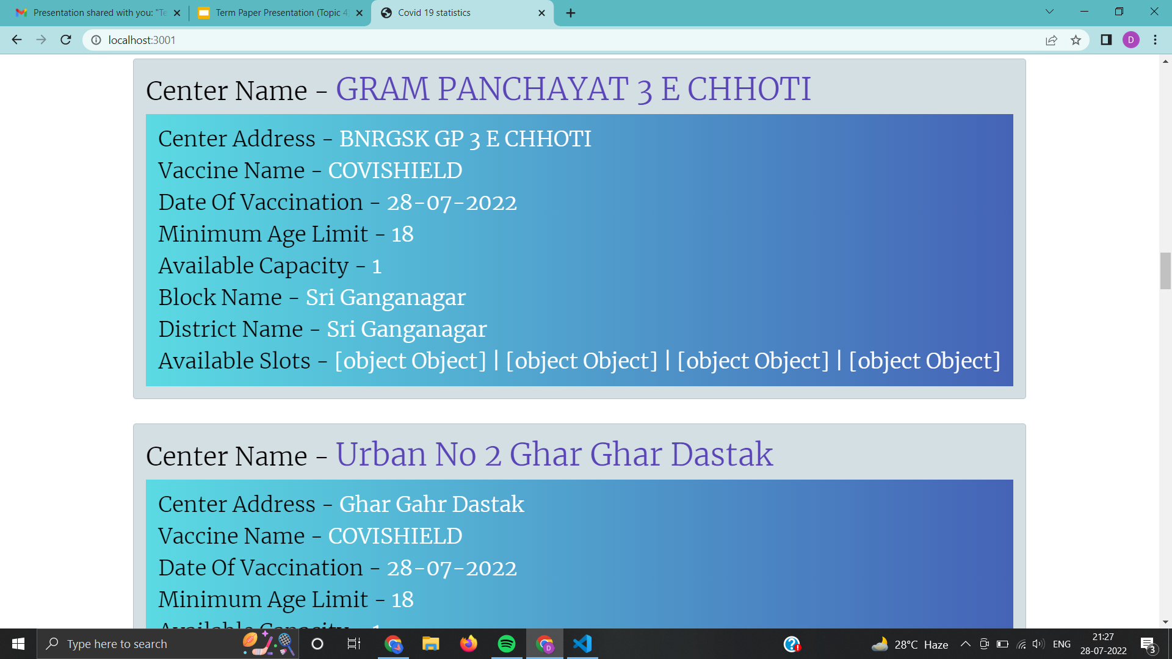
The different centres available for the vaccination will be displayed in the form of cards along with the particular vaccine name, min. Age limit and Available capacity which can be easily scrolled using the mouse pointer.

Slide 13
Future plans
To make the application more country specific by including the data regarding the particular states of a country the one residing in by using the location of the consumer for the past one month or by manually choosing the country.
To include the pictorial representation using different kind of graphs for better understanding of the trends regarding the data.
for the application

Slide 14
References-
https://ourworldindata.org/grapher/covid-vaccination-policy?region=Asia
https://www.syncfusion.com/blogs/post/design-an-interactive-dashboard-for-covid-19-updates-in-javascript.aspx
https://www.w3schools.com/js/
https://github.com/owid/covid-19-data/tree/master/public/data

Slide 15
Thank you.

