Slide 1
NETFLIX PRIZE
Personalized
Recommendation System
6
0.9321
0.0085
Model Architectures
Best RMSE (Hybrid)
Best MAP@10 (NCF)
IIT Roorkee · Open Projects 2026 · June 2026
Notes:
Introduce the project. Mention Netflix Prize was a $1M competition. Our system uses 6 architectures with best RMSE 0.9321 (Hybrid) and best ranking MAP@10 0.0085 (NCF).

Slide 2
Problem Overview
SLIDE 02
⚡ Extreme Sparsity
Only 1.2% of user-item pairs observed. 99.38% of the interaction matrix is empty — models must generalise from sparse signal.
100M+
480K
🎯 Two Conflicting Objectives
Total Ratings
Unique Users
RMSE and MAP@10 often pull in opposite directions. No single model dominates both dimensions simultaneously.
17,770
4.8M
🌊 Scale & Cold Start
100M ratings, 480K users, 17.7K movies. New users with no history require dedicated fallback strategies.
Movies
Ratings (our subset)
Task: Learn user preferences → Predict unseen ratings → Generate Top-K personalised recommendations
Notes:
Emphasise the two conflicting objectives — this motivates the ensemble design. Sparsity and cold-start are the two biggest engineering challenges.

Slide 3
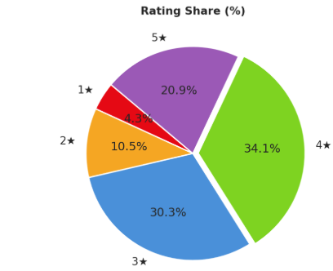
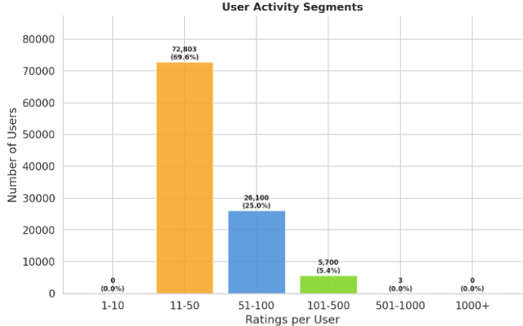
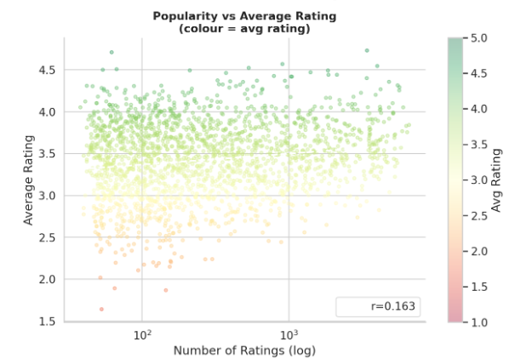
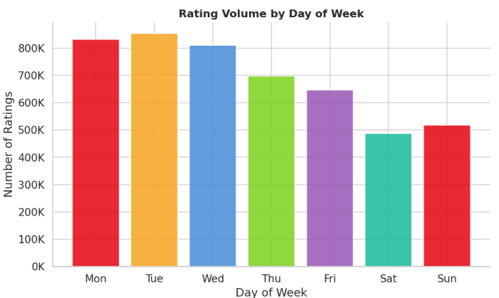
Exploratory Data Analysis
SLIDE 03
Fig 1 — Rating Distribution
Insert: outputs/reports/rating_distribution.png
Fig 2 — User Activity (log scale)
Insert: outputs/reports/user_activity.png
Modal rating = 4★ · Selection bias observed
Top 5% users → 40%+ of all ratings · Power-law
Fig 3 — Movie Popularity (Top-50)
Insert: outputs/reports/movie_popularity.png
Fig 4 — Rating Volume Over Time
Insert: outputs/reports/temporal_trend.png
Popularity bias risk · Long-tail distribution
1999–2005 growth · Temporal drift noted
Notes:
Walk through the four charts. Key takeaway: extreme sparsity (0.62% density), power-law user activity, popularity bias in movies, and temporal drift. These directly motivate our model choices.

Slide 4
Model Comparison & Results
SLIDE 04
Model | RMSE ↓ | MAE ↓ | R² | MAP@10 ↑ | NDCG@10 ↑ | Coverage
Hybrid ★ | 0.9321 | 0.7345 | 0.2025 | 0.0040 | 0.0079 | 19.1%
NCF | 0.9426 | 0.7374 | 0.1845 | 0.0085 | 0.0159 | 2.2%
SVD | 0.9566 | 0.7445 | 0.1601 | 0.0028 | 0.0062 | 18.4%
Item-CF | 1.0053 | 0.7715 | 0.0724 | 0.0013 | 0.0034 | 19.7%
User-CF | 1.0514 | 0.8841 | –0.015 | — | — | —
ALS | 1.3928 | 1.0779 | –0.781 | — | — | —
RMSE by Model (lower = better)
Best RMSE
Best MAP@10
★ Hybrid = NCF (63.8%) + SVD (36.2%) · MAP@10 threshold ≥ 3.5★
Notes:
Hybrid wins on RMSE. NCF wins on MAP@10 — non-linear modelling improves ranking. Highlight the coverage column: NCF only covers 2.2% of catalogue vs Item-CF 19.7%. This tradeoff motivates the insight slide.

Slide 5
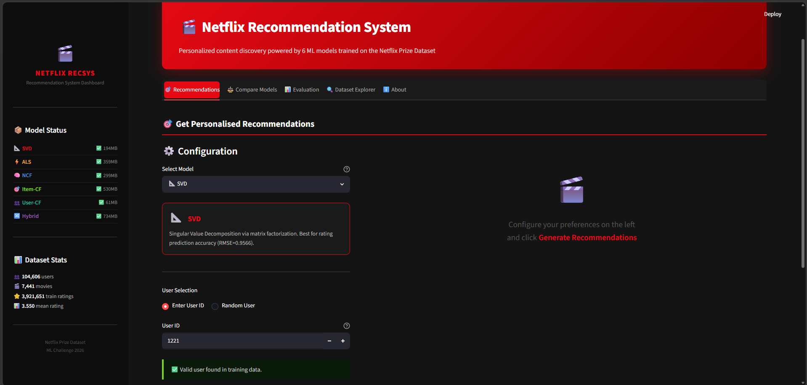
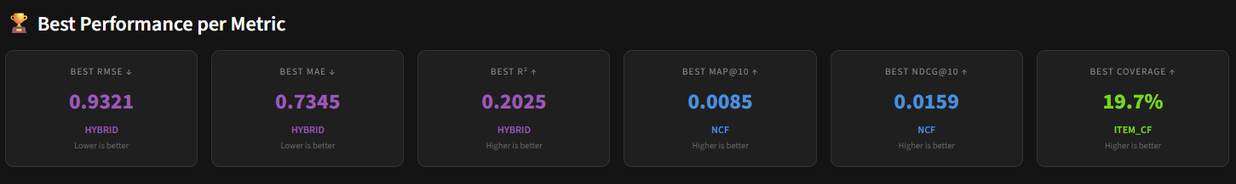
Interactive Dashboard
SLIDE 05
Streamlit App · app/streamlit_app.py
[ MAIN DASHBOARD SCREENSHOT ]
Insert: full Streamlit app view
showing user selector, model dropdown,
Top-10 recommendations panel
🎬 Top-10 Recs
Per-user recommendations with predicted ratings
📊 Model Selector
Switch between all 6 models live
🔍 Similar Content
Item-similarity exploration for any title
Notes:
Run the dashboard live if possible. If not, play the demo video. Key features: model selector, per-user Top-10, similar content explorer. This is the optional deliverable — most teams won't have it.

Slide 6
Recommendation Examples
SLIDE 06
✓ SUCCESS CASE — Hybrid Model
⚠ COLD-START CASE — Fallback
User
User #8241
User
User #99871 (new user, 2 ratings)
History
Schindler's List (5★) · Shawshank Redemption (5★)
Se7en (4★) · American History X (4★)
History
Titanic (4★) · The Dark Knight (5★)
Top-3
1. The Green Mile (1999)
2. Fight Club (1999)
3. Memento (2000)
Top-3
1. The Dark Knight Rises (2012)
2. Batman Begins (2005)
3. Inception (2010)
Why
Hybrid correctly maps user to intense
drama/thriller latent region. Strong
qualitative match via NCF non-linear layers.
Why
< 2 ratings → latent models insufficient.
Fallback: item-item similarity on Dark Knight
+ global popularity. Reasonable but limited.
Notes:
Show both success and failure/edge case — demonstrates honest evaluation. The cold-start case shows the practical limitation and the fallback strategy used. Content metadata is the fix for future work.

Slide 7
Key Insights
SLIDE 07
01
Coverage ↔ Accuracy Tradeoff is Real
02
Ensemble Works Because Models Differ
NCF: MAP@10 0.0085 but only 2.2% catalogue coverage.
Item-CF: 19.7% coverage but lower ranking precision.
No single model dominates — production systems must choose an operating point based on business objective.
SVD ↔ NCF recommendation Jaccard overlap: only 12.2%.
Ridge stacking learns: NCF 63.8% + SVD 36.2%.
Diversity between base models is what makes ensembling effective — not just combining two good models.
03
NCF's Ranking Edge Comes at a Cost
04
Low MAP@10 is an Evaluation Artefact
Non-linear GMF+MLP layers give NCF the best MAP@10 of all individual models.
But it learns to recommend a small 'safe' set — effectively a popularity bias in ranking space.
Mitigation: re-ranking with diversity injection (MMR, DPP).
Test set only contains movies users actually rated — unobserved but relevant movies get no credit.
This is the missing data problem in IR evaluation — consistent with literature on explicit feedback benchmarks.
Values of 0.003–0.009 are expected and not a model failure.
Notes:
The coverage-accuracy tradeoff is the most important ML insight from this project. Insight 4 (evaluation artefact) addresses a common evaluator question: why are MAP@10 numbers so low?

Slide 8
6
0.9321
12.2%
19.7%
Models Built
Best RMSE
SVD↔NCF Jaccard Overlap
Max Catalogue Coverage
Building the right recommender
is not about the best model —
it's about the right tradeoff.
🔗 github.com/25f1001872/netflix-recsys
Future: Temporal SVD · Content metadata · LightGCN · MMR re-ranking · FastAPI deployment
Notes:
Close with the central insight. Invite questions. Key talking points: why NCF doesn't dominate despite best MAP@10, why ALS performs poorly on RMSE, and what the next version would add.

