Slide 1

Project Title - Seasonal Agriculture Performance Analysis
[Loudiya Vikas]
University of Hyderabad
AICTE STU ID : (STU65b702dae1cca1706492634)

Slide 2

PROBLEM STATEMENT
Agricultural performance varies across seasons because of environmental conditions, farming practices, resource availability and market conditions. The project analyzes the agricultural dataset to identify seasonal differences in yield, production, profitability and resource use, and to uncover meaningful patterns, trends and relationships.

Slide 3
The project analyzes 4,000 farm-level records with 28 variables covering location, crop, season, yield, production, profit, rainfall, temperature, water usage and irrigation.
The analysis includes data cleaning and quality checks, descriptive statistics, crop- and season-wise comparisons, correlation analysis and irrigation performance analysis.
Key findings: Kharif has the highest activity and production; Zaid has lower profitability and higher average water usage. Sugarcane and Chilli are the most profitable crops, while drip irrigation shows the highest average profit.

Slide 4

WHO ARE THE END USERS?
• Farmers – seasonal crop and irrigation decisions
• Agricultural officers / extension services – targeted support and advisories
• Agricultural analysts – evidence-based performance comparison
• Policy makers – resource allocation and seasonal support planning
• Irrigation planners – water-use efficiency decisions

Slide 5

Technology Used
Python
Pandas
NumPy
Matplotlib
Seaborn
Data source: seasonal_agriculture_performance_dataset.csv
Analysis type: Data Analytics (no ML/dashboard required)

Slide 6
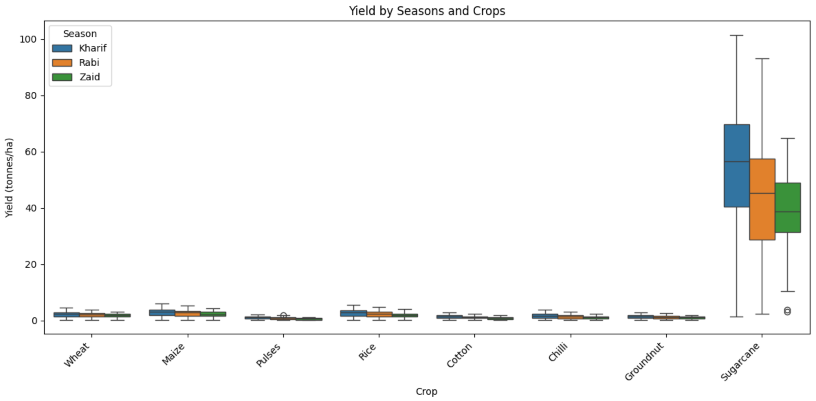
RESULTS
Dataset & overall findings
Average yield: Kharif 5.64 t/ha • Rabi 5.08 t/ha • Zaid 4.67 t/ha
Average profit: Kharif ₹178,914.65 • Rabi ₹87,689.47 • Zaid −₹24,804.82
Highest average water use: Zaid 6,419.89 m³/farm

Slide 7
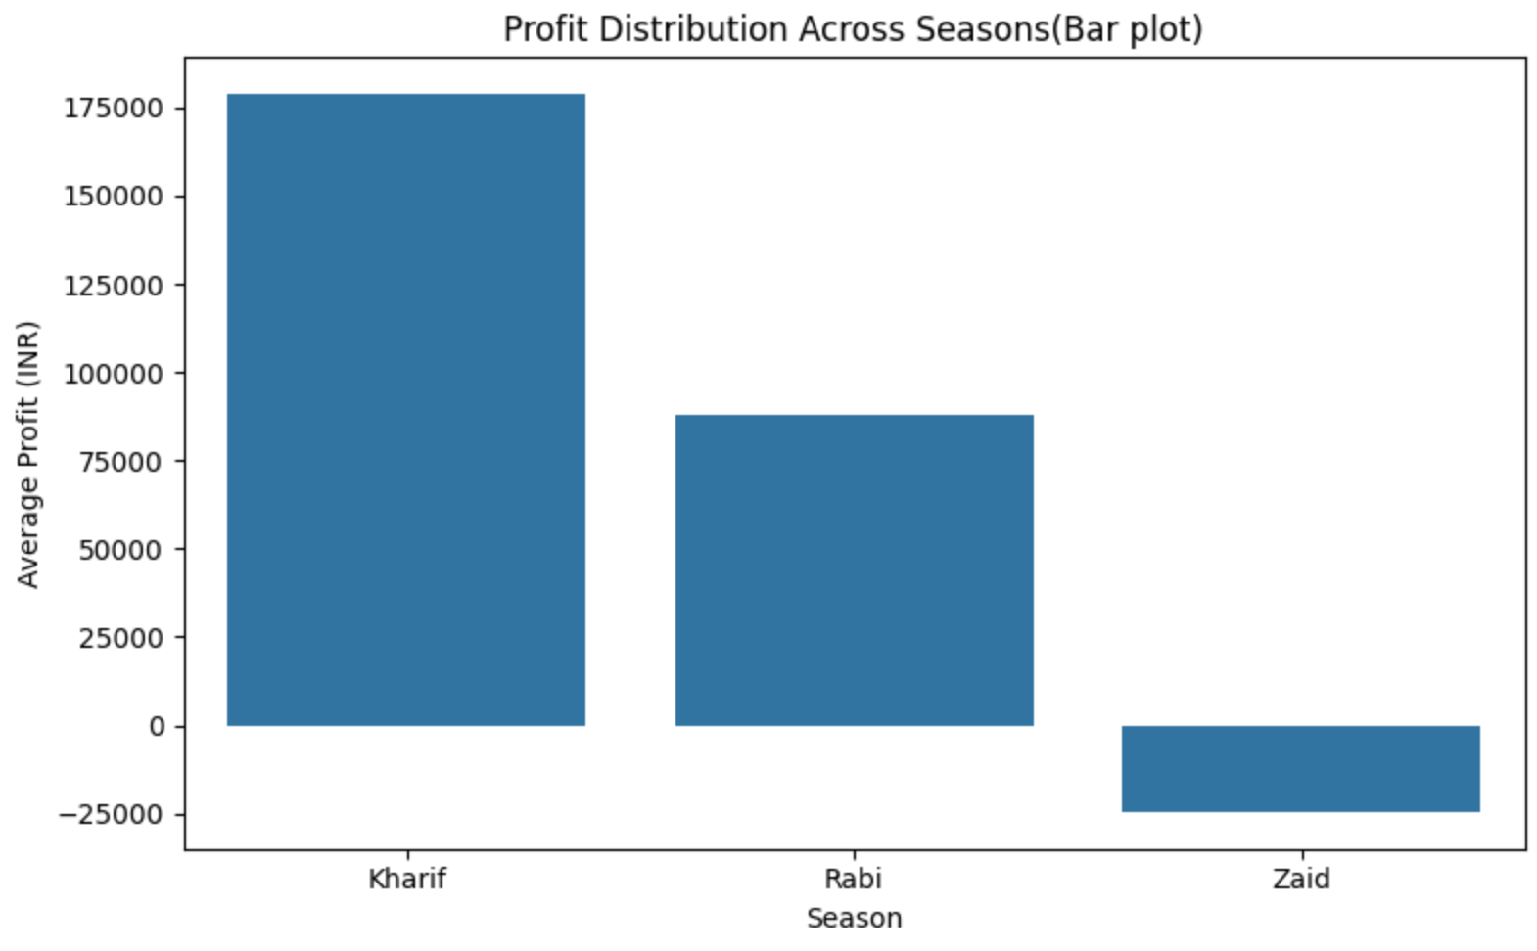
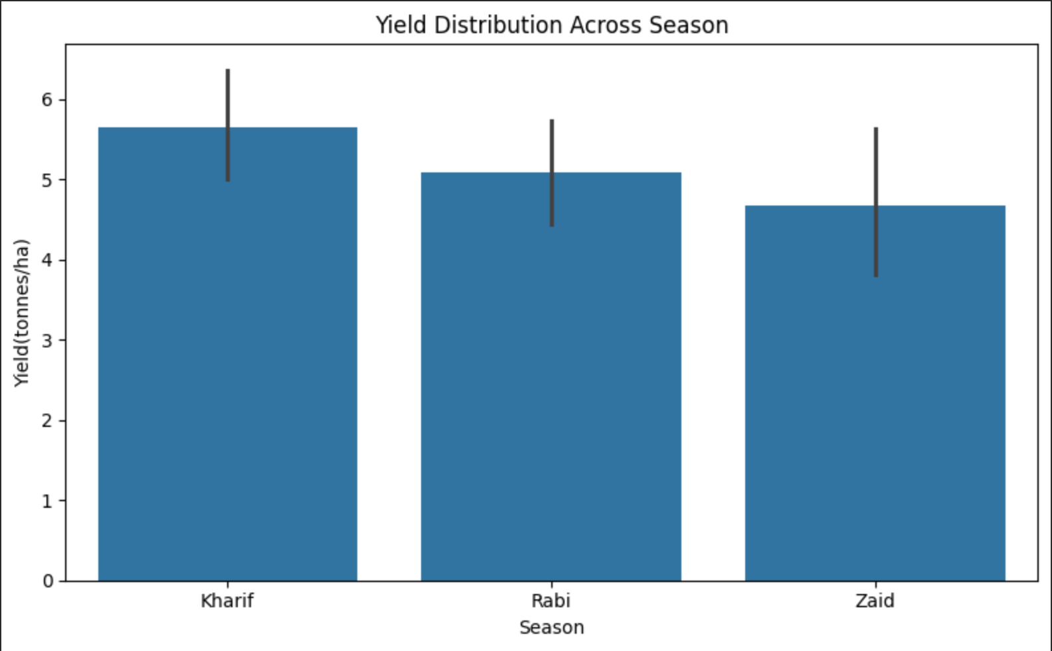
RESULTS
Seasonal comparison
Kharif leads in average yield (5.64 t/ha) and average profit (₹178,914.65). Rabi is moderate, while Zaid has the lowest average yield (4.67 t/ha) and a negative average profit (−₹24,804.82).
Source: supplied Agriculture Analysis PDF

Slide 8
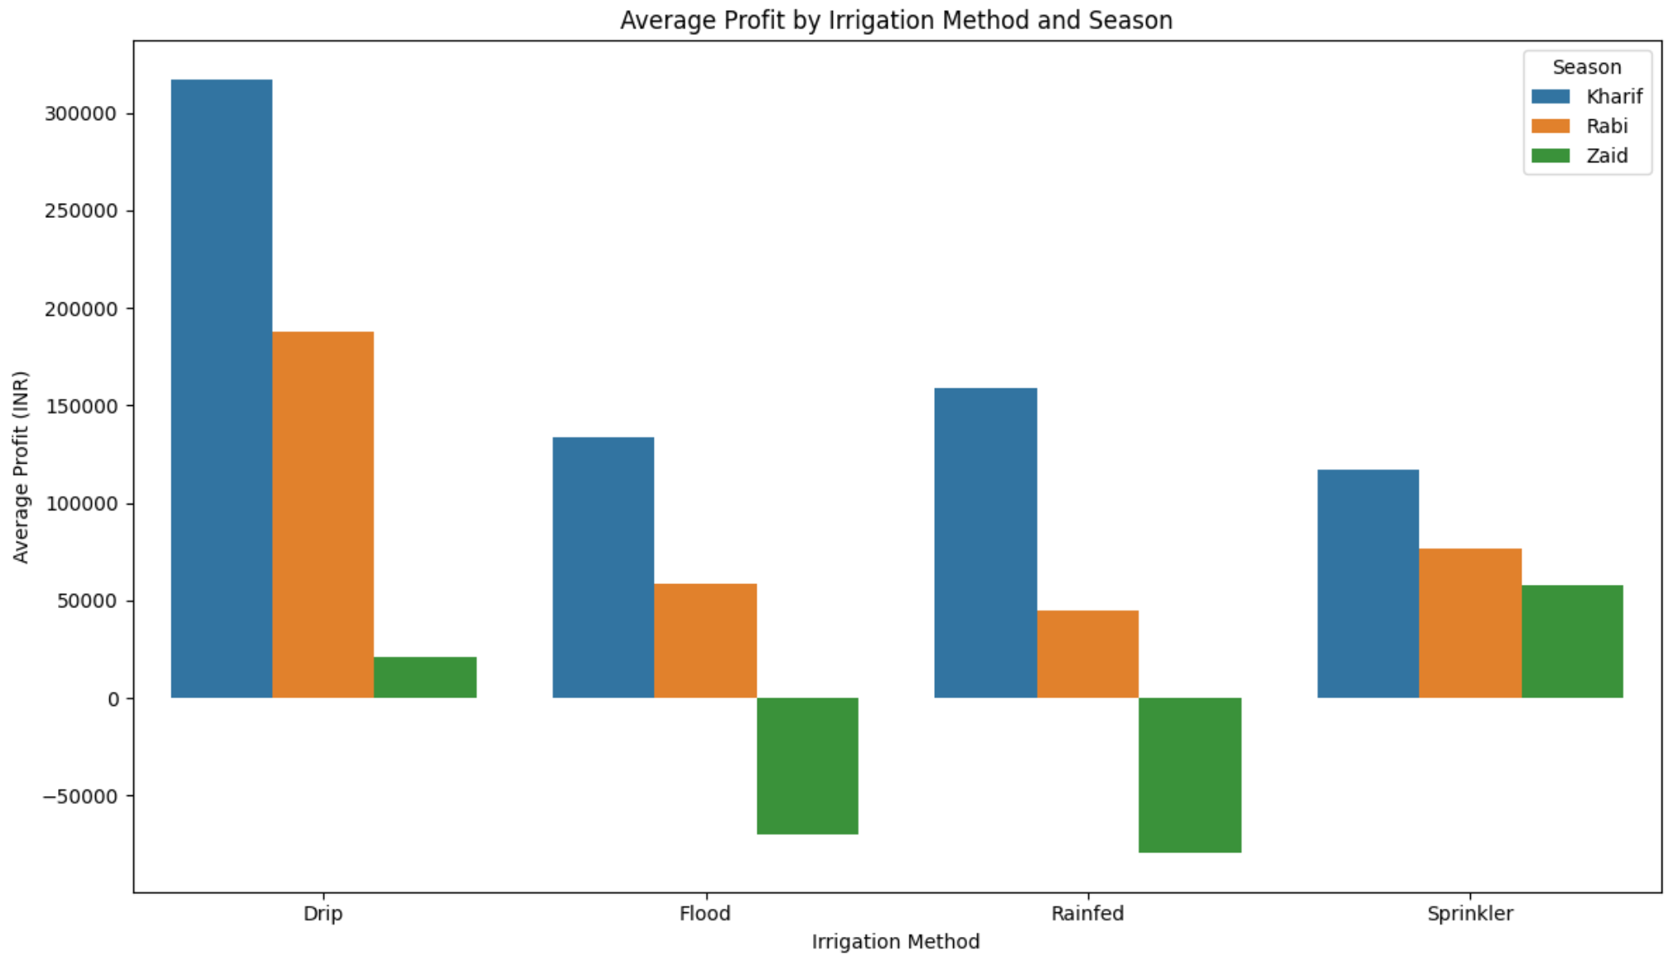
RESULTS
Irrigation profitability
Drip irrigation shows the highest average profit in all three seasons. Flood and Rainfed show average losses in Zaid.
Source: supplied Agriculture Analysis PDF

Slide 9
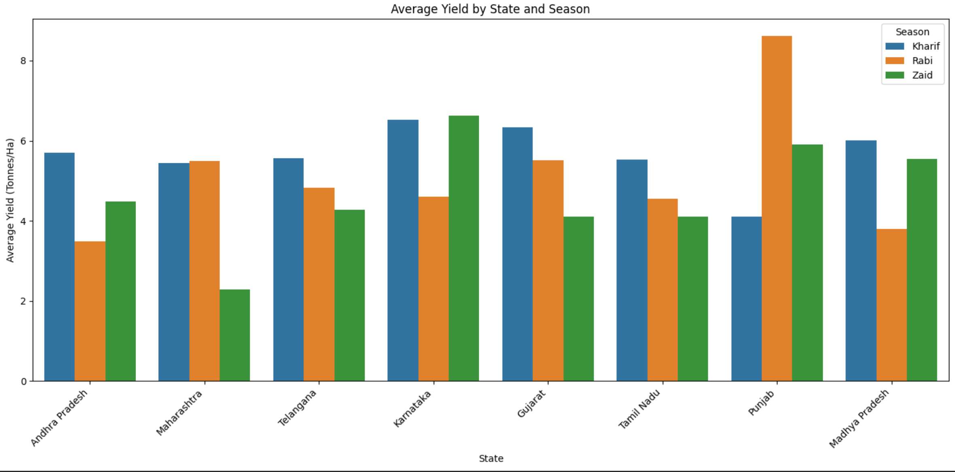
RESULTS
Crop-specific seasonal profitability
Sugarcane and Chilli remain the strongest profit performers across seasons, while staple crops frequently show losses, especially in Zaid.
Source: supplied Agriculture Analysis PDF

Slide 10
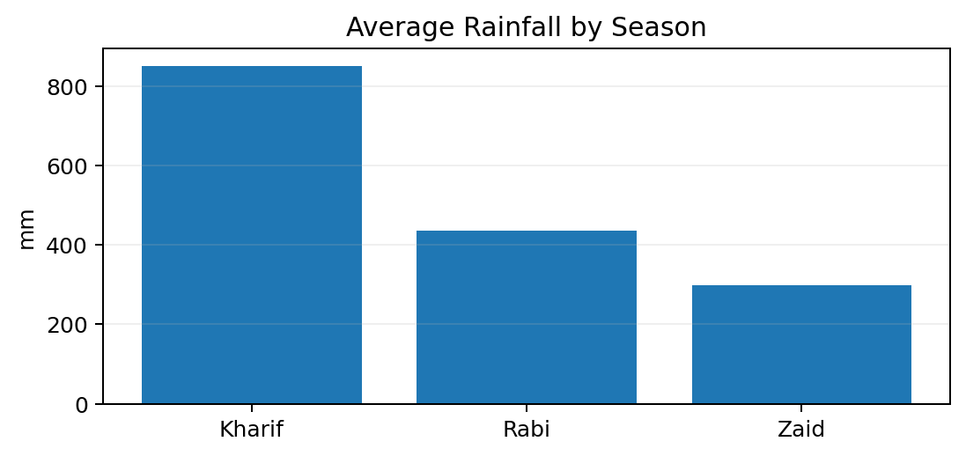
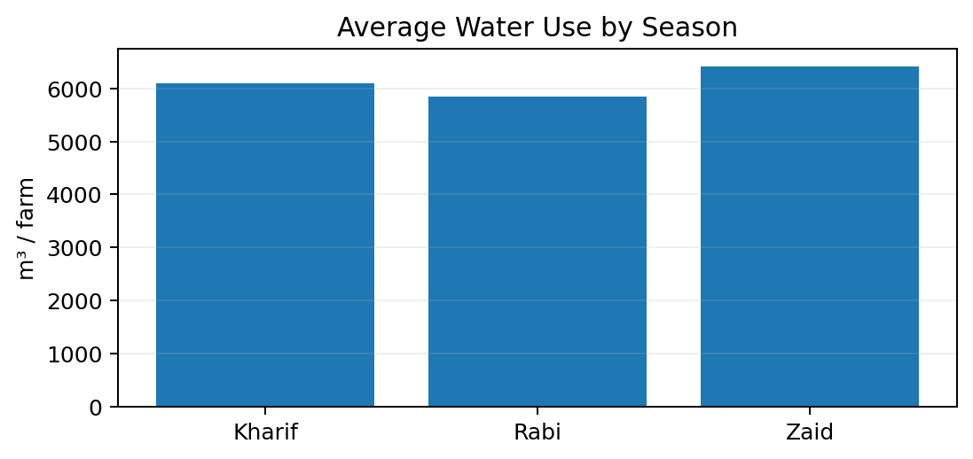
RESULTS
Environmental & resource pattern
Zaid has the lowest average rainfall (299.42 mm), the highest average temperature (31.04°C), and the highest average water use (6,419.89 m³/farm). This indicates greater environmental and resource pressure.
Source: supplied Agriculture Analysis PDF

Slide 11
Future scope
• Develop time-series analysis to study seasonal trends over multiple years.
• Build region-specific crop and seasonal advisories.
• Investigate detailed input costs, market prices and farm-level efficiency.
• Evaluate drought-resistant crops and water-saving practices for Zaid.
• Conduct experiments or causal studies to test irrigation and yield-enhancing practices.
• Use the findings to guide resource allocation, farmer support and sustainable agriculture investments.

Slide 12
GitHub Link
https://github.com/25mcmc14-loudiyavikas/Agricultural_Seasonal_Analysis

Slide 13

VOIS Course completion certificate - Course name- Data Visualization

Slide 14
Thank you
.
.

