Slide 1
CLOUDFLARE WORKERS
EdgeFlow Simulator
EDGE
CACHE
FAILOVER
Distributed edge caching and failover with Python sockets
Kumar Shivam
Registration Number 25MCMC34
Minor III Mini Project
Notes:
Presentation for the implemented EdgeFlow Simulator. Sources used throughout: Cloudflare Workers documentation and Python socketserver documentation.

Slide 2
Project scope
02
The project converts Cloudflare Workers concepts into a small system that can run on one computer.
•
A dispatcher hides edge selection from the client.
•
Two independent edge nodes cache origin responses.
•
Health checks and retry keep the service available after one node stops.
•
Five integration tests verify routing, caching, failover, and errors.
Educational boundary
The simulator does not reproduce global Anycast routing, V8 isolation, TLS, or Cloudflare production scale.
Kumar Shivam 25MCMC34
Distributed Computing Minor III
Notes:
The scope follows the assignment requirement to propose and implement a simplified version. Cloudflare source: https://developers.cloudflare.com/workers/reference/how-workers-works/

Slide 3
EdgeFlow system architecture
03
Edge pool
India 8801
Asia 8802
Client
Dispatcher
port 8800
Origin
port 8900
TCP + newline-delimited JSON
Separate processes and ports preserve message passing even when all components run on localhost.
Kumar Shivam 25MCMC34
Distributed Computing Minor III
Notes:
Architecture implemented in source_code. Real Workers architecture reference: https://developers.cloudflare.com/workers/reference/how-workers-works/

Slide 4
Distributed computing paradigms
04
Client server
Client requests a resource through one public entry point.
Edge computing
Edge processes handle requests before the origin.
Message passing
Processes exchange JSON over TCP instead of shared memory.
Replication and caching
Each edge keeps an independent copy for a fixed TTL.
Event driven concurrency
A threaded handler runs for each accepted connection.
Kumar Shivam 25MCMC34
Distributed Computing Minor III
Notes:
Concept mapping follows Coulouris et al., Distributed Systems Concepts and Design. Cloudflare storage reference: https://developers.cloudflare.com/kv/concepts/how-kv-works/

Slide 5
Implemented algorithms
05
Round robin
The dispatcher rotates the first candidate node for consecutive requests.
Health check and retry
PING uses a short timeout. A failed node is skipped and the next node receives the request.
TTL cache
A valid entry produces HIT. A missing or expired entry fetches from the origin and produces MISS.
Thread per connection
ThreadingTCPServer lets separate client connections make progress concurrently.
Trade-off
Caching reduces origin work but may return an older version until expiry.
Kumar Shivam 25MCMC34
Distributed Computing Minor III
Notes:
Algorithms are implemented in dispatcher.py, edge_server.py, and common.py. Python reference: https://docs.python.org/3/library/socketserver.html

Slide 6
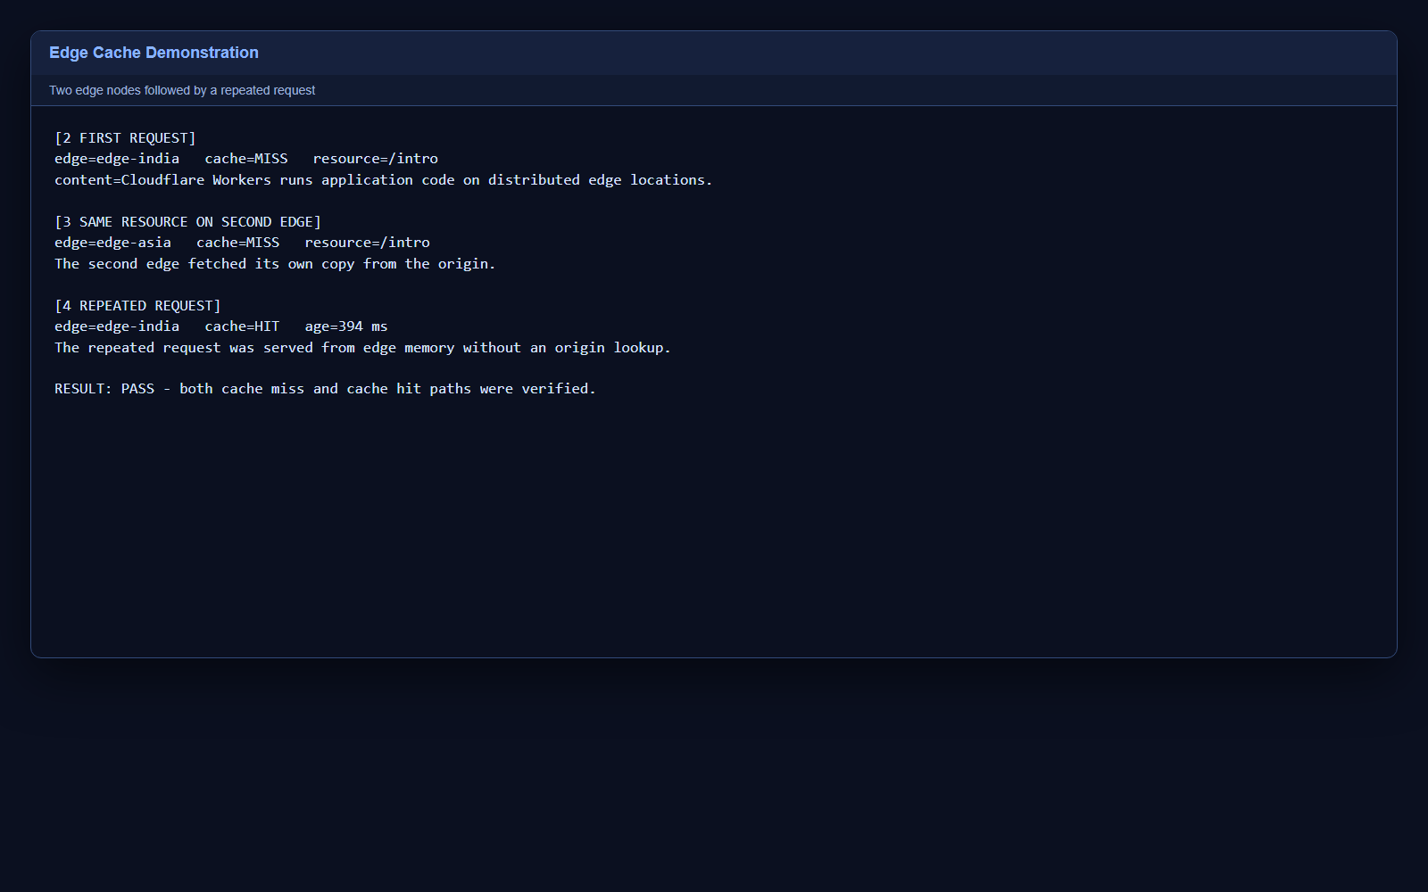
Cache behavior
06
Observed sequence
•
Edge India: MISS
•
Edge Asia: MISS
•
Edge India: HIT
•
Origin lookup avoided on the hit
Kumar Shivam 25MCMC34
Distributed Computing Minor III
Notes:
Screenshot generated from the verified output of python demo.py on 29 October 2026.

Slide 7
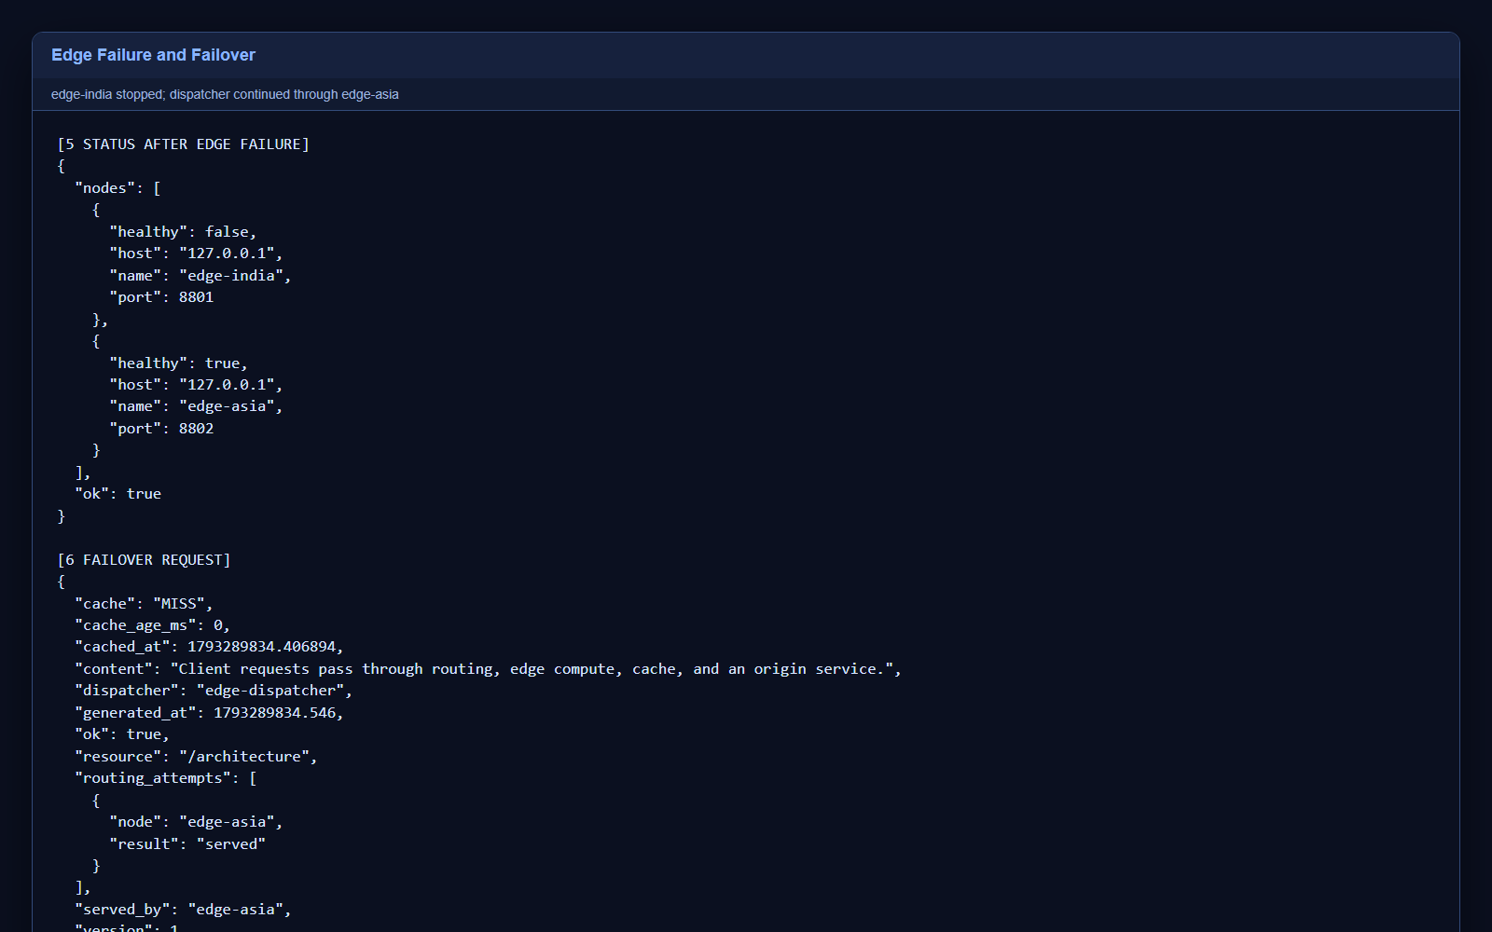
Failure detection and failover
07
Result
•
edge-india health: false
•
edge-asia health: true
•
The request still succeeds
•
served_by: edge-asia
Kumar Shivam 25MCMC34
Distributed Computing Minor III
Notes:
Screenshot generated from the verified output of python demo.py on 29 October 2026.

Slide 8
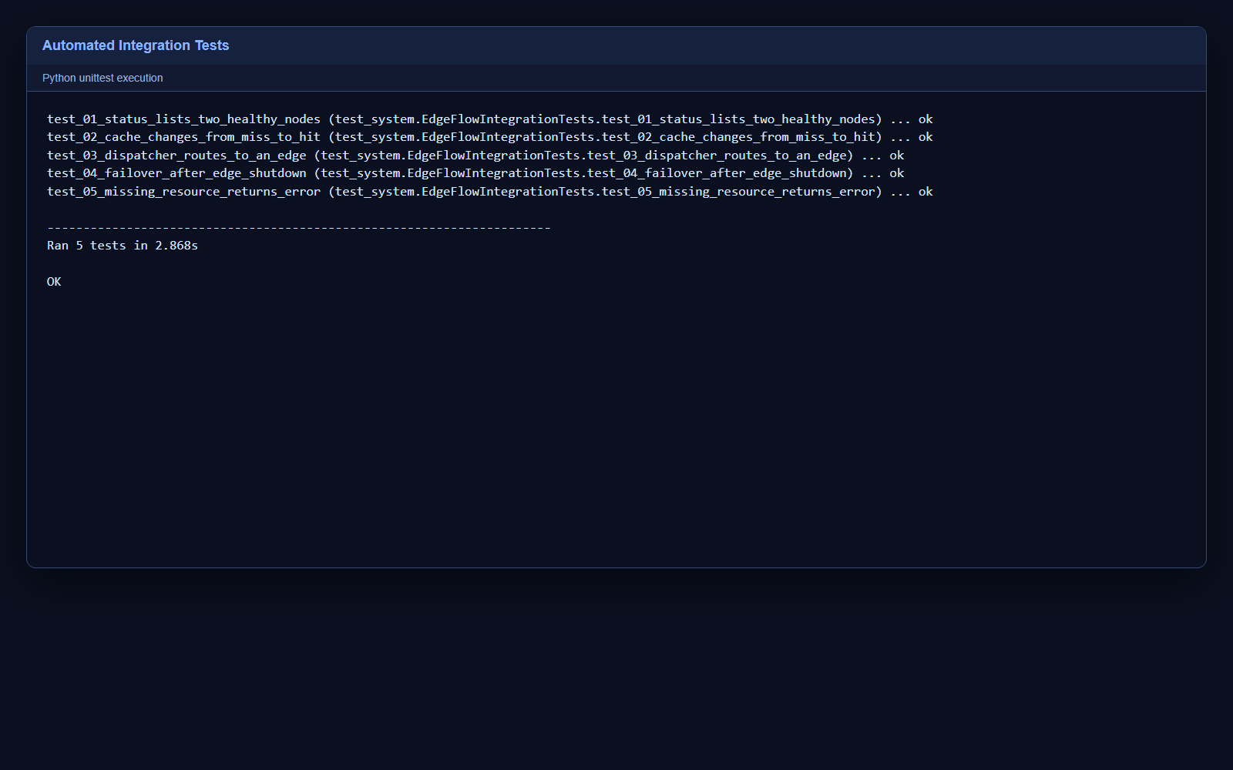
Integration test results
08
Five tests passed
•
Two healthy nodes
•
MISS followed by HIT
•
Dispatcher routing
•
Failover after shutdown
•
Missing resource error
Kumar Shivam 25MCMC34
Distributed Computing Minor III
Notes:
Screenshot generated from python -m unittest -v test_system.py on 29 October 2026.

Slide 9
Project outcome
The working simulator connects the assignment theory to observable distributed-system behavior.
•
The client remains independent of node selection.
•
Caching reduces repeated origin access.
•
One edge can fail without stopping the service.
•
Automated tests make the demonstration repeatable.
Kumar Shivam 25MCMC34
Notes:
Final summary of the implemented and tested submission.

