Slide 1
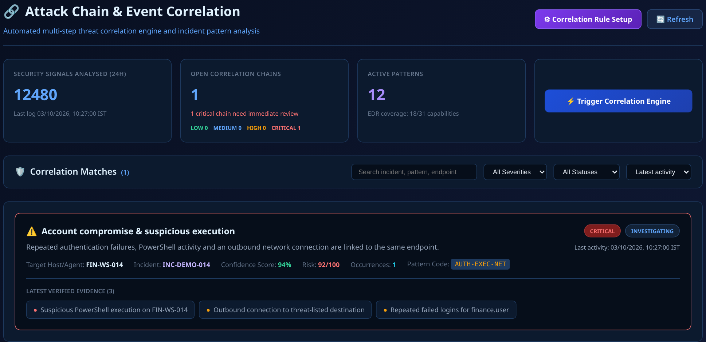
AJNAT
SOC / PRODUCT OVERVIEW
UNIFIED SECURITY OPERATIONS
FROM SIGNAL TO ACTION
AJNAT SOC
See the signals.
Understand the threat.
Coordinate the response.
Endpoint visibility, connected evidence and
incident workflows in one analyst workspace.
Visibility
Context
Control
SIEM
EDR
SOAR
ACTUAL AJNAT UI · SAMPLE DATA
AJNAT SOC · VISIBILITY. CONTEXT. CONTROL.
01 / 12
Notes:
AJNAT SOC — Product overview
Presenter notes (Hinglish):
AJNAT SOC security team ko ek common workspace deta hai. Endpoint, network aur identity ke signals ko saath dekhkar analyst threat samajh sakta hai aur response coordinate kar sakta hai. Aage hum actual UI screens aur ek short incident example dekhenge. Screenshots mein sample data hai.
Visual provenance: Actual AJNAT React UI from company/src/pages/CorrelationPage.jsx. Captured locally with browser-intercepted demonstration API responses; no production telemetry. UI labels and sample counts do not establish measured product performance. See docs/brochure/capture_ui.py and assets/capture-manifest.json.

Slide 2
AJNAT
SOC / WHAT IT DOES
THE PLATFORM
One workspace for the security team.
A SOC (Security Operations Center) monitors activity, investigates threats and coordinates response.
SIEM
EDR
SOAR
Security Information and
Event Management
Endpoint Detection
and Response
Security Orchestration,
Automation and Response
Bring events together
Understand the endpoint
Coordinate the next action
Collect and connect security logs
from configured sources.
Review process, file, network
and authentication activity.
Use rules, playbooks and approvals
to manage supported actions.
Connected sources
Endpoints / Network / Identity / Web applications
AJNAT SOC · VISIBILITY. CONTEXT. CONTROL.
02 / 12
Notes:
One workspace for the security team
Presenter notes (Hinglish):
SOC ka simple meaning hai security monitoring aur incident response ka central function. SIEM logs ko collect aur correlate karta hai. EDR endpoint ke andar ki activity dikhata hai. SOAR approved workflows se response coordinate karta hai. AJNAT in capabilities ko ek operational context mein laata hai.

Slide 3
AJNAT
SOC / HOW IT WORKS
THE OPERATING FLOW
From raw events to a clear next step.
Each stage adds context so an analyst can make an informed decision.
01
02
03
04
Collect
→
Correlate
→
Investigate
→
Respond
Endpoint, network,
web and login events
Related activity,
entities and indicators
Severity, timeline,
evidence and ownership
Approvals, supported
actions and execution logs
Shared event visibility
A connected attack story
An analyst assessment
A recorded outcome
AJNAT SOC · VISIBILITY. CONTEXT. CONTROL.
03 / 12
Notes:
From raw events to a clear next step
Presenter notes (Hinglish):
Pehle configured sources se events aate hain. Correlation related activity ko link karta hai. Analyst severity, timeline aur evidence review karke incident assess karta hai. Uske baad authorized response actions, approvals aur execution result case ke saath record hote hain. Har alert automatically confirmed attack nahi hota.

Slide 4
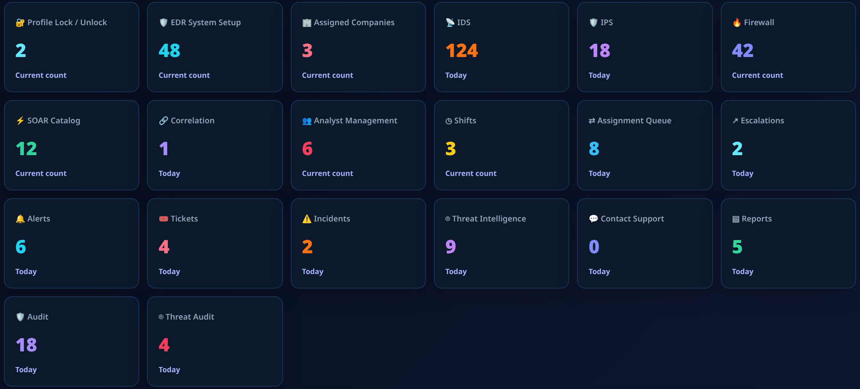
AJNAT
SOC / PRODUCT WALKTHROUGH
01 / SOC OVERVIEW
Start with operational priorities.
A manager view brings company coverage, work queues and security activity together.
1
Coverage
Review assigned companies and security modules.
2
Work queues
See alerts, incidents and escalations in one view.
3
Follow-up
Open reports and audit views to support review and handover.
ACTUAL AJNAT UI / SAMPLE DATA
AJNAT SOC · VISIBILITY. CONTEXT. CONTROL.
04 / 12
Notes:
Start with operational priorities.
Presenter notes (Hinglish):
Yeh actual SOC Manager dashboard hai. Ismein assigned companies, IDS/IPS, firewall aur operational queues ka overview milta hai. Manager yahan se relevant module ya queue open kar sakta hai. Screen ke numbers sirf demonstration data hain; performance ya customer results nahi.
Visual provenance: Actual AJNAT React UI from company/src/pages/analyst/soc/RoleDashboardPage.jsx. Captured locally with browser-intercepted demonstration API responses; no production telemetry. UI labels and sample counts do not establish measured product performance. See docs/brochure/capture_ui.py and assets/capture-manifest.json.

Slide 5
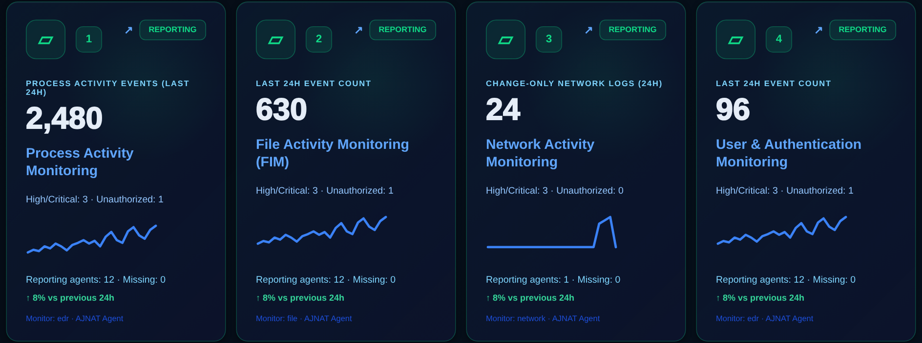
AJNAT
SOC / PRODUCT WALKTHROUGH
02 / ENDPOINT VISIBILITY
Understand activity on the endpoint.
Monitoring modules organize device activity into focused investigation views.
1
Processes & files
Inspect execution activity and file changes.
2
Network & identity
Review connections, DNS and authentication signals.
3
Focused coverage
Choose modules for the endpoint platform and enabled sensors.
ACTUAL AJNAT UI / SAMPLE DATA
AJNAT SOC · VISIBILITY. CONTEXT. CONTROL.
05 / 12
Notes:
Understand activity on the endpoint.
Presenter notes (Hinglish):
EDR page endpoint activity ko monitoring modules mein organize karta hai: process, file, network, authentication aur doosre security areas. Analyst required module open karke related telemetry inspect kar sakta hai. Coverage operating system, permissions, sensors aur configuration par depend karti hai. Shown counters are sample data; this is a cropped view of the existing monitoring-card grid.
Visual provenance: Actual AJNAT React UI from company/src/pages/EDRPage.jsx. Captured locally with browser-intercepted demonstration API responses; no production telemetry. UI labels and sample counts do not establish measured product performance. See docs/brochure/capture_ui.py and assets/capture-manifest.json.

Slide 6
AJNAT
SOC / PRODUCT WALKTHROUGH
03 / EVENT CORRELATION
Connect signals into an attack story.
Related events appear together, with the affected host, severity and supporting evidence.
1
Pattern
See which sequence of activity triggered the correlation.
2
Context
Review the endpoint, risk and investigation status.
3
Evidence
Open linked events before confirming the incident.
ACTUAL AJNAT UI / SAMPLE DATA
AJNAT SOC · VISIBILITY. CONTEXT. CONTROL.
06 / 12
Notes:
Connect signals into an attack story.
Presenter notes (Hinglish):
Correlation page alag events ko ek possible attack chain ke andar dikhata hai. Sample case mein failed logins, PowerShell activity aur outbound connection FIN-WS-014 se linked hain. Analyst pattern, risk aur linked evidence check karta hai. Confidence score ek signal hai; final conclusion evidence review ke baad hota hai.
Visual provenance: Actual AJNAT React UI from company/src/pages/CorrelationPage.jsx. Captured locally with browser-intercepted demonstration API responses; no production telemetry. UI labels and sample counts do not establish measured product performance. See docs/brochure/capture_ui.py and assets/capture-manifest.json.

Slide 7
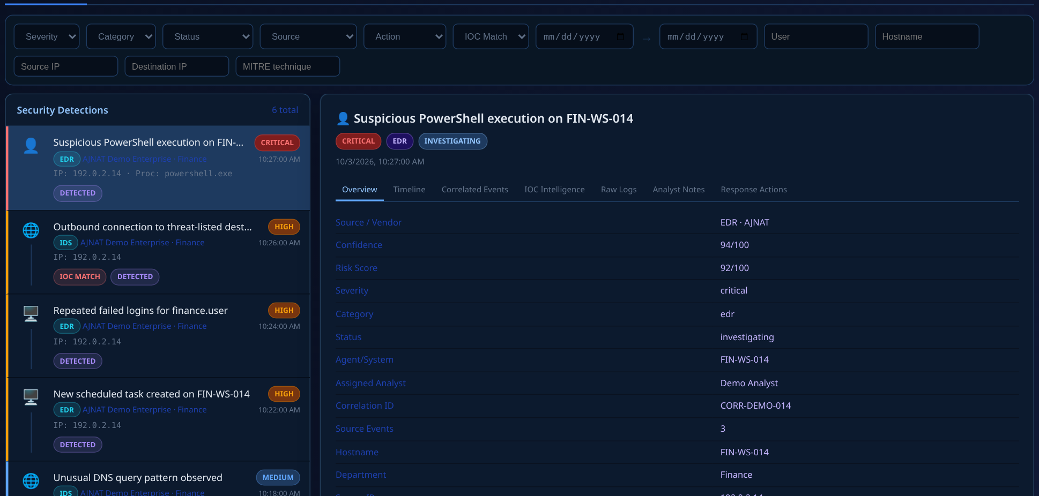
AJNAT
SOC / PRODUCT WALKTHROUGH
04 / INVESTIGATION
Read the evidence before taking action.
Follow the event timeline and inspect the details behind a suspicious signal.
1
Find
Filter by severity, source, status or an indicator.
2
Inspect
Review host, user, process and network details.
3
Assess
Use the timeline, raw logs and analyst notes for the decision.
ACTUAL AJNAT UI / SAMPLE DATA
AJNAT SOC · VISIBILITY. CONTEXT. CONTROL.
07 / 12
Notes:
Read the evidence before taking action.
Presenter notes (Hinglish):
Investigation screen mein left side par events hain aur selected event ki detail right side par aati hai. Analyst host, user, process aur source/destination details ko inspect kar sakta hai. Timeline, correlated events, IOC intelligence, raw logs aur notes context dete hain. AI summaries jahan configured hon wahan assistance de sakti hain; analyst review zaroori hai.
Visual provenance: Actual AJNAT React UI from company/src/pages/ThreatInvestigationPage.jsx. Captured locally with browser-intercepted demonstration API responses; no production telemetry. UI labels and sample counts do not establish measured product performance. See docs/brochure/capture_ui.py and assets/capture-manifest.json.

Slide 8
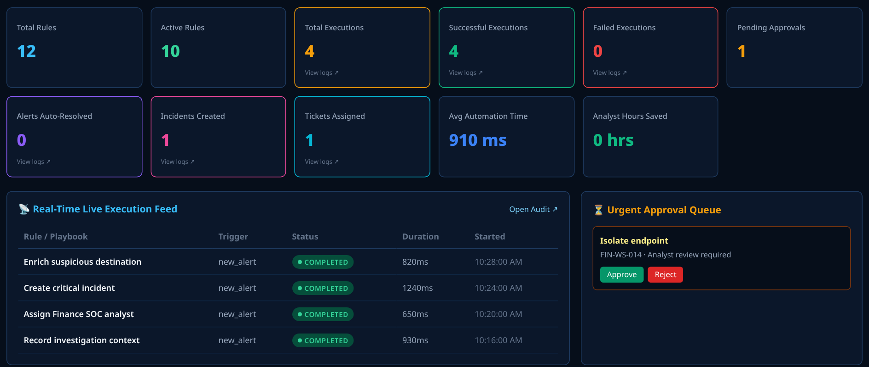
AJNAT
SOC / PRODUCT WALKTHROUGH
05 / COORDINATED RESPONSE
Move from review to a managed response.
SOAR brings automation rules, execution history and pending approvals into one workspace.
1
Orchestrate
Use rules and playbooks to organize response steps.
2
Approve
Review sensitive actions before they execute.
3
Track
Keep the execution status and outcome with the workflow.
ACTUAL AJNAT UI / SAMPLE DATA
AJNAT SOC · VISIBILITY. CONTEXT. CONTROL.
08 / 12
Notes:
Move from review to a managed response.
Presenter notes (Hinglish):
SOAR ka role response steps ko organize karna hai. Rules aur playbooks incident creation, assignment aur supported containment actions coordinate kar sakte hain. Pending approval queue sensitive actions par human control deti hai. Endpoint isolation ya blocking permissions, platform aur integrations par depend karta hai. Screen ke timings aur counts sample values hain, benchmarks nahi.
Visual provenance: Actual AJNAT React UI from company/src/pages/SoarPage.jsx. Captured locally with browser-intercepted demonstration API responses; no production telemetry. UI labels and sample counts do not establish measured product performance. See docs/brochure/capture_ui.py and assets/capture-manifest.json.

Slide 9
AJNAT
SOC / INCIDENT EXAMPLE
ILLUSTRATIVE SCENARIO
One endpoint. Three connected signals.
FIN-WS-014 / Possible account compromise / Requires analyst confirmation
01
02
03
Failed logins
→
Suspicious execution
→
Outbound connection
Repeated authentication
failures for finance.user.
PowerShell activity on
the same endpoint.
A destination that needs
indicator enrichment.
Connect the evidence
Review the case
Choose the response
Correlate the host, identity and time window.
Confirm scope, severity and incident ownership.
Approve supported action and record its result.
AJNAT SOC · VISIBILITY. CONTEXT. CONTROL.
09 / 12
Notes:
One endpoint. Three connected signals
Presenter notes (Hinglish):
Is example mein ek endpoint par teen signals milte hain: repeated failed logins, suspicious PowerShell execution aur unusual outbound connection. AJNAT in events ko link karne aur evidence inspect karne ka workflow deta hai. Analyst scope aur severity confirm karta hai, owner assign hota hai, phir supported response ko approve aur track kiya ja sakta hai. Yeh illustrative case hai; actual breach ya measured outcome nahi.

Slide 10
AJNAT
SOC / OPERATIONAL CONTROL
TEAMS & ACCOUNTABILITY
Clear ownership at every stage.
Role-based workspaces keep investigation, escalation and follow-up organized.
SOC manager
L1 analyst
L2 / L3 analysts
L4 threat intelligence
Priorities, assignment
and team oversight.
Initial review, ticket triage
and escalation.
Deeper investigation
and response coordination.
Indicator context and
threat intelligence work.
Scoped access
Case history
Reports & audit
Company and role context
Owner, decisions and actions
Evidence for review and handover
AJNAT SOC · VISIBILITY. CONTEXT. CONTROL.
10 / 12
Notes:
Clear ownership at every stage
Presenter notes (Hinglish):
SOC manager team priorities aur assignments manage karta hai. L1 initial triage karta hai; L2/L3 detailed investigation aur response coordination karte hain. L4 threat intelligence context par kaam karta hai. Company scope aur role permissions determine karte hain ki user kya dekh aur kar sakta hai. Case history, audit aur reports handover aur review ko support karte hain. Yeh compliance certification ka claim nahi hai.

Slide 11
AJNAT
SOC / WHY IT MATTERS
OPERATIONAL VALUE
Less switching. More connected context.
Keep the investigation and the response in the same operational conversation.
FRAGMENTED OPERATIONS
WITH AJNAT SOC
Separate asset and event views
→
Shared visibility across connected sources
Manual reconstruction of related activity
→
Correlated events with investigation context
Indicators checked in separate tools
→
Threat intelligence alongside relevant evidence
Response decisions spread across handoffs
→
Owned cases, approvals and execution records
VISIBILITY
CONTEXT
CONTROL
Know what is happening
Understand what matters
Choose the next action
AJNAT SOC · VISIBILITY. CONTEXT. CONTROL.
11 / 12
Notes:
Less switching. More connected context
Presenter notes (Hinglish):
Connected workflow ka benefit hai ki analyst ko assets, events, indicators aur response context ek jagah milta hai. Isse review aur handover structured ho sakte hain. Is slide mein operational benefits explain kiye gaye hain; time saving, detection rate ya ROI ke unverified percentage claims nahi diye gaye.

Slide 12
AJNAT
SOC / PILOT & NEXT STEPS
PUT IT IN CONTEXT
See AJNAT SOC
in your environment.
Start with your critical assets, relevant telemetry and a realistic incident workflow.
01
Define the scope
02
Walk through a case
03
Agree on success
Choose endpoints, sources
and access roles.
Follow detection, investigation
and an approved response.
Review coverage, evidence quality
and handover readiness.
AJNAT SOC · VISIBILITY. CONTEXT. CONTROL.
12 / 12
Notes:
See AJNAT SOC in your environment
Presenter notes (Hinglish):
Next step ek focused pilot hai. Pehle critical assets, data sources aur user roles select karein. Phir ek realistic incident ko detection se investigation aur approved response tak walk through karein. Success criteria coverage, evidence quality, action support aur team handover ke around define karein. Deployment se pehle platform support, integrations aur agent permissions confirm karna hoga.

