Slide 1
End-of-Internship Project Presentation
August 2026
Ritvik Narula · Powertrain Practice — Verification & Validation

Slide 2
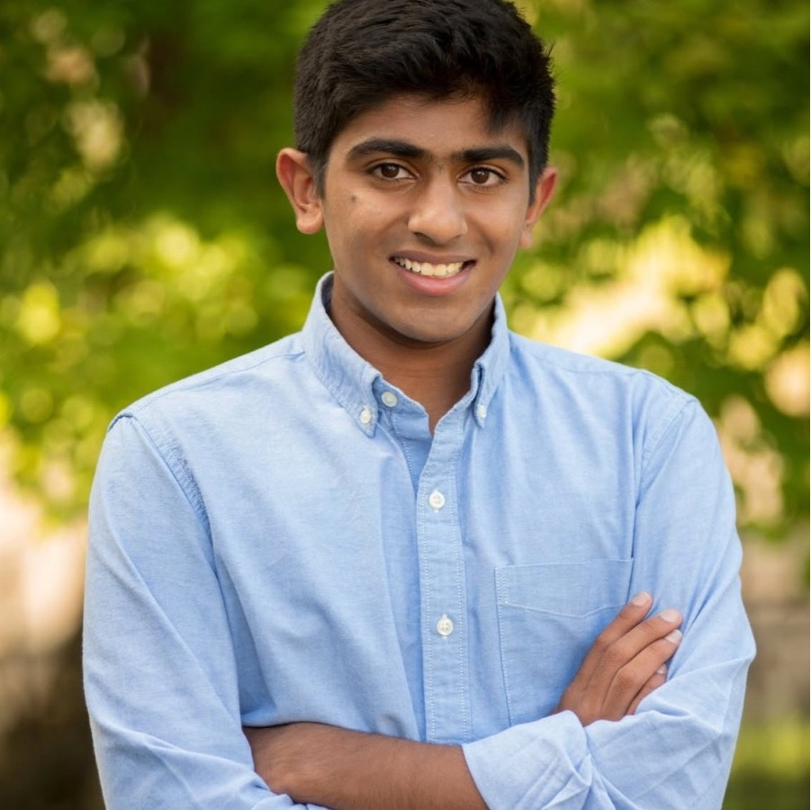
Hello, I'm Ritvik
Ritvik Narula
Computer Engineering undergraduate · sophomore
Interested in computer architecture and low-level programming
- Summer intern on the Powertrain V&V team, working on the ECM hardware-in-the-loop bench
- Two projects this summer: an instrument-automation library, then a natural-language test-automation prototype built on top of it
PHOTO
drop docs/ritvik.jpg
Ritvik Narula

Slide 3
PROJECT 1 · BUILT
Automating the bench instruments

Slide 4
What, why, how
WHAT
WHY
HOW
Build the instrument libraries
Manual verification doesn't scale
SCPI over a raw socket, in Python
- One library per instrument - generator and oscilloscope
- Cross-vendor: Tektronix and Keysight; same calls, right SCPI
- Setup, stimulus, capture and measurement in code
- Reading the scope by hand is slow and subjective
- Automation gives repeatable, tolerance-checked verdicts
- Requirement tags make results traceable
- Pure-Python raw-socket SCPI - no VISA, no vendor DLL
- Captures parsed into one common Waveform object
- Configs are data (JSON); runs in TestStand

Slide 5
Flow - two libraries, one API
Generator drives the ECM; the scope captures the response - all from Python over a raw socket.
Generator library
Oscilloscope library
- Shape, frequency, amplitude, duty, pulse, dwell, modulation
- Generate known signals for self-test
- Configure, acquire and parse -> Waveform
- Measure RMS, frequency, delay, ...; export CSV / PNG
stimulus
response
Function Generator
>
ECM
>
Oscilloscope
AFG31102
device under test
MSO24 / DSO-X 3034G

Slide 6
The main function calls
Function generator
Oscilloscope
configure_function_gen(alias, setup, ch)
Apply a named waveform config; verify
set_function_gen_waveform(...)
Shape / frequency / amplitude / offset
set_function_gen_dwell / modulation(...)
Trapezoid dwell; AM / FM / PWM
function_gen_output_on / off(alias, ch)
Drive the signal (explicit)
configure_scope(alias, setup, ch)
Apply a config; verify each setting
capture_scope / arm_scope / read_scope(...)
Acquire now, or arm for a later event
scope_rms / frequency / delay(...)
Measure features off the Waveform
save_scope_csv / png(alias, path)
Export, labeled by the scope alias

Slide 7
One clean sequence, end to end
The same six steps run every test - from connecting to the bench to saving the labeled result.
1
2
3
4
5
6
Connect
Configure
Arm
Generate
Capture
Save
>
>
>
>
>
find + open
No Dependencies on IP
apply setup
ready to catch
drive signal
read waveform
png + csv
No pauses, no prompts. Once the sequence starts, it runs to a saved, traceable result on its own.

Slide 8
Use cases
Measure RMS voltage
Generator + oscilloscope (self-test)
ts.configure_scope("oscope1","2","1")
ts.capture_scope("oscope1","1")
rms = ts.scope_rms("oscope1", 1)
ts.configure_function_gen("funcgen1",
"triangle_1mhz", "1")
ts.function_gen_output_on("funcgen1",1)
ts.capture_scope("ecm_scope", single=True)
rms = 6.14 V true RMS of a 0-10 V, 1 kHz sine
End-to-end - no ECM needed
The AFG loopback is the headline test: command a known signal, capture it, and prove the pipeline reports it back - no ECM.

Slide 9
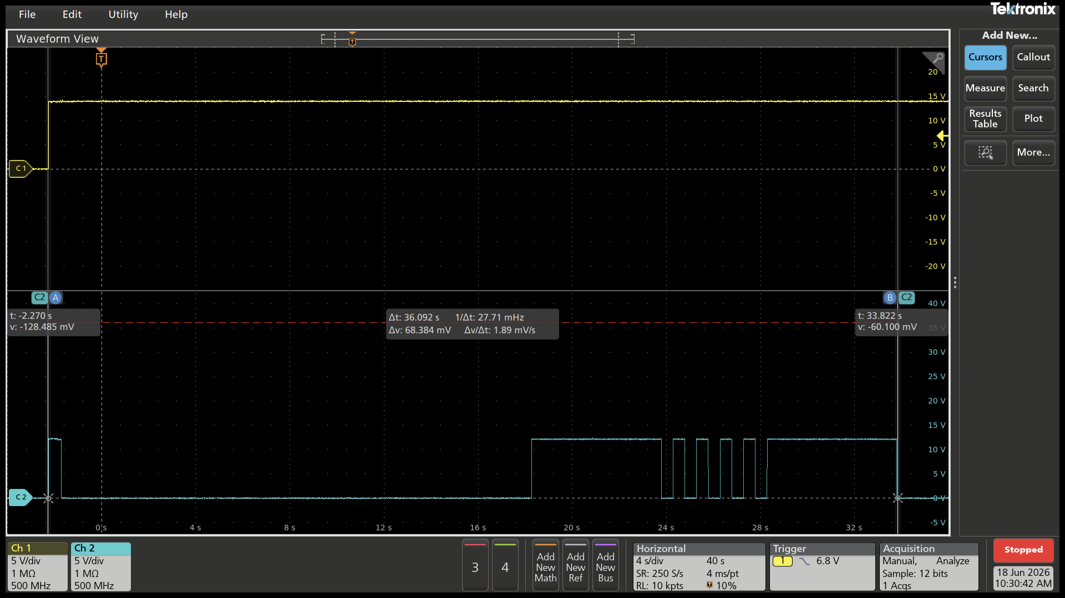
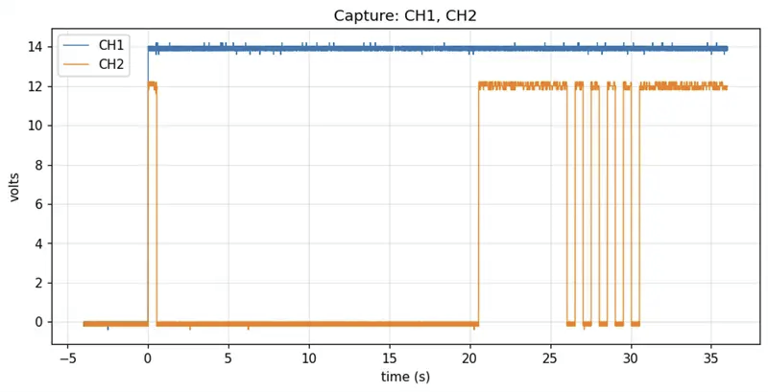
Results – ECM Generated Waveform -> Oscope Reading
Oscilloscope View (Manual Edits)
Library Generated Image Reflecting Actual Waveform
BENCH RESULT: PASS detected, configured, captured, and saved waveform from ECM waveform event

Slide 10
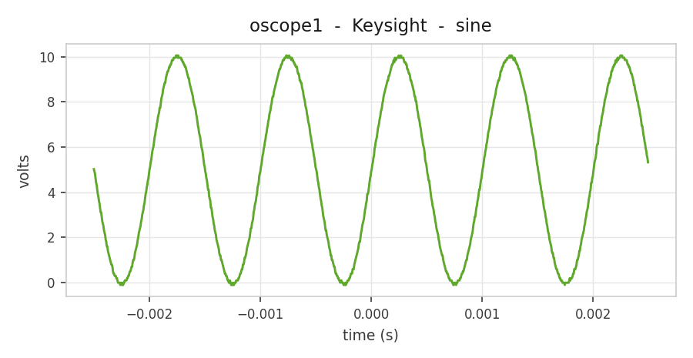
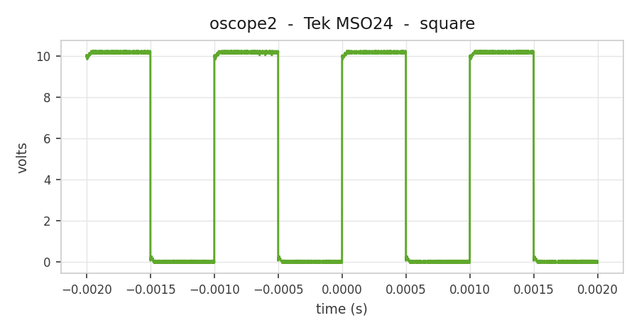
Results - the generator -> scope pipeline
986 pts Vpp 10.15 V RMS 6.14 V
10,000 pts +/-0.5 ms pulse
BENCH RESULT: PASS detected, configured, captured and saved - both vendors, one API.

Slide 11
Instrument automation - major achievements
Cross-vendor, one API
No VISA on the bench
Config-as-data + verify
- Tektronix + Keysight behind identical calls
- Right SCPI chosen per vendor, automatically
- Pure-Python raw-socket SCPI - no driver/license
- One fewer layer to install and debug
- JSON setups; every setting read back PASS/FAIL
- An audit trail for each configure
Measure + evidence
Events, not just snapshots
Validated with no ECM
- RMS, frequency, duty, delay, pulse width, levels
- CSV + PNG auto-saved and labeled
- arm / read captures a one-time event later in a run
- Slow single-shot records (a 20-minute capture)
- AFG self-test: command a signal, prove it comes back
- The whole pipeline tested offline

Slide 12
Instrument automation - what I learned
INSTRUMENTS
DESIGN
DISCIPLINE
Talking to real hardware
One contract, kept small
Offline-first + verified
- SCPI and how instruments actually answer over a socket
- Vendor differences are real - and can hide until you capture
- Everything funnels through a single Waveform object
- A thin, swappable transport the rest of the code never sees
- Read back every setting instead of trusting the write
- Build so it can be tested with no bench attached

Slide 13
PROJECT 2 · RESEARCH + PROTOTYPE
Testing the bench in plain English

Slide 14
Natural-language testing - what & why
Today ECM tests are authored in a rigid tool that needs trained users. The idea: let an engineer write tests in near-English that map to the functions I built.
WHAT
WHY
HOW
Readable keyword steps
Determinism at the bench
Robot Framework -> my API
- A test reads like instructions, not code
- Each step maps 1:1 to a library function call
- No LLM in the run path - no latency, no service, no surprises
- Fast, offline and repeatable - what driving hardware needs
- Keyword-driven: sentence -> teststand_api call
- The path toward the ASAM XIL bench (next project)

Slide 15
Natural-language testing - how it works
"Measure the frequency on channel 1 of my scope"
becomes scope_frequency(alias, 1) - deterministically, no function name in sight.
Plain-English step
Each layer is swappable.
|
- The same English can one day sit on the ASAM XIL API instead of SCPI
- Runs offline against a fake instrument
Robot Framework (keyword-driven)
|
teststand_api (58 functions)
|
Raw-socket SCPI (no VISA)
|
HIL bench: Generator -> ECM -> Oscilloscope

Slide 16
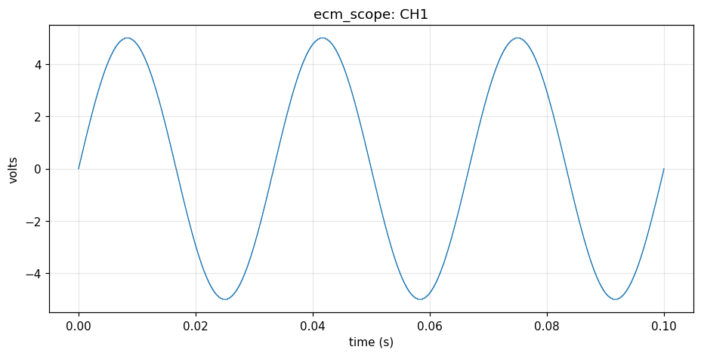
Natural-language use case - one sine, three views
1 · WRITE THE TEST IN PLAIN ENGLISH
3 · CAPTURE THE RESULTING WAVEFORM
Set up a 1 kHz sine wave on the generator
When I set up the generator for a "sine_1k" waveform
Then the waveform shape should be a sine
And the frequency should be 1000 hertz
And the amplitude should be 2 volts
And the output load should be 50 ohms
And the SCPI should be saved to a log
2 · THE LIBRARY EMITS THE EXACT SCPI
SOURce1:FUNCtion:SHAPe SIN
OUTPut1:IMPedance 50.0
SOURce1:FREQuency 1000.0
SOURce1:VOLTage:AMPLitude 2.0
SOURce1:VOLTage:OFFSet 0.0
# + a read-back query to verify each one
ecm_scope CH1 - 1 kHz sine, 2 Vpp
One readable test becomes the exact SCPI on the wire and the captured signal
plain English > SCPI > waveform

Slide 17
Natural-language testing - results
It runs - all green
The SCPI is captured
- Plain-English suites drive the real library, 13 tests pass
- Configure, capture, measure, save - offline
- Every configure writes its exact SCPI to a log
- Both Tektronix and Keysight dialects
Whole workflows
Total coverage
- Converted the ECM-triangle demo 1:1 - same calls, same order
- Connect -> configure -> arm -> capture -> save
- All 58 teststand_api functions reachable by a sentence
Proven end to end: the same library, now driven in English - with the exact SCPI on record.

Slide 18
Natural-language testing - Major Achievements
Working PoC
Offline harness
Workflow conversion
- Robot Framework drives the whole library in English
- A fake instrument so it runs with no bench; SCPI captured
- An existing demo script reproduced 1:1 in plain English
Full NL coverage
Vendor-neutral checks
Research delivered
- A sentence for every one of the 58 functions
- "5 V/div" works for Tektronix and Keysight alike
- A doc mapping the path to the ASAM XIL HIL bench

Slide 19
Natural-language testing - what I learned
TESTING
JUDGEMENT
RESEARCH
Keyword-driven design
When NOT to use an LLM
Reading toward a plan
- How to turn readable sentences into deterministic calls
- Layering a vocabulary so tests read like a paragraph
- Latency and non-determinism are unacceptable driving hardware
- The right tool is boring, fast and offline
- ASAM XIL, pythonnet, and how a HIL bench is really driven
- Turning research into a concrete, buildable next step

Slide 20
Mentorship, collaboration & the KPIT experience
MENTORSHIP
COLLABORATION
THE KPIT EXPERIENCE
Learning from the team
One piece of a bigger system
Engineering, for real
- Reviews and pairing turned rough code into something dependable
-
- My block is one part of a larger test API - keep the surface clean
- Design so others can build on it without knowing the internals
- How HIL benches verify an ECM in a professional V&V workflow
- Traceability and rigor (ASPICE) a school project never teaches
Biggest takeaway: good engineering is as much about a clean, testable contract and working with people as it is about the code itself.

Slide 21

Thank You

