Slide 1
Automating the bench instruments
WHAT
WHY
HOW
Build the instrument libraries
Manual verification doesn't scale
SCPI over a raw socket, in Python
- One library per instrument - function generator and oscilloscope.
- Cross-vendor: Tektronix (AFG31102, MSO24) and Keysight (DSO-X 3034G); same calls, right SCPI per vendor.
- Setup, stimulus, capture and measurement in code.
- A block in the larger test API - others use its output.
- An engineer reads the scope by hand - slow, subjective.
- Output checks can't be regressed across ECM builds.
- Automation gives repeatable, tolerance-checked verdicts.
- Requirement tags make results ASPICE-traceable.
- Pure-Python raw-socket SCPI - no VISA, no vendor DLL.
- All instruments on LAN port 5025; vendor detected from *IDN?.
- Captures parsed into one common Waveform object.
- Configs are data (JSON); runs in pytest / Robot / TestStand.

Slide 2
Flow
Generator drives the ECM; the scope captures the response - both from Python over a raw socket.
SOFTWARE - TWO LIBRARIES, ONE API
DELIVERABLE 01
DELIVERABLE 02
Function Generator Library
Oscilloscope Library
- Shape, frequency, amplitude, offset, duty, pulse
- Enable / disable output channels
- Generate known signals for self-test
- Configure channels, timebase, trigger
- Acquire and parse captures -> Waveform
- Measure features (RMS, pulse width, ...); export CSV / PNG
stimulus
output
Function Generator
->
ECM
->
Oscilloscope
AFG31102
device under test
MSO24 / DSO-X 3034G
PyVISA-free - raw SCPI socket over LAN, port 5025

Slide 3
Function libraries - the main calls
Every call takes an alias and primitive types; the combined module picks the driver by *IDN?.
Function Generator
Oscilloscope
connect_matching(alias, serial)
Open a session to a specific generator by serial.
configure_function_gen(alias, setup, ch)
Apply a named waveform config; verify read-back.
set_function_gen_waveform(alias, ch, ...)
Set shape / frequency / amplitude / offset directly.
function_gen_output_on / off(alias, ch)
Enable or disable an output (explicit).
function_gen_all_off()
Switch every output off - safe cleanup.
detect_bench(port) / connect_matching(...)
Find and open the instruments on the bench.
configure_scope(alias, setup, ch, horizontal_scale)
Apply a config; verify; set the window width.
capture_scope(alias, ch, single)
Acquire the record (free-run, or arm-and-wait).
scope_rms / scope_vmax / scope_pulse_width(...)
Measure features off the captured Waveform.
save_scope_csv / save_scope_png(alias, path)
Export, labeled by the scope alias.

Slide 4
Step 1 - Connect
Find the instruments and open a session to each.
WHAT IT ENTAILS
WHAT TO EXPECT
- detect_bench(5025) scans the network and sends *IDN? to every host.
- Whoever answers as a scope or generator is opened over a raw socket.
- Vendor (Tek / Keysight) is detected from the *IDN? reply.
- Each instrument is named by an alias tied to its serial - stable across IP changes.
- A list of aliases, e.g. ["oscope1", "funcgen1"].
- connect_matching(alias, serial) opens one specific instrument under your name.
ts.detect_bench(5025)
# -> ["oscope1", "funcgen1"]
ts.connect_matching("oscope1",
"MY64520125", 5025)

Slide 5
Step 2 - Configure
Apply a setup and verify every setting read back.
WHAT IT ENTAILS
WHAT TO EXPECT
- configure_scope applies a named config (vertical, timebase, trigger).
- Every setting is read back off the scope and checked - PASS / FAIL.
- The same call drives both vendors; the right SCPI is chosen internally.
- True only if every setting verified.
- get_scope_config_report gives the table (e.g. 13/13).
ts.configure_scope("oscope1", "2", "1",
duration_s=0.02)
ts.get_scope_config_report("oscope1")
# 13/13 settings verified
HOW TO CONFIGURE
- Configs are JSON files of plain numbers. Edit them, or copy template.json and rename.
- Set the capture window per call: configure_scope(..., duration_s=SECONDS).
- duration_s sets s/div = duration_s / 10 (the screen has 10 divisions).

Slide 6
Config parameters - what each field expects
A scope config is a JSON file of plain numbers in the scope's native units. The capture window is NOT in the file - set it per call with duration_s.
HORIZONTAL / ACQUISITION
TRIGGER
PER CHANNEL (channels.1 / .2)
record_length
integer, points - e.g. 10000
trigger_position
0-100 (%) - trigger's spot on screen; 10 = 10% in
sample_rate
S/s, or null - usually null (scope derives it)
acquire_mode
"SAMple" - the acquisition mode
measurement
"rms"/"delay"/... - a note only, no scope effect
(window)
not stored -> configure_scope(.., duration_s=SEC)
trigger_source
"CH1" / "CH2" - channel the trigger watches
trigger_type
"EDGE" - only edge is supported
trigger_slope
"RISE" / "FALL" - which edge fires it
trigger_level
volts, or "half_battery" - the crossing level
trigger_mode
"AUTO" free-run / "NORMal" wait for event
battery_voltage
volts - only to resolve "half_battery"
input_coupling
"DC" / "AC"
vertical_scale
V/div - e.g. 5.0
vertical_position
divisions - Tektronix (Keysight uses offset)
offset
volts, or null
termination
1000000 (1 MOhm) or 50
bandwidth
Hz, or null - Tektronix input BW limit

Slide 7
Step 3 - Capture, measure, save
Read the record, measure it, write the files.
WHAT IT ENTAILS
WHAT TO EXPECT
- capture_scope reads the record into memory.
- single=False free-runs (fast signals); single=True arms one acquisition and waits (slow / single-shot).
- Measurements read the captured data: RMS, Vmax/Vmin, pulse width, mean.
- save_scope_csv / save_scope_png write the waveform, alias in the file name and title.
- Waveform in memory; measured values.
- results/<alias>_<ch>.{csv,png}.
ts.capture_scope("oscope1", "1")
ts.scope_rms("oscope1", 1) # 6.14
ts.save_scope_png("oscope1",
"ch1.png")
# -> results/oscope1_ch1.png

Slide 8
Use case - RMS voltage
OBJECTIVE
Measure the true RMS voltage of a signal on a scope channel.
STEPS
ts.connect_matching("oscope1", "MY64520125", 5025)
ts.configure_scope("oscope1", "2", "1")
ts.capture_scope("oscope1", "1")
rms = ts.scope_rms("oscope1", 1)
EXPECTED RESULT
rms = 6.14 V true RMS of a 0-10 V, 1 kHz sine

Slide 9
Use case - Pulse width (high and low)
OBJECTIVE
Measure how long a square / pulse signal stays high and how long it stays low.
STEPS
ts.configure_scope("oscope2", "2", "1")
ts.capture_scope("oscope2", "1")
pos = ts.scope_pulse_width("oscope2", 1) # high time
neg = ts.scope_pulse_width_negative("oscope2", 1) # low time
EXPECTED RESULT
pos = 0.500 ms neg = 0.500 ms (1 kHz square, 50% duty)

Slide 10
Use case - Generator + oscilloscope (triangle sweep)
The full pipeline: the generator drives a known waveform, the scope captures the response.
OBJECTIVE
Drive a 1 mHz triangle sweep into the ECM and capture the whole 20-minute run in one record - the self-test loopback that validates generator + scope end to end.
STEPS
ts.configure_function_gen("funcgen1", "triangle_1mhz", "1")
ts.function_gen_output_on("funcgen1", 1) # drive the sweep
ts.configure_scope("ecm_scope", "ecm_20min", "1")
ts.capture_scope("ecm_scope", "1", single=True, timeout_s=1380) # arm + wait for the run
ts.save_scope_png("ecm_scope", "triangle.png")
KEY POINTS
- single=True arms one acquisition and blocks until the full slow record fills.
- The wide 120 s/div window needs the Tektronix scope (beyond the Keysight's 50 s/div limit).

Slide 11
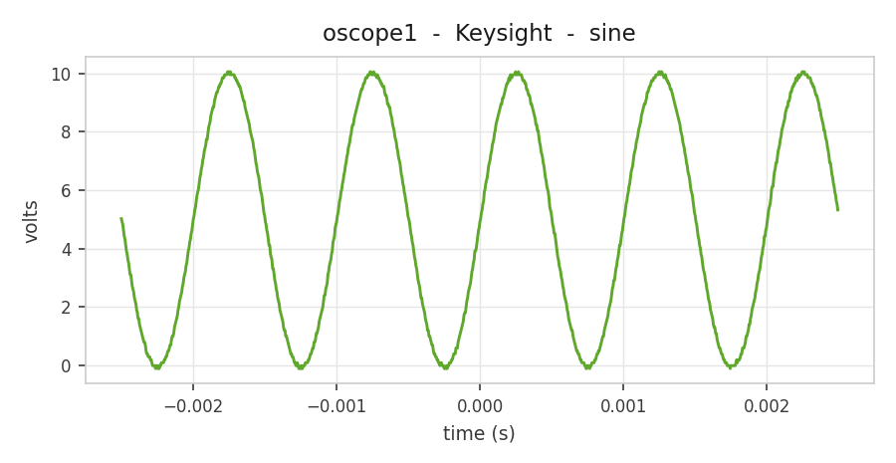
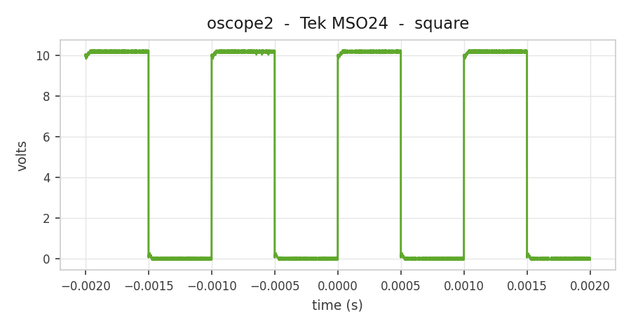
Results - captured off the generator -> scope pipeline
986 pts Vpp 10.15 V RMS 6.14 V
10,000 pts Vpp 10.30 V +/-0.5 ms pulse
BENCH RESULT: PASS detected, configured (13/13 & 15/15), captured, and saved - both vendors, one API.

