Slide 1
Automating the Bench Instruments
August 2026
Powertrain Practice | Verification & Validation

Slide 2
What, why, how
WHAT
WHY
HOW
Build the instrument libraries
Manual verification doesn't scale
SCPI over a raw socket, in Python
- One library per instrument - generator and oscilloscope
- Cross-vendor: Tektronix and Keysight; same calls, right SCPI
- Setup, stimulus, capture and measurement in code
- Reading the scope by hand is slow and subjective
- Automation gives repeatable, tolerance-checked verdicts
- Requirement tags make results traceable
- Pure-Python raw-socket SCPI - no VISA, no vendor DLL
- Captures parsed into one common Waveform object
- Configs are data (JSON); runs in TestStand

Slide 3
Flow
Generator drives the ECM; the scope captures the response - all from Python over a raw socket.
TWO LIBRARIES, ONE API
Generator library
Oscilloscope library
- Shape, frequency, amplitude, duty, pulse, dwell, modulation
- Generate known signals for self-test
- Configure, acquire and parse -> Waveform
- Measure RMS, frequency, delay, ...; export CSV / PNG
stimulus
response
Function Generator
>
ECM
>
Oscilloscope
AFG31102
device under test
MSO24 / DSO-X 3034G

Slide 4
Function libraries - the main calls
Function generator
Oscilloscope
configure_function_gen(alias, setup, ch)
Apply a named waveform config; verify
set_function_gen_waveform(...)
Shape / frequency / amplitude / offset
set_function_gen_dwell / modulation(...)
Trapezoid dwell; AM/FM/PWM
function_gen_output_on / off(alias, ch)
Drive the signal (explicit)
configure_scope(alias, setup, ch)
Apply a config; verify each setting
capture_scope / arm_scope / read_scope(...)
Acquire now, or arm for a later event
scope_rms / frequency / delay(...)
Measure features off the Waveform
save_scope_csv / png(alias, path)
Export, labeled by the scope alias

Slide 5
Step 1 - Connect
Find the instruments and open a session to each.
WHAT IT DOES
WHAT TO EXPECT
- Scan the network; whoever answers is opened over a socket
- Vendor detected automatically from its identity reply
- Named by an alias tied to its serial - stable across IP changes
- A list of aliases, e.g. ["oscope1", "funcgen1"]
ts.detect_bench(5025)
ts.connect_matching("oscope1",
"MY64520125", 5025)

Slide 6
Step 2 - Configure
Apply a setup and verify every setting read back.
WHAT IT DOES
WHAT TO EXPECT
- A named JSON config sets vertical, timebase and trigger
- Every setting is read back and checked - PASS / FAIL
- One call drives both vendors; right SCPI chosen internally
- True only if every setting verified
- 13/13 report for the audit trail
ts.configure_scope("oscope1",
"2", "1", duration_s=0.02)
ts.get_scope_config_report("oscope1")

Slide 7
Step 3 - Capture, measure, save
Read the record, measure it, write the files.
WHAT IT DOES
WHAT TO EXPECT
- capture reads the record; arm/read catches a later event
- Measurements read the data: RMS, frequency, pulse width, delay
- CSV + PNG written with the alias in the file name
- Waveform in memory; measured values
- results/<alias>_<ch>.{csv,png}
ts.capture_scope("oscope1", "1")
ts.scope_rms("oscope1", 1) # 6.14
ts.save_scope_png("oscope1","ch1.png")

Slide 8
Use case - RMS voltage
OBJECTIVE
Measure the true RMS voltage of a signal on a channel.
STEPS
ts.configure_scope("oscope1", "2", "1")
ts.capture_scope("oscope1", "1")
rms = ts.scope_rms("oscope1", 1)
RESULT
rms = 6.14 V true RMS of a 0-10 V, 1 kHz sine

Slide 9
Use case - Pulse width & delay
OBJECTIVE
Measure high/low pulse width, and the delay between two channels.
STEPS
pos = ts.scope_pulse_width("oscope2", 1)
neg = ts.scope_pulse_width_negative("oscope2", 1)
d = ts.scope_delay("oscope2", 1, 2, edge1="falling", edge2="rising")
RESULT
0.500 ms high / 0.500 ms low 1 kHz square, 50% duty

Slide 10
Use case - Generator + oscilloscope
OBJECTIVE
Drive a slow triangle sweep into the ECM and capture the whole run in one record.
STEPS
ts.configure_function_gen("funcgen1", "triangle_1mhz", "1")
ts.function_gen_output_on("funcgen1", 1)
ts.configure_scope("ecm_scope", "ecm_20min", "1", duration_s=1200)
ts.arm_scope("ecm_scope","1"); ... ts.read_scope("ecm_scope")
RESULT
End-to-end self-test - no ECM needed

Slide 11
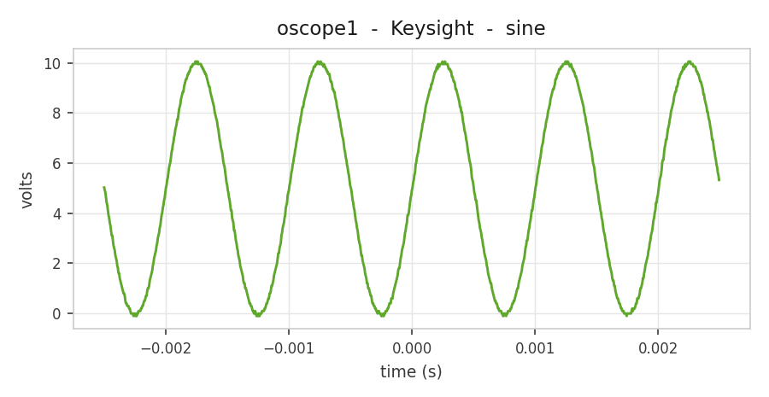
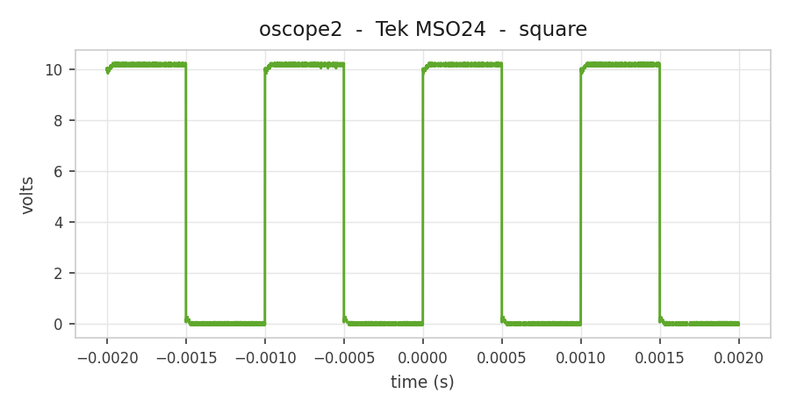
Results - the generator -> scope pipeline
986 pts Vpp 10.15 V RMS 6.14 V
10,000 pts +/-0.5 ms pulse
BENCH RESULT: PASS detected, configured, captured and saved - both vendors, one API.

Slide 12

Thank You

