Slide 1
Ritvik Narula
August 2026
Georgia Tech | Computer Engineering

Slide 2
The problem
Validating an automotive ECM means reading its signals on an oscilloscope - by hand.
Slow & manual
Not repeatable
Not traceable
- An engineer reads the scope for every test
- The automated sequence stops and waits for a person
- Readings are subjective, hard to reproduce
- Can't be regressed across ECM software builds
- No automatic record tying result to requirement
- Hard to prove coverage for audits (ASPICE)
The bottleneck: a human in the middle of an otherwise automated test.

Slide 3
What, why, how
WHAT
WHY
HOW
Automate the instruments
Take the person out of the loop
Plug into the existing test system
- Software that drives the oscilloscope and function generator directly
- One consistent way to set up, capture and measure
- Faster, repeatable, objective results
- Frees engineers from watching a screen
- Slots into TestStand as ordinary Python steps
- Reuses the bench already on the floor - no new hardware
The result: a hands-off measurement block the whole team can rely on.

Slide 4
Where the code sits
THE USUAL WAY VS. THIS PROJECT
Typical setup (VISA)
This project (direct)
TestStand / Python
TestStand / Python
|
|
PyVISA
wrapper library
Raw network socket (SCPI)
just a message
vs
|
|
NI-VISA driver
install + license
Instrument
|
Instrument
3 layers - nothing extra to install
4 layers - an extra driver to install
Why it matters: one fewer layer to install, license and debug on every bench - the code talks to the instrument as plainly as sending a text message.

Slide 5
How it fits on the bench
HIL Bench - TestStand
orchestrates the whole test, hands-off
controls all three over the network (SCPI)
stimulus
response
Function Generator
>
ECM
>
Oscilloscope
creates the input signal
the unit under test
captures the response
The bench runs the ECM, the generator drives it, the scope watches - and the HIL bench commands every piece. No manual step in between.

Slide 6
The building blocks
A small, plain-English set of calls - the same shape for every instrument.
Set up & drive
Capture & measure
connect(...)
Find the instrument and open a session
configure(...)
Apply a saved setup; verify every setting
generate / output_on(...)
Drive a known signal into the ECM
arm(...)
Get ready to catch a one-time event
capture(...)
Read the waveform into memory
rms / frequency / delay(...)
Pull the number the test needs
save_png / save_csv(...)
Store the evidence, auto-labeled
Each call takes a name and plain numbers - readable by anyone, not just the author.

Slide 7
One clean sequence, end to end
The same six steps run every test - from connecting to the bench to saving the labeled result.
1
2
3
4
5
6
Connect
Configure
Arm
Generate
Capture
Save
>
>
>
>
>
find + open
apply setup
ready to catch
drive signal
read waveform
png + csv
Once the sequence starts, it runs to a saved, traceable result on its own.

Slide 8
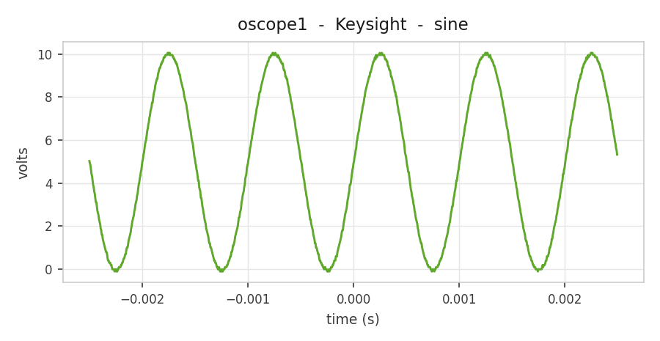
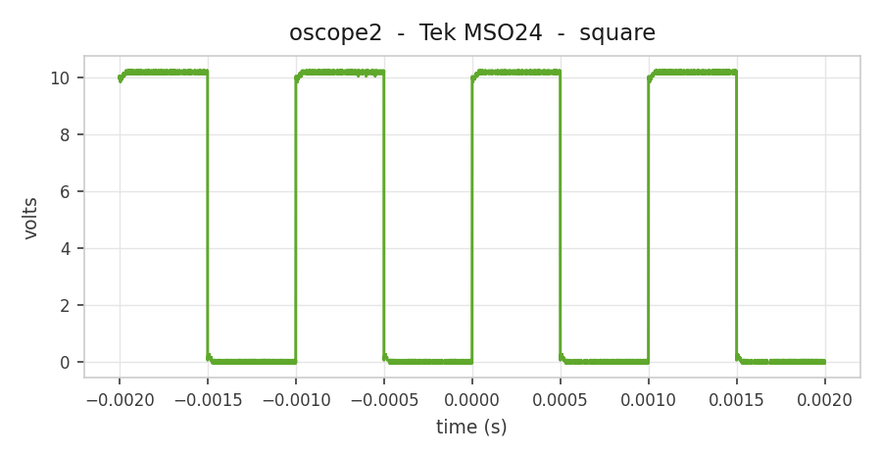
Results
Why it wins
- TestStand no longer pauses for a person to read the scope
- The sequence is hands-off - end to end automated
- Every result is captured, measured and saved the same way
Captured & measured automatically
Timing + levels, saved as evidence
The payoff: what used to be an engineer watching a screen mid-test is now a step that runs itself - saving time on every run and making the whole sequence unattended and repeatable.

Slide 9

Thank You

