Slide 1
teststand_named_demo - routed capture across two scopes
What it does
Detect the instruments on the bench, configure them, drive two waveforms from one function generator into two oscilloscopes, then capture and save each result.
The bench (all on SCPI port 5025)
• funcgen1 Tektronix AFG31102, serial B011788 - stimulus (2 channels)
• oscope1 Keysight DSO-X 3034G, serial MY64520125 - captures the sine
• oscope2 Tektronix MSO24, serial C017370 - captures the square
Where the functions come from
Every call is teststand_api - one module that combines the oscilloscope library and the function-generator library. Instruments are named by serial number, not IP.

Slide 2
The sequence - functions and parameters
Setup
scan_bench(5025) -> Scans all available Ips on port 5025 and returns list of viable Instrument IPs
connect_matching("oscope1", "MY64520125", 5025)
configure_scope("oscope1", "signal_view", "1,2")
Main - create the two waveforms and route them
set_function_gen_waveform("funcgen1", 1, "SIN", 1000, 10, 5) -> oscope1 CH1
set_function_gen_waveform("funcgen1", 2, "SQU", 1000, 10, 5) -> oscope2 CH1
function_gen_output_on("funcgen1", 1) / function_gen_output_on("funcgen1", 2)
Capture + save (repeated per scope)
capture_scope("oscope1", "1")
scope_rms("oscope1", 1) # also scope_vmax / scope_vmin
save_scope_csv("oscope1", "ch1.csv") -> results/oscope1_ch1.csv
save_scope_png("oscope1", "ch1.png") -> results/oscope1_ch1.png
Cleanup
all_function_gen_outputs_off() / disconnect_all()

Slide 3
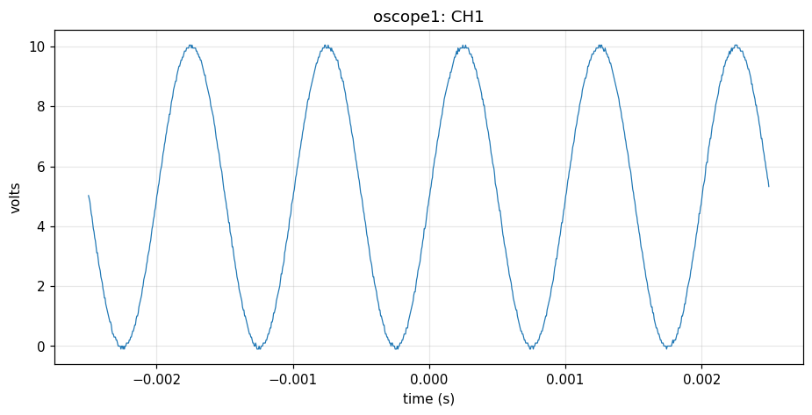
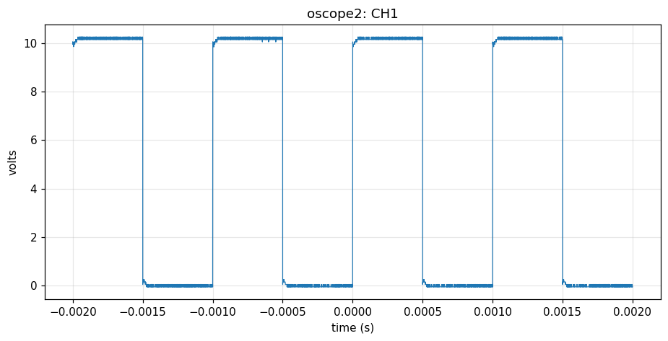
Results
• oscope1 (Keysight, sine): 986 pts, Vpp 10.15 V, RMS 6.14 V - configure 15/15
• oscope2 (Tek MSO24, square): 10,000 pts, Vpp 10.30 V, RMS 7.19 V - configure 13/15
BENCH RESULT: PASS
Saved: results/oscope1_ch1.{png,csv} and results/oscope2_ch1.{png,csv}

