Slide 1
TESTSTAND SEQUENCE · HARDWARE-IN-LOOP BENCH
One generator, two scopes, one routed capture
teststand_named_demo.py — detect › configure › route › capture › save
1 DETECT
›
2 CONFIGURE
›
3 ROUTE
›
4 CAPTURE
›
5 SAVE
scan + match by serial
apply signal_view
2 AFG channels
free-run + freeze
labeled by alias
funcgen1
oscope1
oscope2
Tektronix AFG31102
Keysight DSO-X 3034G
Tektronix MSO24
serial B011788
serial MY64520125
serial C017370
stimulus — 2 channels
capture — CH1 (sine)
capture — CH1 (square)
Where the functions come from Every call is teststand_api — one module unifying the oscilloscope + function-generator libraries. All three instruments share SCPI port 5025 on a link-local bench.

Slide 2
THE SEQUENCE · FUNCTIONS & PARAMETERS
Every step is one teststand_api call
SETUP
MAIN — route
CAPTURE + SAVE
scan_bench(5025)
set_function_gen_waveform("funcgen1", 1, "SIN", 1000)
capture_scope("oscope1", "1")
connect_matching("oscope1", "MY64520125")
set_function_gen_waveform("funcgen1", 2, "SQU", 1000)
scope_rms("oscope1", 1)
configure_scope("oscope1", "signal_view", "1,2")
function_gen_output_on("funcgen1", 1)
save_scope_png("oscope1", "ch1.png")
SIGNAL ROUTING
AFG CH1 SIN · 1 kHz · 10 Vpp · 5 V offset
──────►
oscope1 CH1
AFG CH2 SQU · 1 kHz · 10 Vpp · 5 V offset
──────►
oscope2 CH1
scope_* calls route to the oscilloscope library · function_gen_* calls route to the function-generator library — same module, chosen by *IDN?.

Slide 3
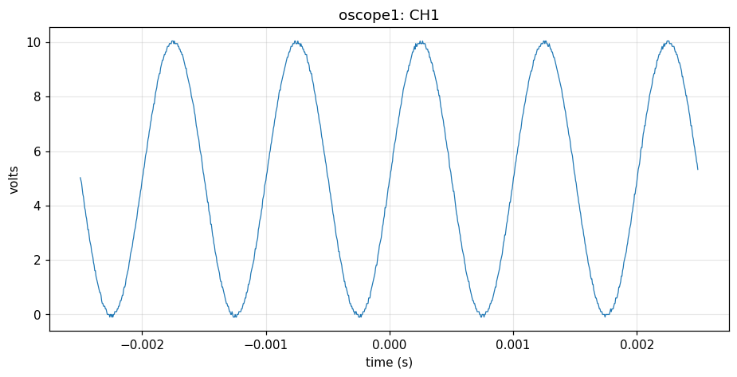
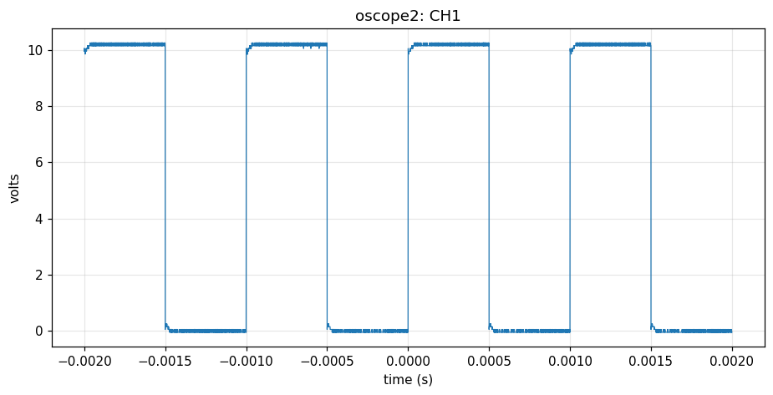
RESULTS · CAPTURED & VERIFIED
Two signals in, two labeled captures out
● BENCH RESULT: PASS
oscope1 Keysight · sine
oscope2 Tek MSO24 · square
986 pts Vpp 10.15 V RMS 6.14 V
10 000 pts Vpp 10.30 V RMS 7.19 V
configure 15/15 verified
configure 13/15 (timebase quantized)
SAVED
results/oscope1_ch1.{png,csv} results/oscope2_ch1.{png,csv}

