Slide 1
Bench setup - do this once before any use case
Three instruments on a link-local HIL bench, all reached over SCPI port 5025.
PHYSICAL SETUP
1. With every instrument powered OFF, connect each one to the Ethernet switch, then connect the switch into the HIL bench network.
2. Power on the instruments.
3. On the Tektronix oscilloscope, set the Socket Server to Terminal mode on port 5025 (Utility -> I/O -> Socket Server). The Keysight scope and the AFG already use 5025.
4. On all devices set the Subnet Mask to 255.255.0.0
SOFTWARE BRING-UP (Python / TestStand)
import teststand_api as ts
ts.detect_bench(5025) # find + open every instrument on port 5025
# -> ["oscope1", "oscope2", "funcgen1"]
detect_bench identifies each instrument by *IDN? and opens it with the right driver. To target one device by serial instead, use connect_matching("oscope1", "MY64520125", 5025).

Slide 2
Use case 1 - RMS voltage
OBJECTIVE
Measure the true RMS voltage of a signal on a scope channel.
STEPS (after the bench setup)
ts.connect_matching("oscope1", "MY64520125", 5025) # the Keysight scope
ts.configure_scope("oscope1", "signal_view", "1")
ts.set_function_gen_waveform("funcgen1", 1, "SIN", 1000, 10, 5) # 1 kHz sine
ts.function_gen_output_on("funcgen1", 1)
ts.capture_scope("oscope1", "1")
rms = ts.scope_rms("oscope1", 1)
EXPECTED RESULT
rms = 6.14 V true RMS of the 0-10 V, 1 kHz sine

Slide 3
Use case 2 - Pulse width (positive & negative)
OBJECTIVE
Measure how long a square / pulse signal stays high and how long it stays low.
STEPS (after the bench setup)
ts.connect_matching("oscope2", "MSO24", 5025) # the Tektronix MSO24
ts.configure_scope("oscope2", "signal_view", "1")
ts.set_function_gen_waveform("funcgen1", 2, "SQU", 1000, 10, 5) # 1 kHz square
ts.function_gen_output_on("funcgen1", 2)
ts.capture_scope("oscope2", "1")
pos = ts.scope_pulse_width("oscope2", 1) # high time
neg = ts.scope_pulse_width_negative("oscope2", 1) # low time
EXPECTED RESULT
pos = 0.500 ms neg = 0.500 ms
period = 1.000 ms, 50% duty (a 1 kHz square)

Slide 4
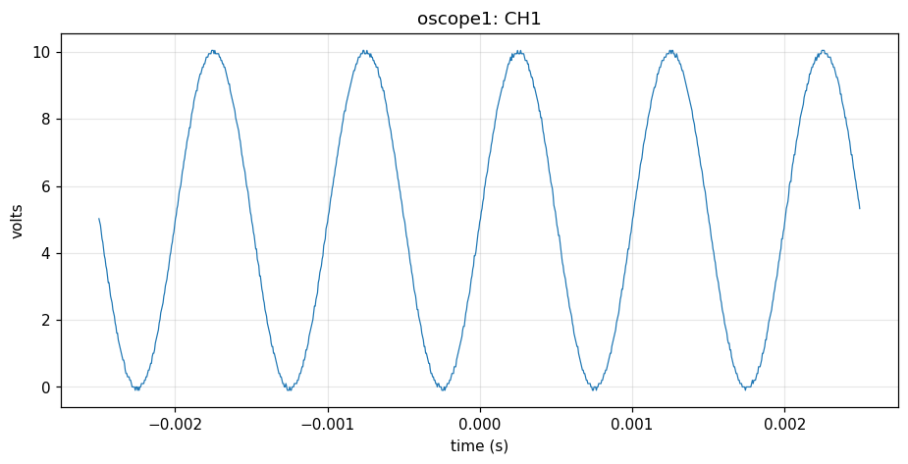
Use case 3 - Capture and save the waveform
OBJECTIVE
Capture a channel and save the waveform to CSV + PNG, labeled by scope name.
STEPS (after the bench setup)
EXPECTED RESULT
ts.connect_matching("oscope1",
"MY64520125", 5025)
ts.configure_scope("oscope1",
"signal_view", "1")
# drive a 1 kHz sine on funcgen1 CH1
ts.capture_scope("oscope1", "1")
ts.save_scope_csv("oscope1", "ch1.csv")
ts.save_scope_png("oscope1", "ch1.png")
oscope1_ch1.png 986 pts, Vpp 10.15 V
Saved to results/oscope1_ch1.png and results/oscope1_ch1.csv - the scope alias is written into both the file name and the plot title.

