Slide 1
Deep Tissue Characterization: Applications in Intravascular Ultrasound
Inter disciplinary project in CAMP
Presented By: Priya Goel, Pratiksha Jain
BMC, Chair of Computer Aided Medical Procedures Technische Universität München, Germany.
Supervisor
Sailesh Conjeti, CAMP, TUM
Examiner:
Prof. Dr. Nassir Navab, CAMP, TUM

Slide 2
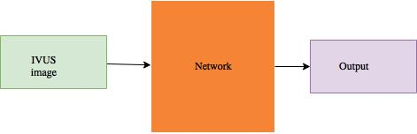
Overview
Goals and Objectives
Definitions
List of the state of the art
Overview of the baseline paper
Proposed method
Description of the data set
Results
Summary

Slide 3
Goal & Objectives
Goal: Given an IVUS image segment plaque mask and characterize colocated heterogenous tissues.
Objective 1: Plaque mask prediction using fully convolutional neural network.
Objective 2: Tissue characterization problem (4 label output : Calcified mask ,Fibrotic mask, Lipidic mask, Necrotic mask) using fully convolutional neural network in different configurations of decoder blocks and interpreting the results.

Slide 4
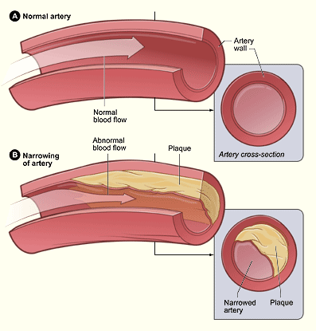
Definitions
Plaque is made up of fat, cholesterol, calcium, and other substances found in the blood.
It hardens and narrows arteries which limits the flow of oxygen-rich blood to organs and other parts of your body.
Atherosclerosis is a disease in which plaque builds up inside arteries.
Different Atherosclerosis-Related Diseases are Coronary Heart Disease, Carotid Artery Disease, Peripheral Artery Disease, Chronic Kidney Disease.
https://www.nhlbi.nih.gov/health/health-topics/topics/atherosclerosis

Slide 5
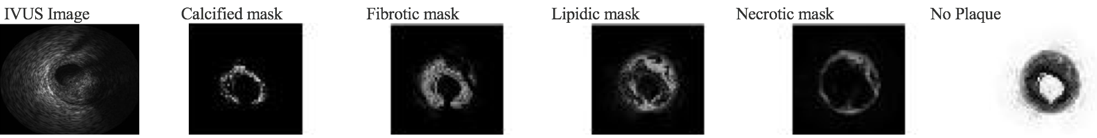
Intravascular Ultrasound (IVUS)
predominant imaging modality
real-time cross-sectional images of arteries
assists clinicians to infer about atherosclerotic plaques composition.
Why Tissue Characterization ?
Plaque: heterogeneous and colocated.
Fibrous tissue, lipid deposits and calcifications.
Characterizing colocated heterogeneous tissue will help clinicians to assess plaque vulnerability.
Sheet, D., Karamalis, A., Eslami, A., Noël, P., Chatterjee, J., Ray, A.K., Laine, A.F., Carlier, S.G., Navab, N. and Katouzian, A., 2014. Joint learning of ultrasonic backscattering statistical physics and signal
confidence primal for characterizing atherosclerotic plaques using intravascular ultrasound. Medical image analysis, 18(1), pp.103-117.
Notes:
Each of these tissue backscatter ultrasonic pulses with a characteristic intensity in a B mode IVUS image.
Colocated heterogenous tissue backscatter mixed signals appearing as non unique intensity patterns in B mode IVUS image.
Plaque without calcification is soft plaque which is early manifestation of plaque development.

Slide 6
State of the art
MR images were segmented using model-based segmentation and fuzzy clustering to detect the vessel wall, lumen and lipid core boundaries.
Model-based segmentation, fuzzy clustering
Atherosclerotic carotid plaque segmentation: The method uses despeckle filtering and snakes for segmenting the atherosclerotic carotid plaque from ultrasound images.
Despeckle filtering and Snakes
Assembling weak classifiers using boosting schemes. Classifier learn texture patterns of the plaque using local binary patterns.
Classifier based
Lumen and vessel wall are segregated using a nearest neighbor classification approach.
Pujol, O., Rotger, D., Radeva, P., Rodriguez, O. and Mauri, J., 2003, September. Near real-time plaque segmentation of IVUS. In Computers in Cardiology, 2003 (pp. 69-72). IEEE
Dinesh, M.S., Devarakota, P. and Kumar, J., 2010, March. Automatic detection of plaques with severe stenosis in coronary vessels of CT angiography. In SPIE Medical Imaging (pp. 76242Q-76242Q). International Society for Optics and Photonics.
Loizou, C.P., Pattichis, C.S., Istepanian, R.S.H., Pantziaris, M. and Nicolaides, A., 2004, September. Atherosclerotic carotid plaque segmentation. In Engineering in Medicine and Biology Society, 2004. IEMBS'04. 26th Annual International Conference of the IEEE (Vol. 1, pp. 1403-1406). IEEE.
Adame, I.M., Van Der Geest, R.J., Wasserman, B.A., Mohamed, M.A., Reiber, J.H.C. and Lelieveldt, B.P.F., 2004. Automatic segmentation and plaque characterization in atherosclerotic carotid artery MR images. Magnetic Resonance Materials in Physics, Biology and Medicine, 16(5), pp.227-234.
Cheng, J., Li, H., Xiao, F., Fenster, A., Zhang, X., He, X., Li, L. and Ding, M., 2013. Fully automatic plaque segmentation in 3-D carotid ultrasound images. Ultrasound in medicine & biology, 39(12), pp.2431-2446.

Slide 7
State of the art
Random Forest and Rulefit
Random Forests and RuleFit are used.
The decision function is learned by a support vector machine (SVM)
SVM based
Vessel Intensity and geometric features are used to train a random forest (RF) classifier with four decisions.
Sun, Y.V., Bielak, L.F., Peyser, P.A., Turner, S.T., Sheedy, P.F., Boerwinkle, E. and Kardia, S.L., 2008. Application of machine learning algorithms to predict coronary artery calcification with a sibship‐based design. Genetic epidemiology, 32(4), pp.350-360.
Cetin, S. and Unal, G., 2012. Automatic detection of coronary artery stenosis in CTA based on vessel intensity and geometric features. In Proc. of MICCAI Workshop” 3D Cardiovascular Imaging: a MICCAI segmentation Challenge.
Toledano, M., Lindenbaum13, M., Lessick46, J., Dragu, R., Ghersin56, E., Engel56, A. and Beyar246, R., Learning to Detect Coronary Artery Stenosis from Multi-Detector CT imaging.
Notes:
(no plaque, three plaque types(calcified, soft, and mixed)).

Slide 8
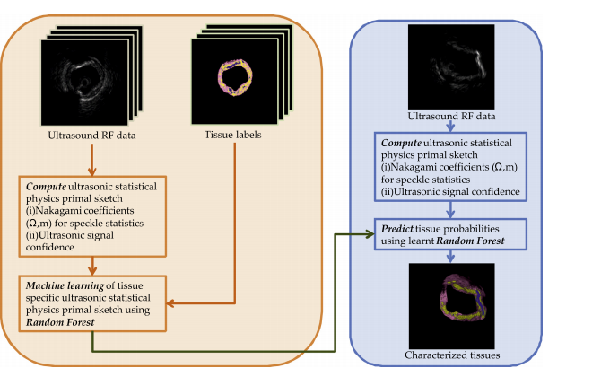
Baseline Paper
Address co-located heterogeneous tissues problem probabilistically.
Random Forest.
Results were highly concurrence with traditional tissue histology.
Sheet, D., Karamalis, A., Eslami, A., Noël, P., Chatterjee, J., Ray, A.K., Laine, A.F., Carlier, S.G., Navab, N. and Katouzian, A., 2014. Joint learning of ultrasonic backscattering statistical physics and signal confidence primal for characterizing atherosclerotic plaques using intravascular ultrasound. Medical image analysis, 18(1), pp.103-117.

Slide 9
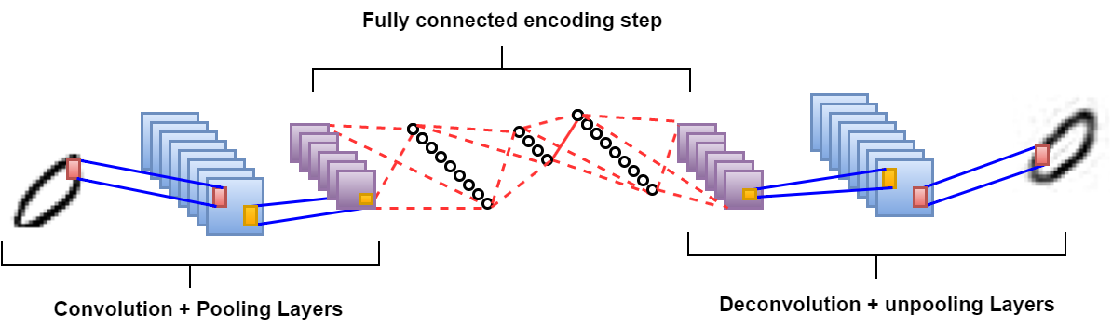
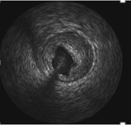

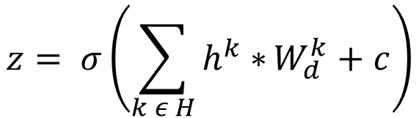

Proposed approach
Fully Convolutional Network: Preserve the input’s neighborhood relations and spatial locality in latent higher-level representations
$$y^{k}= σ\left(x∗W^{k}+ b^{k}\right)$$
$$z= σ\left(\sum_{k ε H}{h^{k}∗}W_{d}^{k}+c\right)$$
Convolution
Masci, J., Meier, U., Cireşan, D., & Schmidhuber, J. (2011, June). Stacked convolutional auto-encoders for hierarchical feature extraction. In International Conference on Artificial Neural Networks (pp. 52-59). Springer Berlin Heidelberg.

Slide 10
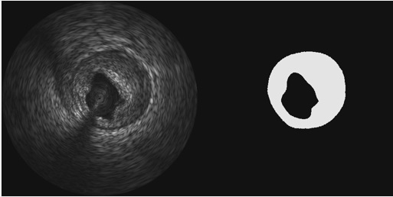
Data set decription task 1: Plaque segmentation
Data Set :
Input IVUS images as imdb.data
Label Plaque segmented output label
Number of Samples:
25 patient (Total 1802 images before augmentation of data with 10 degree rotation)
Size: 512 x 512 x 1 x 1802 → reduced to 256 x256 x 1 x 1802
IVUS Plaque label
Notes:
Augmentation : Extract rotation invariant features.

Slide 11
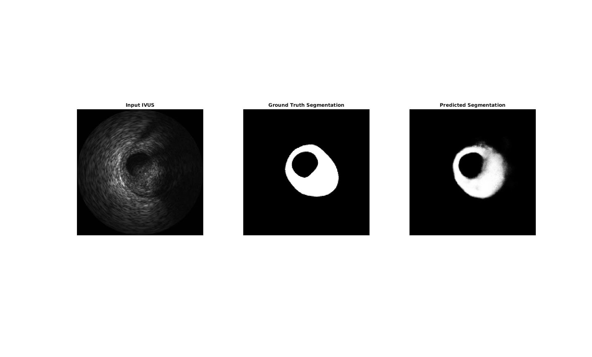
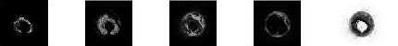
Data set decription task 2 : Tissue chracterization
Data Set :
Input IVUS images
Label 5 Labsel Output Label 1: Calcified Mask
Label 2: Lipidic Mask
Label 3: Lipidic Mask
Label 4: Necrotic Mask
Label 5: No Plaque
Number of Samples:
25 patient (Total 1802 images before augmentation of data with 10 degree rotation)
Size: 512 x 512 x 1 x 1802 → reduced to 256 x256 x 1 x 1802
IVUS Image Calcified mask Fibrotic mask Lipidic mask Necrotic mask No plaque

Slide 12
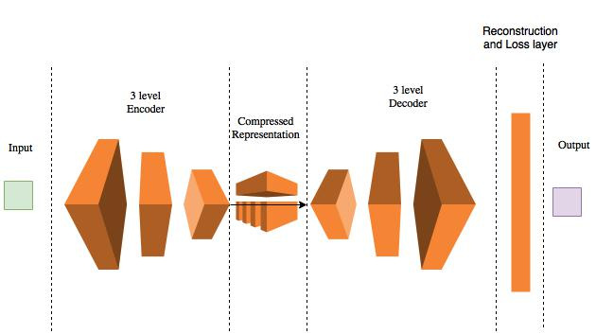
Segmenting Plaque from IVUS Data Using 3D Fully Convolutional Networks
Overview:
Encoder Block : Each encoder block with Convolution layer, Batch Normalization layer, ReLU layer and Pooling Layer.
Decoder Block : Each decoder block with unpool layer, Concat layer, 2 Convolution layers, Batch Normalization and ReLU layer.
Reconstruction Layer(Convolutional Layer)
Loss used : L2 loss
3D FCN architecture for estimating CT image from MRI image

Slide 13
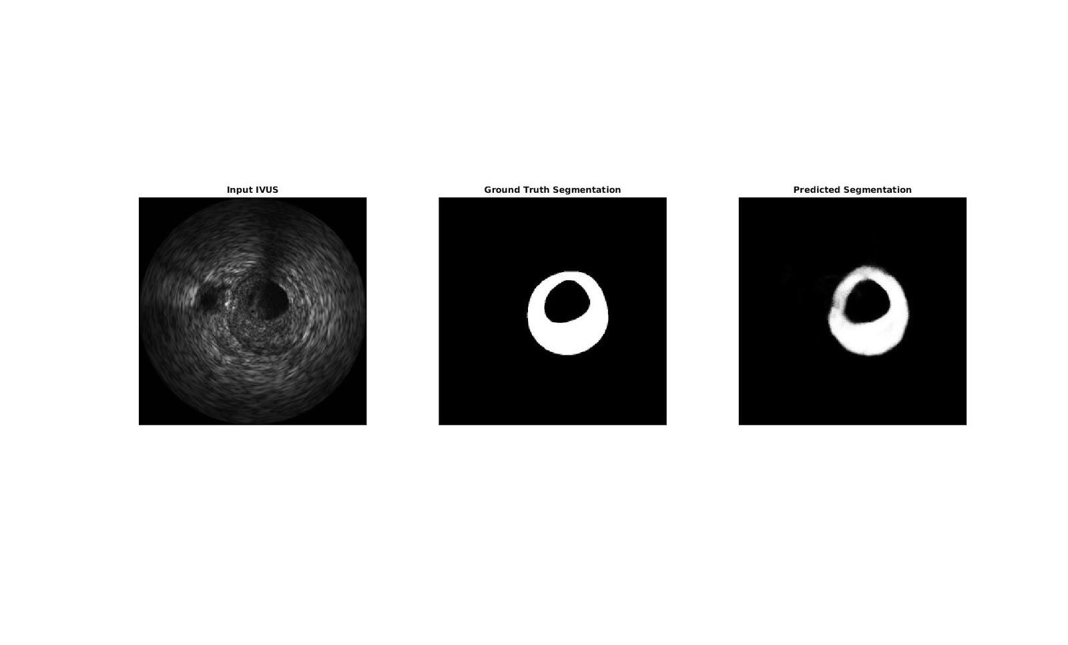
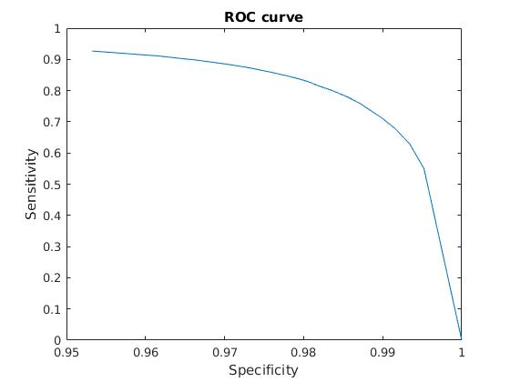
Results of Plaque Segmentation
Average Dice similarity .803 Average Jaccard similarity : .691

Slide 14
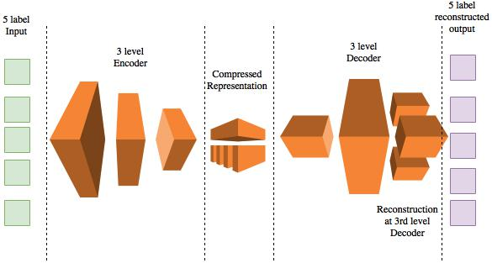
Tissue Characterization from IVUS Data Using 3D Fully Convolutional Networks
Overview:
Encoder Block : Each encoder block with Convolution layer, Batch Normalization layer, ReLU layer and Pooling Layer.
Decoder Block : Each decoder block with unpool layer, Concat layer, 2 Convolution layers, Batch Normalization and ReLU layer.
5 Reconstruction Layers at Third Level Decoder.
Loss used : L2 loss

Slide 15


Results of Tissue Characterization
Ground Truth
IVUS image
Calcified mask
Fibrotic mask
Lipidic mask
Necrotic mask
Output Labels
Calcified mask
Fibrotic mask
Lipidic mask
Necrotic mask

Slide 16
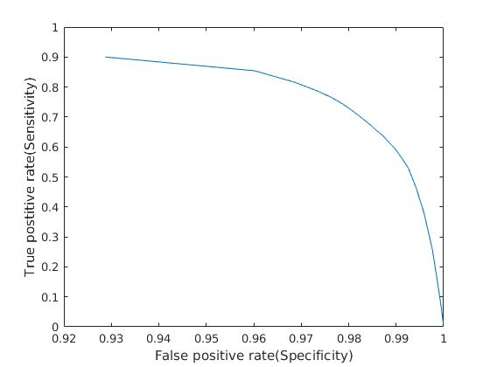

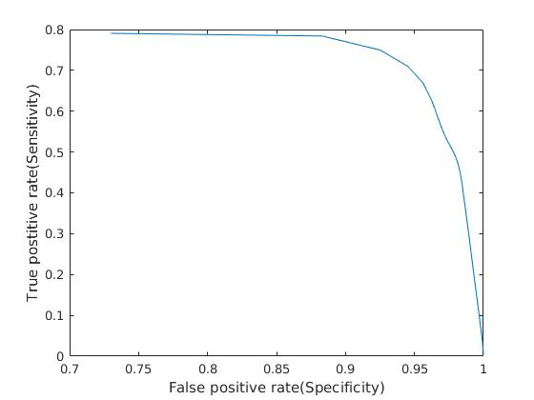
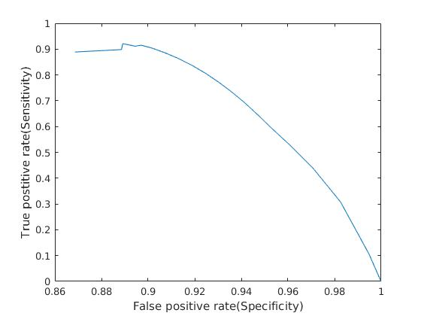
ROC Curves of Tissue Characterization
Calcified mask
Fibrotic mask
Lipidic mask
Necrotic mask

Slide 17
Accuracy and Similarity of Tissue Characterization
Tissue | Accuracy | Dice Similarity | Jaccard Similarity
Calcified | .980 | .868 | .768
Fibrotic | .946 | .673 | .510
Lipidic | .927 | .766 | .626
Necrotic | .943 | .800 | .671

Slide 18
Summary
Plaque segmentation
Plaque mask was segmented in IVUS with 80% similarity to its corresponding ground truth.
Tissue Characterization
Calcified and Necrotic masks have been characterized with near 80-85% similarity with corresponding labels.
Fibrotic and Lipidic masks were characterized with 65-75% similarity with corresponding labels.

Slide 19
Thank You

