Slide 1
Lecture #0
R Programming
(INT232)

Slide 2
Course Overview
L T P :
Text Book
1. DATA ANALYTICS USING R BY SEEMA ACHARYA
Reference Books:
1. DATA ANALYSIS : USING STATISTICS AND PROBABILITY WITH R LANGUAGE BY BISHNU PARTHA SARATHI, BHATTACHERJEE VANDANA
2. DATA SCIENCE AND MACHINE LEARNING IN R BY REEMA THAREJA
3. DATA ANALYTICS BY ANIL MAHESHWARI
2 | 0 | 2

Slide 3
Marks Breakup
Credits:- 3
Marks Breakup:
* 2 Best CA out of 3 CA each of 30 marks
Activity | Marks
Attendance | 5
Continuous Assessment | 45
End-Term Practical (ETP) | 50
Total | 100

Slide 4

Detail of academic task
AT1: Quiz
AT2: Assignment Based Test
AT3: Project
*** best 2 out of 3 ***
Notes:
2 best out of 3 ATs. One AT is Poster Presentation in which you need to allocate individual topic related to the course to each student in 2nd week. Student will prepare a research paper on that topic and will present it in the form of poster presentation in 12th week

Slide 5
OPEN EDUCATIONAL RESOURCE
Course Code | Course Title | Unit mapped | Broad topic/Sub Topic | OER Type | Title of OER | *%age unit mapped with OER (approx) | Source URL
INT232: Data Science Toolbox: R Programming |  | Unit 1 | Installation and development environment overview Introduction to basics | Reading material (website) | INT232 | 100 | https://www.tutorialspoint.com/r/index.htm
INT232: Data Science Toolbox: R Programming |  | Unit 2 | Vectors and matrices Factors Data frames Lists | Reading material (website) | INT232 | 100 | https://www.tutorialspoint.com/r/index.htm
INT232:Data Science Toolbox:R Programming |  | Unit 3 | R syntax Data input and output in R | Reading material (website) | INT232 | 100 | https://www.tutorialspoint.com/r/index.htm
INT232: Data Science Toolbox:R Programming |  | Unit 4 | Advanced R programming Data manipulation with R using | Reading material (website) | INT232 | 100 | https://www.tutorialspoint.com/r/index.htm
INT232: Data Science Toolbox:R Programming |  | Unit 5 | Text mining in R Social media data mining | Reading material (website) | INT232 | 100 | https://www.tutorialspoint.com/r/index.htm
INT232: Data Science Toolbox:R Programming |  | Unit 6 | Data Visualization With R | Reading material (website) | INT232 | 100 | https://www.tutorialspoint.com/r/index.htm
Lovely Professional University, Phagwara

Slide 6
Course Outcomes
CO1 :: Analyze and configure R software for statistical programming environment and describe
generic programming language concepts implemented in a high-level statistical language
CO2 :: Demonstrate the programs in the R environment to create custom analytical models to
meet the dynamic business needs
CO3 :: Evaluate and verify the analysis findings by using various packages in R programming
CO4 :: Visualize and customize the various graphical packages for creating various types of
graphs, plots and charts.
CO5 :: Review advanced data science concepts using predictive analytics fundamentals
CO6 :: Appraise and verify the analysis findings by conducting various statistical tests

Slide 7
Program Outcomes
PO1
Engineering Knowledge:: Apply the knowledge of mathematics, science, engineering fundamentals, and an engineering specialization to the solution of complex engineering problems.
PO2
Problem Analysis:: Identify, formulate, research literature, and analyze complex engineering problems reaching substantiated conclusions using first principles of mathematics, natural sciences, and engineering sciences.
PO3
Design/development of solutions:: Design solutions for complex engineering problems and design system components or processes that meet the specified needs with appropriate consideration for the public health and safety, and the cultural, societal, and environmental considerations.
PO4
Conduct investigations of complex problems:: Use research-based knowledge and research methods including design of experiments, analysis and interpretation of data, and synthesis of the information to provide valid conclusions.

Slide 8
Program Outcomes
PO5
Modern tool usage:: Create, select, and apply appropriate techniques, resources, and modern engineering and IT tools including prediction and modeling to complex engineering activities with an understanding of the limitations.
PO6
The engineer and society:: Apply reasoning informed by the contextual knowledge to assess societal, health, safety, legal and cultural issues and the consequent responsibilities relevant to the professional engineering practice.
PO7
Environment and sustainability:: Understand the impact of the professional engineering solutions in societal and environmental contexts, and demonstrate the knowledge of, and need for sustainable development.
PO8
Ethics:: Apply ethical principles and commit to professional ethics and responsibilities and norms of the engineering practice.
PO9
Individual and team work:: Function effectively as an individual, and as a member or leader in diverse teams, and in multidisciplinary settings.

Slide 9
Program Outcomes
PO10
Communication:: Communicate effectively on complex engineering activities with the engineering community and with society at large, such as, being able to comprehend and write effective reports and design documentation, make effective presentations, and give and receive clear instructions.
PO11
Project management and finance:: Demonstrate knowledge and understanding of the engineering, management principles and apply the same to one’s own work, as a member or a leader in a team, manage projects efficiently in respective disciplines and multidisciplinary environments after consideration of economic and financial factors.
PO12
Life-long learning:: Recognize the need for, and have the preparation and ability to engage in independent and life-long learning in the broadest context of technological change.
PO13
Competitive Skills:: Ability to compete in national and international technical events and building the competitive spirit along with having a good digital footprint.

Slide 10

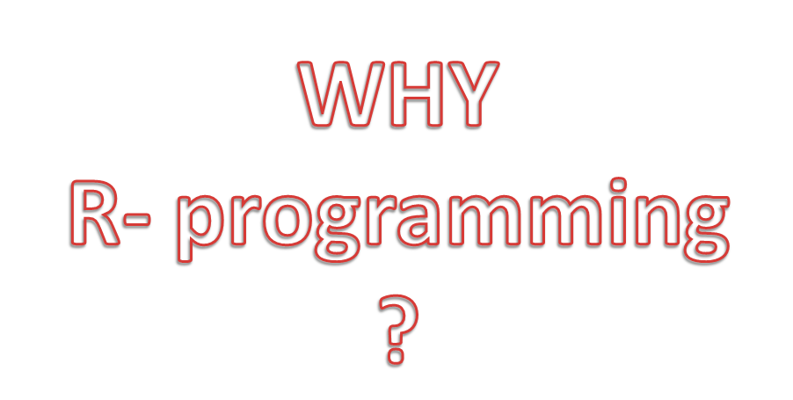

Slide 11
R Studio
R provides a wide variety of statistical (linear and nonlinear modelling, classical statistical tests, time-series analysis, classification, clustering)
One of R’s strengths is the ease with which well-designed publication-quality plots can be produced, including mathematical symbols and formulae where needed.

Slide 12
The R environment consists of an integrated suite of software facilities designed for data manipulation, calculation, and graphical display. The environment features:
A high-performance data storage and handling facility
A suite of operators for array calculations, mainly matrices
A vast, easily understandable, integrated assortment of intermediate tools dedicated to data analysis
Graphical facilities for data analysis and display that work either for on-screen or hardcopy
The well-developed, simple and effective programming language, featuring user-defined recursive functions, loops, conditionals, and input and output facilities.

Slide 13
What is R Used For?
Although R is a popular language used by many programmers, it is especially effective when used for
Data analysis
Statistical inference
Machine learning algorithms

Slide 14
Unit 1- Installation And Development Environment Overview, Introduction To Basics
Downloading And Installing R From CRAN
Installing R On Your Windows Computer
Installation R studio
Libraries In R And R Studio
Installing Packages
Using R Reference Card
Discover The Basic Data Types And Operators In R

Slide 15
Unit 2- Detailed Data Types
Vectors And Matrices : Learn How To Work With Vectors And Matrices In
R Factors : R Stores Categorical Data In Factors, Learn How To Create Subset And Compare Categorical Data
Data Frames : Creating, Merging, Naming, Filtering, Indexing And Selection In Data Frames
Lists : Naming, Extracting, Adding, Deleting Components From Lists, Sub Setting A List

Slide 16
Unit 3- R Syntax And Data Input And Output
Conditional Statements
Loops
Functions And Packages In
CSV Files,
Excel Files And SQL With R

Slide 17
Unit 4- Advanced R programming and Data manipulation
Mathematical Functions
Apply Family Of Functions
Regular Expressions
Dates And Timestamps
Data Filters
Handling Missing Data
Dplyr
Tidyr
Pipe

Slide 18
Unit 5- Text mining in R
Text Mining Functions
String Functions Used In R
Analyzing Text Data For Mining Social Media Data Mining
Facebook Data Analysis
Twitter Data Analysis

Slide 19
Unit 6- DATA VISUALIZATION WITH R
Explanation And Implementation Of Basic Types Of Graphs (SCATTER PLOT, LINE CHART, BAR CHART, PIE CHART)
Explanation And Implementation Of Advanced Types Of Graphs (Word Cloud, Heat Map, Bollinger Band, Donut Chart Etc.)
Dynamic Visualization Using Ggplots
Advanced Visualization Using PLOTLY
Implementation Of DASHBOARDS Using RMARKDOWN

Slide 20
Learning Outcomes
Use and get to know about the essential data structures, functions and packages used in R
Students will learn about the basic commands and packages provided by the R tool.
Students will learn how to use the advanced R functions for Analysis.
Learn about various text mining functions in R.
Use and customize the various graphical packages for creating various types of graphs, plots and charts
Analyze real life business problems by using various statistical methods
Integrate data to provide mashed-up dashboards

Slide 21
MOOCs
R Programming
https://www.coursera.org/learn/r-programming

Slide 22



