Slide 1
VeriMed Intelligence
Scan. Verify. Stay Safe. — AI-Powered Counterfeit Medicine Countermeasures
Product Proposal & Ecosystem Showcase

Slide 2
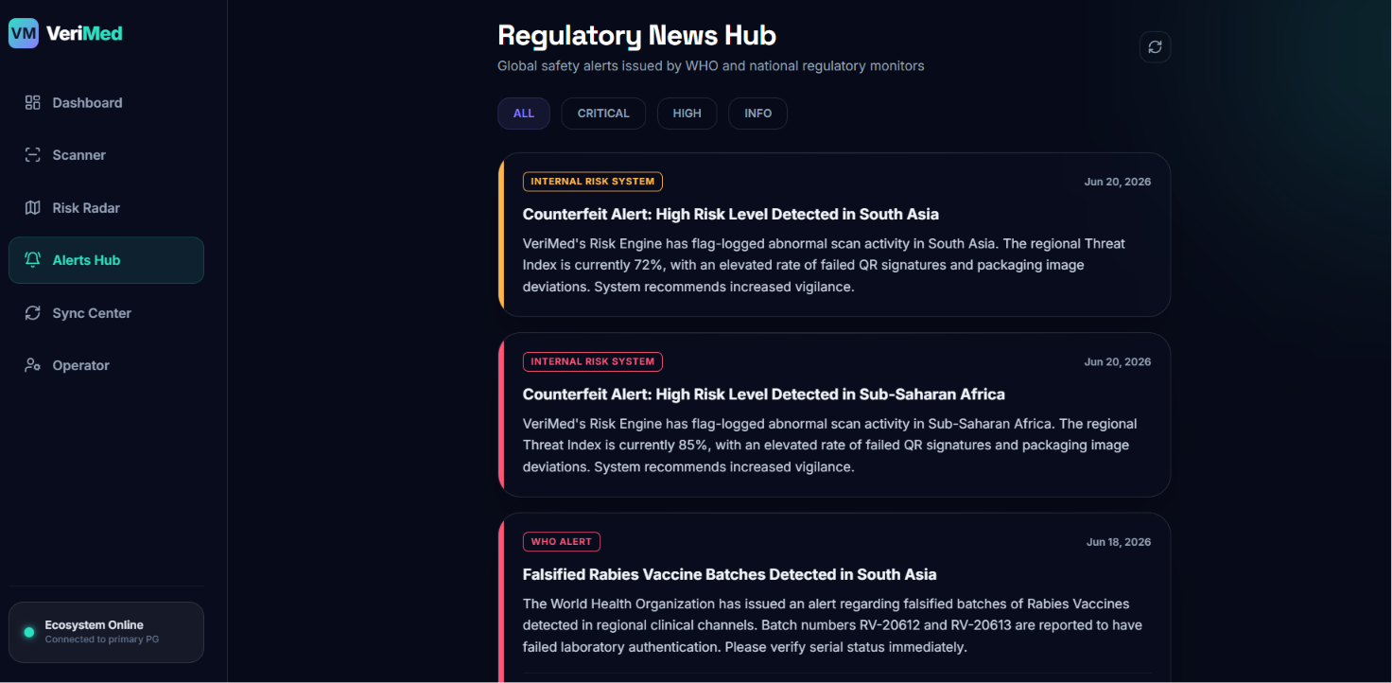
The Counterfeit Drug Epidemic
• Global Threat Vector: Up to 10% of medical products in low- and middle-income countries are falsified or substandard (WHO estimates).
• Severe Healthcare Impact: Responsible for hundreds of thousands of preventable deaths annually, including pediatric pneumonia and malaria cases.
• Connectivity Gaps: Traditional verification networks fail in remote regions (Sub-Saharan Africa, rural South Asia) due to offline environments.
• Advanced Imitations: Holograms and packaging are increasingly easy for counterfeiters to visually clone, requiring algorithmic vision verification.
[ DRAG & DROP SCREENSHOT: REGIONAL NEWS / ALERTS HUB ]

Slide 3
The VeriMed Solution Architecture
01. AI Packaging Print Vision Evaluates logo displacements, typographical kerning anomalies, and color spectrum deviations in real-time.
02. SmartID Cryptographic QR Decrypts Decodes DCGI-standard QR parameters and verifies digital signatures utilizing cached manufacturer public keys.
03. Offline-First Synchronizer Center Saves verification outboxes locally to SQLite / LocalStorage, and automatically syncs when network connectivity returns.
04. Dynamic Threat Maps & News Hub Gathers scanning metadata to dynamically map local threat indices and alerts operators in high-risk zones.

Slide 4
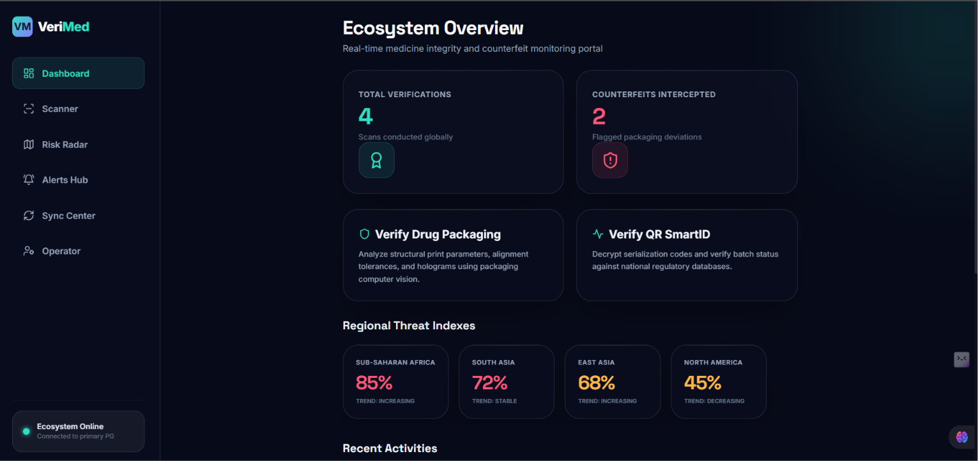
Product Showcase: Integrity Dashboard
Central Command Hub
• Dynamic counts displaying total scans conducted and counterfeits blocked.
• Regional Threat Index widgets showing active threat levels and trend metrics.
• Recent activity logs providing immediate audits on verified and suspect batches.
• Responsive sidebar menu converting into a floating glass tab bar on mobile layouts.
[ DRAG & DROP SCREENSHOT: INTEGRITY DASHBOARD VIEW ]

Slide 5
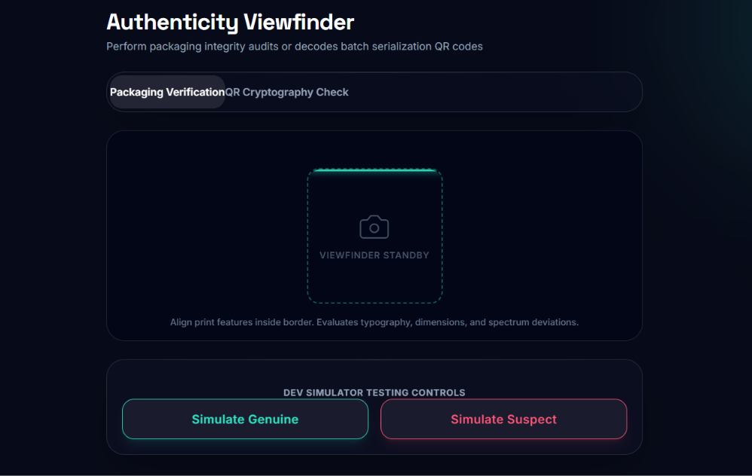
Product Showcase: Verification Viewfinder
Real-time Verification Scanner
• Switches between print packaging vision analysis and DCGI standard barcode scan modes.
• Sweeping laser animations guide the operator to align components inside the viewfinder frame.
• Developer simulator triggers facilitate comprehensive testing without native hardware cameras.
• Instantly triggers detailed reports or alerts if print or signature tolerances fail.
[ DRAG & DROP SCREENSHOT: SCANNER VIEWFINDER VIEW ]

Slide 6
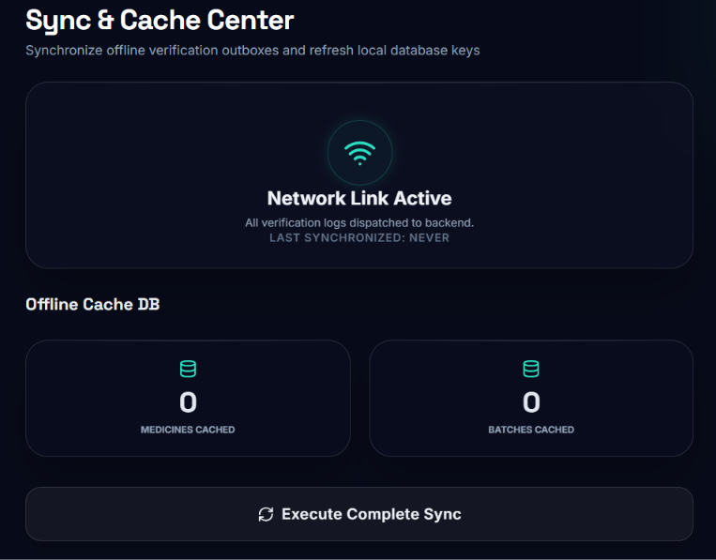
Offline-First Sync Strategy
• Local Cache Mirroring: Uses LocalStorage (web) / SQLite (native mobile) databases to cache up to 100 batch files and manufacturer keys within a 50km radius of the operator.
• Queued Outbox Pipeline: If disconnected, scans and reports are stored locally. Sync Center shows outbox status and triggers dynamic uploads once back online.
• Dynamic Key Fetching: A 7-day expiration index downloads updated cryptographic signature prefixes to verify batches offline without server lookups.
[ DRAG & DROP SCREENSHOT: SYNC & CACHE CENTER VIEW ]

Slide 7
Technical Stack & Scalability
• High-Performance Backend: FastAPI, SQLAlchemy 2.0 ORM, AsyncSession, Uvicorn server, Pydantic V2 validations, PostgreSQL, and Redis cache databases.
• Modular Service Layer: Decoupled services for EfficientNet-B0 CV simulations, QR cryptographical decodes, and geopolitical risk engines.
• Responsive Web Dashboard: Vite + React + Tailwind CSS client with Lucide icons. Desktop navigation converts into a bottom tab bar on mobile layouts.
• Security Standards: Auto-documented REST APIs under Swagger (/docs) with full HTTP Exception handling and token-based signature verification.

Slide 8
VeriMed: Scan. Verify. Stay Safe.
Establishing a trust boundary for clinical supply chains in remote regions.
Thank you! Open for Questions.

