Slide 1

AI / ML TRAINING · DAY 2 · PHASE B — MATHEMATICAL FOUNDATIONS
Linear Algebra
The language of data, models & transformations
Vectors · matrices · tensors · norms · transformations · eigenvectors · rank
Unit U4 · Built from Module 1.3 · ~2.5 teaching hrs + lab

Slide 2







ORIENTATION
Phase B begins — the maths under the models
Why now: you just learned NumPy in U3 — linear algebra is what those arrays mean. Every dataset, weight matrix and embedding is a vector or matrix.
1
2
3
Scalars → tensors
Dot, cross & norms
Matrix ops & special matrices
How data is represented
Length, angle, similarity
Inverse, trace, identity
4
5
6
Transformations
Eigenvalues & eigenvectors
Rank, basis & similarity
Rotation & scaling
Directions a map preserves
Solve systems · cosine
U4 · Linear Algebra
2

Slide 3
S.No | Real-World Scenario | What is Represented as a Vector? | Example Vector | AI/ML Application
1 | Netflix Movie Recommendation | User's movie preferences | [5, 3, 1, 2] (Action, Comedy, Romance, Horror) | Personalized movie recommendations
2 | ChatGPT | Word/Sentence embedding | [0.65, 0.82, 0.41, ...] | Natural Language Processing
3 | Face Recognition | Facial features | [0.32, 0.85, 0.76, ...] | Face identification
4 | Medical Diagnosis | Patient health parameters | [120, 95, 72, 24] | Disease prediction
5 | Self-Driving Cars | Camera image features | [0.25, 0.91, 0.63, ...] | Object detection
6 | Banking | Customer transaction behavior | [Income, Balance, Transactions] | Fraud detection

Slide 4
1
REPRESENTING DATA
Scalars, vectors, matrices & tensors
From a single number to multi-dimensional arrays — the containers that hold every dataset and model weight.
Linear Algebra · Day 2 · 01 / 07

Slide 5



REPRESENTATION
Scalars, vectors, matrices & tensors
0-D
1-D
2-D
n-D
Scalar
Vector
Matrix
Tensor
a single number
a list of numbers
rows × columns
a stack of matrices
5
[2, 5, 1]
[[1,2],[3,4]]
shape (3,2,2)
tensor_shapes.py
In ML terms
import numpy as np
v = np.array([2, 5, 1]) # vector, shape (3,)
M = np.array([[1, 2], [3, 4]]) # matrix, shape (2, 2)
T = np.ones((3, 2, 2)) # tensor, shape (3, 2, 2)
One sample = a vector · a dataset = a matrix · a batch of images = a 4-D tensor.
IN-CLASS LAB Tensor ops in NumPy — addition, transpose and reshape.
The .shape attribute is the first thing to check on any ML array.
U4 · Linear Algebra
4

Slide 6




GEOMETRY OF VECTORS
Dot & cross products, and norms
Dot product
vectors.py
a·b = Σ aᵢbᵢ — measures alignment; zero means perpendicular
import numpy as np
a = np.array([1, 2, 3])
b = np.array([4, 0, 1])
np.dot(a, b) # 7 (alignment)
np.cross(a, b) # perpendicular vec
np.linalg.norm(a) # L2 length
np.linalg.norm(a, 1) # L1 length
cos = a@b/(norm(a)*norm(b)) # similarity
Cross product
a×b — a new vector perpendicular to both (3-D)
Norms (length)
L1 = Σ|aᵢ| · L2 = √Σaᵢ² · L∞ = max|aᵢ|
Cosine similarity
cos θ = a·b / (‖a‖‖b‖) — angle, not magnitude
IN-CLASS LAB Compute L1 / L2 norms + cosine similarity on 3 vector pairs.
Cosine similarity is the backbone of search, recommendations and embeddings.
U4 · Linear Algebra
5

Slide 7
S.No | Application | Vector 1 | Vector 2 | Dot Product Tells Us | Real-Life Outcome
1 | Netflix | User preferences | Movie features | How well the movie matches the user | Recommend similar movies
2 | Google Search | Search query | Webpage content | Relevance score | Rank webpages
3 | Face Recognition | Face vector | Stored face vector | Facial similarity | Unlock phone / Attendance
4 | Fraud Detection | Current transaction | Normal transaction pattern | Transaction similarity | Detect anomalies
5 | Self-Driving Cars | Captured object | Learned object features | Object similarity | Recognize traffic signs
6 | Resume Screening | Candidate skills | Job requirements | Skill match score | Shortlist candidates

Slide 8
Norm | Simple Meaning | Real-World Scenario | Example | AI/ML Application
Norm | Length or size of a vector | Walking from home to college | The distance you travel from home to college | Measuring the magnitude of feature vectors
L1 Norm (Manhattan/City Block Distance) | Total distance traveled along horizontal and vertical paths | Driving through city roads | A taxi in New York travels block by block instead of diagonally | Lasso Regression, Sparse Models, Feature Selection
L2 Norm (Euclidean Distance) | Straight-line (shortest) distance between two points | Flying a drone directly to its destination | A drone flies directly from Point A to Point B | K-Means Clustering, KNN, Image Recognition
Infinity Norm (Maximum Norm) | Largest value in a vector | Finding the highest exam score | Student marks: [85, 92, 78] → Maximum = 92 | Detecting maximum error, Quality Control, Neural Networks

Slide 9
MATRIX OPERATIONS
Operations & special matrices
Identity I
Inverse A⁻¹
matrix_ops.py
diagonal of 1s; A·I = A
A·A⁻¹ = I (undoes a map)
A = np.array([[2., 1.], [1., 3.]])
A @ B # matrix multiply
A.T # transpose
np.linalg.inv(A) # inverse
np.trace(A) # sum of diagonal = 5
np.allclose(A, A.T) # symmetric?
np.allclose(Q.T @ Q, np.eye(2)) # orthogonal?
Diagonal
Symmetric / Orthogonal
non-zero only on diagonal
Aᵀ = A · AᵀA = I
IN-CLASS LAB Compute inverse & trace; test whether matrices are symmetric & orthogonal.
Multiplication is composition: applying one transformation after another.
U4 · Linear Algebra
6

Slide 10
2
TRANSFORMATIONS & STRUCTURE
How matrices move and describe space
Matrices are actions on space. Eigenvectors, rank and basis reveal what those actions really do.
Linear Algebra · Day 2 · 02 / 07

Slide 11
MATRICES AS ACTIONS
Transformations: rotation & scaling
scaled + rotated
Scaling — stretch / shrink along axes — diagonal matrix
Rotation — turn vectors by angle θ — rotation matrix
original
Shear / reflection — skew or mirror space
rotate.py
theta = np.radians(25)
R = np.array([[np.cos(theta), -np.sin(theta)],
[np.sin(theta), np.cos(theta)]])
R @ point # rotate a point about the origin
IN-CLASS LAB Apply 2 transformations; plot the original vs the transformed shape.
U4 · Linear Algebra
8

Slide 12
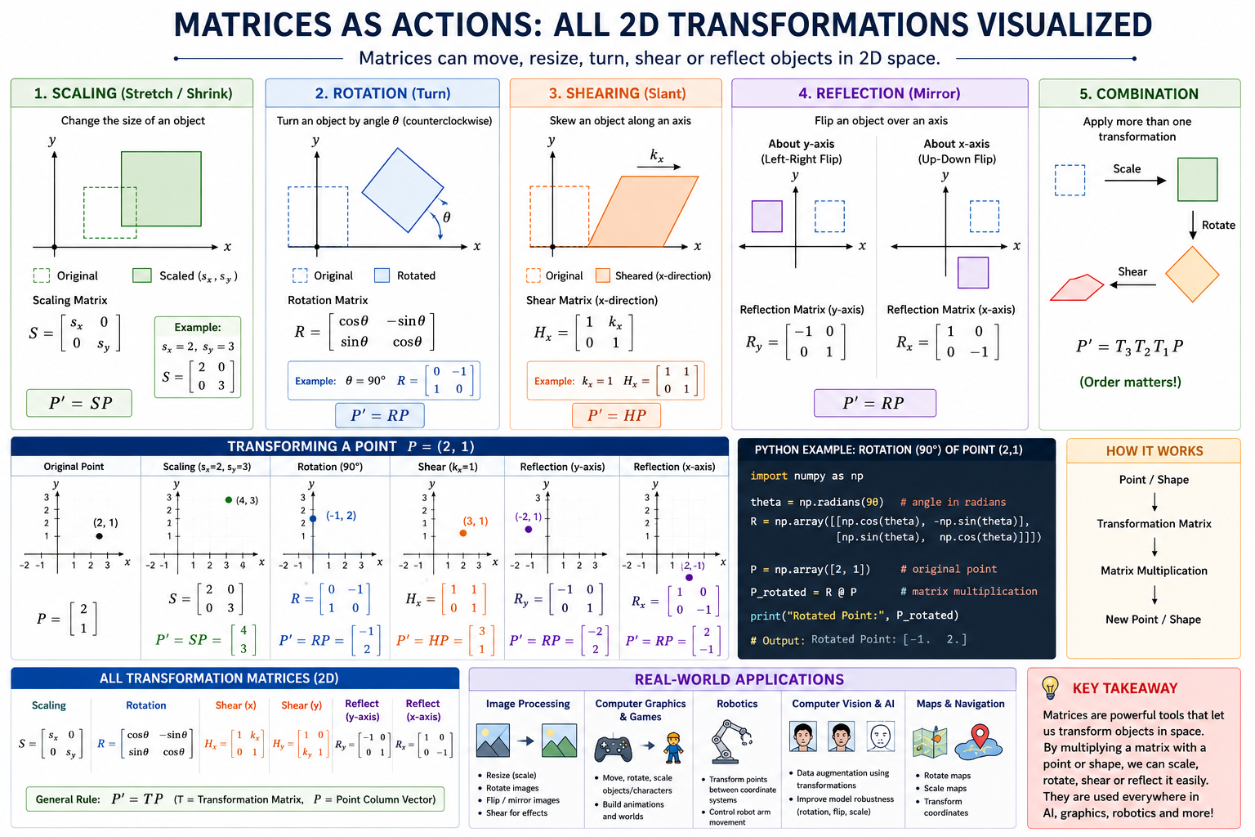

Slide 13
INVARIANT DIRECTIONS
Eigenvalues & eigenvectors
A v = λ v
eigen.py
A = np.array([[2., 0.],
[0., 3.]])
vals, vecs = np.linalg.eig(A)
vals # array([2., 3.]) -> the λ's
vecs # columns are the eigenvectors
# check: A @ v equals lambda * v
np.allclose(A @ vecs[:,0], vals[0]*vecs[:,0])
the matrix only stretches v — it never rotates it
Eigenvector v — a direction a transformation leaves pointing the same way
Eigenvalue λ — how much that direction is stretched (or flipped if negative)
Why it matters — the foundation of PCA, SVD and stability analysis
IN-CLASS LAB Find eigenvalues/vectors of a 2×2 matrix and verify A·v = λ·v.
The applied side — PCA, SVD, dimensionality reduction — returns in U11.
U4 · Linear Algebra
9

Slide 14
Application | What Eigenvectors Find | What Eigenvalues Tell
PCA | Best directions in data | How much information each direction contains
Face Recognition | Important facial features | Which features are most important
Netflix | Hidden user preferences | Importance of each preference pattern
Google Search | Important webpage relationships | Page importance
Speech Recognition | Important voice characteristics | Significant voice components
Fraud Detection | Normal transaction patterns | Degree of abnormality

Slide 15




STRUCTURE OF A MATRIX
Rank, basis & Gaussian elimination
Gaussian elimination
solve_system.py
row-reduce to echelon form to solve Ax = b
# Solve a 3x3 system A x = b
A = np.array([[2,1,-1],[ -3,-1,2],[-2,1,2]])
b = np.array([8, -11, -3])
x = np.linalg.solve(A, b) # [2, 3, -1]
np.linalg.matrix_rank(A) # 3 (full rank)
# full rank -> unique solution exists
Rank
number of independent rows/cols — the 'real' dimensions
Basis & span
the minimal set of vectors that builds the whole space
Null space
the directions a matrix collapses to zero
IN-CLASS LAB Solve a 3×3 system; interpret its rank and null space.
Rank tells you whether a system has one, none, or infinitely many solutions.
U4 · Linear Algebra
10

Slide 16
S.No | Scenario | Matrix Represents | Independent Rows/Columns | Rank | Explanation
1 | Classroom Attendance | Student attendance for different days | Each day's attendance is unique | High Rank | Every day's attendance provides new information.
2 | Duplicate Student Records | Same student record repeated | Duplicate rows | Low Rank | Repeated rows do not add new information.
3 | Sensor Network | Temperature sensors | Sensors placed at different locations | High Rank | Each sensor gives unique measurements.
4 | Hospital Patient Records | BP, Sugar, BMI, Age | Different medical parameters | High Rank | Each parameter provides unique health information.
5 | Image Processing | Pixel matrix | Independent pixel patterns | High Rank | More independent patterns = richer image information.
6 | Recommendation System | User ratings for movies | Different user preferences | High Rank | More unique preferences improve recommendations.

Slide 17
S.No | Real-World Scenario | Problem | How Gaussian Elimination Helps | AI/ML Application
1 | Banking | Find loan, interest, and EMI values | Solve multiple financial equations | Financial Analytics
2 | Traffic Analysis | Find vehicles on different roads | Eliminate traffic counts road by road | Smart Traffic Management
3 | Electrical Circuits | Find unknown currents and voltages | Solve simultaneous circuit equations | Circuit Simulation
4 | Supply Chain | Determine stock in warehouses | Solve inventory equations | Logistics Optimization
5 | Robotics | Calculate robot arm movement | Solve coordinate equations | Robot Motion Planning
6 | Machine Learning | Solve linear regression equations | Compute model parameters | Model Training

Slide 18
VECTOR SPACES IN PRACTICE
Similarity & embeddings
Words, images and users all become points in a high-dimensional vector space. Closeness in that space means similarity in meaning.
Embeddings
Cosine similarity
Nearest neighbours
Map text/images to vectors that capture meaning
Compare direction, not length — robust to scale
Closest vectors = most similar items
embedding_similarity.py
from numpy.linalg import norm
def cosine(a, b): return a @ b / (norm(a) * norm(b))
cosine(king, queen) # ~0.85 (close in meaning) vs cosine(king, apple) # ~0.10
IN-CLASS LAB Compare the cosine similarity of 2 text embeddings.
U4 · Linear Algebra
11

