Slide 1

AI / ML TRAINING · DAY 2 · PHASE B — MATHEMATICAL FOUNDATIONS
Probability & Statistics
Part 1 — Descriptive Statistics
Central tendency · spread · shape · correlation · summarizing data
Unit U6 · Built from Module 1.4 + 2.2 · Day 2 portion (continues on Day 3)

Slide 2






ORIENTATION
Why statistics? Know your data before you model
The big idea: before training any model you must understand the data. Descriptive statistics summarise a dataset in a few numbers — its centre, spread, shape and relationships.
1
2
3
4
5
Data & variables
Central tendency
Spread
Shape
Correlation
categorical vs numerical
mean · median · mode
range · variance · std · IQR
skew · quartiles · box plot
how variables move together
Part 2 (Day 3) continues with probability, Bayes' theorem, distributions and information theory (entropy / KL / mutual information).
U6 · Probability & Statistics (Part 1)
2

Slide 3
1
THE CENTRE OF YOUR DATA
Types of data & central tendency
First classify your variables, then summarise where the data sits — its typical value.
Probability & Statistics · Part 1 · 01 / 06

Slide 4
FOUNDATION
Types of data & variables
CATEGORICAL
NUMERICAL
labels & groups
measured quantities
Nominal
no order — colour, city, gender
Discrete
countable — number of children
Ordinal
ordered — small / medium / large
Continuous
any value — height, temperature
Why it matters: the data type decides which statistics, charts and encodings you can use.
Rule of thumb Mean & standard deviation suit numerical data; counts & mode suit categorical data; the median is safe for skewed or ordinal data.
U6 · Probability & Statistics (Part 1)
4

Slide 5

WHERE THE DATA SITS
Measures of central tendency
Mean — the average — sum ÷ count; sensitive to outliers
Skewed data: mean ≠ median
Median — the middle value when sorted; robust to outliers
Mode — the most frequent value; the only one for categories
mean x̄ = (1/n) Σ xᵢ
add every value, divide by how many there are
right-skewed → mean pulled right of the median
IN-CLASS LAB Compute mean, median and mode on a provided CSV.
U6 · Probability & Statistics (Part 1)
5

Slide 6
HOW SPREAD OUT IT IS
Measures of spread (dispersion)
Range — max − min; quick but outlier-sensitive
spread.py
Variance σ² — average squared distance from the mean
import numpy as np
data = np.array([4, 8, 6, 5, 3, 9, 7])
data.mean() # average
data.var() # variance σ²
data.std() # std deviation σ
data.max() - data.min() # range
q1, q3 = np.percentile(data, [25, 75])
iqr = q3 - q1 # interquartile range
Std deviation σ — √variance — spread in the data's own units
IQR — Q3 − Q1; the middle 50%, robust to outliers
σ² = (1/n) Σ (xᵢ − x̄)²
IN-CLASS LAB Compute variance, standard deviation and IQR for a numeric column.
Two datasets can share a mean yet behave very differently — spread tells them apart.
U6 · Probability & Statistics (Part 1)
6

Slide 7
Key Takeaways
Standard deviation measures how spread out numbers are from the mean.
Variance calculates the average degree to which each number is different from the mean.
Both metrics help assess volatility in financial returns.
High standard deviation indicates a wide range of returns.
Both tools are key for investment risk assessment.
Variance shows how much the values of a data set vary from each other, while standard deviation reflects how much they vary from the mean.

Slide 8
2
SHAPE & RELATIONSHIPS
Distribution shape & correlation
Beyond centre and spread: how a distribution leans, where its quartiles fall, and how variables move together.
Probability & Statistics · Part 1 · 02 / 06

Slide 9
THE SHAPE OF A DISTRIBUTION
Skew, quartiles & the box plot
Percentiles & quartiles — Q1 (25%), Q2 = median (50%), Q3 (75%)
Box plot — the five-number summary
Five-number summary — min · Q1 · median · Q3 · max
Skewness — right-skew: tail to the right (mean > median)
IQR & outliers — points beyond Q1−1.5·IQR or Q3+1.5·IQR
min
Q1
median
Q3
max
the box spans the middle 50% (IQR); whiskers reach the rest
IN-CLASS LAB Compute the five-number summary and read a box plot of a column.
U6 · Probability & Statistics (Part 1)
8

Slide 10
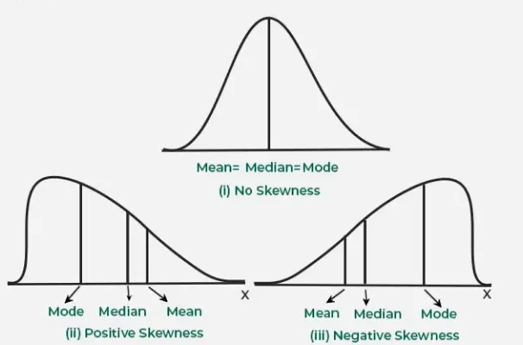
Types of Skewness
Skewness describes the direction and degree of asymmetry in a dataset’s distribution. Various types are as follows:
1. Positive Skewness (Right Skew)
In a positively skewed distribution, the right tail is longer than the left which means most data points are on the left with a few large values pulling the distribution to the right.
Relationship:
Mean > Median > Mode
Examples: Income distribution, exam scores and stock market returns.
2. Negative Skewness (Left Skew)
In a negatively skewed distribution, the left tail is longer which means most data points are on the right with a few smaller values pulling the distribution to the left.
Relationship:
Mean < Median < Mode
Examples: Test scores on easy exams, age at retirement and gestational age at birth.
3. Zero Skewness (Symmetrical Distribution)
Zero skewness shows a perfectly symmetrical distribution where the mean, median and mode are equal. In a symmetrical distribution, the data points are evenly distributed around the central point.
Relationship:
Mean = Median = Mode
Example: A perfectly balanced dataset with equal frequencies of all values.

Slide 11
HOW VARIABLES RELATE
Correlation & covariance
Covariance — do two variables move together? (units-dependent)
Positive correlation (r ≈ 0.99)
Correlation r — covariance scaled to −1 … +1 (unitless)
+1 / −1 / 0 — perfect positive / perfect negative / no linear link
Caution — correlation is not causation; it only sees linear links
IN-CLASS LAB Build a correlation matrix; spot the most and least related features.
U6 · Probability & Statistics (Part 1)
9

Slide 12
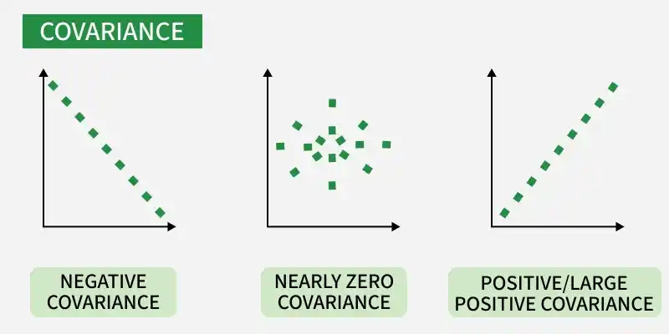
Covariance and Correlation: Covariance and correlation are the two key concepts in Statistics that help us analyze the relationship between two variables.
Covariance measures how two variables change together, indicating whether they move in the same or opposite directions.
What is Covariance
Covariance measures how two random variables change together. It is calculated by averaging the product of their deviations from their means.
A positive value means they move in the same direction, while a negative value means they move in opposite directions.
Types of Covariance
Positive Covariance: When one variable increases, the other variable tends to increase as well and vice versa.
Negative Covariance: When one variable increases, the other variable tends to decrease.
Zero Covariance: There is no linear relationship between the two variables; they move independently of each other.

Slide 13
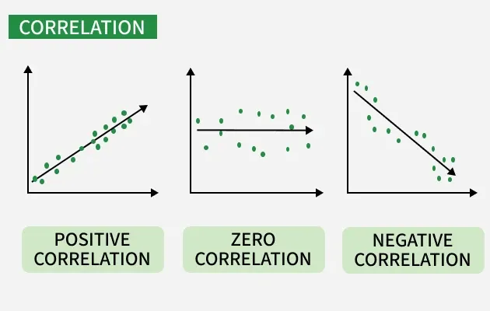
What is Correlation
Correlation is a standardized measure of the strength and direction of the linear relationship between two variables. It is derived from covariance and ranges between -1 and 1. Unlike covariance, which only indicates the direction of the relationship, correlation provides a standardized measure.
Positive Correlation (close to +1): As one variable increases, the other variable also tends to increase.
Negative Correlation (close to -1): As one variable increases, the other variable tends to decrease.
Zero Correlation: There is no linear relationship between the variables.

Slide 14
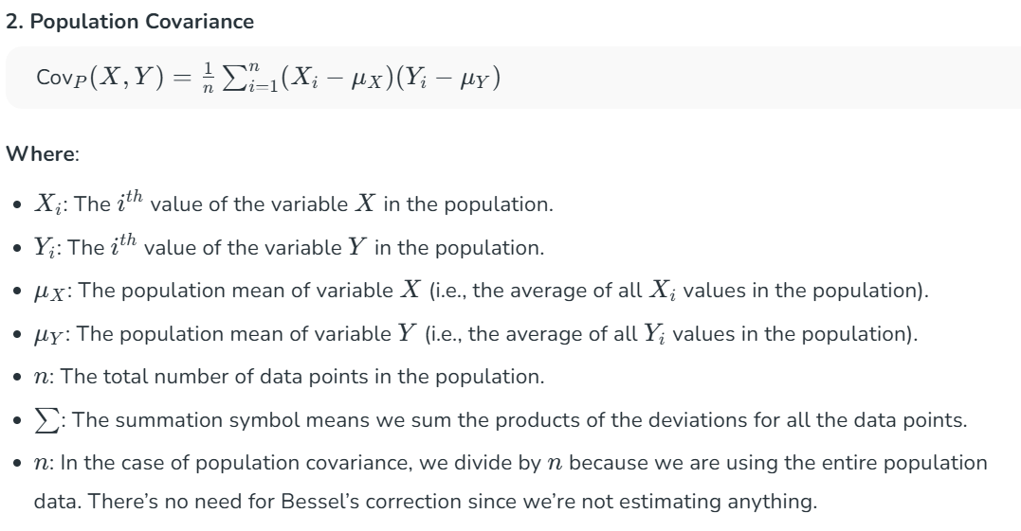
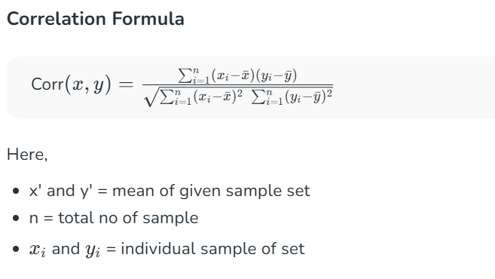

Slide 15

PUTTING IT TOGETHER
Summarizing a dataset in practice
PROFILE
SUMMARISE
SPREAD/ SHAPE
RELATE
.info() .dtypes
.describe()
.std() .skew()
.corr()
summary.py
.describe() gives it all at once
import pandas as pd
df = pd.read_csv('data.csv')
df.describe() # count, mean, std, min, quartiles, max
df['age'].median() # robust centre
df.corr(numeric_only=True) # correlation matrix
count · mean · std · min · 25% · 50% · 75% · max
— one call returns centre, spread and shape for every numeric column.
IN-CLASS LAB Run a full descriptive-stats report on a provided CSV and write 3 insights.
U6 · Probability & Statistics (Part 1)
10

Slide 16



WRAP-UP
Recap, homework & what comes next
KEY TAKEAWAYS
HOMEWORK / SELF-PACED
UP NEXT — PART 2 (DAY 3)
Data type decides which stats apply
Mean/median/mode describe the centre
Variance, std & IQR describe the spread
Skew & quartiles describe the shape
Correlation shows how variables relate
Compute mean / median / mode on a CSV
Compute variance, std & IQR for a column
Build the five-number summary + box plot
Generate a correlation matrix
Write 3 insights from .describe()
Probability theory & axioms; conditional probability
Bayes' theorem — medical-test & spam examples
Distributions (Gaussian, Poisson) + entropy, KL & MI
In ML: descriptive stats are the first thing you compute on any dataset — they reveal scale, skew, outliers and leaks before a single model is trained.
U6 · Probability & Statistics (Part 1)
11

