Slide 1


Competency -3 - Reading Skills
c. Identifying Tone, Themes & Ideas
Department of English
Module 3: Session -10
Professional Writing : Common Short Professional Documents

Slide 2
AIM OF THE SESSION
To train the students in professional writing skills.
INSTRUCTIONAL OBJECTIVES
To encourage the students to draft technical reports, memos, etc.,
LEARNING OUTCOMES
At the end of this session, students will be able to::
Identify various purposes of professional writing skills .
The students will be able to draft reports, memos etc,,

Slide 3
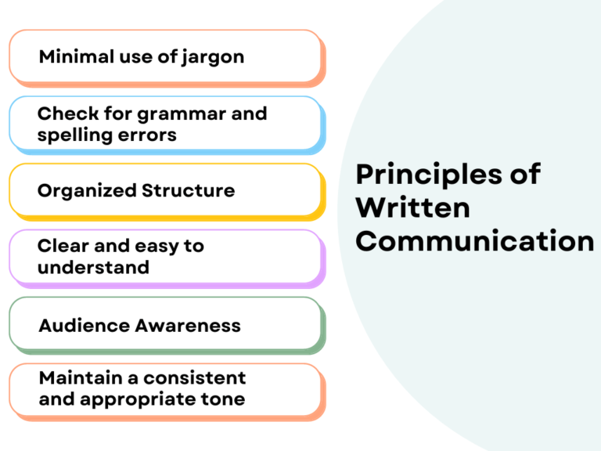
Principles of Written Communication

Slide 4
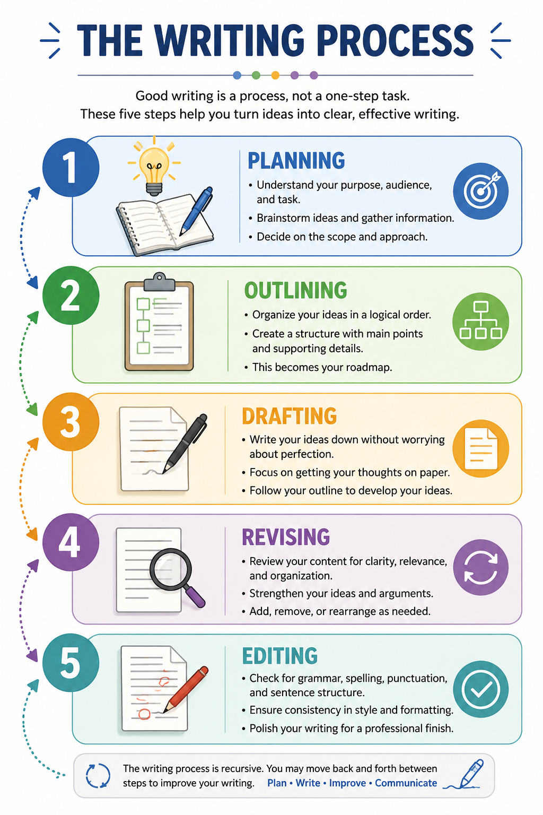

Slide 5
Tone in writing
Professional courtesy
‘You-attitude', and positive phrasing of negative messages.
The You-Attitude is a writing style that looks at things from the reader’s point of view rather than the writer's. It focuses on what the reader wants to know, how they are affected, and what they stand to gain.
The Shift: Move away from "I," "me," "we," and "our" (writer-centric) and focus on "you" and "your" (reader-centric).
The Goal: Show the reader how the information protects their time, solves their problem, or benefits them directly.

Slide 6
continuation.,
Writer-Centric (Me-Attitude) | Reader-Centric (You-Attitude) | Why it Works
We are pleased to announce that we have upgraded our server capacity. | You can now experience faster page load times and zero downtime due to our recent server upgrades. | Connects the feature directly to a benefit the user actually cares about.
I need you to fill out this form so I can process the application. | To process your application quickly, please complete the attached form. | Framed as a way to speed up their results, not a chore for the writer.

Slide 7
Common Short Professional Documents
1. Notes
2. Memo
4. Short Reports

Slide 8
Notes
Purpose: To capture an accurate, objective record of meetings, lab discussions, or project reviews for tracking progress and accountability.
Principles:
Absolute objectivity—record facts, decisions, and assignments, not personal opinions.
Conciseness—eliminate conversational filler and focus purely on action items.
Conventions:
Written in clear past tense and passive voice.
Structured with metadata (Date, Time, Attendees) followed by a designated Action Matrix listing: Task | Responsible Person | Deadline.

Slide 9
Memo
Notes
Example: A Project Review
Date: 2026-08-27 Time: 10:00 – 10:30 AM Attendees: Dr. A. Lee, Dr. B. Smith, Technician C. Jones Subject: Weekly Project X Progress Review
Summary: Project X status was reviewed.Three equipment calibration issues were identified and discussed.
Action Matrix:
Task Responsible Person Deadline
Calibration logs were requested for review. C. Jones 2026-08-29
New reagent was ordered. B. Smith 2026-08-28
The protocol draft was sent to Dr. Lee for approval. A. Lee 2026-09-01

Slide 10
Memo
Memo
Purpose: To communicate internal updates, policy changes, or operational instructions within an organization or department.
Principles:
Directness—use the "Bottom Line Up Front" (BLUF) approach to state the main point immediately.
Clarity—use professional, single-topic focus to prevent confusion.
Conventions:
Standard formal header block: TO:, FROM:, DATE:, SUBJECT:.
Avoid formal salutations (e.g., "Dear Sir") or sign-offs; use bullet points and bold headers for quick readability.

Slide 11
Memo
Memo
Example: IT System Upgrade
MEMORANDUM
TO: All Department Heads FROM: IT Support Team DATE: August 27, 2026 SUBJECT: Mandatory Software Update This Friday
All company laptops must be updated to the new security patch by 5:00 PM this Friday, August 30. Unpatched devices will lose network access on Monday.
Details:
What to do: Run the "Update Now" icon on your desktop. The install takes 20 minutes.
Schedule: Run the update during lunch or after your last meeting.
Exceptions: Marketing and Finance teams – run the update before 3:00 PM due to batch processing.
Support: Call IT hotline (ext. 5678) if you see error code X-401.
No action is needed if you already received the confirmation email from IT this morning.

Slide 12
Short Report
Purpose: To present technical data, feasibility studies, inspection outcomes, or project status updates for decision-making.
Principles:
Data-driven analysis—base all conclusions strictly on verifiable evidence, testing, or factual measurements.
Structural organization—guide the reader logically from problem statement to resolution.
Conventions:
Standardized technical layout: Title/Header → Introduction → Findings/Data → Conclusions → Recommendations.
Uses visuals (charts, tables, schematics) labelled with captions and clear unit metrics.

Slide 13
Short Report
EXAMPLE: A Short Report on Student Portal Login Service
Title: Load Test Results – Student Portal Login Service Date: August 27, 2026 Prepared by: CSE Infrastructure Team
1. Introduction The student portal crashed twice last week during exam result announcements. We ran a load test on August 26 to measure maximum concurrent users the login service can handle before failing.
2. Findings / Data
Test tool: Apache JMeter (simulated users).
Server: 4 vCPUs, 16 GB RAM.
Results table:

Slide 14
Short Report
Concurrent Users Avg Response Time (ms) Error Rate (%)
100 120 0.0
500 340 0.2
1,000 890 3.5
1,500 2,100 12.8 (timeout)
CPU usage at 1,500 users: 94% (peak).
Memory usage at 1,500 users: 88%.
3. Conclusion The service works well up to 500 users. At 1,000 users, response time slows and errors start. At 1,500 users, the system becomes nearly unresponsive due to CPU and memory exhaustion.
4. Recommendations
Add one more server (scale horizontally) before the next exam period.
Implement a queue system to limit login requests to 500 per minute.
Retest after changes with the same load profile.

Slide 15
Portfolio Activity 3
Project Use-Case: A Professional Document
Refer to Portfolio Activity 3 for instructions.

Slide 16
Let’s Watch…
https://www.youtube.com/watch?v=ZQaNPzzT3yE
https://www.youtube.com/watch?v=860LtRxP3rw
https://www.youtube.com/watch?v=KGImUx4zg64
https://www.youtube.com/watch?v=l3yWmXbC36s

Slide 17
The Writing Process (For Reference)
Planning is the brainstorming and research phase where you define your purpose, analyze your target audience, and gather relevant information or data. It sets a clear direction for the project, ensuring you know why you are writing and who you are writing for before putting down full paragraphs.
Outlining is creating a structural framework or roadmap of your document, arranging your main points and supporting details into a logical sequence. It Prevents writer's block and ensures a coherent flow of ideas, making it easier to see how different sections connect before you start drafting.
Drafting is the process of turning your outline into full sentences and paragraphs, focusing on getting your ideas down on paper without worrying about perfection. It moves the project from a conceptual plan to an actual manuscript, prioritizing momentum, substance, and the rough expression of thoughts.
Revising is Looking at the "big picture" of the draft to improve its core structure, logic, tone, and clarity. This can involve adding, removing, or rearranging large sections of text. It ensures that your arguments make sense, your evidence is strong, and the overall organization serves the reader effectively.

Slide 18
The Writing Process (For Reference)
Editing is the fine-tuning phase that focuses on the mechanics of writing, including correcting grammar, punctuation, spelling, word choice, and sentence structure. It polishes the document to a professional standard, eliminating distractions and ensuring that your ideas are communicated flawlessly.

Slide 19
SELF-ASSESSMENT QUESTIONS
Scenario-Based: Imagine your company is changing its internal policy regarding hybrid work schedules. Which writing format is the most appropriate tool to quickly mass-distribute this operational update and establish an official internal record?
A) Short Report
B) Summary
C) Memo Writing
D) Note Making

Slide 20
Terminal Questions
Why is it recommended to use your own words when condensing large volumes of information during note making rather than copying the source verbatim?
What are the two or three critical things a writer must define or gather during the Planning stage before they actually start writing sentences?
How does creating an Outline directly help a writer avoid writer's block and ensure a logical flow of ideas?
How does the focus of the Editing stage differ from the focus of the Revising stage?

Slide 21
REFERENCES FOR FURTHER LEARNING OF THE SESSION
e-References:
https://paperpal.com/blog/academic-writing-guides/what-is-report-writing-format-types-examples
https://www.successcds.net/learn-english/writing-skills/note-making-and-summarising-format.html
https://methodologyhub.com/writing/writing-process/

Slide 22
THANK YOU
Team – Language Skills for Engineers

