Slide 1


Department of English
Module 2 –Technical vocabulary VS General Vocabulary
Collocations, Idioms, Phrasal Verbs, Professional Expressions, Tone-Carrying Words, Hedging & Softening, Assertive vs Tentative Language, Positive vs Negative Framing
Explaining Technical Ideas to Non-Technical Audiences
Session - 6

Slide 2
AIM OF THE SESSION
To equip learners with the difference in using Technical vocabulary and General vocabulary including collacations, hedging and softening language and, enabling them to communicate ideas clearly, coherently, and persuasively.
INSTRUCTIONAL OBJECTIVES
This Session is designed to:
To distinguish between Technical vocabulary and General vocabulary
To use appropriate expressions for each context.
To structure professional expressions using hedging and softening language
LEARNING OUTCOMES
At the end of this session, you should be able to:
Use suitable expressions in professional and casual conversations.
Participate effectively in positive and negative framing situations.

Slide 3
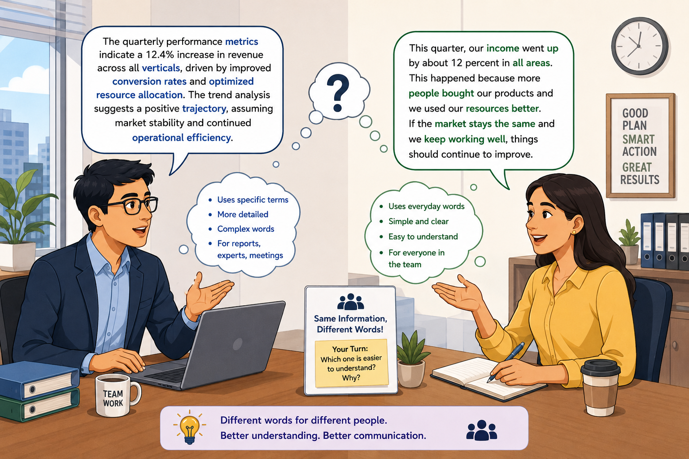
WARM UP

Slide 4
DISCUSSION
Whose language is Technical?
What are it’s features?
What is the purpose of using Technical language?
Where do we use general language?
What are it’s features?

Slide 5
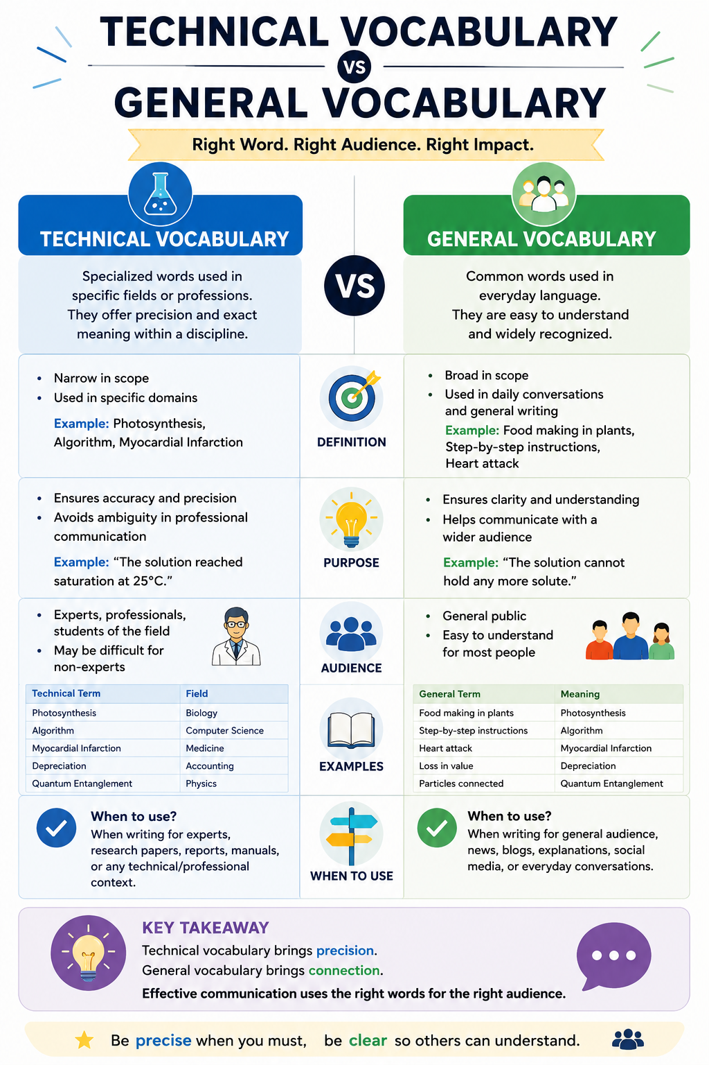

Slide 6
Explaining Technical Ideas to Non-Technical Audiences
Presenting technical ideas to non-technical audiences requires translating complex data into relatable, impact-driven narratives.
Activity-1

Slide 7
Collocations and Phrasal verbs
Collocations are words that naturally and frequently occur together in English. Native speakers use these combinations automatically because they sound natural.
Verb + Noun
Adjective + Noun
Adverb + Adjective
Verb + Adverb
Ex: Make a decision, Pay attention, Heavy rain, Strong coffee, Conduct research, etc….
A phrasal verb is a verb combined with a preposition or an adverb (or both). Together, they create a new meaning that is often different from the meaning of the original verb.
Verb + Preposition/Adverb
Ex: Carry out, Give up, Look after, Set up, Turn off

Slide 8
Tone Carrying Words
Tone-carrying words are words or phrases that reveal the speaker's or writer’s
attitude,
emotion, or
level of certainty toward the message or the audience.
They influence how a message is perceived, not just what it means.
In professional communication, tone-carrying words help make your language polite, respectful, confident, cautious, persuasive, or empathetic.

Slide 9
Contd….
They help us:
Communicate politely and professionally.
Avoid sounding rude or demanding.
Show confidence or caution when needed.
Build positive workplace relationships.
Adapt our language to different audiences.
Ex: please ,kindly, could , would, may , appreciate , certainly , definitely , clearly ,undoubtedly ,confidently

Slide 10
Hedging and Softening Language
Hedging language is the use of cautious, tentative, or qualifying words to soften statements and avoid making absolute claims.
It involves using specific grammar devices to soften claims, avoid over-generalization, and express professional uncertainty.

Slide 11
Contd….
Hedging adverbs (possibly, probably, perhaps) or modal verbs (may, might, could) would soften the language.
Ex: Night shifts cause sleep disorders in all workers.
Night shifts might/may/possibly cause sleep disorders in workers. (Softens the claim from 100% certainty).

Slide 12
Assertive VS Tentative Language
Assertive language expresses ideas with confidence and certainty, while tentative language expresses ideas with caution, politeness, or uncertainty.
Assertive Language | Tentative Language
Shows confidence and certainty | Shows caution or uncertainty
Used when giving facts, instructions, or making strong recommendations | Used when expressing opinions, suggestions, or discussing uncertain information
Direct and clear | Polite and flexible
Common in leadership and decision-making | Common in academic writing and diplomacy

Slide 13
Portfolio Activity 2
Personal Word Bank and Jargon-to-Plain English Rewrite
Refer Portfolio Activity 2 and Complete Tasks 6 & 7

Slide 14
Summary
In today's academic and professional world, what you say is important, but how you say it is equally important. These language skills help you communicate clearly, professionally, and confidently with different audiences. Whether you are writing a report, attending an interview, giving a presentation, working in a team.Explaining technical ideas to non-technical audiences does not mean reducing accuracy—it means replacing unfamiliar terms with familiar words, examples, and analogies so the audience understands the same concept.

Slide 15
Terminal Questions
1. Which sentence sounds more natural?
a) Do a decision
b) Make a decision
2. Complete the sentence: The technician __________ the machine before leaving.
(turn off / turn up)
3. Which audience needs more technical vocabulary?
a) Engineers
b) School children
4. Rewrite the sentence positively:
"Your report is full of mistakes."

Slide 16
Video Links
1.https://videohighlight.com/v/NG44swIzykA?aiFormatted=false&language=en&mediaType=youtube&summaryType=default&utm_source=chatgpt.com
2. https://www.ted.com/talks?utm_source=chatgpt.com
References
Joseph M. Williams & Joseph Bizup. Style: Lessons in Clarity and Grace.
Richard C. Larson. Technical Communication.

Slide 17
THANK YOU
Team – Language Skills for Engineers

