Slide 1
BUILD YOUR FIRST MONSTER APP
Jean-Roch Maitre (JR)

Slide 2
What’s Monster?
New UI developed by 2600hz
Responsive for Desktops and Tablets
Internationalizable (already available in English and French)
Developer-friendly (app store, widgets, SDK)

Slide 3
Let’s write some code!
https://github.com/2600hz/monster-ui/blob/master/docs/kazoocon.md
Get the code from the link above or just follow the presentation

Slide 4
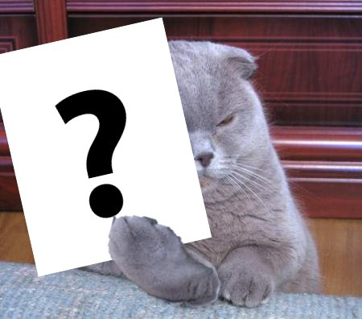
Questions

Slide 5
(and go get some drinks!)

