Slide 1
BUILD YOUR FIRST MONSTER APP
Jean-Roch Maitre
Joris Tirado

Slide 2
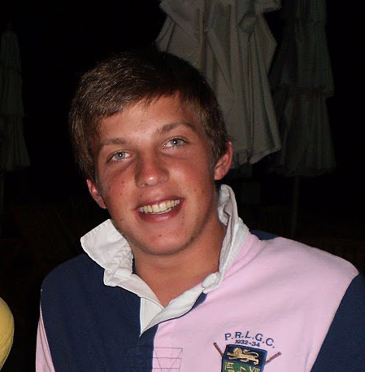
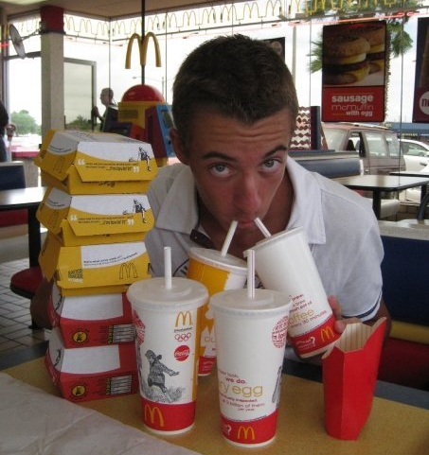
Presenters
Jean-Roch Maitre
Lead Front-End Engineer @ 2600hz
IRC Handle: JR^
Joris Tirado
Front-End Engineer @ 2600hz
IRC Handle: azefiel

Slide 3
What’s Monster?
new User Interface
Responsive
Internationalization
Developer-friendly
Notes:
New UI developed by 2600hz
Responsive for Desktop and Tablets
Internationalizable (already available in English and French)
Developer-friendly (app store, widgets, SDK)

Slide 4
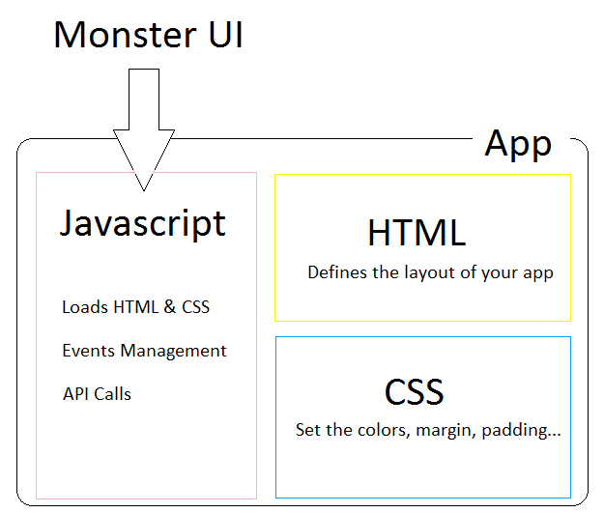
What’s a Monster app?

Slide 5
What’s in the app we’re about to code?
Simple single-purpose app
Track new call events
List call events live
Notes:
We want to show you the basics of codding a Monster app so we will keep it simple
The app will try to track all new call events happening on a Kazoo Account
The goal is to see the events in our app as we place calls form a softphone

Slide 6
Requirements
Local Monster UI
Account credentials
Softphone
IDE or text editor
Notes:
Have access to a local Monster UI
Have credentials to log in to your local UI
Have a softphone registered to this account
Be able to edit some code (vim, Sublime Text, Notepad++)

Slide 7
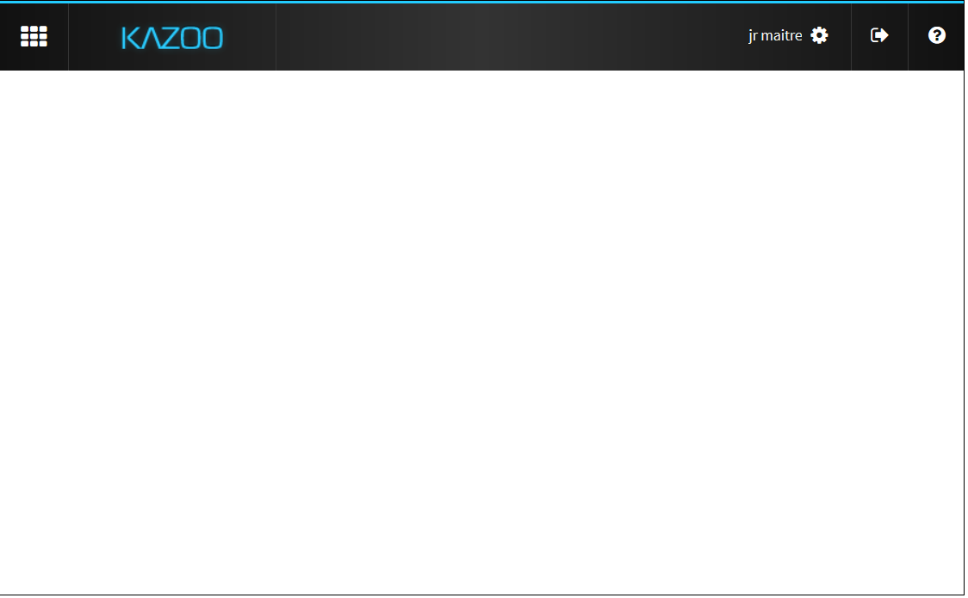
Launching the Monster
Go at the address of your local Monster UI
Log in with the credentials given to you this morning

Slide 8
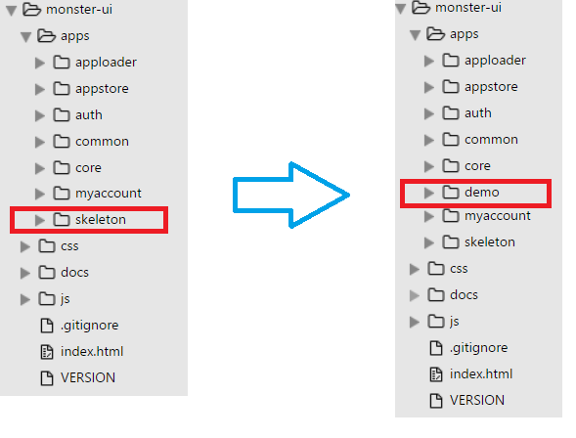
Creating the demo app folder

Slide 9
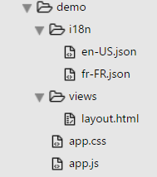
Understanding my app folder
i18n strings in /i18n
HTML in the /views
CSS in app.css
The magic in app.js

Slide 10
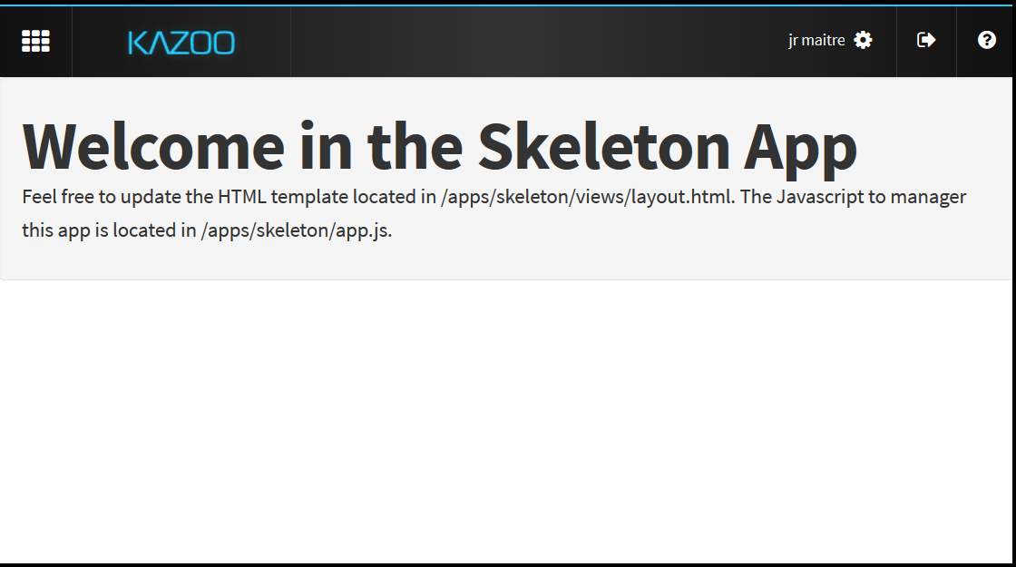
Check the results

Slide 11
Now let’s write some code!
https://github.com/2600hz/monster-ui/blob/master/docs/kazoocon.md
Get the code from the link above or just follow the presentation

Slide 12
Let’s change the HTML
Remove everything inside layout.html
Copy the HTML block on the GitHub page
Paste it in your layout.html, and save the file!
We need to get the i18n strings as well!
Remove everything in your i18n/en-US.json file
On the GitHub page, copy the i18n block
Paste it in your en-US.json file, and save it
We basically just replaced our welcome message with a mysterious table!

Slide 13
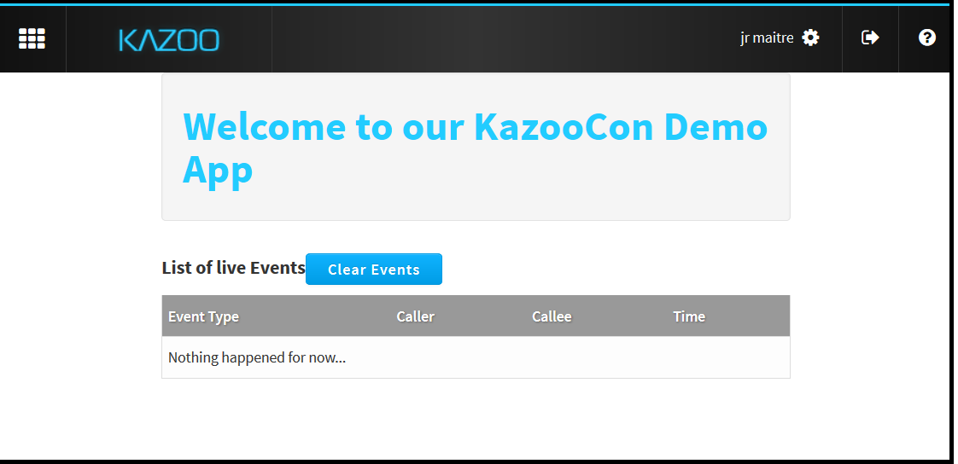
Check the results

Slide 14
Where’s the magic at?
We need to add some JavaScript to track the Call Events now…
Go at the GitHub page, and get the Socket Events section
Go in the app.js file, and paste the section just after the render function (don’t forget to add a coma after the brace of the render function!)
Uncomment the self.bindEvents(skeletonTemplate) function
This function subscribes to a monster socket, and then trigger some JavaScript functions if those events are raised

Slide 15
Where’s the magic at?
In order for our demo to work, we need to add 2 more things we’re using in this function
First, we need to create a new event.html template inside the views folder and paste the code from the GitHub page in there
Then we need to add the formatEvent function from the GitHub page after our bindEvents function in the app.js file
formatEvent will allow us to give formattedData to our HTML template, so it doesn’t have to do any logic
The event.html template is just a table row we’ll add each time we catch an event

Slide 16
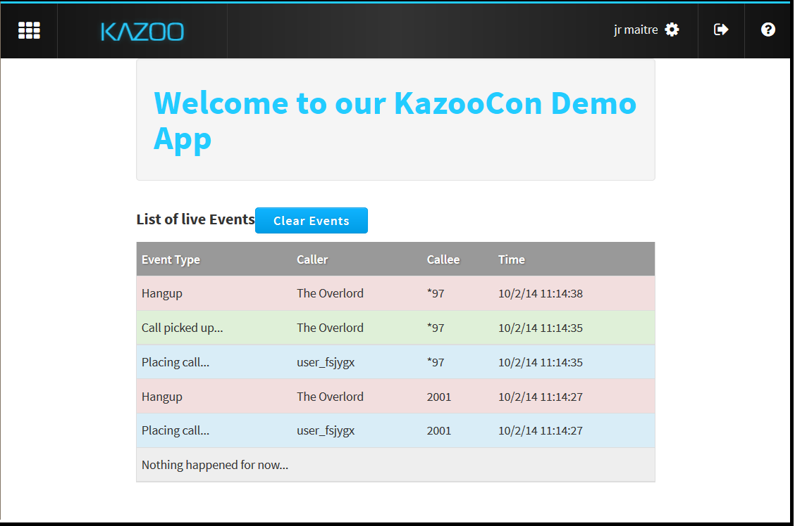
Woohoo!

Slide 17
Quick glance at the Kazoo JS SDK
Call any Kazoo API
Released as a jQuery plugin
Quick example
Notes:
Call any supported Kazoo API from your Monster app
Usable outside Monster if you need to use it in your own UI
Let’s look at a quick example

Slide 18
The future of Monster UI
New back-end APIs
Allow developers to sell apps
Building new cool apps
Come talk to us
Notes:
Improvement of the app store with new back-end APIs to allow you to sell apps!
Now that the core is “done”, we’ll focus on building new cool apps (Callflow Manager, User Portal, Faxbox Manager …)
We want your feedback, come see the Front-End team and ask us questions!

Slide 19
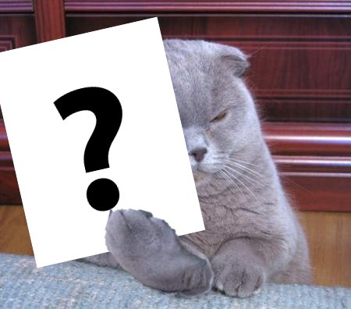
Questions

