Slide 1
Plant - o - Matic
ENG5220: Real Time Embedded Programming (2020-21)
Date: 27/01/2021
Team #21 Adil Shakeel (2624480S) Aigerim Abdurakhmanova (2588842A) Medet Kassymov (2568401K)

Slide 2
Contents
What / Why
Budget
3D Model / Flowchart
Slide 3
Slide 4
Slide 5

Slide 3
Automated Plant Irrigation System:
What
Applications:
Domestic Plant Monitoring
Potential for use in agro-industry
(A lot more is still yet to come)
Why

Slide 4
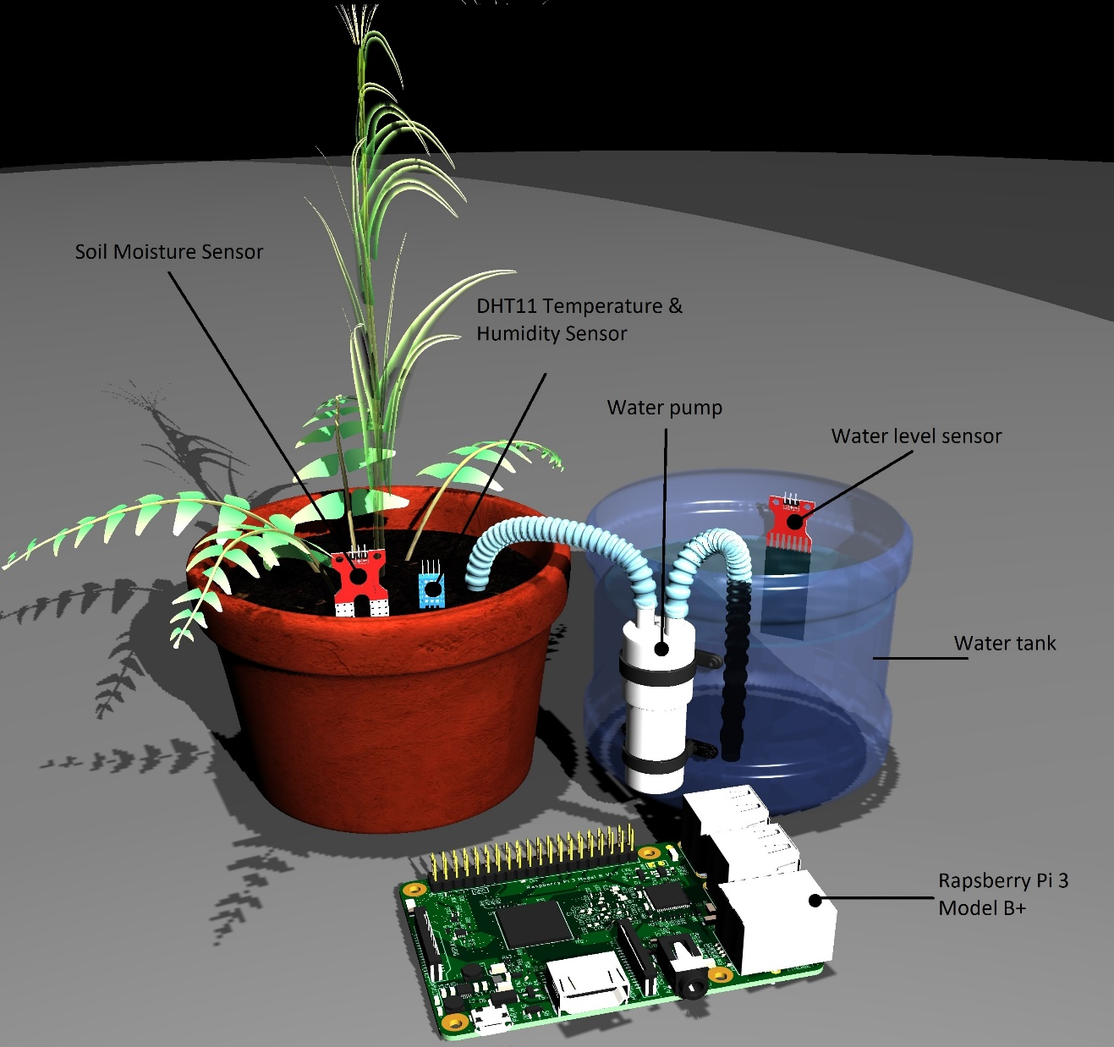
3D Model / Flowchart
START
Temperature , Moisture, Water Level
Is Soil moist enough ?
NO
Is Water Level LOW ?
YES
Alarm, Manually fill the Tank
YES
NO
Pump is OFF
Pump is ON
(A lot more is still yet to come)

Slide 5
Budget
COST (£)
Raspberry Pi 3 Model B+
33.90
Flash memory card - 32 GB for Raspberry Pi
3.55
DHT11 Temperature and Humidity Sensor Module
2.68
Water Level Sensor
3.00
Automatic Irrigation Kit (Soil Moisture Sensor, Pump, Relay, Wires)
7.68
£ 50.81

Slide 6


THANK YOU!

