Slide 1
CAP182 • CAPSTONE PROJECT • PART C
From registration
to first deposit
A data-science lifecycle story: SS1 problem framing → SS2 model selection → SS3 activation evidence
THE BUSINESS QUESTION
Who needs help completing the journey from sign-up to a funded account?
Bernette Lesejane • 26303406 • STADIO PGDip Data Science
01 / 12
Notes:
Time: 0:00–0:45 (45 seconds)
On camera: Begin with your face visible. Use the first sentence as the attention hook.
“Every funded investor begins as a sign-up—but not every sign-up reaches a first deposit. In this project, I ask how STADIOEquities could recognise accounts that may need help completing that journey. I will connect the business problem and governance plan from SS1, the evidence and model choices from SS2, and the account-activation analysis from SS3. The goal is not to put a label on a customer. It is to learn whether early information can help the business offer timely, useful support. I’ll show what the data and models can tell us, where the evidence is still limited, and what should be tested before any real-world rollout.”

Slide 2
BUSINESS UNDERSTANDING
A sign-up is not yet an investor
SS1 frames the gap between acquisition and first funded activity.
The gap
The question
The decision
The SS1 brief describes 2.3 million registered accounts and a material drop between registration and funded investing. This is project context—not the modelling sample size.
Can registration, onboarding and early behaviour identify accounts that will make a first deposit within 90 days?
Use risk ranking to prioritise human support or helpful onboarding nudges—then test whether support changes outcomes.
SUCCESS IS NOT
SUCCESS SHOULD BE
More clicks or accuracy alone
More incremental first deposits at acceptable cost—with fair, compliant treatment
CLIENT LENS
Find the right account, at the right time, with helpful support—not a punitive label.
Source: README_SS1.md, Parts A-B. The 2.3m figure is stated in the brief; SS3 models a separate extract.
CAP182 • SS3 PART C • STADIOEQUITIES
02 / 12
Notes:
Time: 0:45–1:35 (50 seconds)
“The SS1 brief describes a large registered customer base and a business challenge: registration does not necessarily turn into funded investing. The brief cites 2.3 million registered accounts, but that is context—not the sample used in SS3. The project question is whether account information and early behaviour can help predict a first deposit within 90 days. That prediction could help prioritise onboarding education or human support when staff capacity is limited. The business outcome should not be model accuracy alone. It should be more incremental first deposits at an acceptable cost, achieved with fair and compliant customer treatment. That final impact must be demonstrated through an intervention test, not assumed from a prediction.”

Slide 3
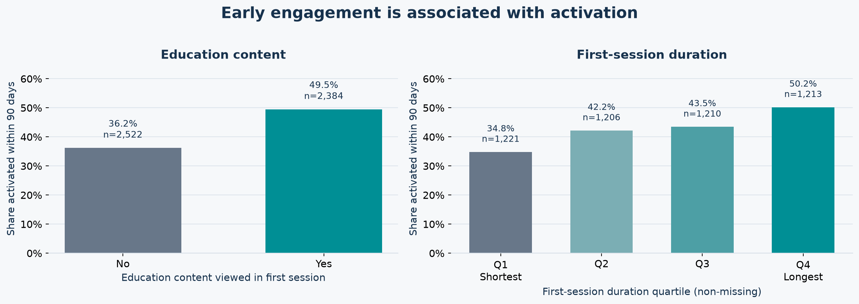
EXPLORATORY ANALYSIS
Early engagement tracks with activation
Two observed patterns from the 4,906-account cohort ? useful for hypotheses, not causal claims.
Interpretation: association can guide a support experiment; it does not show that content or session length causes a deposit.
Source: table01_registration_onboarding + table02_initial_session_behaviour; first-session duration n=4,850 non-missing.
03 / 12
Notes:
Time: 1:35–2:35 (60 seconds)
“These two charts summarise early exploratory patterns in the 4,906-account modelling population. In the first-session table, accounts that viewed education content had a 49.5 percent activation rate, compared with 36.2 percent among those that did not. In the second chart, activation rises from about 34.8 percent in the shortest first-session-duration quartile to about 50.2 percent in the longest. These are useful clues: educational content and deeper early engagement may help us understand where onboarding support could be relevant. But they are associations, not evidence that making someone watch more content will cause a deposit. Other factors may explain the difference, and the extract is a limited sample. We use these findings to motivate tests, not to prescribe customer behaviour.”

Slide 4
SS1 GOVERNANCE: RAAIDD
The original plan anticipated risks that the extract makes concrete
RAAIDD = Risks, Actions, Assumptions, Issues, Decisions and Dependencies.
RISK • data coverage
RISK • time drift
RISK • privacy
SS1 assumption: ≥100K accounts and 12–18 months. SS3 extract: 4,906 unique accounts. Useful for development; not proof about the full 2.3m base.
SS1 flagged behaviour drift and recommended recent-cohort testing / quarterly review. SS3 uses a random split, not a chronological test.
SS1 flagged POPIA and pseudonymisation. Use approved data, restrict access, and do not publish account-level predictions or identifiers.
ASSUMPTIONS • ISSUES • DECISIONS
Assumption: planned ≥100K accounts / 12–18 months; delivered extract has 4,906.
Issues: account/time coverage, mixed date formats and point-in-time status of some features.
Decisions: 90-day activation target; split changed from planned 60/20/20 to 70/15/15; 52 requested fields became 169 encoded features.
ACTIONS + DEPENDENCIES: confirm the extract and event-time definitions; obtain compliance approval before time-safe modelling and a pilot; then validate on later cohorts.
Source: README_SS1.md, Part E RAAIDD / decisions; SS3 results/01_dataset_summary.csv and 02_split_summary.csv.
CAP182 • SS3 PART C • STADIOEQUITIES
04 / 12
Notes:
Time: 2:35–3:25 (50 seconds)
“SS1 used a RAAIDD log to track risks, actions, assumptions, issues, decisions and dependencies. SS3 makes several of those assumptions concrete. The plan anticipated at least 100,000 accounts over 12 to 18 months; the available modelling extract contains 4,906 unique accounts. That is enough for a development exercise, but not evidence that the model represents the full customer base. SS1 also identified temporal drift and privacy as risks. The SS3 evaluation uses a random split rather than a later-time cohort, so drift remains untested. Before any pilot, the business must confirm event timestamps, data permissions, and a POPIA-compliant purpose and access process. This is a living governance log, not a box-ticking exercise.”

Slide 5
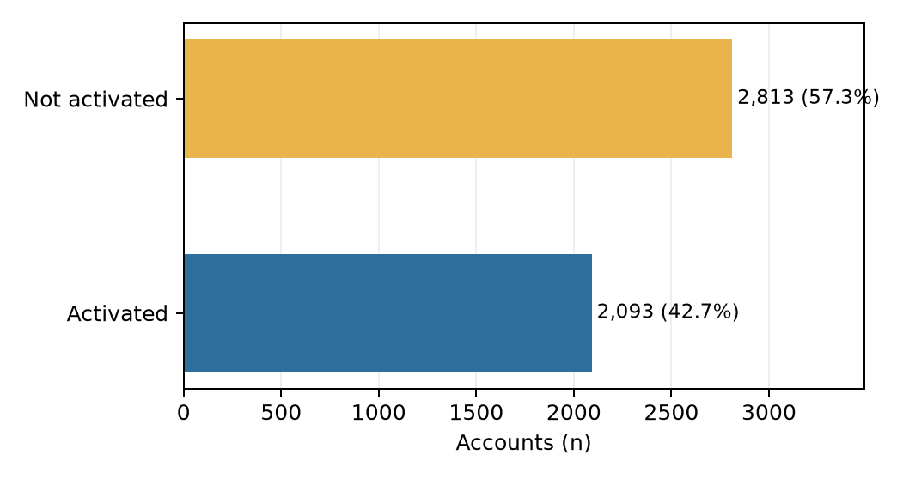
SS1 → SS3: DATA UNDERSTANDING
The data dictionary becomes an account-level evidence map
Twelve source tables describe funnel, behaviour, communication, compliance and technical context.
SELECTED DATA DOMAINS & EXAMPLES
Funnel / target
registration date, channel, onboarding status, activated
Early behaviour
first-session duration, screen views, early sessions
Contact / messaging
email opens, support, push / in-app response
Compliance / device
KYC status / timing, device, OS, browser, connection
Marketing
campaign exposures, clicks, spend and channels (aggregated)
Data quality: 14 duplicate rows removed; category spelling/case normalised; registration dates in four formats. Class 0: not activated (57.3%); Class 1: activated (42.7%).
9 TABLES USED
3 TABLES EXCLUDED
Support tickets • feedback • post-deposit activity
Source: SS1 data request / dictionary; SS3 results/01_table_relevance.csv, 01_dataset_summary.csv, 01_date_formats.csv.
CAP182 • SS3 PART C • STADIOEQUITIES
05 / 12
Notes:
Time: 3:25–4:25 (60 seconds)
“The data dictionary specified 12 linked source tables: registration and onboarding, early behaviour, communications, marketing, KYC and device context, among others. Nine were used fully or partly. Support tickets were excluded because timestamps could not confirm they were available before activation; feedback was incomplete and included a label-related field; and post-deposit activity existed only for activated accounts. The target is a first deposit within 90 days. We removed 14 exact duplicate rows, standardised category labels and dates, and removed deposit- and outcome-derived fields to reduce leakage. Numeric and categorical preprocessing was fitted on training data. The final split was stratified 70/15/15—different from the 60/20/20 originally planned—and one-hot encoding produced 169 model inputs. These choices are recorded so results can be interpreted and reproduced.”

Slide 6
SS2: EVIDENCE AND MODEL SELECTION
Literature guides choices; the benchmark identifies a candidate
UCI Bank Marketing: 45,211 records with about 11% positive; F1 was more informative than accuracy alone.
SS2 model | Accuracy | F1 (yes) | Precision | Recall
Logistic Regression | 0.755 | 0.373 | 0.27 | 0.62
Random Forest | 0.893 | 0.318 | 0.63 | 0.21
XGBoost | 0.838 | 0.459 | 0.38 | 0.59
Weterings et al. (2019)
Activation study: XGBoost is a strong baseline; define the time cut-off and prevent future-event leakage.
Moro, Cortez & Rita (2014)
Bank-campaign evidence: later-period performance may fall; time-based testing and lift matter.
SS2 chose XGBoost: test F1 0.459; CV mean F1 0.446 vs LR 0.373 and RF 0.314.
Isen et al. (2026), as reviewed
Integrate touchpoints and evaluate conversion / retention outcomes, not clicks alone.
SS2 and SS3 are different datasets and positive-class definitions: do not compare their F1 values as if they were the same test.
Literature summarized in SS2 Part A: Weterings et al. (2019); Moro et al. (2014); Isen et al. (2026). SS2 results: READMEPartB&C.md.
CAP182 • SS3 PART C • STADIOEQUITIES
06 / 12
Notes:
Time: 4:25–5:20 (55 seconds)
“SS2 provided both context and a modelling benchmark. Its UCI Bank Marketing dataset contains 45,211 records from a Portuguese bank campaign, with roughly 11 percent positive outcomes. After dropping call duration because it is only known after a call, XGBoost achieved the strongest SS2 F1 score: 0.459 on its test set and about 0.446 in cross-validation. The literature review also highlighted activation modelling, interpretable event histories, and the value of time-aware evaluation and lift-based targeting. Those sources helped motivate the SS3 model candidates and safeguards. However, the UCI campaign outcome is not the same as STADIOEquities 90-day account activation. So SS2 guides our choices; its F1 values cannot be compared directly with SS3 or treated as proof that XGBoost must win here.”

Slide 7
SS3: METHOD AND CODE
The SS2 toolkit is applied to account activation
Key safeguard: fit transformations and resampling on training data only.
1 Source
2 Split
3 Prepare
4 Balance
5 Compare
6 Evaluate
12 tables
account-level join
70 / 15 / 15
stratified IDs
train-fit impute
scale + one-hot
SMOTE k=5
train only
LR • RF • XGB
average probabilities
validation +
unseen test
Code choices
Models
Median numeric imputation + scaling; categorical imputation + one-hot; outlier caps learned on train; deposit-derived leakage removed.
LR = interpretable baseline; RF = bagged trees; XGBoost = boosted trees; ensemble = averaged probabilities. Seed = 42.
Validation and test retain natural prevalence. Applying SMOTE before splitting would leak neighbour information.
Source: SS3 notebook sections 02 Data preparation and 03 Model training; results/02_split_summary.csv.
CAP182 • SS3 PART C • STADIOEQUITIES
07 / 12
Notes:
Time: 5:20–6:20 (60 seconds)
“SS3 compares Logistic Regression, Random Forest and XGBoost, with an ensemble that averages predicted probabilities. Logistic Regression is the interpretable baseline; Random Forest combines many decision trees; and boosting builds trees sequentially to correct earlier errors. We stratified account IDs into training, validation and unseen test sets at 70, 15 and 15 percent. Imputation, scaling, category encoding and outlier caps were learned from training data. SMOTE was also applied only to training data, so validation and test retain the natural class balance. This matters because resampling before the split could let information from held-out examples influence training. The validation set supports development checks; the unseen test set is reserved for final performance reporting.”

Slide 8
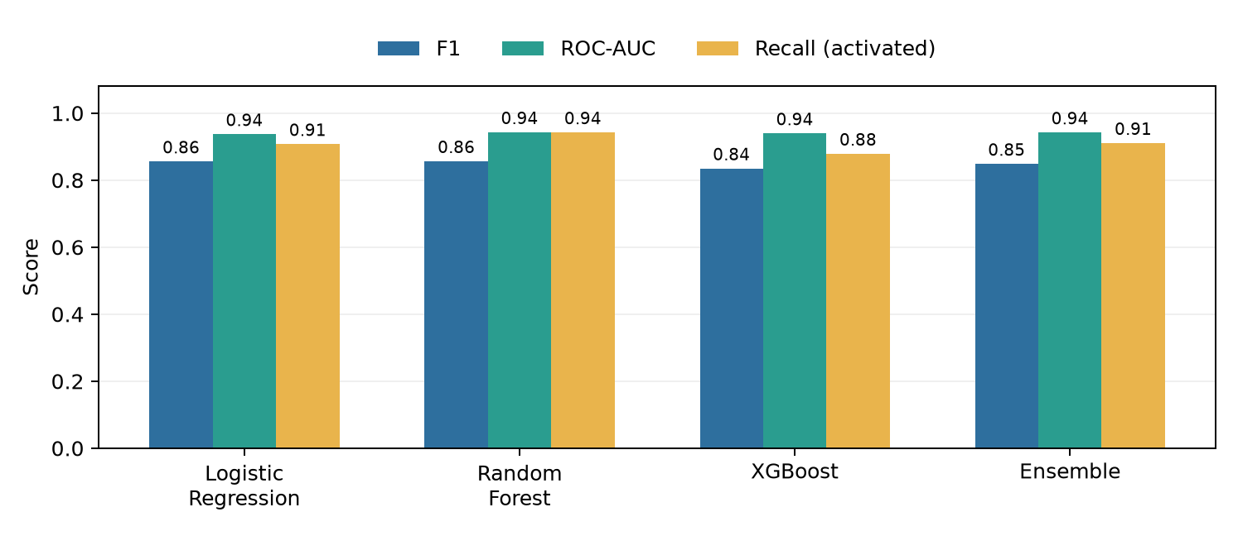
SS3: MODEL EVALUATION
On unseen accounts, no single model wins every objective
Test set: 736 accounts, 314 activated. Evaluate more than accuracy.
RANDOM FOREST
F1 0.857 AUC 0.943 Acc 0.865
LOGISTIC REGRESSION
F1 0.856 AUC 0.937 Acc 0.870
ENSEMBLE
F1 0.849 AUC 0.942 Acc 0.861
RF leads recall (0.943), F1 (0.857), AUC (0.943); LR leads accuracy (0.870) and precision (0.810). Choose by the cost of misses vs. unnecessary contact.
At 0.5 classification threshold; positive class = activated. Source: results/04_metrics_all_splits.csv. Brier lower is better.
CAP182 • SS3 PART C • STADIOEQUITIES
08 / 12
Notes:
Time: 6:20–7:30 (70 seconds)
“The unseen test set contains 736 accounts, including 314 activated accounts. At the 0.5 classification threshold, Random Forest gives the highest F1 at 0.857, recall of 0.943 and ROC AUC of 0.943. Logistic Regression has the highest accuracy, 0.870, and precision, 0.810, with F1 almost tied at 0.856. XGBoost’s test F1 is 0.835. This is not a universal winner story: the best choice depends on whether the business wants to reduce missed activations, avoid unnecessary outreach, or preserve interpretability. The chart shows why accuracy alone is insufficient. A decision-maker should choose the operating point with a clearly stated cost of false positives and false negatives, then validate that choice prospectively.”

Slide 9
CLIENT LENS: FROM SCORE TO SERVICE
A capacity-based shortlist can focus support—but it is not causal proof
Retrospective test scenario: contact the 30% with the lowest ensemble activation probabilities.
221
218 / 221
51.7%
98.6%
accounts selected
non-activators in list
of test non-activators reached
list precision for stalling
ENSEMBLE LABEL AT THRESHOLD 0.5 (ACTUAL × PREDICTED)
Actual | Predicted 0: not activated | Predicted 1: activated
Not activated | 348 | 74
Activated | 28 | 286
How to interpret
The low-score outreach ranking differs from the 0.5 class threshold. High list precision does not mean every stalling account is reached.
NEXT TEST: randomise eligible high-risk accounts to supportive outreach vs. business-as-usual.
Source: results/04_outreach_coverage_test.csv and 04_test_predictions.csv. Random-list baseline = 57.3% non-activation prevalence.
CAP182 • SS3 PART C • STADIOEQUITIES
09 / 12
Notes:
Time: 7:30–8:25 (55 seconds)
“To make the results practical, the analysis simulated selecting the 30 percent of test accounts with the lowest ensemble activation scores. That gave a list of 221 accounts; 218 were non-activators, so the retrospective list precision was 98.6 percent. The list covered 51.7 percent of all non-activators in the test set. This is a capacity scenario, not a campaign result. It does not show that contacting these people would change their behaviour; it only shows how the model ranked this held-out sample. The next step is to randomise eligible high-risk accounts between supportive outreach and business-as-usual. Then compare incremental 90-day activation and cost, while ensuring the intervention is helpful and appropriate.”

Slide 10
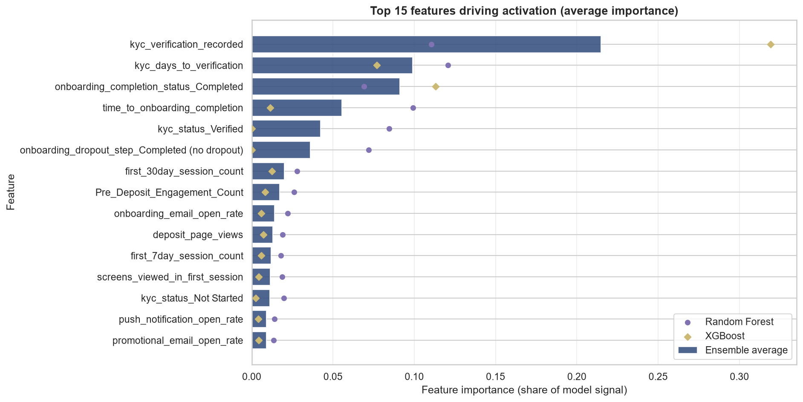
DATA SCIENCE LENS: EXPLAINABILITY
KYC progress and onboarding completion carry strong model signals
Importance answers “what helped prediction?”—not “what causes activation?”
KYC recorded
Largest ensemble-average importance (~0.215). Verify availability at scoring time.
KYC verification days
Second-ranked (~0.099). Could reflect process completion or a later snapshot.
Onboarding completion
Completion and elapsed time rank highly; investigate timing and actionability.
GO / NO-GO GATE: exclude any feature recorded after the prediction cut-off.
Source: results/03_feature_importance.csv and results/figures/07_feature_importance_top15.png. Importance is not causal attribution.
CAP182 • SS3 PART C • STADIOEQUITIES
10 / 12
Notes:
Time: 8:25–9:20 (55 seconds)
“The feature-importance chart highlights KYC status, KYC verification time and onboarding completion as strong predictive signals. Importance tells us what the fitted model used; it does not establish cause or customer intent. It also raises a timing question: was each KYC value genuinely available at the moment the business would score an account? If not, it must be removed. The model pipeline contains 169 encoded inputs, so the project has not yet demonstrated a simpler production model. Logistic Regression gives a useful lower-complexity benchmark. The next technical step is a controlled feature-ablation study: reduce inputs, then compare performance, calibration, stability and operational cost. Complexity should only be reduced when evidence shows the smaller model is still fit for purpose.”

Slide 11
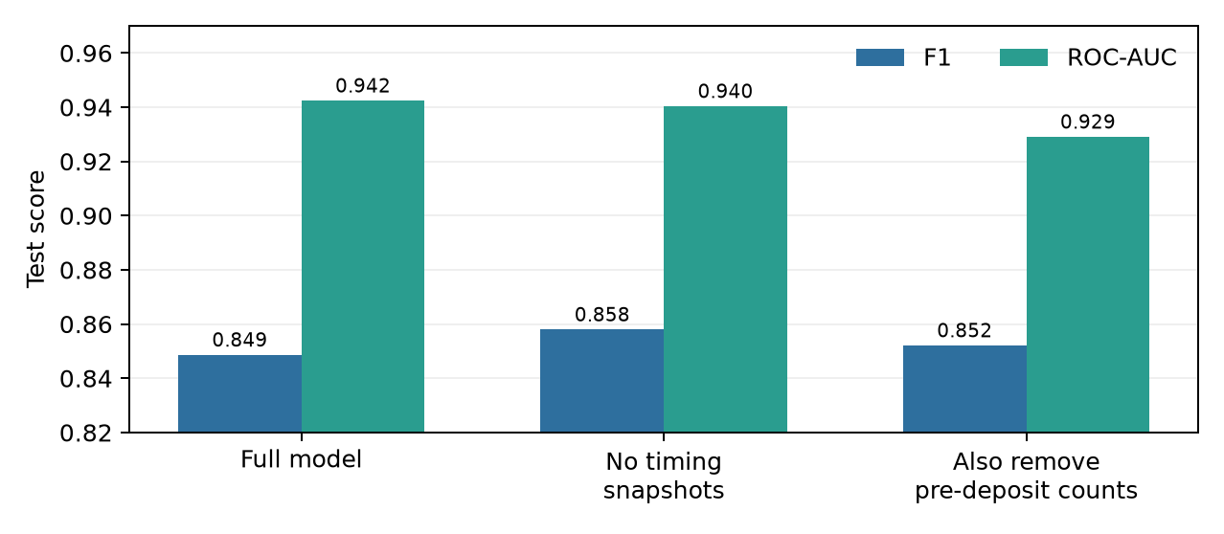
EVALUATION: STABILITY AND LIMITS
Promising results still need a time-aware test
Read the holdout, cross-validation, sensitivity and governance evidence together.
TRAINING CV • 5 FOLDS × 10 REPEATS
Logistic Regression
0.848
95% CI 0.844–0.853
Random Forest
0.852
95% CI 0.849–0.856
XGBoost
0.848
95% CI 0.844–0.852
RF mean F1 is higher by ~0.004; intervals overlap. t-tests and Mann–Whitney tests disagree.
Random split
Train/test gap
Snapshot sensitivity
No chronological holdout; drift remains untested.
Near-perfect tree training scores vs ~0.84–0.86 test F1 suggest overfit risk.
Similar scores do not rule out leakage; audit event timestamps.
Source: results/05_cv_confidence_intervals.csv, 05_paired_ttests.csv, 05_mann_whitney_cv.csv, 04_sensitivity_analysis.csv.
CAP182 • SS3 PART C • STADIOEQUITIES
11 / 12
Notes:
Time: 9:20–10:10 (50 seconds)
“Repeated stratified cross-validation used five folds and ten repeats. Mean F1 was about 0.852 for Random Forest, 0.848 for Logistic Regression, and 0.848 for XGBoost. Their confidence intervals overlap, so the small difference does not justify claiming a decisive model winner. The tree models also score extremely highly on training data, which warrants attention to overfitting. Most importantly, the split was random, not chronological. It cannot tell us how performance changes on newer customers or after product changes. A time-based holdout, event-time audit, and prospective monitoring of calibration, drift, missingness and precision at the available contact capacity are needed before operational use.”

Slide 12
RECOMMENDATION & CONCLUSION
Controlled learning—not automatic decisions
Conclusion: the model can rank risk; a pilot must show whether support changes outcomes.
01 Validate timing
Lock score moment; audit KYC, deposit and engagement timestamps.
02 Validate transport
Test later cohorts and permitted segments; monitor prevalence and calibration.
03 Pilot support
Randomise outreach vs. holdout; measure 90-day uplift and cost.
04 Govern
POPIA review, minimisation, access, fairness and human oversight.
05 Monitor
Drift, missingness and precision at capacity; set rollback/retraining triggers.
DECISION REQUEST: approve a privacy-reviewed, time-valid randomised pilot—not full automated deployment.
Client outcome: timely, relevant assistance. Technical outcome: prospective evidence, calibrated decisions and measured governance.
CAP182 • SS3 PART C • STADIOEQUITIES
12 / 12
Notes:
Time: 10:10–10:50 (40 seconds)
“My recommendation is a staged, privacy-reviewed pilot—not automated deployment. First confirm when each feature becomes available; then test on later cohorts; finally randomise supportive outreach and measure incremental activation, customer experience and cost. Keep human oversight, data minimisation and clear rollback criteria in place. The project’s contribution is an end-to-end, leakage-aware starting point that connects the business question to a testable account-ranking approach. It has not yet proven that a model-driven intervention increases deposits. The decision now is whether to fund that next experiment. Thank you.”
On camera: Return to your face for the final sentence and sign-off.

