Slide 1
CAP182 • CAPSTONE PROJECT • PART C
From registration
to first deposit
A data-science lifecycle story: SS1 problem framing → SS2 model selection → SS3 activation evidence
THE BUSINESS QUESTION
Who needs help completing the journey from sign-up to a funded account?
Bernette Mogwera Lesejane • 26303406 • STADIO PGDip Data Science
01 / 13

Slide 2
BUSINESS UNDERSTANDING
A sign-up is not yet an investor
SS1 frames the gap between acquisition and first funded activity.
The gap
The question
The decision
The SS1 brief describes 2.3 million registered accounts and a material drop between registration and funded investing. This is project context—not the modelling sample size.
Can registration, onboarding and early behaviour identify accounts that will make a first deposit within 90 days?
Use risk ranking to prioritise human support or helpful onboarding nudges—then test whether support changes outcomes.
SUCCESS IS NOT
SUCCESS SHOULD BE
More clicks or accuracy alone
More incremental first deposits at acceptable cost—with fair, compliant treatment
CLIENT LENS
Find the right account, at the right time, with helpful support—not a punitive label.
Source: README_SS1.md, Parts A-B. The 2.3m figure is stated in the brief; SS3 models a separate extract.
CAP182 • SS3 PART C • STADIOEQUITIES
02 / 13

Slide 3
LIFECYCLE MAP
Six stages; one decision-focused story
The workflow loops back when evidence raises a new question.
01
Business
02
Data
03
Prepare
Why is activation leaking? Define the 90-day outcome.
What exists, what is reliable, what arrives in time?
Create safe account-level predictors and splits.
04
Model
05
Evaluate
06
Act & learn
Compare LR, RF, XGBoost and an ensemble.
Test ranking, errors, stability and capacity.
Pilot intervention; monitor value, fairness and drift.
Retrospective ranking supports a controlled pilot; it is not proof that outreach causes deposits.
Lifecycle: business understanding → data understanding → preparation → modelling → evaluation → deployment / monitoring.
CAP182 • SS3 PART C • STADIOEQUITIES
03 / 13

Slide 4
SS1 GOVERNANCE: RAAIDD
The original plan anticipated risks that the extract makes concrete
RAAIDD = Risks, Actions, Assumptions, Issues, Decisions and Dependencies.
RISK • data coverage
RISK • time drift
RISK • privacy
SS1 assumption: ≥100K accounts and 12–18 months. SS3 extract: 4,906 unique accounts. Useful for development; not proof about the full 2.3m base.
SS1 flagged behaviour drift and recommended recent-cohort testing / quarterly review. SS3 uses a random split, not a chronological test.
SS1 flagged POPIA and pseudonymisation. Use approved data, restrict access, and do not publish account-level predictions or identifiers.
ASSUMPTIONS • ISSUES • DECISIONS
Assumption: planned ≥100K accounts / 12–18 months; delivered extract has 4,906.
Issues: account/time coverage, mixed date formats and point-in-time status of some features.
Decisions: 90-day activation target; split changed from planned 60/20/20 to 70/15/15; 52 requested fields became 169 encoded features.
ACTIONS + DEPENDENCIES: confirm the extract and event-time definitions; obtain compliance approval before time-safe modelling and a pilot; then validate on later cohorts.
Source: README_SS1.md, Part E RAAIDD / decisions; SS3 results/01_dataset_summary.csv and 02_split_summary.csv.
CAP182 • SS3 PART C • STADIOEQUITIES
04 / 13

Slide 5
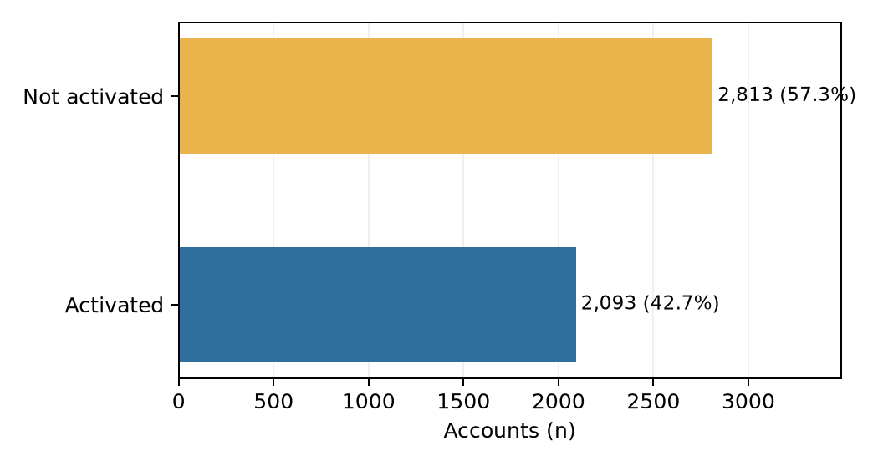
SS1 → SS3: DATA UNDERSTANDING
The data dictionary becomes an account-level evidence map
Twelve source tables describe funnel, behaviour, communication, compliance and technical context.
SELECTED DATA DOMAINS & EXAMPLES
Funnel / target
registration date, channel, onboarding status, activated
Early behaviour
first-session duration, screen views, early sessions
Contact / messaging
email opens, support, push / in-app response
Compliance / device
KYC status / timing, device, OS, browser, connection
Marketing
campaign exposures, clicks, spend and channels (aggregated)
Data quality: 14 duplicate rows removed; category spelling/case normalised; registration dates in four formats. Class 0: not activated (57.3%); Class 1: activated (42.7%).
9 TABLES USED
3 TABLES EXCLUDED
Support tickets • feedback • post-deposit activity
Source: SS1 data request / dictionary; SS3 results/01_table_relevance.csv, 01_dataset_summary.csv, 01_date_formats.csv.
CAP182 • SS3 PART C • STADIOEQUITIES
05 / 13

Slide 6
SS2: EVIDENCE AND MODEL SELECTION
Literature guides choices; the benchmark identifies a candidate
UCI Bank Marketing: 45,211 records with about 11% positive; F1 was more informative than accuracy alone.
SS2 model | Accuracy | F1 (yes) | Precision | Recall
Logistic Regression | 0.755 | 0.373 | 0.27 | 0.62
Random Forest | 0.893 | 0.318 | 0.63 | 0.21
XGBoost | 0.838 | 0.459 | 0.38 | 0.59
Weterings et al. (2019)
Activation study: XGBoost is a strong baseline; define the time cut-off and prevent future-event leakage.
Moro, Cortez & Rita (2014)
Bank-campaign evidence: later-period performance may fall; time-based testing and lift matter.
SS2 chose XGBoost: test F1 0.459; CV mean F1 0.446 vs LR 0.373 and RF 0.314.
Isen et al. (2026), as reviewed
Integrate touchpoints and evaluate conversion / retention outcomes, not clicks alone.
SS2 and SS3 are different datasets and positive-class definitions: do not compare their F1 values as if they were the same test.
Literature summarized in SS2 Part A: Weterings et al. (2019); Moro et al. (2014); Isen et al. (2026). SS2 results: READMEPartB&C.md.
CAP182 • SS3 PART C • STADIOEQUITIES
06 / 13

Slide 7
SS3: METHOD AND CODE
The SS2 toolkit is applied to account activation
Key safeguard: fit transformations and resampling on training data only.
1 Source
2 Split
3 Prepare
4 Balance
5 Compare
6 Evaluate
12 tables
account-level join
70 / 15 / 15
stratified IDs
train-fit impute
scale + one-hot
SMOTE k=5
train only
LR • RF • XGB
average probabilities
validation +
unseen test
Code choices
Models
Median numeric imputation + scaling; categorical imputation + one-hot; outlier caps learned on train; deposit-derived leakage removed.
LR = interpretable baseline; RF = bagged trees; XGBoost = boosted trees; ensemble = averaged probabilities. Seed = 42.
Validation and test retain natural prevalence. Applying SMOTE before splitting would leak neighbour information.
Source: SS3 notebook sections 02 Data preparation and 03 Model training; results/02_split_summary.csv.
CAP182 • SS3 PART C • STADIOEQUITIES
07 / 13

Slide 8
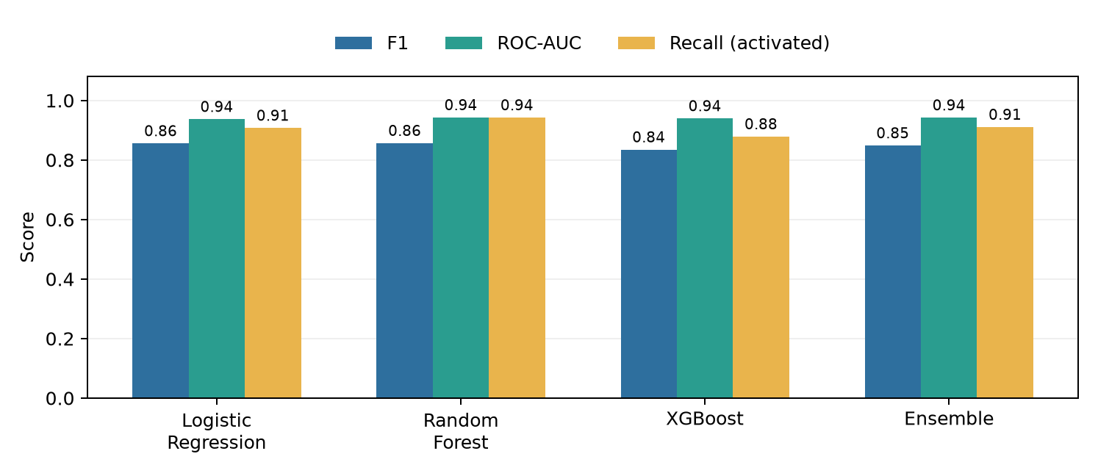
SS3: MODEL EVALUATION
On unseen accounts, no single model wins every objective
Test set: 736 accounts, 314 activated. Evaluate more than accuracy.
RANDOM FOREST
F1 0.857 AUC 0.943 Acc 0.865
LOGISTIC REGRESSION
F1 0.856 AUC 0.937 Acc 0.870
ENSEMBLE
F1 0.849 AUC 0.942 Acc 0.861
RF leads recall (0.943), F1 (0.857), AUC (0.943); LR leads accuracy (0.870) and precision (0.810). Choose by the cost of misses vs. unnecessary contact.
At 0.5 classification threshold; positive class = activated. Source: results/04_metrics_all_splits.csv. Brier lower is better.
CAP182 • SS3 PART C • STADIOEQUITIES
08 / 13

Slide 9
CLIENT LENS: FROM SCORE TO SERVICE
A capacity-based shortlist can focus support—but it is not causal proof
Retrospective test scenario: contact the 30% with the lowest ensemble activation probabilities.
221
218 / 221
51.7%
98.6%
accounts selected
non-activators in list
of test non-activators reached
list precision for stalling
ENSEMBLE LABEL AT THRESHOLD 0.5 (ACTUAL × PREDICTED)
Actual | Predicted 0: not activated | Predicted 1: activated
Not activated | 348 | 74
Activated | 28 | 286
How to interpret
The low-score outreach ranking differs from the 0.5 class threshold. High list precision does not mean every stalling account is reached.
NEXT TEST: randomise eligible high-risk accounts to supportive outreach vs. business-as-usual.
Source: results/04_outreach_coverage_test.csv and 04_test_predictions.csv. Random-list baseline = 57.3% non-activation prevalence.
CAP182 • SS3 PART C • STADIOEQUITIES
09 / 13

Slide 10
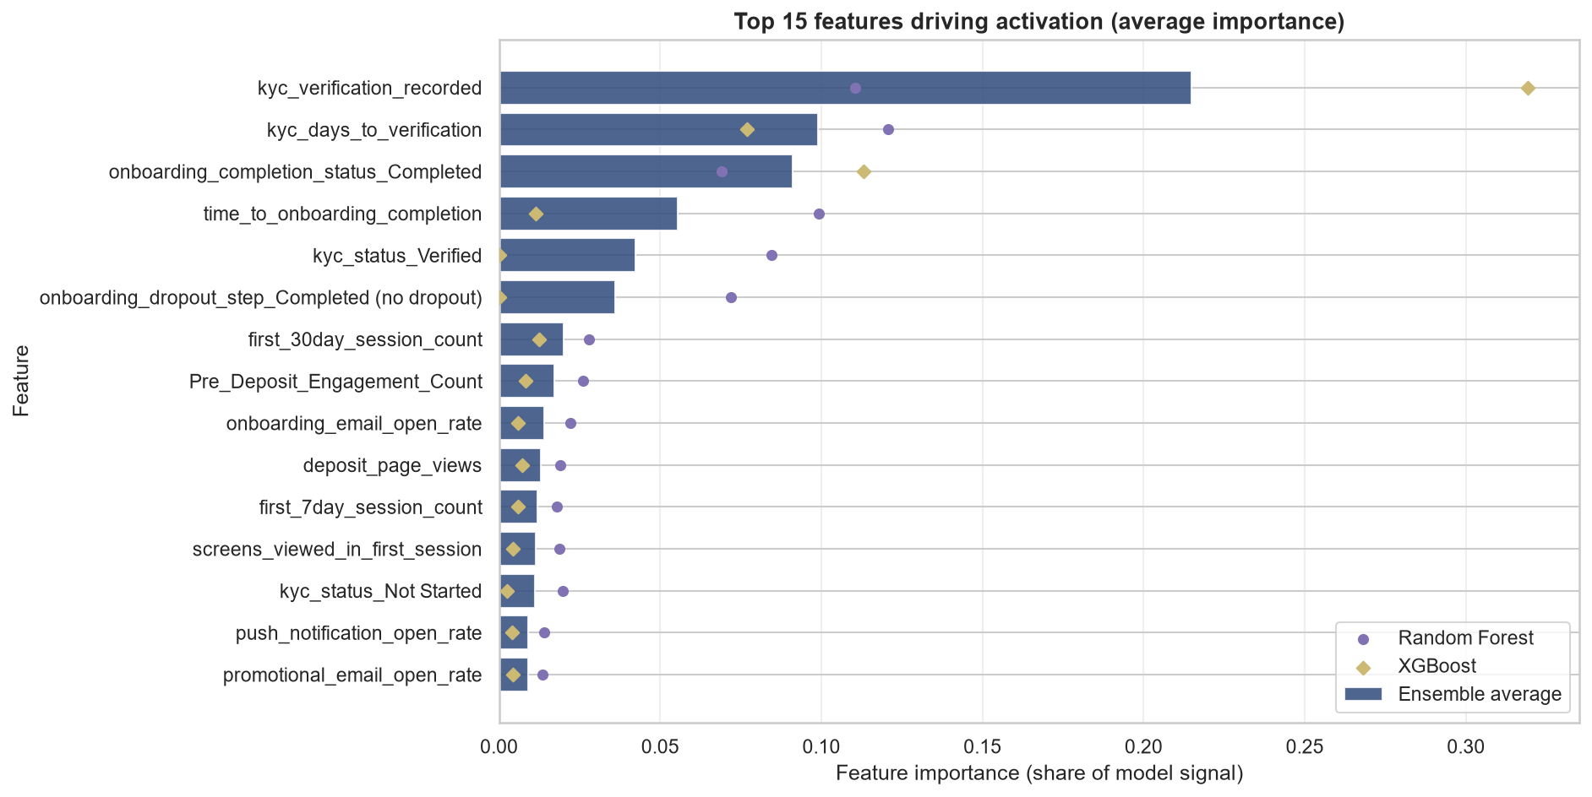
DATA SCIENCE LENS: EXPLAINABILITY
KYC progress and onboarding completion carry strong model signals
Importance answers “what helped prediction?”—not “what causes activation?”
KYC recorded
Largest ensemble-average importance (~0.215). Verify availability at scoring time.
KYC verification days
Second-ranked (~0.099). Could reflect process completion or a later snapshot.
Onboarding completion
Completion and elapsed time rank highly; investigate timing and actionability.
GO / NO-GO GATE: exclude any feature recorded after the prediction cut-off.
Source: results/03_feature_importance.csv and results/figures/07_feature_importance_top15.png. Importance is not causal attribution.
CAP182 • SS3 PART C • STADIOEQUITIES
10 / 13

Slide 11
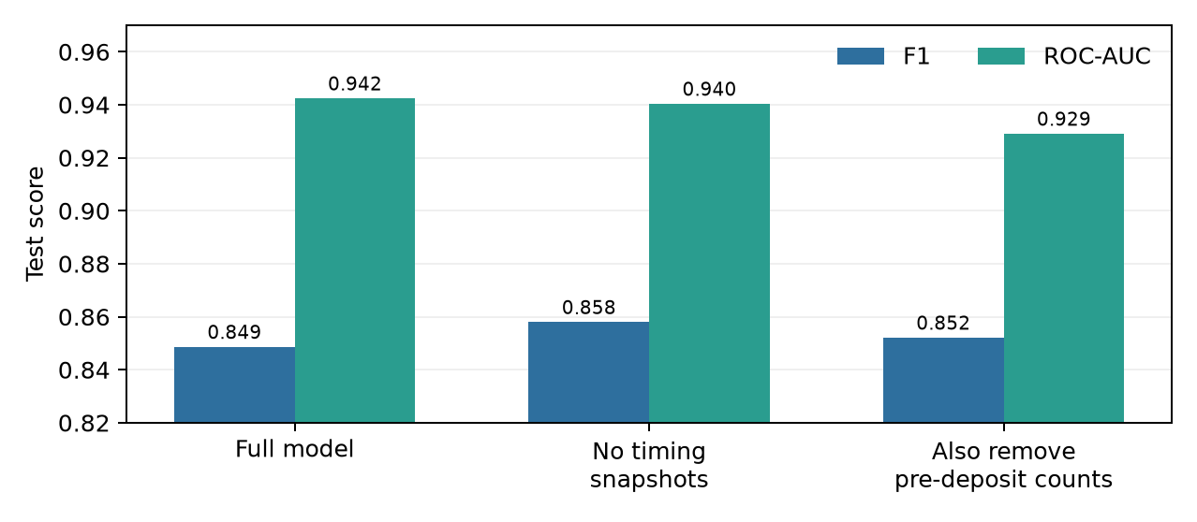
EVALUATION: STABILITY AND LIMITS
Promising results still need a time-aware test
Read the holdout, cross-validation, sensitivity and governance evidence together.
TRAINING CV • 5 FOLDS × 10 REPEATS
Logistic Regression
0.848
95% CI 0.844–0.853
Random Forest
0.852
95% CI 0.849–0.856
XGBoost
0.848
95% CI 0.844–0.852
RF mean F1 is higher by ~0.004; intervals overlap. t-tests and Mann–Whitney tests disagree.
Random split
Train/test gap
Snapshot sensitivity
No chronological holdout; drift remains untested.
Near-perfect tree training scores vs ~0.84–0.86 test F1 suggest overfit risk.
Similar scores do not rule out leakage; audit event timestamps.
Source: results/05_cv_confidence_intervals.csv, 05_paired_ttests.csv, 05_mann_whitney_cv.csv, 04_sensitivity_analysis.csv.
CAP182 • SS3 PART C • STADIOEQUITIES
11 / 13

Slide 12
RECOMMENDATION
Controlled learning—not automatic decisions
The next question is which helpful action changes the outcome.
01 Validate timing
Lock score moment; audit KYC, deposit and engagement timestamps.
02 Validate transport
Test later cohorts and permitted segments; monitor prevalence and calibration.
03 Pilot support
Randomise outreach vs. holdout; measure 90-day uplift and cost.
04 Govern
POPIA review, minimisation, access, fairness and human oversight.
05 Monitor
Drift, missingness and precision at capacity; set rollback/retraining triggers.
DECISION REQUEST: approve a privacy-reviewed, time-valid randomised pilot—not full automated deployment.
Client outcome: timely, relevant assistance. Technical outcome: prospective evidence, calibrated decisions and measured governance.
CAP182 • SS3 PART C • STADIOEQUITIES
12 / 13

Slide 13
REFERENCES & PROVENANCE
From prediction to responsible impact
Evidence base and the central takeaway.
We can rank activation risk—now we must prove how to reduce it.
Weterings, K., Bromuri, S. & van Eekelen, M. (2019).
Explaining customer activation with deep attention models. ECIS 2019, Research Paper 151. aisel.aisnet.org/ecis2019_rp/151/
Moro, S., Cortez, P. & Rita, P. (2014).
A data-driven approach to predict the success of bank telemarketing. Decision Support Systems, 62, 22–31. doi:10.1016/j.dss.2014.03.001
Isen, B. et al. (2026), as reviewed in SS2.
The impact of customer analytics on sales funnel conversion and customer retention. Asian Journal of Economics, Business and Accounting, 26(1), 207–224.
UCI Bank Marketing dataset.
Moro, Cortez & Rita (2014). UCI Machine Learning Repository. doi:10.24432/C5K306.
Project artefacts.
README_SS1.md; SS2 resubmission literature review / README; SS3_PartB.ipynb; results/*.csv; results/figures/*.png.
Aggregate evidence only. Do not distribute client-level data or predictions without authorisation.
CAP182 • SS3 PART C • STADIOEQUITIES
13 / 13

