Slide 1
CAP182 | CAPSTONE PROJECT
From customer
activation challenge
to evidence-led action
STADIOEquities account activation prediction
SS1 Problem framing | SS2 Prototype | SS3 Client-data validation
Bernette Mogwera Lesejane | PGDip Data Science
Video presentation - 10 to 12 minutes
01

Slide 2
ROADMAP
A four-part story
From the client need to a responsible path forward
01
Problem statement
02
Solution performance
Why activation matters and what SS1 set out to solve.
What SS2 taught us and what SS3 test results show.
03
Modeling approach
04
Next steps
Client data, leakage controls, models, and validation.
How to validate and pilot the approach with the client.
Presentation structure follows the sample: Problem | Performance | Modeling | Next steps
02

Slide 3
01 | PROBLEM STATEMENT
Registration is not activation
The business question is whether an account makes its first deposit within 90 days.
BUSINESS CHALLENGE
42.7%
Activated in client extract
How can STADIOEquities identify new accounts that may stall before funding?
2,093 of 4,906 unique accounts
57.3%
Not activated in 90 days
2,813 accounts in this modelling dataset
SS1 defined the activation problem and requested 12 linked data tables to describe onboarding, engagement, marketing, compliance, and customer context.
Opportunity
Prioritise timely, relevant support.
Source: SS1 project brief; SS3 results/01_class_balance.csv
03

Slide 4
01 | PROBLEM STATEMENT
Three submissions, one evolving project
Each stage added a new piece: define the problem, test methods, then improve validity.
SS1
SS2
SS3
Frame
Prototype
Validate
Define account activation as the business problem. Specify the 12 data sources needed to understand the funnel.
>
Build a customer-level workflow with cleaning, RFM features, Random Forest, XGBoost, and an ensemble.
>
Use the client activation label, screen for leakage, split by account, and evaluate on unseen accounts.
BUSINESS QUESTION + DATA REQUEST
INITIAL MODELLING EXPERIENCE
DECISION-READY EVIDENCE BASE
The central lesson: a high score is only useful when the target and evaluation represent the real decision.
Sources: README_SS1.md | SS2 notebooks/evaluation | SS3_PartB.ipynb
04

Slide 5
02 | SOLUTION PERFORMANCE
Why the SS3 evaluation is more credible
SS2 generated a useful prototype, and exposed why label construction must be scrutinised.
SS2 | EXPLORATORY RETAIL PROTOTYPE
SS3 | CLIENT-LABELLED ACTIVATION
100%
0.942
reported accuracy
ensemble ROC-AUC on unseen test accounts
The activation label was defined from recency and purchase frequency; those variables were also predictors. This creates target leakage, so perfect reported metrics do not establish real-world predictive performance.
Uses the client's 90-day activation field, removes outcome-derived predictors, fits preprocessing on training data, and reports a separate unseen test set.
Interpret as a prototype result, not a deployment benchmark.
A realistic benchmark, with remaining limits to validate.
The target and dataset changed between SS2 and SS3; the metrics are not a like-for-like model comparison.
Sources: SS2 preprocessing / feature engineering and Part C metrics | SS3 results/04_metrics_all_splits.csv
05

Slide 6
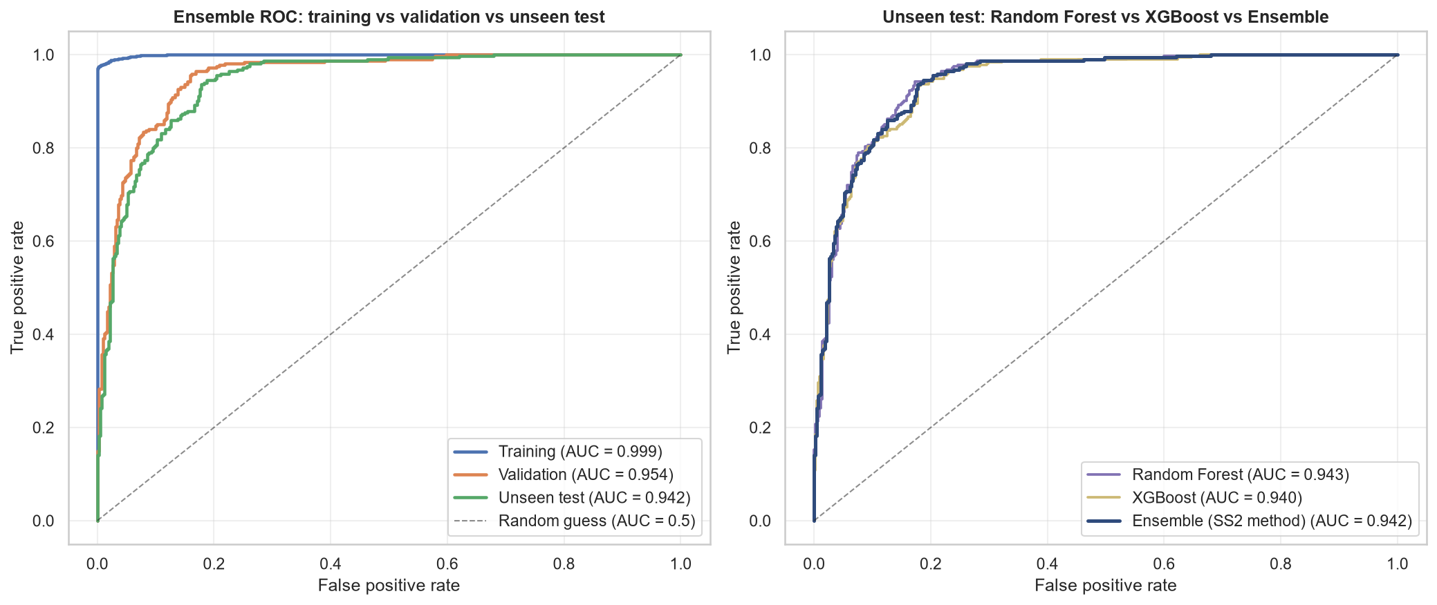
02 | SOLUTION PERFORMANCE
SS3 test performance: strong ranking, not perfection
Held-out ROC-AUC is similar across the three models; the choice depends on business error costs.
0.942
Ensemble ROC-AUC
RF 0.943 | XGBoost 0.940
91.1%
Ensemble recall
Activated class at threshold 0.5
79.4%
Ensemble precision
F1 0.849 | PR-AUC 0.915
Training scores are higher: monitor overfitting and drift.
Test set: 736 unseen accounts
Source: SS3 results/04_metrics_all_splits.csv and results/figures/02_roc_curves.png
06

Slide 7
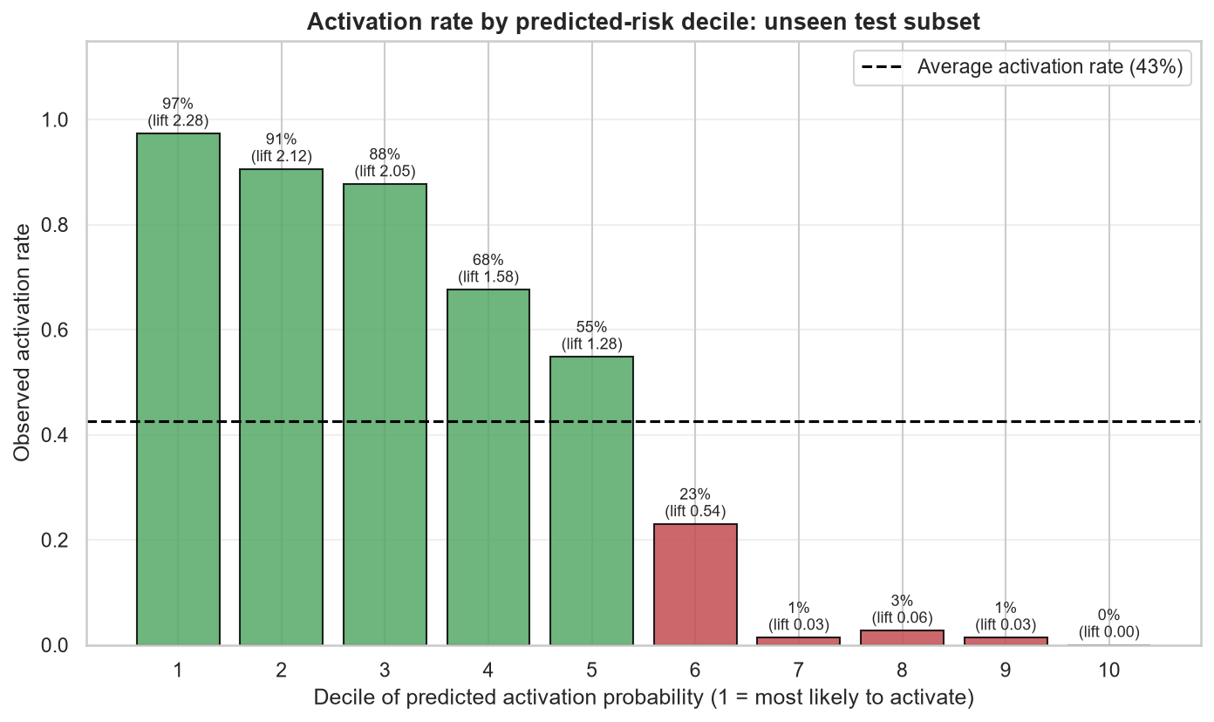
02 | SOLUTION PERFORMANCE
A risk ranking can focus limited outreach
Accounts with lower predicted activation probability are ranked as higher risk of not activating.
221
Test accounts selected
Lowest 30% by activation score
218
Were non-activators
98.6% precision in selected group
51.7%
Test non-activators reached
218 of 422 non-activators
Retrospective ranking simulation - not measured campaign lift.
Sources: SS3 results/04_outreach_coverage_test.csv and results/figures/08_decile_lift_test.png
07

Slide 8
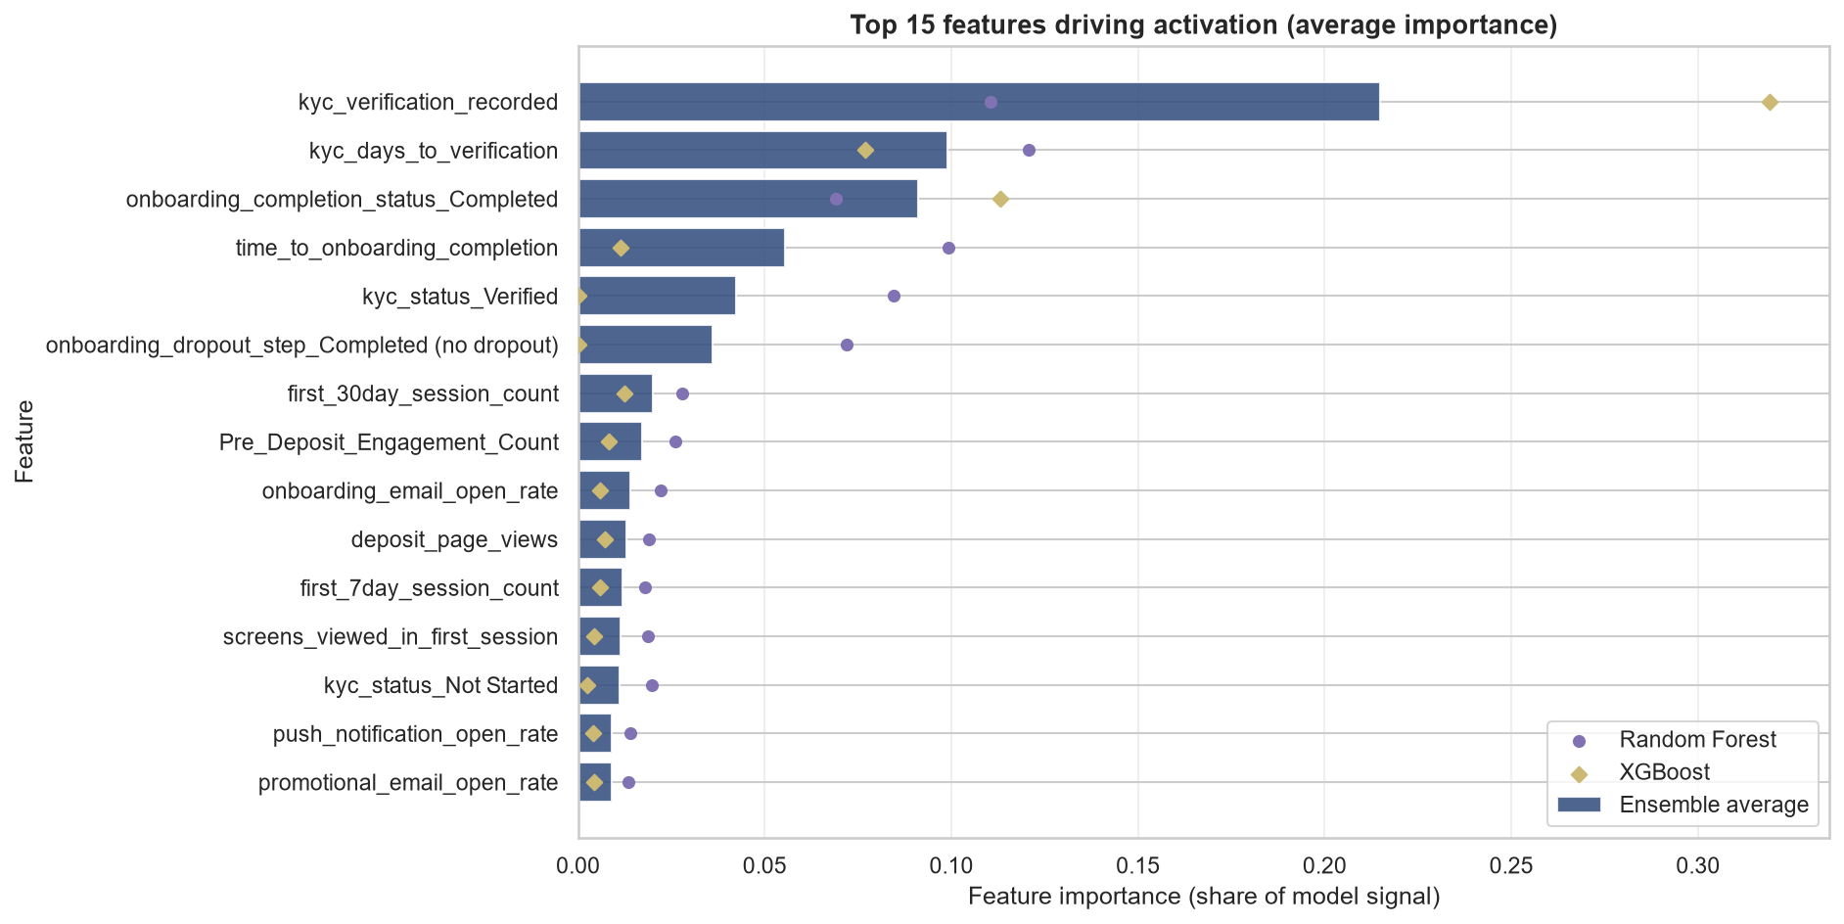
03 | MODELING APPROACH
A leakage-aware pipeline, from tables to scores
The process is reproducible and keeps model fitting separate from final testing.
12 tables -> 9 used
>
4,906
>
70 / 15 / 15
>
Train only
>
RF + XGB
>
Test once
review tables
unique accounts
train / validation / test
fit preprocessing + SMOTE
average probabilities
metrics + outreach ranking
Key safeguards
- Remove label and post-outcome leakage
- Fit imputation, scaling, encoding, and caps on training only
- Apply SMOTE to training only
- Exclude gender from modelling; inspect timing-sensitive KYC fields
Source: SS3_PartB.ipynb; results/03_feature_importance.csv; results/02_split_summary.csv
08

Slide 9
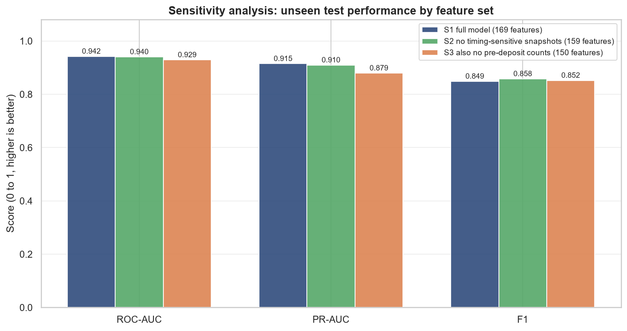
03 | MODELING APPROACH
Robustness is encouraging; readiness is not yet proven
Removing uncertain-timing fields reduces risk; temporal and operational checks remain.
0.942
Full feature set
ROC-AUC | 169 features
0.940
No timing snapshots
ROC-AUC | 159 features
0.929
Also remove pre-deposit counts
ROC-AUC | 150 features
Still verify point-in-time data, calibration, subgroup fairness, privacy, and performance drift.
Source: SS3 results/04_sensitivity_analysis.csv and results/figures/11_sensitivity_analysis.png
09

Slide 10
04 | NEXT STEPS
Pilot carefully before production
Recommendation: test a human-guided, risk-ranked onboarding intervention, not an automated decision.
1
Validate
Test on a newer time-based cohort; confirm features existed at decision time.
The takeaway
2
Define policy
Set outreach capacity, eligibility, success metric, and cost per contact.
SS1 framed the need.
SS2 built the prototype.
SS3 produced the more credible test.
Next: validate in time, then learn through a controlled pilot.
3
Run controlled pilot
Compare targeted support with a suitable control group; measure incremental deposits.
4
Monitor responsibly
Track calibration, ranking, subgroup outcomes, drift, access, and retraining triggers.
Thank you | Questions
Sources: SS1 project brief | SS2 recommendation and notebooks | SS3 notebook and results | sample presentation structure
10

