Slide 1
PROJECT PART B
L&T EDUTECH • ELECTRONICS PROJECT
JFET Output
Characteristics
Simulation, observation & analysis
Voltage-controlled current source | High input impedance
Prepared by: Harsh, Yashank , Aryan, Navya TEAM no. 56

Slide 2
Project objectives
What this experiment demonstrates
01 Output curves
02 Current control
03 Input impedance
Plot drain current ID against drain-source voltage VDS for several fixed gate-source voltages VGS.
Show that VGS controls the channel current, while ID becomes nearly constant in the saturation region.
Explain why the reverse-biased gate-channel PN junction draws extremely little current.
Expected result: a family of ID–VDS curves with lower ID for more-negative VGS.
2

Slide 3
JFET: operating principle
Junction Field-Effect Transistor
• A JFET is a three-terminal, majority-carrier device: Gate (G), Drain (D), and Source (S).
• For an n-channel JFET, the gate-channel PN junction is normally reverse-biased.
• Changing VGS changes the depletion-region width and narrows or widens the conducting channel.
• The drain-source voltage drives current through the channel; VGS controls how much current can flow.
3

Slide 4
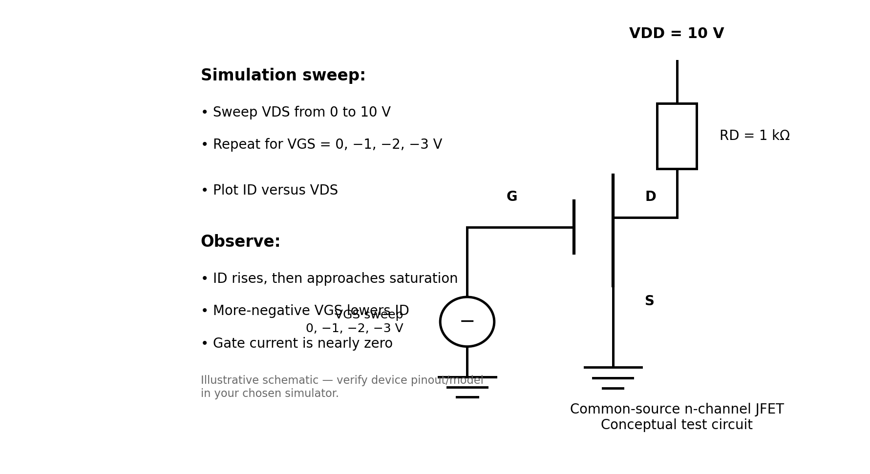
Simulation circuit & setup
Conceptual KiCad/LTspice-style test schematic
Simulation plan
• Device: n-channel JFET
• Sweep VDS: 0–10 V
• Step VGS: 0, −1, −2, −3 V
• Plot ID versus VDS
• Record gate current IG
Note: schematic is an illustrative circuit image, not a screenshot or a live simulator result.
4

Slide 5
Simulation procedure
How to reproduce the experiment in KiCad / ngspice or another SPICE simulator
• Select an n-channel JFET model and verify its pin order (G, D, S) from the model/library.
• Build a common-source circuit; connect the source to ground and bias the gate at 0, −1, −2, and −3 V.
• Run a DC sweep of VDS from 0 V to 10 V for each fixed VGS value.
• Plot ID against VDS; use the same axes for all gate-bias curves.
• Measure IG or observe the gate current separately to confirm it is very small.
5

Slide 6
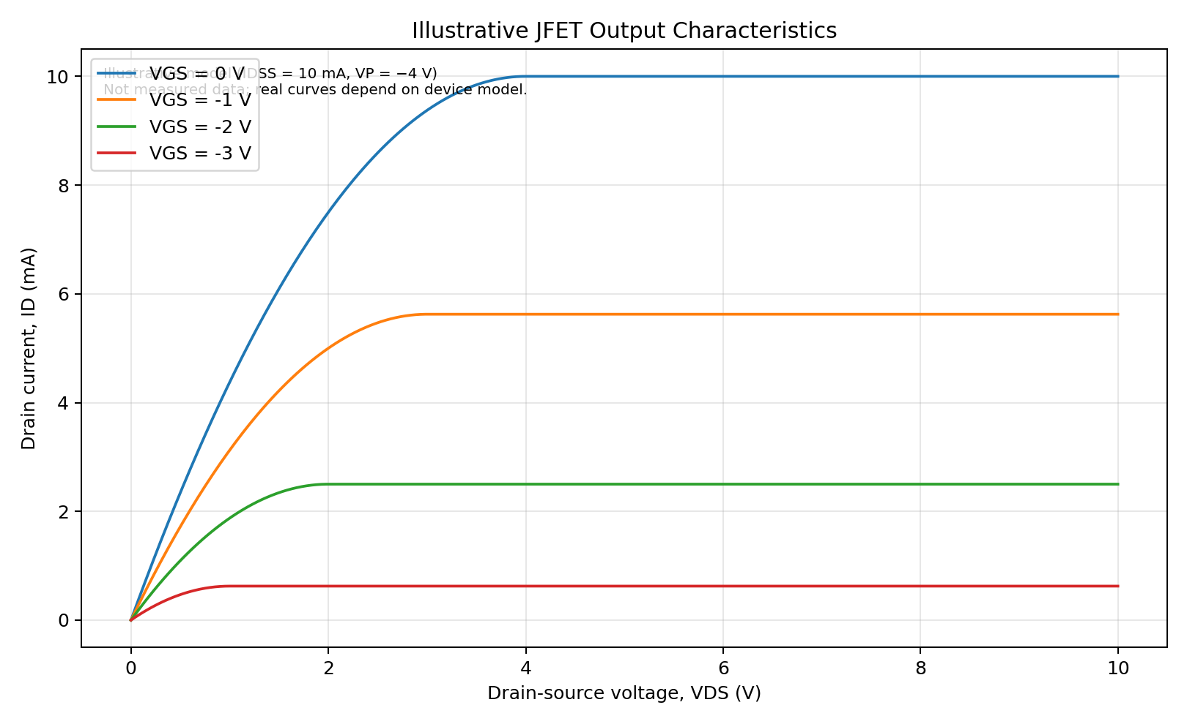
Output characteristics: ID versus VDS
Illustrative model curves — replace with simulator-exported data for final measured results
What to observe
• ID rises at low VDS.
• Curves flatten as the channel enters saturation.
• More-negative VGS reduces ID.
• Near cutoff, ID approaches zero.
6

Slide 7
Inference 1: voltage-controlled current source
Why the JFET behaves like a current source in saturation
Control variable: VGS
Output variable: ID
A more-negative gate voltage widens the depletion regions and reduces channel conductance. Therefore, the drain current is set mainly by VGS.
In the saturation region, increasing VDS causes only a small change in ID. The device approximates a voltage-controlled current source over this region.
Important: a JFET is not an ideal current source; ID still varies somewhat with VDS and temperature.
7

Slide 8
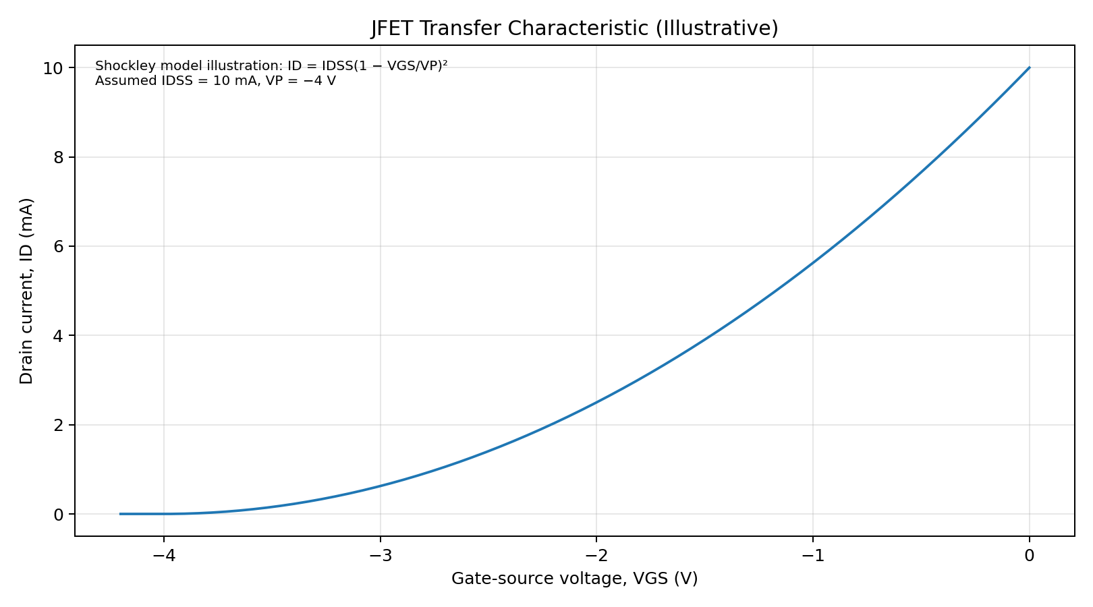
Transfer characteristic & model
Shockley equation for an n-channel JFET
Shockley relation
ID = IDSS (1 − VGS / VP)²
IDSS: drain current at VGS = 0
VP: pinch-off/cutoff voltage (negative for n-channel)
As VGS approaches VP, ID approaches zero.
8

Slide 9
Inference 2: high input impedance
Why the gate draws very little current
• The gate-channel PN junction is reverse-biased during normal operation.
• A reverse-biased PN junction conducts only a tiny leakage current, so gate current IG is approximately zero.
• Input resistance Rin ≈ |VGS / IG| is therefore very large (often in the megaohm range or higher; device and circuit dependent).
• Because the input draws little current, the JFET can sense a signal without heavily loading the previous stage.
9

Slide 10
Observation table & analysis
Qualitative expected observations; enter simulator readings in your final report
VGS (V) | ID at low VDS | ID in saturation | Inference
0 | Rises with VDS | Highest curve | Channel least depleted
−1 | Rises with VDS | Lower than VGS = 0 | Gate bias reduces current
−2 | Rises with VDS | Lower again | Narrower conducting channel
−3 | Rises with VDS | Near cutoff (model dependent) | Strong channel restriction
Use the exact device model and simulator measurements to complete a quantitative results table.
10

Slide 11
Applications & practical limitations
Applications
Limitations
Good practice
• High-impedance amplifiers
• Sensor front ends
• Analog switching
• Low-noise input stages
• Device parameters vary
• Leakage rises with temperature
• Saturation is not perfectly flat
• Maximum ratings must be respected
• Use a real model
• Check pinout
• Record units and axes
• Label simulated vs measured data
11

Slide 12
Conclusion
• The output curves show a rising ohmic region followed by an approximately constant-current saturation region.
• The gate-source voltage controls the drain current, supporting the voltage-controlled-current-source interpretation.
• The reverse-biased gate junction has very small current, giving the JFET a high input impedance.
• The simulation should be repeated with the chosen JFET's actual SPICE model before claiming measured numerical results.
Thank you • Questions?

