Slide 1
CMPE 273 · Final Project · Spring 2026
EraseGraph
Frontend Dashboard
Backend Orchestrator
RabbitMQ Event Bus
Verifiable deletion propagation across distributed systems — observable, traceable, and cryptographically auditable.
5 Cleanup Workers
Proof & Audit Chain
Haoyuan Shan
Vritika Malhotra
Sakshat Patil
Asim Mohammed
GDPR / CCPA compliant · Event-driven · 10+ microservices · Kubernetes-ready

Slide 2
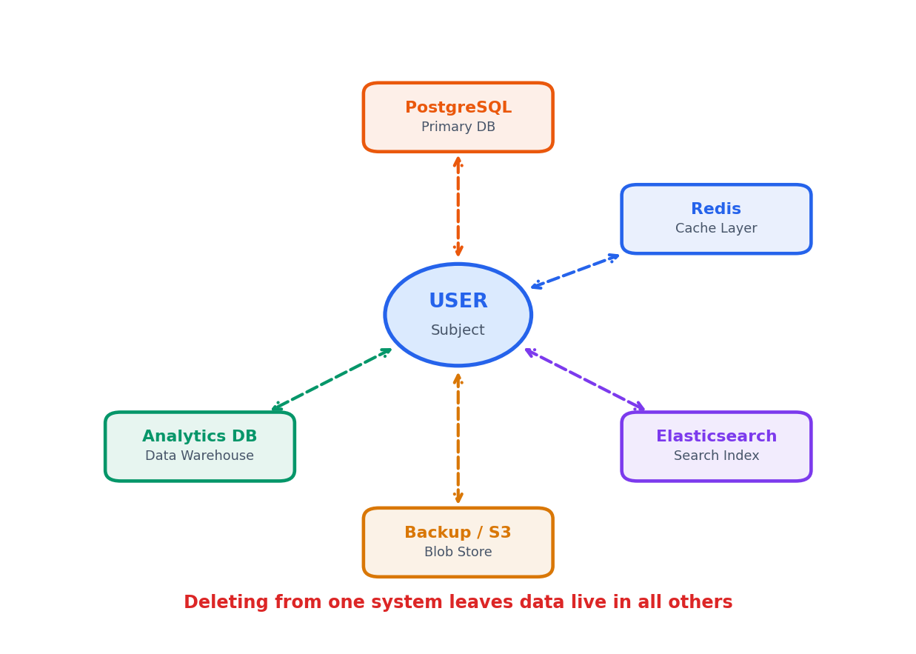
The Deletion Problem
User data lives in multiple systems simultaneously — removing it from one leaves stale copies everywhere else.
Fragmented data stores
▸ Primary DB, cache, search, analytics, and backup each hold a copy.
Single-system deletes are not enough
▸ Removing from Postgres leaves Redis, Elasticsearch, S3, analytics untouched.
Compliance demands proof
▸ GDPR Art.17 & CCPA require auditable evidence of propagated deletion.
No visibility into partial failures
▸ Without tracing, a partial failure is silent — some services succeed, others fail.

Slide 3
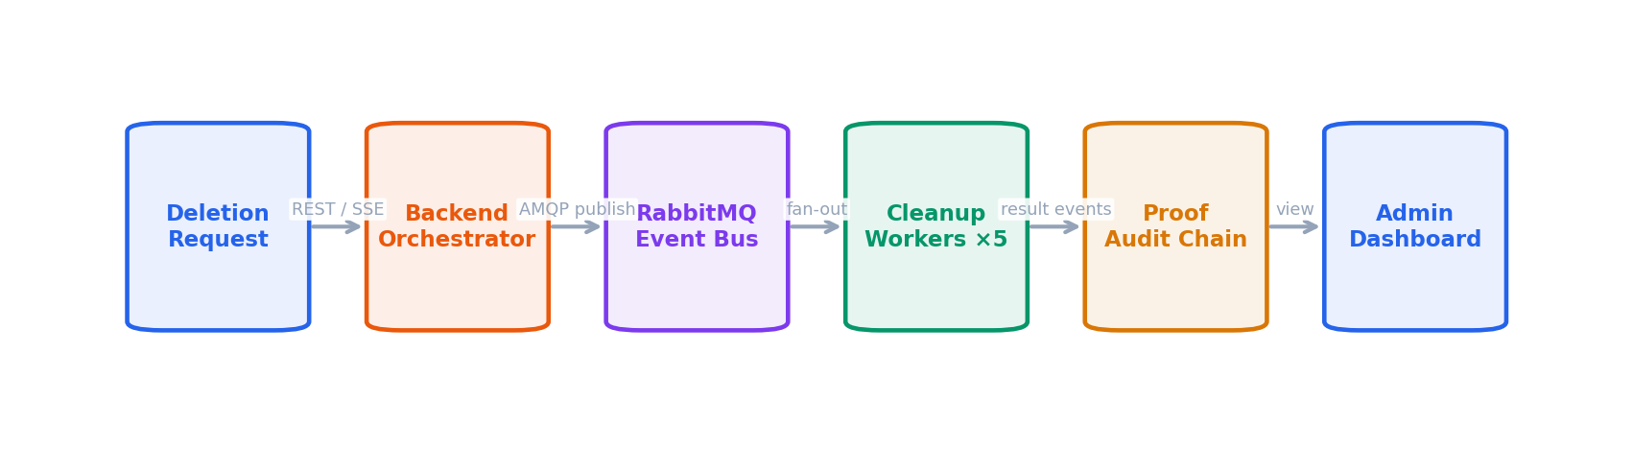
Our Solution: Event-Driven Orchestration
One request triggers coordinated, parallel deletion across every data store — with a cryptographic audit trail.
Orchestrated Cleanup
Resilient by Default
Cryptographic Audit Trail
▸ One API request → 5 systems cleaned in parallel
▸ Retry queues + dead-letter exchange (DLQ)
▸ Every event SHA-256 hash-chained
▸ Event-driven workers — independently deployable
▸ Circuit breakers prevent cascade failures
▸ Tamper-evident — modify any record, chain breaks
▸ Backend aggregates results into a final status
▸ Idempotency guards prevent double-processing
▸ Exportable JSON proof + one-click verification

Slide 4
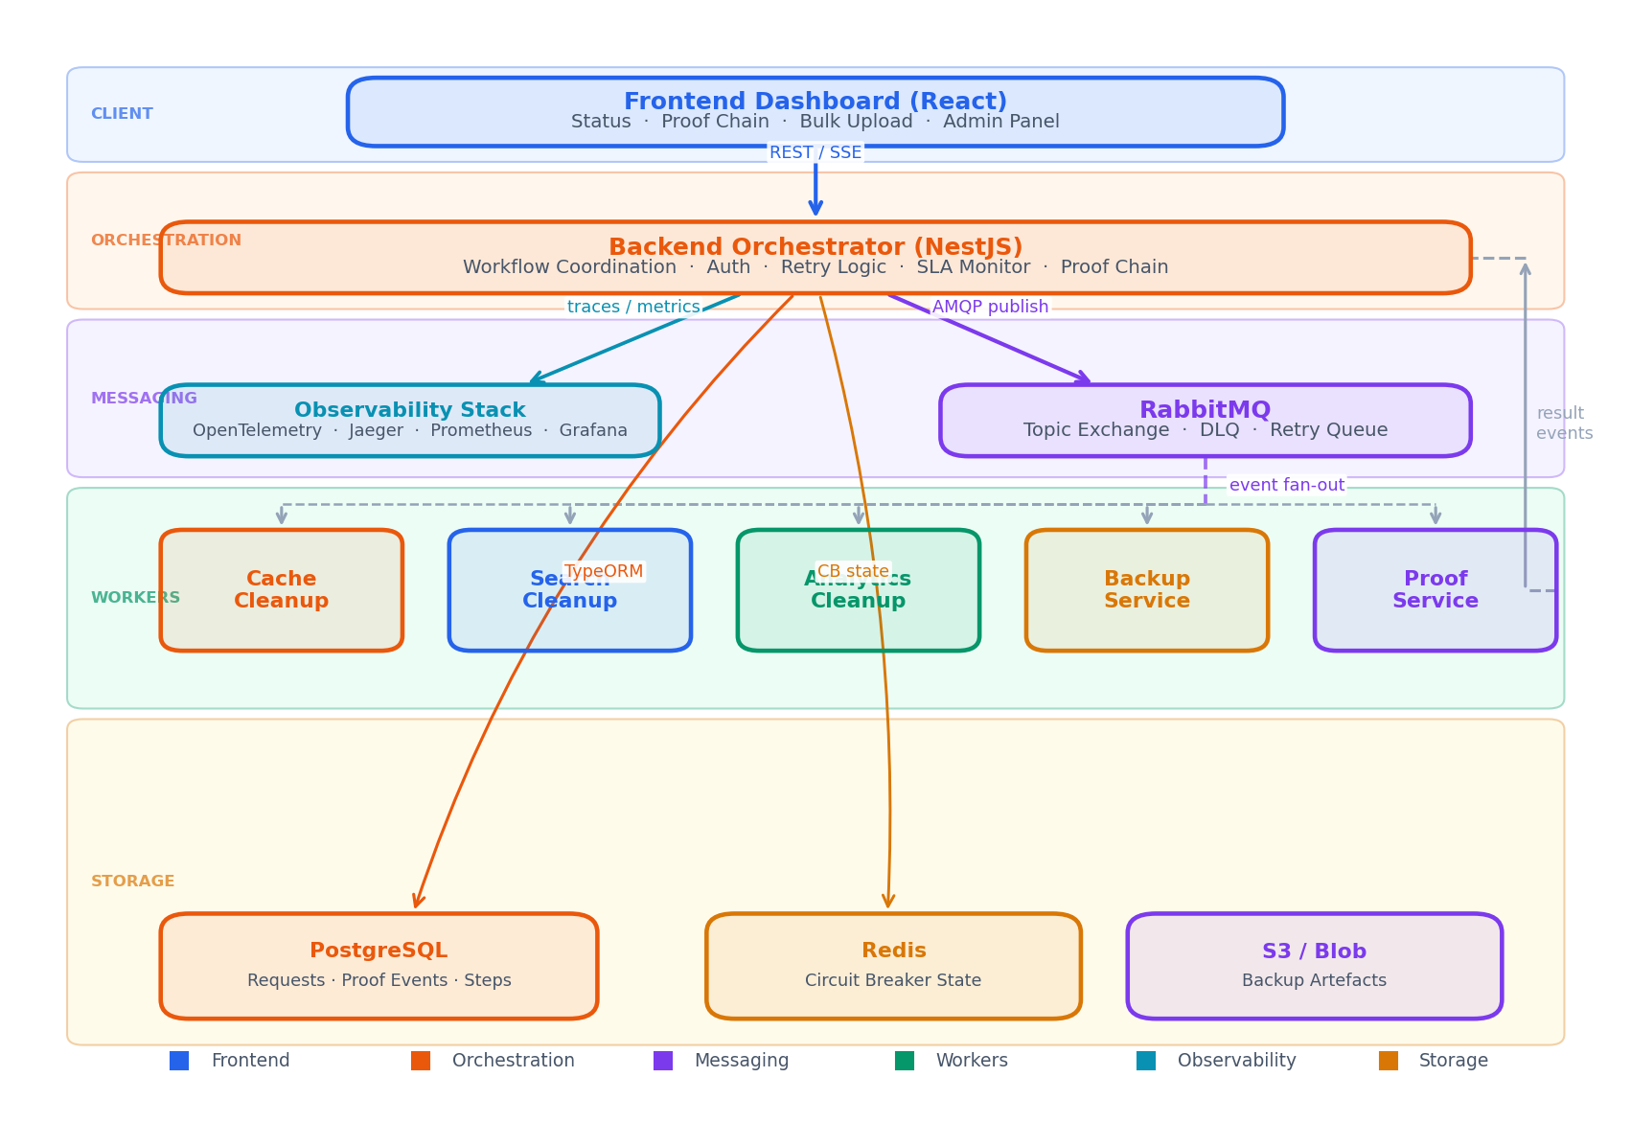
System Architecture
Frontend · Backend · RabbitMQ · 5 Cleanup Workers · Proof Service · PostgreSQL · Redis · S3

Slide 5
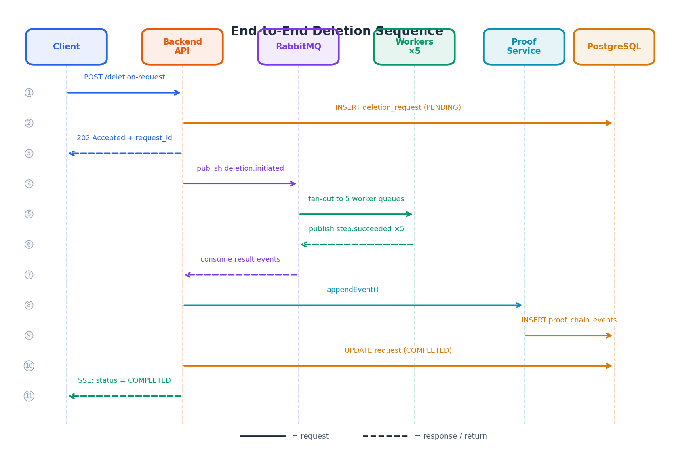
Request Sequence — Step by Step
How a single deletion request flows through every service layer — from REST call to SSE completion event.

Slide 6
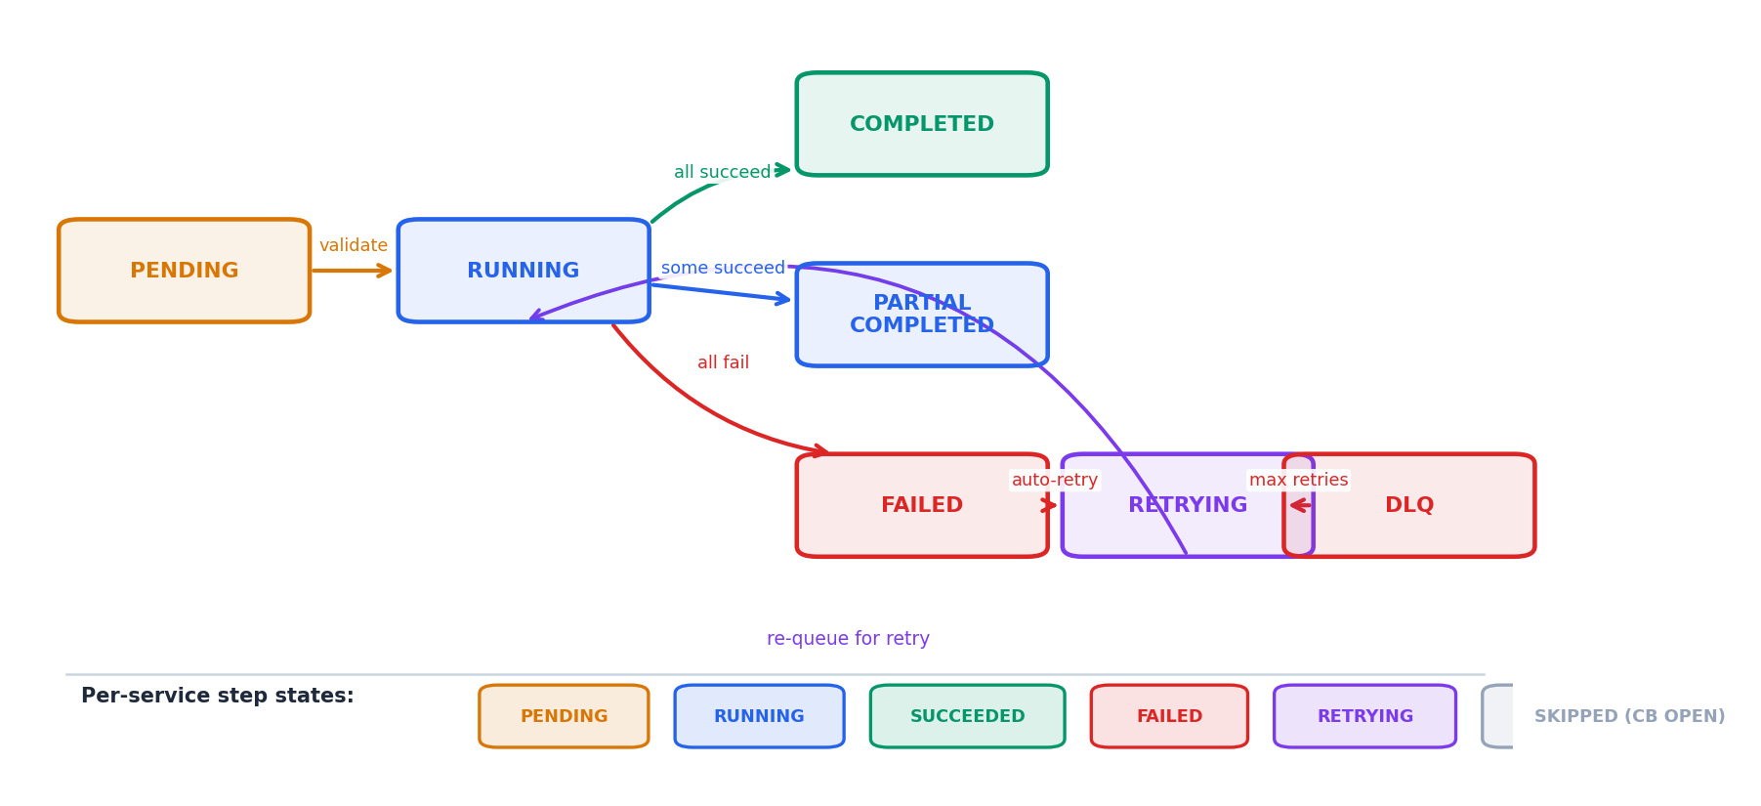
Request Lifecycle & State Machine
Every deletion moves through a well-defined state machine with step-level visibility per service.
Step states per service
PARTIAL_COMPLETED is intentional
Each worker independently reports PENDING → RUNNING → SUCCEEDED / FAILED. The orchestrator aggregates into a final request-level status.
Non-critical services (analytics, backup) failing does not block primary deletion. Auditors see exactly which systems were cleaned — more informative than binary pass/fail.

Slide 7
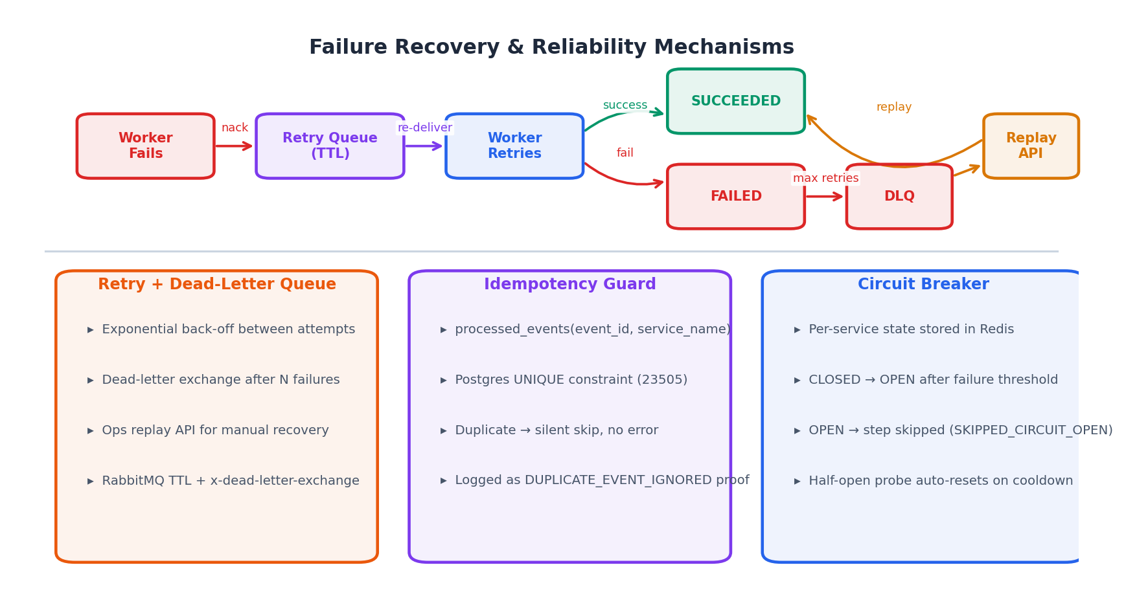
Reliability Design
Three layered mechanisms ensure every deletion eventually completes — or is explicitly accounted for.

Slide 8
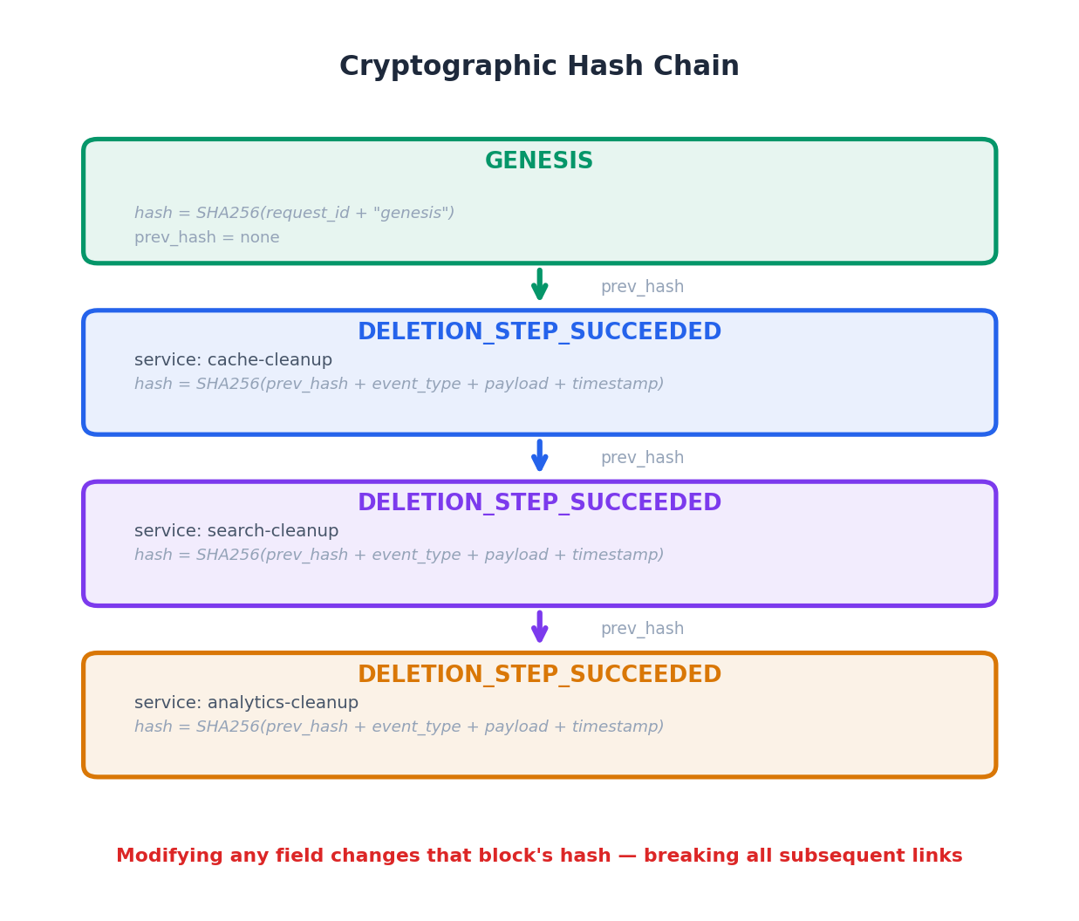
Proof & Auditability
Every deletion event is hash-chained. Modify any record and verification fails — cryptographically guaranteed.
Hash-chained proof events
▸ Each event stores SHA-256(prev_hash + type + payload + ts).
▸ Any tampering breaks the chain from that point onwards.
Advisory lock during writes
▸ pg_advisory_xact_lock ensures sequential writes
▸ under concurrent load — no race conditions.
Export & one-click verification
▸ Full chain exported as JSON. Verify reports
▸ VERIFIED or TAMPERED per-record.
Compliance-ready
▸ Satisfies GDPR Art.17 & CCPA deletion audit requirements.

Slide 9
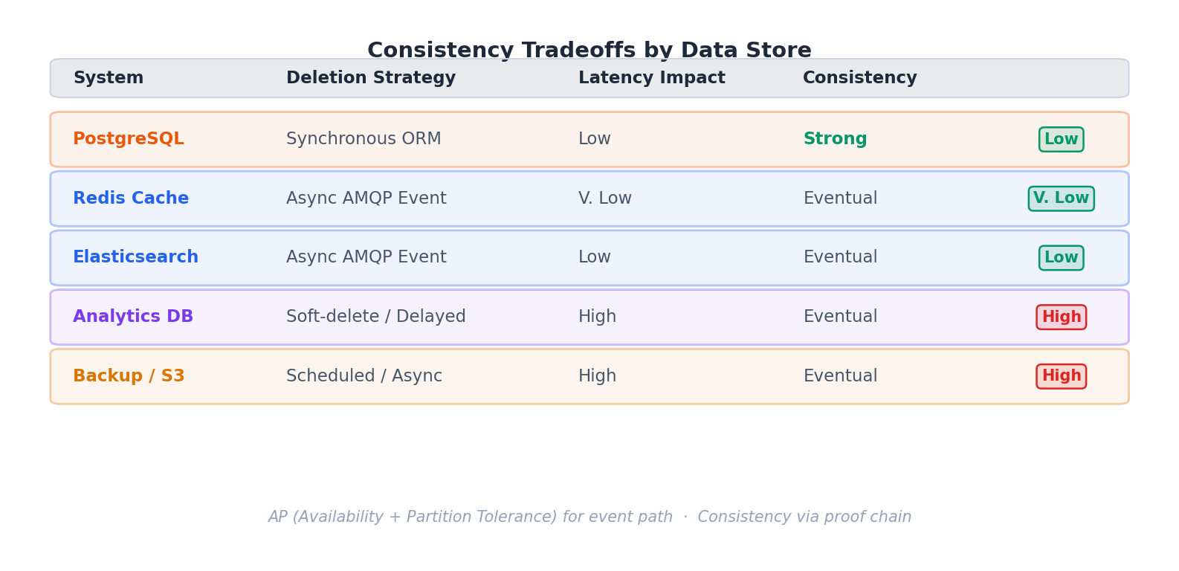
Consistency & Tradeoffs
Deliberate tradeoffs per data store. Not all systems require the same consistency guarantee.
Why PARTIAL_COMPLETED is good design
CAP Theorem position
Rather than failing entirely when analytics is slow, we record partial success. Auditors see exactly which systems were cleaned — more informative than binary pass/fail.
We favour AP (Availability + Partition Tolerance) for the event-driven path. The cryptographic proof chain provides Consistency through eventual convergence and tamper detection.

Slide 10
Observability & Operations
Every request, event, and failure is traced, measured, and surfaced in real time.
OpenTelemetry + Jaeger
Observability Stack
▸ Distributed traces span all service boundaries.
▸ See exactly where latency and failures occur.
OpenTelemetry
Jaeger
Prometheus
Grafana
Prometheus + Grafana
SSE Streaming
▸ Throughput, step duration, retry counts, CB state
▸ exported and visualised on live dashboards.
Admin Dashboard
Admin Panel surfaces
▸ Real-time health, circuit breaker state per service,
▸ Per-service health (healthy / degraded / down)
▸ SLA violations with timestamps, DLQ message count.
▸ Circuit breaker state — CLOSED / OPEN / HALF-OPEN
Real-time SSE Streaming
▸ SLA violations with timestamps and service name
▸ Frontend receives live status updates — no polling.
▸ DLQ message count + one-click replay trigger
▸ Cryptographic attestation per deletion request

Slide 11
Kubernetes-Ready, Cloud-Deployed
Every service containerised — local via Docker Compose, production-grade on Kubernetes / GKE.
Docker Compose (local dev)
Services deployed
▸ Single command spins up all 12+ services,
▸ Postgres, Redis, RabbitMQ, Jaeger, Prometheus.
Backend API
Frontend
Cache Cleanup
Search Cleanup
Kubernetes (production)
Analytics Cleanup
Backup Service
Proof Service
▸ Deployment manifests, Services, ConfigMaps for every
RabbitMQ
PostgreSQL
Redis
Jaeger
Prometheus
▸ component. Workers scale horizontally.
Cloud Deployment (GKE)
▸ Live on cloud cluster. All services verified running
▸ end-to-end in a production-like environment.
Environment isolation
65
15
5
100%
▸ Secrets via .env.example — zero credentials committed.
Unit Tests
Test Suites
Data Stores
Passing

Slide 12
Key Results
What we built and demonstrated across the full semester.
65
15
5
3
10+
Unit Tests Passing
Test Suites
Data Stores
Reliability Layers
Microservices
Complete Distributed System
Verifiable Proof Chain
Failure-Safe by Design
▸ 10+ microservices coordinating deletion across 5 data store types.
▸ Cryptographic hash chain for every deletion request.
▸ Retry + DLQ + idempotency + circuit breaker.
▸ Event-driven, independently deployable workers.
▸ Tamper detection works at the single-record level.
▸ No deletion lost silently, even under partitions.
▸ Full lifecycle: request intake → audit export.
▸ One-click verify: VERIFIED / TAMPERED result.
▸ DLQ replay ensures ops can recover any failed step.
EraseGraph demonstrates that compliance-grade deletion propagation is achievable with event-driven orchestration, reliability engineering, and cryptographic auditability.

Slide 13
Challenges & Lessons Learned
Building a reliable distributed system is harder than it looks — here is what we learned.
Distributed idempotency
Hash chain concurrency
Circuit breaker persistence
Trace context across async
▸ Ensuring exactly-once processing across async workers
▸ Concurrent inserts can corrupt prev_hash references
▸ State must survive worker restarts — stored in Redis
▸ OpenTelemetry span context lost across RabbitMQ boundaries
▸ Race conditions on duplicate events required DB-level unique constraints
▸ Solved with pg_advisory_xact_lock for sequential writes
▸ Half-open probe logic required careful timeout tuning
▸ Required manual W3C trace-context header propagation
▸ Clock skew makes timestamp-only deduplication unreliable
▸ Verified correct under load with integration tests
▸ Unexpected: CB state affects DLQ routing decisions
▸ Jaeger now shows full end-to-end trace per request
Key lesson: Event-driven fanout beats synchronous RPC for deletion — lower coupling, better scalability, explicit failure visibility.

Slide 14
Future Work
Three directions to take EraseGraph from a proof-of-concept to a production-grade platform.
Scalability
Compliance Automation
Intelligence & Resilience
Replace RabbitMQ with Apache Kafka
GDPR / CCPA deletion certificate generation
Observability-driven optimisation
▸ Persistent, replayable event log for replay-on-demand
▸ Automated PDF deletion certificate with proof hash
▸ ML anomaly detection on deletion latency patterns
▸ Consumer group auto-scaling with KEDA on Kubernetes
▸ SLA violation reports emailed to data officers
▸ GraphQL audit query API for flexible reporting
▸ Partition deletion requests by user_id for parallelism
▸ Multi-region data residency tagging per request
▸ Chaos engineering suite (fault injection, partition tests)
▸ Exactly-once delivery with Kafka transactions
▸ Webhook notifications to data subjects on completion
▸ Auto-remediation: trigger replay on SLA breach detection

Slide 15
Team Contributions
Responsibility breakdown — who owned what and the impact delivered.
Member
Owned Areas
Key Deliverables
Impact
Haoyuan Shan
GitHub consolidation · K8s / cloud deployment · backend integration
K8s manifests, cloud deployment, proof-chain optimisation, demo data
Turned the project into a cohesive, demo-ready deliverable
Vritika Malhotra
Retry · DLQ · idempotency · circuit breaker · reliability docs
Circuit breaker service, DLQ replay, idempotency guard, unit tests
Improved failure recovery & robustness of distributed deletion
Sakshat Patil
Frontend dashboard · workflow UX · real-time status experience
React pages, SSE streaming UI, bulk upload, admin front-end
Improved visualisation quality and demo clarity
Asim Mohammed
Consistency semantics · backend / admin workflow · state model
SLA monitor, SSE backend, deletion-request service, state design
Improved state-model clarity and operational reliability
R = Responsible A = Accountable C = Consulted I = Informed

Slide 16
Thank you.
Questions?
EraseGraph — Verifiable deletion propagation · CMPE 273 Spring 2026
Event-Driven
Cryptographic Proof
Reliability First
GDPR / CCPA Ready
10+ Microservices
Kubernetes

