Slide 1

Enigma
Enigma <number>

Slide 2
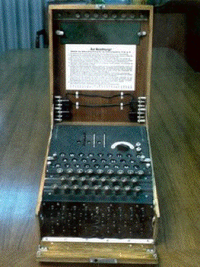
Enigma

Slide 3
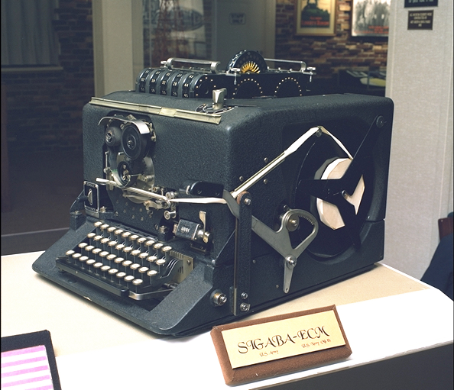
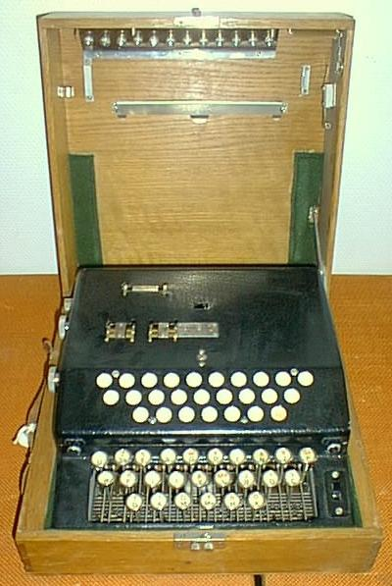
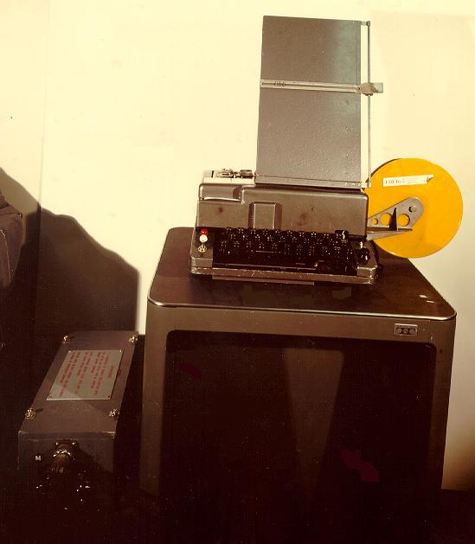
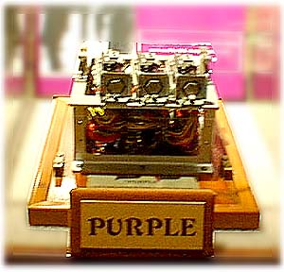
Sigaba - USA
B-21 - Sweden
BID - Canada
Purple - Japan

Slide 4
Enigma
Developed and patented (in 1918) by Arthur Scherbius
Many variations on basic design
Eventually adopted by Germany
  For both military and diplomatic use
  Many variations used
Broken by Polish cryptanalysts, late 1930s
Exploited throughout WWII
  By Poles, British, Americans
Enigma <number>

Slide 5
Enigma
Turing was one of Enigma cryptanalysts
Intelligence from Enigma vital in many battles
  D-day disinformation
  German submarine “wolfpacks”
  Many other examples
May have shortened WWII by a year or more
Germans never realized Enigma broken ⎯ Why?
  British were cautious in use of intelligence
  But Americans were less so (e.g., submarines)
  Nazi system discouraged critical analysis…
Enigma <number>

Slide 6
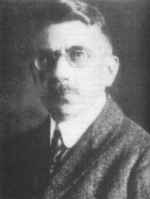
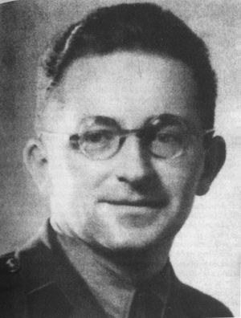
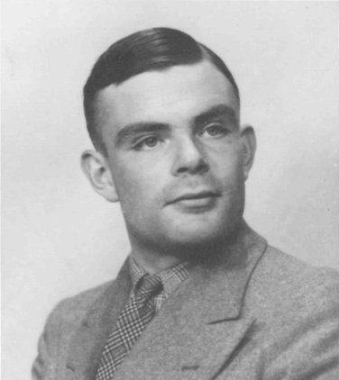
Arthur Scherbius
Marian Rejewski
Bletchley Park
Alan Turing
1912 ~ 1954

Slide 7
Enigma
To encrypt
  Press plaintext letter, ciphertext lights up
To decrypt
  Press ciphertext letter, plaintext lights up
Electo-mechanical
Enigma <number>

Slide 8
Enigma Crypto Features
3 rotors
  Set initial positions
Moveable ring on rotor
  Odometer effect
Stecker (plugboard)
  Connect pairs of letters
Reflector
  Static “rotor”
Enigma <number>

Slide 9
Substitution Cipher
Enigma is a substitution cipher
But not a simple substitution
  Perm changes with each letter typed
Another name for simple substitution is mono-alphabetic substitution
Enigma is an example of a poly-alphabetic substitution
How are Enigma “alphabets” generated?
Enigma <number>

Slide 10
Enigma Components
Each rotor implements a permutation
The reflector is also a permutation
  Functions like stecker with 13 cables
Rotors operate almost like odometer
  Reflector does not rotate
  Middle rotor occasionally “double steps”
Stecker can have 0 to 13 cables
Enigma <number>

Slide 11
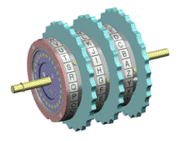
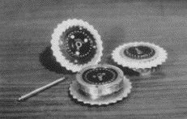
Enigma Rotors
Three rotors
Assembled rotors
Enigma <number>

Slide 12
Rotors and Reflector
Each rotor/reflector is a permutation
Overall effect is a permutation
Due to odometer effect, overall
permutation changes at each step
Enigma <number>

Slide 13
Why Rotors?
Inverse permutation is easy
  Need inverse perms to decrypt!
  Pass current thru rotor in opposite direction
Can decrypt with same machine
  Maybe even with the same settings…
Rotors provide easy way to generate large number of permutations mechanically
Otherwise, each perm would have to be wired separately (as in Purple cipher…)
Enigma <number>

Slide 14
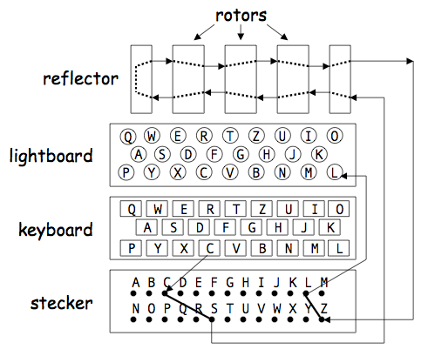
Wiring Diagram
Enter C
Stecker: C to S
S permuted to Z by rotors/reflector
Stecker: Z to L
L lights up
Enigma <number>

Slide 15
Enigma is Its Own Inverse!
Suppose at step i, press X and Y lights up
  Let T = permutation thru reflector
  Let L = thru leftmost rotor from right to left
  Let M = thru middle rotor, right to left
  Let R = thru rightmost rotor, right to left
Then Y = S⁻¹R⁻¹M⁻¹L⁻¹TLMRS(X)
Where “inverse” is thru the rotor from left to right (inverse permutation)
Note: reflector is its own inverse
  Only one way to go thru reflector
Enigma <number>

Slide 16
Inverse Enigma
Suppose at step i, we have
Y = S⁻¹R⁻¹M⁻¹L⁻¹TLMRS(X)
Then at step i
X = S⁻¹R⁻¹M⁻¹L⁻¹TLMRS (Y)
Since T = T⁻¹
Why is this useful?
Enigma <number>

Slide 17
Enigma Key?
What is the Enigma key?
  Machine settings
What can be set?
  Choice of rotors
  Initial position of rotors
  Position of movable ring on rotor
  Choice of reflector
  Number of stecker cables
  Plugging of stecker cables
Enigma <number>

Slide 18
Enigma Keyspace
Choose rotors
  26! ⋅ 26! ⋅ 26! = 2²⁶⁵
Set moveable ring on right 2 rotors
  26 ⋅ 26 = 2^{9.4}
Initial position of each rotor
  26 ⋅ 26 ⋅ 26 = 2^{14.1}
Number of cables and plugging of stecker
  Next slide
Choose of reflector
  Like stecker with 13 cables…
  …since no letter can map to itself
Enigma <number>

Slide 19
Enigma Key Size
Let F(p) be ways to plug p cables in stecker
  Select 2p of the 26 letters
  Plug first cable into one of these letters
  Then 2p - 1 places to plug other end of 1st cable
  Plug in second cable to one of remaining
  Then 2p - 3 places to plug other end
  And so on…
F(p) = binomial(26,2p) ⋅ (2p−1) ⋅ (2p−3) ⋅ ⋅⋅⋅ ⋅ 1
Enigma <number>

Slide 20
Enigma Keys: Stecker
F(0) = 1 F(1) = 325
F(2) = 44850 F(3) = 3453450
F(4) = 164038875 F(5) = 5019589575
F(6) = 100391791500 F(7) = 1305093289500
F(8) = 10767019638375 F(9) = 53835098191875
F(10) = 150738274937250 F(11) = 205552193096250
F(12) = 102776096548125 F(13) = 7905853580625
F(0) + F(1) + … + F(13) = 532985208200576 = 2^{48.9}
Note that maximum is with 11 cables
Note also that F(10) = 2^{47.1} and F(13) = 2^{42.8}
Enigma <number>

Slide 21
Enigma Keys
Multiply to find total Enigma keys
2²⁶⁵ ⋅ 2^{9.4} ⋅ 2^{14.1} ⋅ 2^{48.9} ⋅ 2^{42.8} = 2³⁸⁰
“Extra” factor of 2^{14.1}
2²⁶⁵ ⋅ 2^{9.4} ⋅ 2^{48.9} ⋅ 2^{42.8} = 2³⁶⁶
Equivalent to a 366 bit key!
Less than 10⁸⁰ = 2²⁶⁶ atoms in observable universe!
Unbreakable? Exhaustive key search is certainly out of the question…
Enigma <number>

Slide 22
In the Real World (ca 1940)
5 known rotors: 5⋅4⋅3 = 2^{5.9}
Moveable rings on 2 rotors: 2^{9.4}
Initial position of 3 rotors: 2^{14.1}
Stecker usually used 10 cables: 2^{47.1}
Only 1 reflector, which was known: 2⁰
Number of keys “only” about
2^{5.9} ⋅ 2^{9.4} ⋅ 2^{14.1} ⋅ 2^{47.1} ⋅ 2⁰ = 2^{76.5}
Enigma <number>

Slide 23
In the Real World (ca 1940)
Only about 2^{76.5} Enigma keys in practice
Still an astronomical number
  Especially for 1940s technology
But, most of keyspace is due to stecker
If we ignore stecker…
  Then only about 2²⁹ keys
  This is small enough to try them all
Attack we discuss “bypasses” stecker
Enigma <number>

Slide 24
Enigma Attack
Many different Enigma attacks
  Most depend on German practices…
  …rather than inherent flaws in Enigma
Original Polish attack is noteworthy
  Some say this is greatest crypto success of war
  Did not know rotors or reflector
  Were able to recover these
  Needed a little bit of espionage…
Enigma <number>

Slide 25
Eingma Attack (1)
Theorem: Let P be a permutation with cycle type C, then for any permutation S, S⁻¹PS is a permutation with the same cycle type C as P.
Rotor setting and Message setting:
Re-encryption of message setting
Enigma <number>

Slide 26
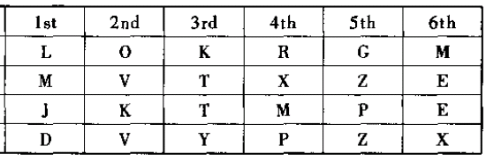


Y = S⁻¹R⁻¹M⁻¹L⁻¹TLMRS(X)
Y = S⁻¹P_{i}S(X)
L = S⁻¹P₀S(?)
R= S⁻¹P₃P₀S(L)
R = S⁻¹P₃S(?)
S⁻¹P₃P₀S
(AFW)(BQZKVELRIB)(CHGOYDPC)(JMXZTNUJ)
Enigma <number>

Slide 27
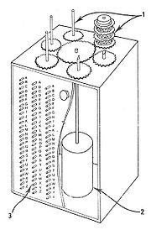
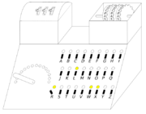
S⁻¹P₃P₀S=(AFW)(BQZKVELRIB)(CHGOYDPC)(JMXZTNUJ)
P₃P₀ ~ S⁻¹P₃P₀S
Cyclometer (1934), devised by Rejewski to catalogue the cycle structure of Enigma permutations.
Bomba kryptologiczna (Cryptologic bomb).
1: Rotors. 2: Electric motor. 3: Switches.
Enigma <number>

Slide 28
Enigma Attack (2)
The attack we discuss here
  Assumes rotors are known
  Shows flaw in Enigma
  Requires some known plaintext (a “crib” in WWII terminology)
  Practical today, but not quite in WWII
Enigma <number>

Slide 29
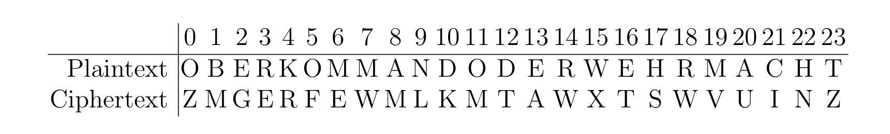
Enigma Attack (2)
Suppose we have known plaintext (crib) below
Let P_{i} be permutation (except stecker) at step i
S is stecker Y = S⁻¹R⁻¹M⁻¹L⁻¹TLMRS(X)
  M = S⁻¹ P₈S(A) ⇒ S(M) = P₈S(A)
  E = S⁻¹ P₆S(M) ⇒ S(E) = P₆S(M)
  A = S⁻¹ P₁₃S(E) ⇒ S(A) = P₁₃S(E)
Combine to get “cycle” P₆P₈P₁₃S(E) = S(E)
Enigma <number>

Slide 30
Enigma Attack (2)
Also find the cycle
  E = S⁻¹ P₃S(R) ⇒ S(E) = P₃S(R)
  W = S⁻¹ P₁₄S(R) ⇒ S(W) = P₁₄S(R)
  W = S⁻¹ P₇S(M) ⇒ S(W) = P₇S(M)
  E = S⁻¹ P₆S(M) ⇒ S(E) = P₆S(M)
Combine to get P₃ P₁₄⁻¹ P₇ P₆⁻¹ S(E) = S(E)
Enigma <number>

Slide 31
Enigma Attack (2)
Guess one of 2²⁹ settings of rotors
  Then all putative perms P_{i} are known
If guess is correct cycles for S(E) hold
  If incorrect, only 1/26 chance a cycle holds
But we don’t know S(E)
  So we guess S(E)
For correct rotor settings and S(E),
  All cycles for S(E) must hold true
Enigma <number>

Slide 32
Enigma Attack (2)
Using only one cycle in S(E), must make 26 guesses and each has 1/26 chance of a match
  On average, 1 match, for 26 guesses of S(E)
  Number of “surviving” rotor settings is about 2²⁹
But, if 2 equations for S(E), then 26 guesses for S(E) and only 1/26² chance both cycles hold
  Reduce possible rotor settings by a factor of 26
  With enough cycles, will have only 1 rotor setting!
  In the process, stecker (partially) recovered!
Divide and conquer!
Enigma <number>

Slide 33
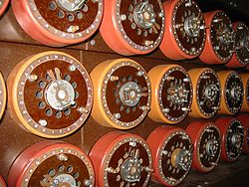
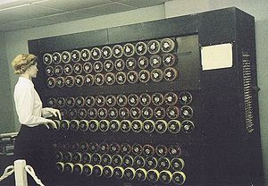
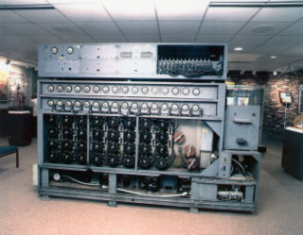
The bombe
The Bombe replicated the action of several Enigma machines wired together. Each of the rapidly rotating drums, pictured above in a Bletchley Park museum mockup, simulated the action of an Enigma rotor.
US bombe
Enigma <number>

Slide 34
Bottom Line
Enigma was ahead of it’s time
Weak, largely due to combination of “arbitrary” design features
  For example, right rotor is “fast” rotor
  If left rotor is “fast”, it’s stronger
Some Enigma variants used by Germans are much harder to attack
  Variable reflector, stecker, etc.
Enigma <number>

Slide 35
Bottom Line
Germans confused “physical security” and “statistical security” of cipher
  Modern ciphers: statistical security is paramount
  Embodied in Kerckhoffs Principle
Pre-WWII ciphers, such as codebooks
  Security depends on codebook remaining secret
  That is, physical security is everything
Germans underestimated statistical attacks
Enigma <number>

Slide 36
Bottom Line
Aside…
Germans had some cryptanalytic success
  Often betrayed by Enigma decrypts
In one case, before US entry in war
  British decrypted Enigma message
  German’s had broken a US diplomatic cipher
  British tried to convince US not to use the cipher
  But didn’t want to tell Americans about Enigma!
Enigma <number>

Slide 37
Bottom Line
Pre-computers used to attack Enigma
Most famous, were the
  Polish “bomba”, British “bombe”
  Electro-mechanical devices
British bombe, essentially a bunch of Enigma machines wired together
Could test lots of keys quickly
Noisy, prone to break, lots of manual labor
Enigma <number>

