Slide 1
Encryption
Enc

Slide 2
Block Cipher Modes
Electronic Codebook (ECB) mode
  Encrypt each block independently
  There is a serious weakness
Cipher Block Chaining (CBC) mode
  Chain the blocks together
  Better than ECB, virtually no extra work
Counter Mode (CTR) mode
  Like a stream cipher (random access)

Slide 3
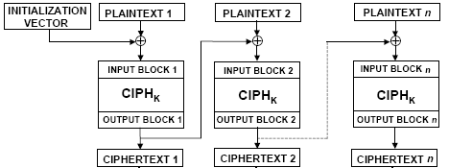
General Encryption Mode
ECB、CBC、CFB、OFB、CTR
CBC (Cipher Block Chaining Mode)

Slide 4
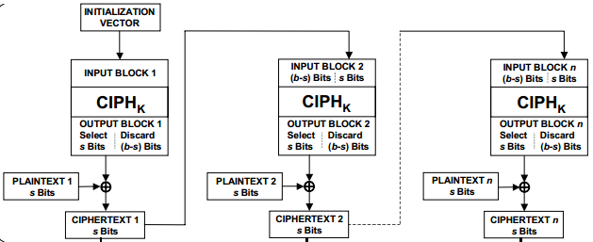
CFB (Cipher Feedback Mode)

Slide 5
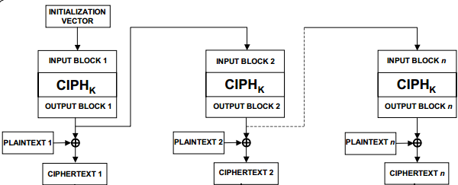
OFB (Output Feedback Mode)

Slide 6
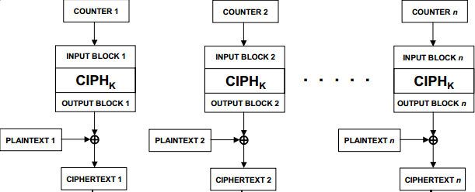
CTR (Counter Mode)

Slide 7
ECB Mode
Notation: C=E(P,K)
Given plaintext P₀,P₁,…,P_{m},…
Obvious way to use a block cipher is
Encrypt Decrypt
C₀ = E(P₀, K), P₀ = D(C₀, K),
C₁ = E(P₁, K), P₁ = D(C₁, K),
C₂ = E(P₂, K),… P₂ = D(C₂, K),…
For a fixed key K, this is an electronic version of a codebook cipher (no additive)
A new codebook for each key

Slide 8
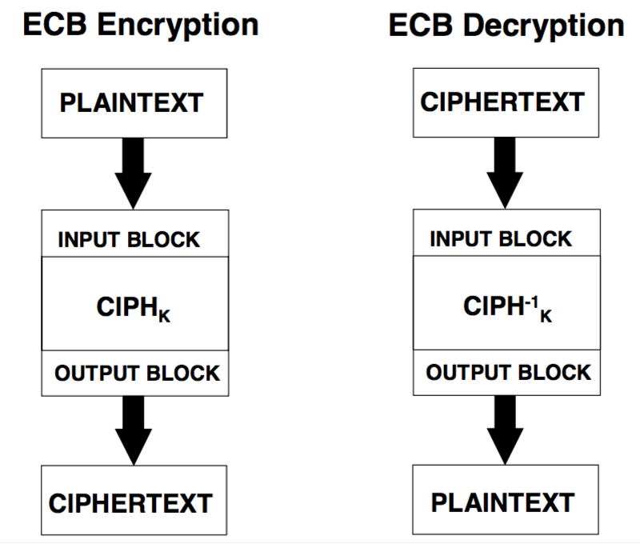
Enc

Slide 9
ECB Cut and Paste Attack
Suppose plaintext is
Alice digs Bob. Trudy digs Tom.
Assuming 64-bit blocks and 8-bit ASCII:
P₀ = “Alice di”, P₁ = “gs Bob. ”,
P₂ = “Trudy di”, P₃ = “gs Tom. ”
Ciphertext: C₀,C₁,C₂,C₃
Trudy cuts and pastes: C₀,C₃,C₂,C₁
Decrypts as
Alice digs Tom. Trudy digs Bob.

Slide 10
ECB Weakness
Suppose P_{i} = P_{j}
Then C_{i} = C_{j} and Trudy knows P_{i} = P_{j}
This gives Trudy some information, even if she does not know P_{i} or P_{j}
Trudy might know P_{i}
Is this a serious issue?

Slide 11
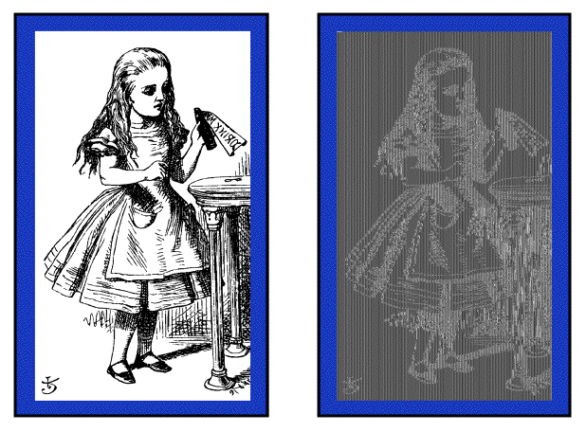
Alice Hates ECB Mode
Alice’s uncompressed image, Alice ECB encrypted (TEA)
Why does this happen?
Same plaintext block ⇒ same ciphertext!

Slide 12

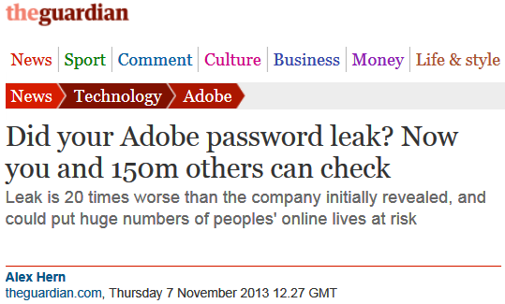


Slide 13
CBC Mode
Blocks are “chained” together
A random initialization vector, or IV, is required to initialize CBC mode
IV is random, but need not be secret
Encryption Decryption
C₀ = E(IV ⊕ P₀, K), P₀ = IV ⊕ D(C₀, K),
C₁ = E(C₀ ⊕ P₁, K), P₁ = C₀ ⊕ D(C₁, K),
C₂ = E(C₁ ⊕ P₂, K),… P₂ = C₁ ⊕ D(C₂, K),…

Slide 14
CBC Mode
Identical plaintext blocks yield different ciphertext blocks
Cut and paste is still possible, but more complex (and will cause garbles)
If C₁ is garbled to, say, G then
P₁ ≠ C₀ ⊕ D(G, K), P₂ ≠ G ⊕ D(C₂, K)
But P₃ = C₂ ⊕ D(C₃, K), P₄ = C₃ ⊕ D(C₄, K),…
Automatically recovers from errors!

Slide 15
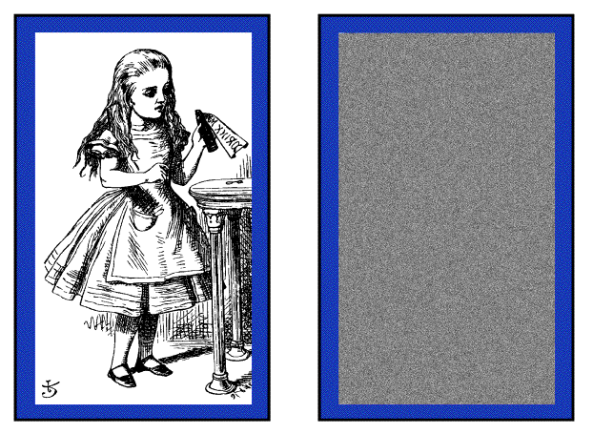
Alice Likes CBC Mode
Alice’s uncompressed image, Alice CBC encrypted (TEA)
Why does this happen?
Same plaintext yields different ciphertext!

Slide 16
Counter Mode (CTR)
CTR is popular for random access
Use block cipher like stream cipher
Encryption Decryption
C₀ = P₀ ⊕ E(IV, K), P₀ = C₀ ⊕ E(IV, K),
C₁ = P₁ ⊕ E(IV+1, K), P₁ = C₁ ⊕ E(IV+1, K),
C₂ = P₂ ⊕ E(IV+2, K),… P₂ = C₂ ⊕ E(IV+2, K),…
CBC can also be used for random access!!!

Slide 17
Encryption Security model
Semantic security
Encryption algorithm
……
(m₀,m₁)
d
Attacker
E(m_{d})
d’
……
Adv(A) = Pr[d=d’]-1/2
* S. Goldwasser and S. Micali, Probabilistic encryption. Journal of Computer and System Sciences, 28:270-299, 1984

Slide 18
Left-or-right security
Encryption algorithm
(m1₀,m1₁)
E(m1_{d})
d
Attacker
……
(mq₀,mq₁)
d’
E(mq_{d})
* M. Bellare, A. Desai, E. Jokipii and P. Rogaway. A Concrete Security Treatment of Symmetric Encryption: Analysis of the DES Modes of Operation. 1997.

Slide 19
CBC Mode
IV should be chosen independently,
cannot be predicted by adversary

Slide 20
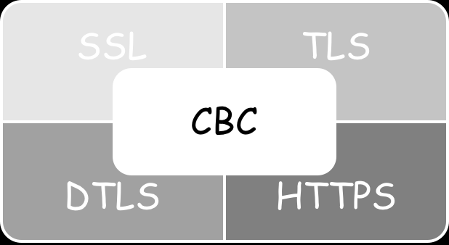
Side-channel attacks on CBC
[Vau02]
BEAST [DR11]
IV misuse
Padding Oracle
CRIME/BREACH
Lucky 13
[DR12, GHP13]
[AP12]

Slide 21
The BEAST
[1] Duong T, Rizzo J. Here come the⊕ Ninjas. Unpublished manuscript, 2011.
Padding Oracle
[1] Vaudenay, S., "Security Flaws Induced by CBC Padding - Applications to SSL, IPSEC, WTLS ....", EUROCRYPT 2002. http://lasecwww.epfl.ch/php_code/publications/
[2] Vaudenay, S., Canvel, B., Hiltgen, A., and M. Vuagnoux, "Password Interception in a SSL/TLS Channel", CRYPT0 2003 http://lasecwww.epfl.ch/pub/lasec/doc/CHVV03.ps, 2003.
Lucky 13
[1] AlFardan N J, Paterson K G. Plaintext-recovery attacks against datagram TLS. Network and Distributed System Security Symposium (NDSS 2012). 2012.
[2] AlFardan, N. J., Paterson, K. G. Lucky thirteen: Breaking the TLS and DTLS record protocols. In IEEE Symposium on Security and Privacy. 2013, February. http://www.isg.rhul.ac.uk/tls/Lucky13.html
CRIME/BREACH
[1] Thai Duong and Julianno Rizzo. The CRIME Attack, September 2012. https://docs.google.com/presentation/d/11eBmGiHbYcHR9gL5nDyZChu_-lCa2GizeuOfaLU2HOU/
[2] GLUCK Y, HARRIS N, PRADO A Á. BREACH: REVIVING THE CRIME ATTACK. 2013.
[3] John Kelsey. Compression and information leakage of plaintext. FSE 2002.

Slide 22
Security Flaws Induced by CBC Padding
CBC model
RC5-CBC-PAD
How must the receiver behave if the padding is not correct?
* S. Vaudenay. Security flaws induced by CBC padding – Applications to SSL, IPSEC, WTLS... EUROCRYPT ’02.

Slide 23
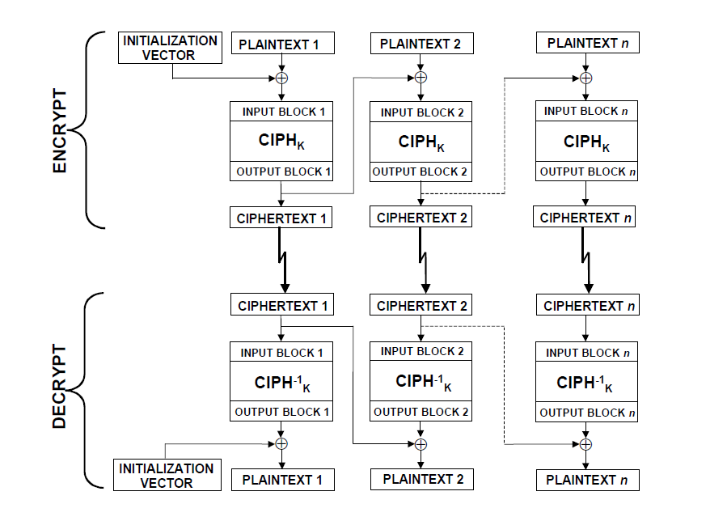
CBC mode

Slide 24
RC5-CBC-PAD
88888888
7777777
666666
55555
4444
333
22
1

Slide 25
C₁C₂…C_{n}
Alice
Bob
Error, send again!
M
C₁C₂…C_{n}
M||pad
M₁M₂…M_{n}
M₁M₂…M_{n}
Pad ?
C₁C₂…C_{n}

Slide 26
Alice
Bob
C₁C₂…C_{n}
Error, send again!
Malice

Slide 27
Decrypt any ciphertext using padding oracle
C₁
.
.
.
C_{n-1}
C_{n}
M₁
.
.
.
M_{n-1}
M_{n}
88888888
7777777
666666
55555
4444
333
22
1
C_{n-1}
C_{n-1}⊕T
M_{n}
M_{n}⊕T

Slide 28
1) Recover the last byte of M_{n}
C₁
.
.
.
C_{n-1}
C_{n}
M₁
.
.
.
M_{n-1}
M_{n}
88888888
7777777
666666
55555
4444
333
22
1
2) Recover other bytes of M_{n}
3) Recover other M_{i}

Slide 29

1) Recover the last byte of M_{n}
C_{n-1}
C_{n}
D_{K}
D_{K}
M_{n}
88888888
7777777
666666
55555
4444
333
22
1
Which one?
Enc

Slide 30
2) Recover other bytes of M_{n}
M_{n}
Once we know the last byte of M_{n}, we change it to 2
and change the left byte.
 |  |  |  |  |  |  | 2
If and only if 22, padding is corret.
 |  |  |  |  |  | 3 | 3
 |  |  |  |  | 4 | 4 | 4
……
Enc

Slide 31

3) Recover other M_{i}
C_{n-2}
C_{n-1}
D_{K}
D_{K}
Change the last byte of M_{n-1},
until pass.
M_{n-1}
88888888
7777777
666666
55555
4444
333
22
1
Enc

