Slide 1
Authentication
MAC

Slide 2
Data Integrity
Integrity ⎯ prevent (or at least detect) unauthorized modification of data
Example: Inter-bank fund transfers
  Confidentiality is nice, but integrity is critical
Encryption provides confidentiality (prevents unauthorized disclosure)
Encryption alone does not assure integrity (recall one-time pad and attack on ECB)
MAC

Slide 3
MAC
Message Authentication Code (MAC)
  Used for data integrity
  Integrity not the same as confidentiality
MAC

Slide 4
Message Authentication Code (MAC)
Message
MAC_K
Tag T

Slide 5
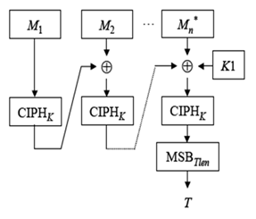
CBC-MAC
CBC-MAC mode

Slide 6
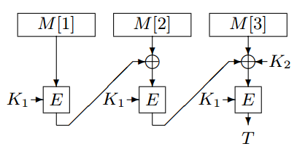
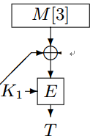
CBC-MAC does not support variable-length messages
M[3] ⨁T’ ⨁T
known： (M[1] M[2] M[3], T)
(M[1] M[2], T’)
forgery： (M[1] M[2] M[3] M[3] ⨁T’ ⨁T, T)

Slide 7

A simple modification——EMAC
K₂
padding：10*
disadvantage：additional block if the message is in block

Slide 8
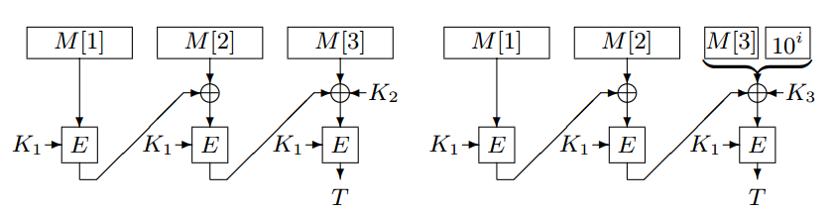

XCBC -> TMAC -> OMAC
XCBC: K₁, K₂, K₃ three independent keys
TMAC : (K₂, K₃) = (K₂ •u, K₂)
OMAC: (K₂, K₃) = (L•u, L•u²) or (L•u, L•u⁻¹)
OMAC1
OMAC2

Slide 9
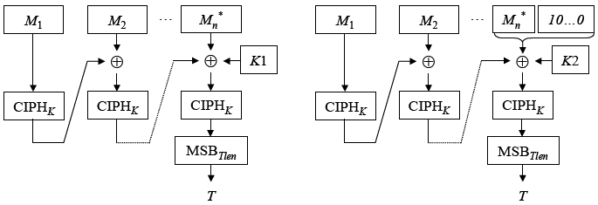
CMAC = OMAC1
K1= L∙u, K2 = L∙u^2, L=E_K(0^n)

Slide 10
Standardization of MAC
standardizing bodies | standard file | MAC
ISO | ISO/IEC 9797 | CBC-MAC，HMAC
IETF | RFC 2104 | HMAC
 | RFC 4418 | UMAC
 | RFC 4493 RFC 4494 | CMAC
ANSI | ANSI X9.9 | CBC-MAC
 | ANSI X9.19 | CBC-MAC
 | ANSI X9.7 | HMAC
NIST | FIPS PUB 113 | CBC-MAC
 | FIPS PUB 198 | HMAC
 | 800-38B | CMAC
JSA | JIS X.5055 | CBC-MAC，HMAC
TTA | TTA.IF-RFC4493 | CMAC
BSI | BS ISO/IEC 9797 | CBC-MAC，HMAC
中国国家标准化管理委员会 | GB/T15852 | CBC-MAC，HMAC

Slide 11
Authentication Security model
MAC
Attacker
……
(M,T)
Adv(A) = Pr[MAC (M)=T]
MAC

Slide 12
128-EIA3
1) Introduction
2) Construction of 128-EIA3
3) Analysis of 128-EIA3
4) Modification of 128-EIA3
5) Security of 128-EIA3
MAC

