Slide 1
knet 1.4.x
Cross platform, Light-weight, Multithreading net library

Slide 2
Keywords
Cross-platform
Light weight
Non-blocking
TCP
Multi-threading
Load balance
RPC
Code generating
Cross thread send

Slide 3
Design
loop
balancer
channel & channel reference
timer
framework
RPC object
RPC framework generating

Slide 4
balancer & loop
balancer
channel
accept/connect
balance
thread
thread
thread
thread
loop
loop
loop
loop

Slide 5
loop & channel
Accepted channel
try balancing
Connected channel
Accepted channel
from other loop
host
host
Active channels
Closed channels

Slide 6
loop
kloop_t
The implementation of loop
epoll
IOCP
Select
Channel lists
Active channel list
Closed channel list
Channel timeout
Connect timeout
Idle timeout
Channel lifecycle
Channel in closed list and zero reference will be destroyed

Slide 7
channel
Connector
Always host by the kloop_t which invoke function ‘kloop_create_channel’
Acceptor
With kloop_balancer_t
May balanced by kloop_balancer_t to other kloop_t
Hosted by current kloop_t
Without kloop_balancer_t
Always host by the kloop_t which invoke function ‘kloop_create_channel’
Cross thread send
Send data via the channel which hosted by other kloop_t
Not a highly efficient way compare to send from hosted kloop_t
Reference
kchannel_ref_share
kchannel_ref_leave

Slide 8
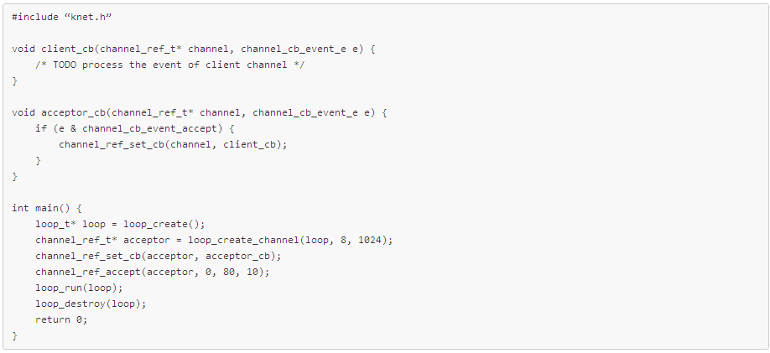
Sample – Acceptor

Slide 9
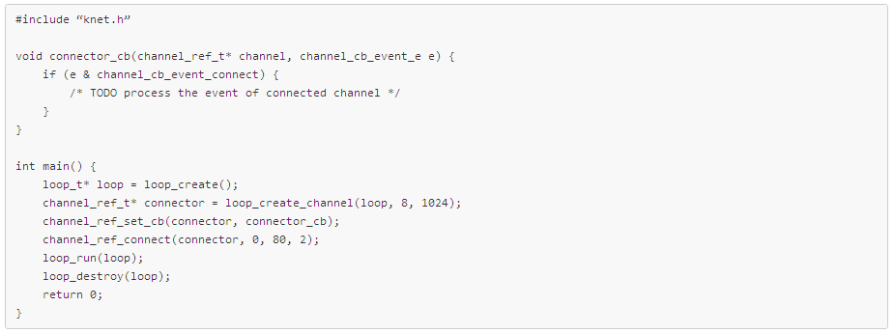
Sample - Connector

Slide 10
Channel event
channel_cb_event_connect
Connect to remote host successfully
channel_cb_event_accept
Accept a new client successfully
channel_cb_event_recv
Received from peer
channel_cb_event_send
Sent to peer
channel_cb_event_close
Channel closed
channel_cb_event_timeout
Channel idle timeout
channel_cb_event_connect_timeout
Connect to remote host timeout

Slide 11
Channel reference
kchannel_ref_share
Increase the reference count of kchannel_ref_t
Call the method when you hold kchanne_ref_t out of hosted kloop_t
kchannel_ref_leave
Decrease the reference count of kchannel_ref_t
Call the method when you don’t need this channel in current thread
kchannel_ref_t can be destroyed when reference count reach to zero
kchannel_ref_close
Close channel and switch channel from active channel list to closed channel list
kloop_t iterate closed list periodically and destroy zero-reference channel

Slide 12
balancer
The mediator of loops’ balance
Dynamic load balancing
Balance according to active channel count
Thread safety
Attach
Detach

Slide 13
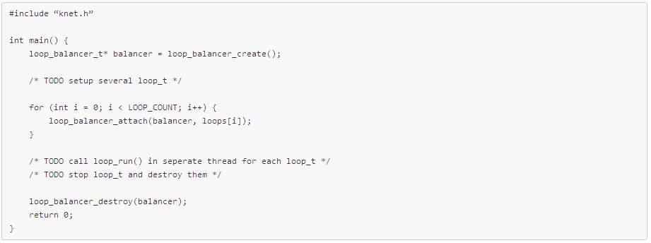
Sample - Balancer

Slide 14
RPC framework
Light weight
Proxy & stub
Non-blocking & no return RPC method
Simple object type system
Number
String
Array
Not easy to use

Slide 15
RPC - Type
Type | Byte | Description
i8 | 1 | 1 byte signed integer
i16 | 2 | 2 bytes signed integer
i32 | 4 | 4 bytes signed integer
i64 | 8 | 8 bytes signed integer
ui8 | 1 | 1 byte unsigned integer
ui16 | 2 | 2 bytes signed integer
ui32 | 4 | 4 bytes signed integer
ui64 | 8 | 8 bytes signed integer
string | - | String
object | - | Structural data
[] | - | Array
<> | - | Table

Slide 16
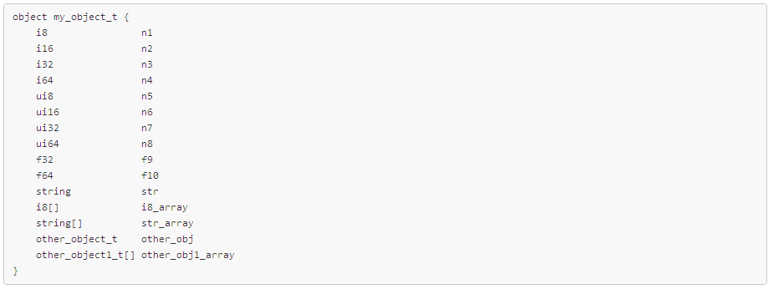
RPC - Method
method name
second parameter
first parameter
integer
string
array

Slide 17
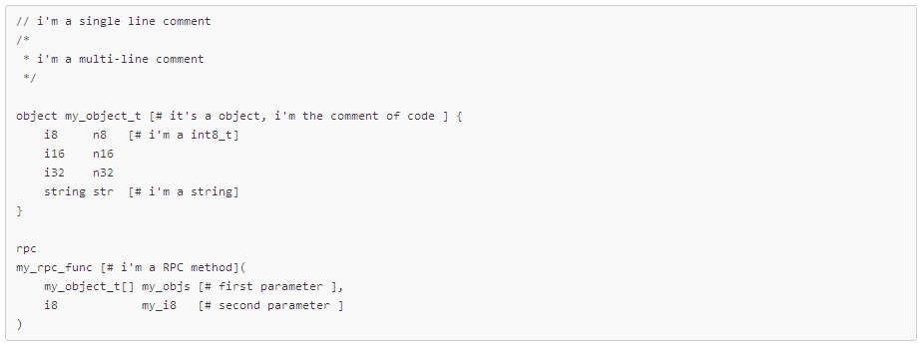
RPC - Comment
Comment of .rpc file
Comment of target language

Slide 18
RPC code generating
krpc
krpc -d output-directory -f input_rpc_file -n rpc_class_name -l the_language_to_generate
{rpc_class_name}.h
{rpc_class_name}.cpp
Mapping rpc type to specific language type
Easy to use

Slide 19
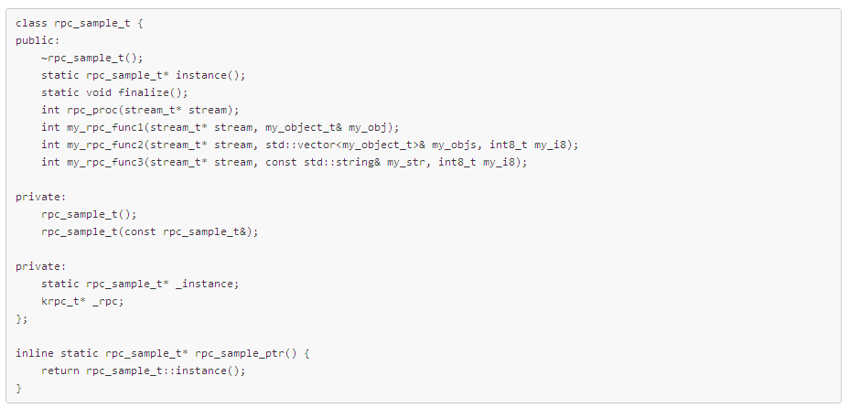
Sample – RPC entry class
singleton
RPC process method
RPC method
Helper macro of singleton access

Slide 20
Thanks
https://github.com/dennis-kk/knet
https://github.com/dennis-kk/knet/tree/master/examples
https://github.com/dennis-kk/knet/tree/master/krpc/examples

