Slide 1
Artificial intelligence: Ideas & their evolution
Lecture 1 of “Mathematics and AI”

Slide 2
Outline
What is AI?
Approaches to AI
The Dartmouth Workshop
Separating the What and How
Course information

Slide 3
“As soon as it works, nobody calls it AI anymore.”
What is AI?
Attributed to John McCarthy

Slide 4
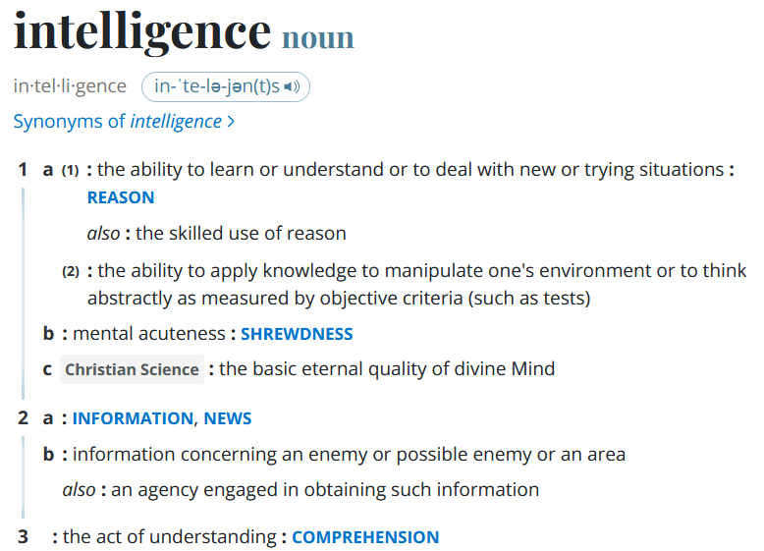
Intelligence
Schwarze Math 76.01 Summer 2024
Source: www.merriam-webster.com

Slide 5
Intelligence
Schwarze Math 76.01 Summer 2024
Source: www.merriam-webster.com

Slide 6
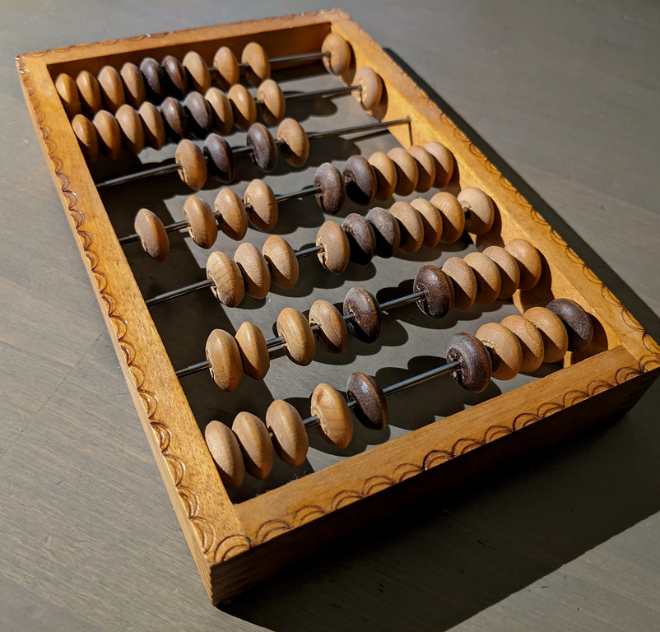
Reason
Schwarze Math 76.01 Summer 2024

Slide 7
Information
Schwarze Math 76.01 Summer 2024

Slide 8
Comprehension
Schwarze Math 76.01 Summer 2024

Slide 9
The Turing Test
Schwarze Math 76.01 Summer 2024

Slide 10
Strong and weak AI
Schwarze Math 76.01 Summer 2024

Slide 11
“Artificial intelligence is the science of making machines do things that would require intelligence if done by men.”
Approaches to AI
Marvin Minsky 1968

Slide 12
Logical approach
Schwarze Math 76.01 Summer 2024

Slide 13
Goedel’s incompleteness theorem
Schwarze Math 76.01 Summer 2024

Slide 14
Probabilistic approach
Schwarze Math 76.01 Summer 2024

Slide 15
Neuro-inspired approach
Schwarze Math 76.01 Summer 2024

Slide 16
Evolutionary approach
Schwarze Math 76.01 Summer 2024

Slide 17
The Dartmouth Workshop

Slide 18
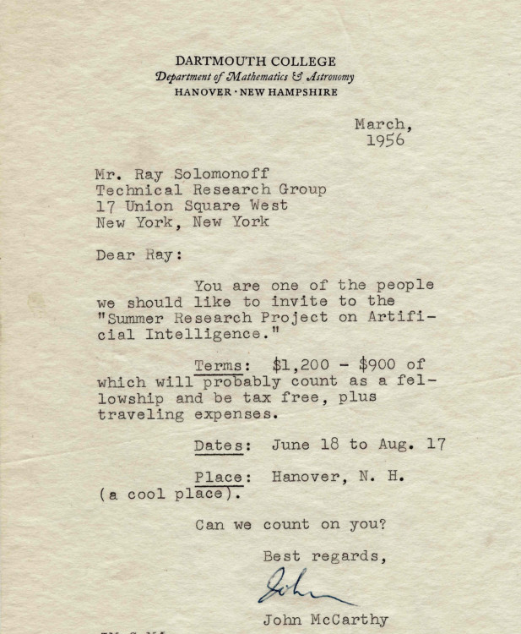
John McCarthy

Slide 19
Can we count on you?

Slide 20
The Birthplace of AI

Slide 21
“A man provided with paper, pencil, and rubber, and subject to strict discipline, is in effect a universal machine.”
What and how?
Alan Turing 1948

Slide 22
What and how?

Slide 23
Venn diagram of AI

Slide 24
Everything is statistics

Slide 25
Course information
Classes
Quizzes
Homework
Course project
Links

