Slide 1

IBM BOB AI INNOVATION HACKATHON 2026
AI SMART CLASSROOM
CLASSROOM 204
GUARDIAN
AI
“A classroom that thinks before it acts.”
E
S
ENERGY
P
SAFETY
S
POWER
SECURITY
AI • ENERGY • SAFETY • SECURITY • AUTOMATION
Team H4X | CHARUSAT
01

Slide 2

01 — THE PROBLEM
A smart classroom can still waste energy & miss risks
Four everyday gaps — one missing layer: intelligence.
E
ENERGY WASTE
P
POWER PROBLEMS
S
SAFETY RISKS
G
SECURITY GAPS
Lights, AC and devices can remain ON when the room is empty.
Abnormal electrical conditions can threaten sensitive equipment.
Smoke, overheating and unusual conditions may go unnoticed.
Unusual or unauthorized activity needs faster detection.
“The problem is not lack of technology. The problem is lack of intelligence.”
02

Slide 3

02 — THE BIG IDEA
What if the classroom could think — and protect?
Two capabilities converge into one AI decision layer.
SMART CLASSROOM
OUTCOMES
AI DECISION ENGINE
OCCUPANCY
POWER
⚡ Save energy
Context + patterns
→ best action
TEMP
DEVICES
🛡 Protect equipment
🚨 Alert staff
Automation makes the classroom smart. • Power Guard makes it safer.
03

Slide 4
03 — THE SOLUTION
AI Smart Classroom Guardian
SENSE → THINK → PROTECT → ACT
01
SENSE
02
UNDERSTAND
03
PROTECT & DECIDE
04
ACT
Sensors • smart meter • occupancy
AI analyzes occupancy • energy • power
Power Guard detects abnormal conditions
Controls devices • alerts staff
ONE LOOP: SENSE → THINK → PROTECT → ACT
04

Slide 5
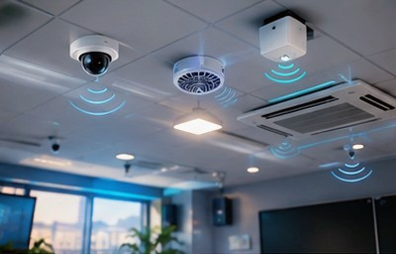
04 — SYSTEM ARCHITECTURE
From classroom signals to intelligent action
A single pipeline connects sensing, AI analysis, Power Guard and response.
OCCUPANCY
POWER
TEMPERATURE
DEVICES
DATA LAYER
AI
AI AUTOMATION
P
POWER GUARD
Energy analysis + occupancy context
Power analysis + anomaly detection
AI DECISION ENGINE
05

Slide 6

05 — THE AI BRAIN
Why AI? Because context beats simple rules.
Traditional automation reacts to one signal. Our guardian combines context.
TRADITIONAL RULE
AI CONTEXT
IF nobody detected → OFF
Occupancy + timetable + power + energy pattern
One condition
One action
↓
AI DECISION
Keep active • Save energy • Alert • Protect
“Automation follows rules. AI understands context.”
06

Slide 7
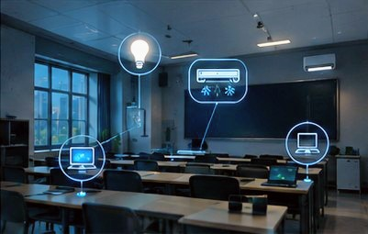
06 — HERO FEATURE
⚡ POWER GUARD
Protecting the classroom before damage happens.
POWER GUARD
POWER DATA
REAL-TIME WATCH
Voltage
AI MONITORING
Current
Power consumption
RISK ANALYSIS
Sudden changes
PROTECT / ALERT
Abnormal patterns
Abnormal condition? → identify early → respond
07

Slide 8

07 — INTEGRATION
When Power Guard meets smart automation
One brain. Two missions: SAVE ENERGY + PROTECT EQUIPMENT.
P
POWER GUARD
A
AI AUTOMATION
Power condition analysis
→ anomaly detection
→ protective response
AI DECISION
Occupancy + energy
→ context analysis
→ optimization
SAFE • EFFICIENT • AWARE
Empty + normal → save | Occupied + normal → operate | Abnormal → alert + protect
08

Slide 9

08 — ENERGY INTELLIGENCE
We don't simply switch devices OFF.
We decide when energy should be used.
OCCUPANCY
TIMETABLE
TEMPERATURE
DEVICE STATUS
POWER DATA
AI ENERGY DECISION
EMPTY CLASSROOM
OCCUPIED CLASSROOM
ABNORMAL POWER
💡 Lights → OFF
❄ AC → energy-save
📽 Projector → OFF
💡 Lights → ON
❄ AC → appropriate mode
⚡ Power Guard → warning
🛡 Protective response
09

Slide 10
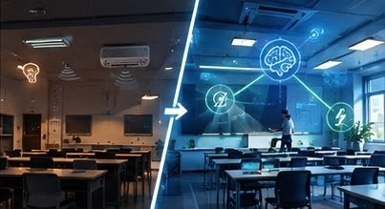
09 — AWARENESS
One dashboard. Complete classroom awareness.
A judge should understand the system in five seconds.
CLASSROOM 204
NORMAL
CLASSROOM 205
⚠ ABNORMAL
👥 Occupancy
EMPTY
👥 Occupancy
OCCUPIED
💡 Lights
ON → optimizing
💡 Lights
ON
❄ AC
ON → energy save
❄ AC
ON
⚡ Power status
NORMAL
⚡ Power status
ABNORMAL
🛡 Power Guard
ACTIVE
🛡 Power Guard
ACTIVE
Energy-saving action recommended.
Power anomaly detected • Protection / alert triggered
10

Slide 11
10 — SAFETY + SECURITY
Beyond energy: the classroom becomes aware.
Detect unusual conditions early and surface them clearly.
S
SAFETY
G
SECURITY
P
POWER
Temperature • smoke • unusual conditions
→ Faster awareness
→ Staff alert
Occupancy • unusual activity
→ Anomaly awareness
→ Admin notification
Voltage • current • power pattern
→ Early anomaly detection
→ Protective response
THE GUARDIAN CONNECTS SIGNALS THAT ARE USUALLY SEPARATE.
11

Slide 12
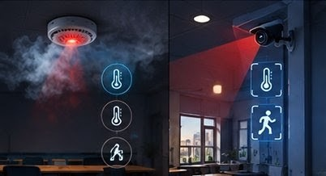
11 — DIFFERENTIATION
Why our solution is different
Not another smart classroom. A classroom with a protective intelligence layer.
CAPABILITY
TYPICAL SMART CLASSROOM
OUR GUARDIAN
Automation
Rules-based
AI understands context
Energy
Device control
Energy intelligence
Power
Monitoring
Power Guard + response
Risk
Reactive
Proactive anomaly awareness
System
Separate functions
Integrated guardian
SMART ≠ AUTOMATIC | SMART = AWARE + INTELLIGENT + PROTECTIVE
12

Slide 13
12 — THE CLOSE
A classroom should not only know what is happening.
It should know what to do next.
⚡
AI
A
G
POWER GUARD
AI
AUTOMATION
GUARDIAN
PROTECT
THINK
OPTIMIZE
ACT
“We are not just making a classroom smart.”
“We are giving it the intelligence to save energy, detect risk, and protect itself.”
LET THE CLASSROOM THINK. • LET THE POWER GUARD PROTECT.
THANK YOU • TEAM H4X
13

