Slide 1
AI TRAVEL COMPANION
A Live, Intelligent Travel Assistant That Plans, Adapts, and Reacts in Real Time
Full-Stack Web Engineering Spec & Live Demonstration • Hackathon Presentation
Tech Stack: React.js • Spring Boot 3 (Java 21) • MySQL • JWT • Contextual AI Engine
Project By: Maheen Fatima
GitHub: github.com/26fatimasiddiqui-create/ai_travel_companion

Slide 2
THE FUNDAMENTAL DILEMMA
Travel Apps Stop Working the Moment Your Trip Starts
Traditional planning tools are static checklists — unequipped for unpredictable travel realities.
01
Static, Fragile Itineraries
A fixed PDF or checklist created weeks prior to departure. When sudden rain occurs, the app continues directing travelers to open-air parks with zero proactive alternatives.
02
Blind to Live Operational Reality
Monument ticket booths closing in 45 minutes, unexpected traffic gridlocks on key avenues, or surging peak tourist queues are completely ignored until travelers arrive at locked gates.
03
Disconnected from Travelers' Reality
One-size-fits-all tourist lists that ignore individual energy, emotional mood, physical mobility needs (wheelchair/senior), and real-time wallet exhaustion.

Slide 3
PARADIGM SHIFT
From Rigid Static Itinerary to an Active Living Companion
Direct comparative analysis of traveler experience in typical scenarios.
TRADITIONAL TRAVEL PLATFORMS
✕ Rigid Fixed Schedule: 'Visit monument at 2:00 PM' regardless of weather.
✕ Zero Budget Awareness: Allows travelers to unknowingly blow their budget on day 1.
✕ Ignores Mood: Forces identical historical itineraries whether feeling adventurous or fatigued.
✕ Post-Trip Disconnect: Leaves users with disconnected photo galleries and lost receipts.
AI TRAVEL COMPANION (OUR SYSTEM)
✓ Live Situational Reactivity: Detects rain and dynamically suggests covered havelis nearby.
✓ Proactive Budget Optimization: Real-time ledger balances spending and injects cheaper stops.
✓ Dynamic Mood Alignment: 7 distinct travel moods recalibrate stops, meals, and exploration pacing.
✓ Continuous Timeline Preview: Minute-by-minute day simulation eliminates all 'what-if' anxiety.

Slide 4
★ FLAGSHIP INNOVATION
Live AI Travel Companion: Real-Time Situational Assistant
An intelligent copilot watching the clock, meteorological sensors, and wallet simultaneously.
WEATHER TRIGGER
Passing Rain Detected
Weather sensor detects 80% rain probability near Hawa Mahal. Swaps outdoor promenade for sheltered Indo-Saracenic galleries at Albert Hall Museum 6 minutes away.
TIMING TRIGGER
Attraction Closing in 45 Min
City Palace ticket counters close at 5:00 PM. Companion alerts traveler to enter royal galleries now and postpone the rooftop coffee break to 5:30 PM.
TRANSIT TRIGGER
Traffic Bottleneck Bypass
Severe road congestion detected near Ajmeri Gate. Recommends Jaipur Pink Metro Line 1 at Chandpole Station, saving 22 minutes of transit delay.
BUDGET TRIGGER
Budget Threshold Alert
Itinerary costs approach the ₹5,000 budget cap. Automatically replaces expensive fine-dining dinner with authentic 4.8-star heritage courtyard thali, saving ₹850.
Transparent Traveler Controls: [Accept Recommendation] updates route • [Keep Current] dismisses • [Ask AI Why] provides full reasoning.

Slide 5
★ SIGNATURE INNOVATION
AI Trip Simulation: Minute-by-Minute Day Preview
Preview the entire day before stepping foot outside the hotel lobby.
CONFIDENCE OVER ANXIETY
• Realistic Transitions: Calculates actual door-to-door transit, walking buffers, and crowd queuing windows.
• Interactive Timeline Scrubber: Play, pause, or step forward through the day with real-time cost and crowd gauges.
• Atmosphere Synchronization: Displays temperature, humidity, and sun exposure warnings for every stop.
DAY 1 BENCHMARK SIMULATION SEQUENCE (JAIPUR)
[08:30 AM] Depart Hotel (₹0)
↳ Heritage Haveli Lobby — Morning prep, hydration & metro card check
[09:00 AM] Hawa Mahal (Palace of Winds) (₹100)
↳ 90 mins duration — Early arrival ensures uncrowded facade & courtyard
[10:35 AM] Scenic Shaded Walk to City Palace (Free)
↳ 5 mins transit — Pedestrian pink stone corridor avoiding midday sun
[12:15 PM] Traditional Thali Lunch (₹350)
↳ LMB Sweets Johari Bazaar — Air-conditioned indoor dining & local delicacies
[01:30 PM] Jantar Mantar Royal Observatory (₹200)
↳ Astronomical UNESCO heritage site with audio tour
[04:00 PM] Pink Metro Return Ahead of Rush Hour (₹30)
↳ Air-conditioned metro transit back to residence before traffic peak

Slide 6
INTELLIGENT PERSONALIZATION
Mood-Based Travel Planning & AI Budget Optimization
Dynamic behavioral adaptation and continuous financial protection.
7 DYNAMIC MOOD PROFILES
• Relaxed: Slow morning pacing, shaded haveli courtyards, calm garden tea.
• Adventure: Aravalli hilltop fort hikes, outdoor stepwell exploration, brisk transit.
• Romantic: Sunset viewpoints over Nahargarh, intimate rooftop candlelit dining.
• Photography: Golden-hour facade timing at sunrise, geometric stepwell shadows.
• Food Lover: Centuries-old artisan sweet shops, street kachoris, spice markets.
• Family & Solo: Safe pedestrian verandas, stroller-friendly paths, verified social cafes.
AI BUDGET OPTIMIZER & LEDGER
• Total Allocation: ₹5,000 strictly controlled cap for the 3-day Jaipur journey.
• Multi-Category Tracking: Categorized under Hotel, Food, Transport, Tickets, Emergency, Other.
• Automated Threshold Alert: Triggers immediate savings suggestions if projected cost > 85% of budget.
• Smart Substitutions: Recommends Rajasthan Department Composite Pass (saves ₹700) and Pink Metro instead of chauffeur cabs (saves ₹1,850).
• Live Expense Logging: Travelers record transactions on the go with automatic remaining recalculations.

Slide 7
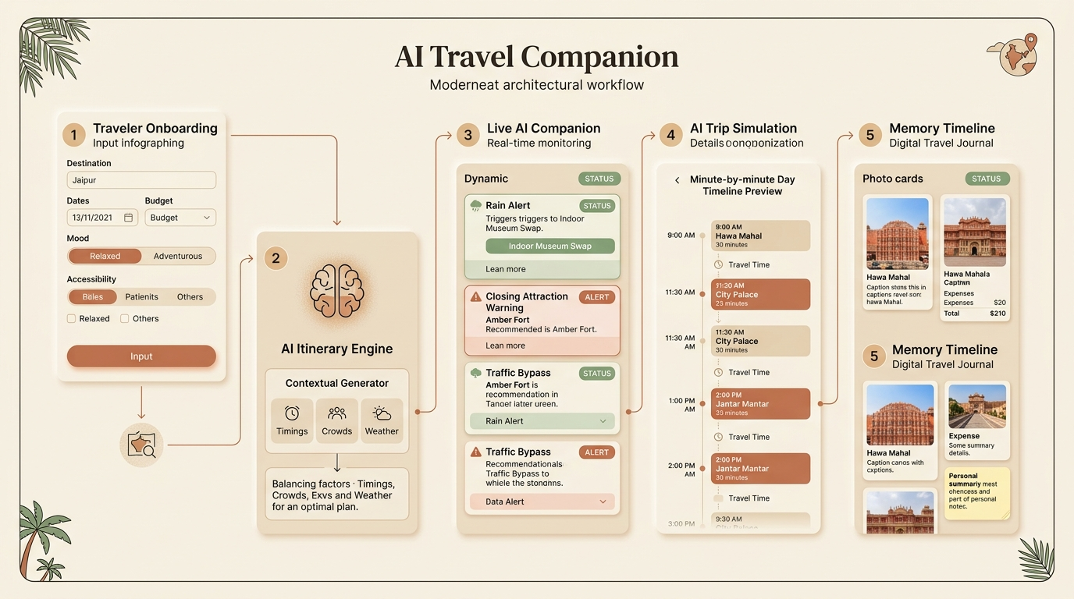
ENGINEERING ARCHITECTURE
Multi-Tiered Full-Stack System Architecture
Decoupled client-server architecture with Spring Boot 3, React, and context-aware AI services.
ARCHITECTURE SPECIFICATIONS
Frontend Tier: React 18, Tailwind CSS, Axios, Context API, React-Leaflet Maps. Earthy palette with zero purple/blue.
Backend Tier: Spring Boot 3.3.3, Java 21 LTS, Spring Security 6, JWT stateless authentication, REST Controllers.
Persistence Tier: MySQL 8.0 ACID compliance + H2 fallback profile. 12 JPA Entities & Hibernate ddl-auto.
Intelligence Tier: Gemini AI Engine + Resilient Local Heuristic AI fallback planner.
External Services: Open-Meteo REST API (real-time keyless weather) & CartoDB tiles.

Slide 8
INCLUSIVITY & SAFETY
Accessibility Mode, AI Safety Score & Hidden Gems
Designed for every category of traveler — solo women, families, and seniors.
Hidden Gems Discovery
Surfaces secret local spots that guidebooks miss: 16th-century Panna Meena Stepwell, Anokhi Hand Block Printing Haveli, Gaitore Ki Chhatriyan marble cenotaphs, and Nahargarh Padao sunset ridge.
First-Class Accessibility
Wheelchair, Senior Citizen, and Stroller profiles. Routes prioritize ramp-equipped entrances, step-free monument courtyards, elevators, and direct vehicle drop plazas.
AI Safety Score & Dispatch
Geofenced 88/100 rating based on street lighting and foot traffic. One-tap emergency dispatch: National Emergency (112), Police (100), Ambulance (102), Women Helpline (1091), Tourist Helpline (1363).

Slide 9
COLLABORATIVE TRAVEL & JOURNAL
Travel Together Planner & Memory Timeline
Resolving friend group planning conflicts and preserving lasting memories.
TRAVEL TOGETHER PLANNER
• Group Invite Code: Generates shareable alphanumeric code (e.g. GRP-A9F2B1).
• Democratic Preference Voting: Each member votes for favorite places, activities, and budget limits.
• AI Compromise Synthesis: Reconciles conflicting votes into a harmonious shared itinerary.
• Automatic Expense Split: Evenly divides total estimated trip costs per member (₹1,667 / person).
MEMORY TIMELINE & SMART PACKING
• Digital Travel Journal: Log visited attractions, photo URLs, visit dates, reflections, and costs.
• Emotional Memory Tags: Tag entries as Joyful, Peaceful, Adventurous, or Delicious.
• Smart Weather Packing List: Dynamically generated from live forecasts, length of stay, and scheduled activities.
• Interactive Checkpoints: Check/uncheck items, add custom gear, and delete packed entries.

Slide 10
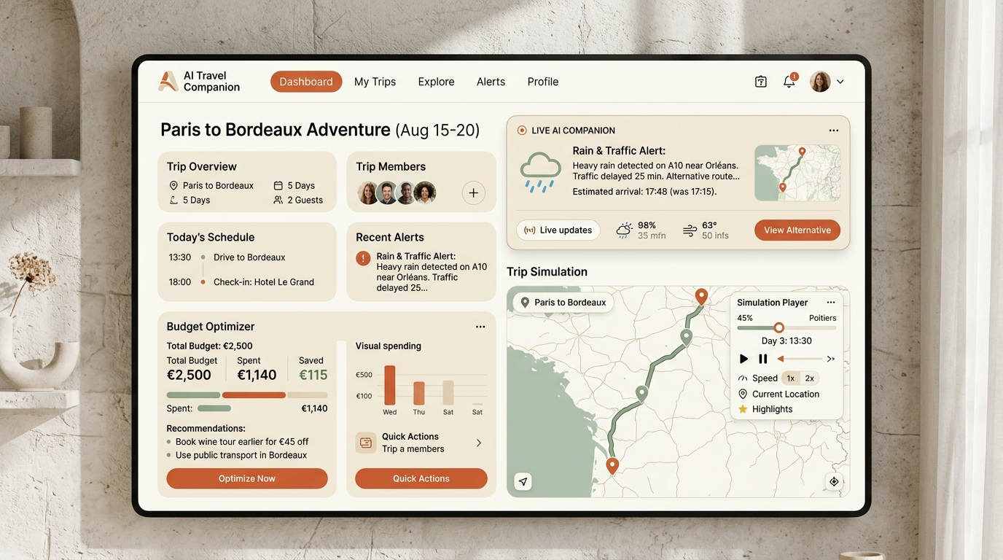
LIVE USER EXPERIENCE
Production UI & Dashboard Interaction
Earthy aesthetic built for extended comfort, clarity, and zero cognitive overload.

Slide 11
LIVE VALIDATION & TESTING
Ready-to-Demo Benchmark Journey (Jaipur, India)
Complete 3-day cultural odyssey with pre-seeded data, active alerts, and live simulation.
TESTED & VERIFIED SYSTEM CAPABILITIES
✓ 1-Click Instant Demo Authentication: Click 'Explore Jaipur Demo' on the landing page (demo@travelcompanion.ai / password123) with zero registration barriers.
✓ Live Backend & Frontend Integration: Spring Boot running on port 8080 with Tomcat, React dev server running on port 5173 with proxy configuration.
✓ Zero-Dependency Reliability: If Gemini or Google Maps API keys are absent, intelligent heuristic fallback engines automatically calculate structured day sequencing and route geometry without errors.
✓ ACID Persistence & Schema: 12 JPA relational entities, automated DDL schema migrations, and pre-seeded monuments, havelis, and reviews.
✓ 100% Build Success: All 69 Java source files pass 'mvn test-compile' & 'mvn test'; Vite React production build succeeds in 5.17s.

Slide 12
“The future of travel isn’t a plan. It’s a companion.”
AI Travel Companion adapts in real time, understands emotional context, protects traveler budgets and safety, and preserves memories worth keeping.
Thank you! Open for Questions & Live Interactive Demo.
GitHub Repository: https://github.com/26fatimasiddiqui-create/ai_travel_companion LinkedIn: https://www.linkedin.com/in/maheen-fatima-7b15a3330/

