Slide 1

GridGuard AI
Power Outage Prediction & Grid Equipment Failure Advisor

Slide 2


The Problem
Unexpected Failures
Power transformers and substations fail without warning, causing outages and service disruptions across the grid.
Schedule-Based Maintenance
Maintenance decisions rely on fixed schedules rather than real-time equipment condition data.
Weather Risk Ignored
Weather amplifies equipment failure risk, but is not integrated into maintenance planning workflows.

Slide 3

The Gap
Data Exists — Insight Doesn't
Condition data is collected but never converted into actionable failure probability scores.
Siloed Context
Historical incidents and weather signals remain disconnected from the maintenance decisions that need them most.
No Unified Risk Ranking
No existing system ranks assets by both failure likelihood and downstream grid impact simultaneously.

Slide 4



Our Solution
Unified Platform
Random Forest ML
Priority Engine
Assets, sensors, incidents, weather, and field crews in one risk-management system.
Predicts equipment failure probability from multi-source operational data.
Combines failure risk, grid impact, and weather context into a single composite score.

Slide 5




Core Value Proposition
Predict
Prioritize
Estimate failure probability from multi-source operational data.
Rank assets by consequence to the grid, not just failure likelihood.
Act
Prepare
Generate maintenance recommendations with specific, actionable timeframes.
Recommend field crews and optimal pre-positioning locations.

Slide 6

How It Works: The Pipeline
Priority Score Formula
Aggregate Sensor Data
Compute Priority Score
Join Weather & Incidents
Risk levels classified as Low / Medium / High / Critical from the Random Forest output.
50%
30%
20%
Failure Risk
Grid Impact
Weather Risk

Slide 7
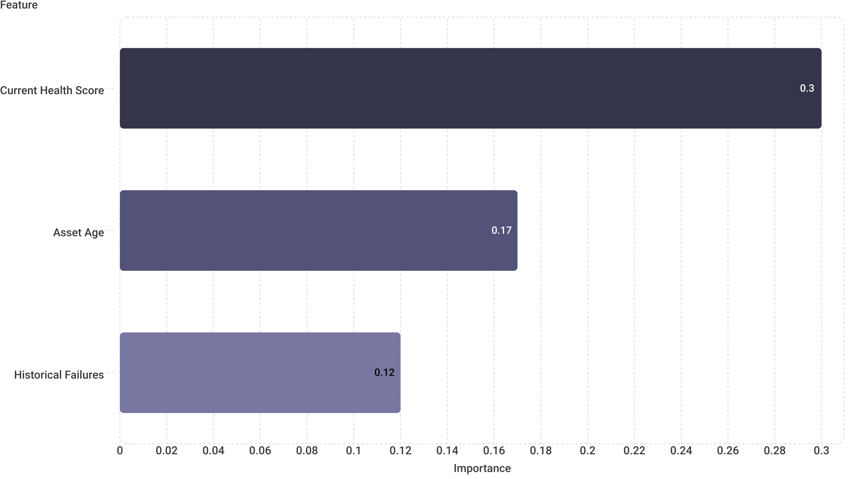
Model Performance
99.68%
100%
0.998
Accuracy
Recall
ROC-AUC
Evaluated on 1,250 test cases
Zero missed failure events
Near-perfect discrimination
Top Predictive Features
Trained on 3,750 rows with 300-estimator Random Forest ensemble.

Slide 8



Operational Outputs
Maintenance Recommendations
1
Critical → 2 hrs | High → 24–72 hrs | Medium → 7 days | Low → routine schedule.
Crew Pre-Positioning
2
Assign available teams to high-priority assets by geography before failures occur.
Grid Advisor
3
Operator-oriented summary of highest-risk assets and outage-prone areas.
Scenario Simulation
4
Test what-if weather and load conditions without persisting changes to the live system.

Slide 9

Technology Stack
Backend
Python · Flask · SQLAlchemy · SQLite
Machine Learning
Scikit-learn Random Forest (300 estimators)
Frontend
HTML / CSS / JavaScript · Chart.js · Leaflet + OpenStreetMap
Data Engineering
Pandas · NumPy for aggregation and feature engineering

Slide 10
Next Steps
01
02
Validate with Real Utility Data
Scale Infrastructure
Confirm model performance against real-world failure outcomes from utility partners.
Migrate to PostgreSQL and integrate streaming sensor telemetry for production loads.
03
04
Advance the Model
Harden for Production
Add SHAP explainability, temporal sequence models, and network topology analysis.
Implement authentication, audit logging, and production safety controls.

