Slide 1
Summer training /MINI Project
BY :-
Meenal Baranwal

Slide 2

Amazon clone (front-end)

Slide 3
ABOUT
AKTU ROLL NO :
SHIVAM DUBEY ----2202840100201
BRANCH:- CSE

Slide 4
Introduction
In the ever-evolving landscape of web development, creating dynamic and visually appealing websites has become both an art and a science. Welcome to our HTML, CSS, and JavaScript project—a journey into the heart of modern web development. In this project, we embark on a compelling exploration of these fundamental technologies to build an engaging and functional web application.
The internet has transformed the way we connect, communicate, and conduct business. An integral part of this transformation lies in the web technologies that power the websites and applications we interact with daily.
HTML (HyperText Markup Language), CSS (Cascading Style Sheets), and JavaScript form the core trio behind every web page you visit. Together, they enable us to craft stunning visuals, ensure seamless user experiences, and add interactivity to our digital creations.

Slide 5
*HTML*: The foundation of our web project, HTML provides the structure and content of web pages. It allows us to define headings, paragraphs, images, links, and much more. We'll use HTML to create the skeleton of our web application, organizing content in a logical and meaningful manner.
*CSS*: Cascading Style Sheets, or CSS, brings aesthetics to the forefront. With CSS, we can style our web pages, making them visually appealing and responsive across various devices. Our project will delve into CSS to design a captivating user interface, ensuring that our web application stands out in both form and function.
*JavaScript*: As the dynamic force behind the scenes, JavaScript empowers us to create interactive and responsive web applications. With JavaScript, we can add functionality such as form validation, animations, and real-time updates. Our project will leverage the power of JavaScript to make our web application not just beautiful but also highly functional.

Slide 6
Throughout this project, we will explore these technologies in-depth, starting with the basics and gradually moving towards more advanced concepts. Our goal is to provide a comprehensive and hands-on learning experience for both beginners and those looking to expand their web development skills.
Our project will not only equip you with the knowledge and skills to build a fully functional web application but also foster a deeper appreciation for the artistry and innovation that lie at the core of web development. We invite you to join us on this exciting journey as we unlock the potential of HTML, CSS, and JavaScript to create a web application that is as informative as it is visually appealing, and as engaging as it is functional.

Slide 7
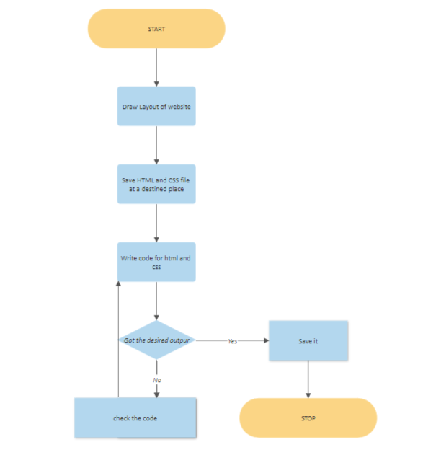

Slide 8
Basic tags used:-
Some of the basic tags are:
1.<html> - defines the html document . This element tells a browser that this is an HTML document. This tag is defined at the top of the html file and at the end of file.
2.<head> - defines information about the document. The browser does not display the “head information “to the user.
3.<title> - defines the document title. Title tag is used in between <head> and</head> tag because it is title tag in section of <head> tag.

Slide 9
4.<body> - defines The document’s body. The body element defines the document’s body. It contains all the comment of the document.
5.<p> - defines a paragraph. This tag is used for creating the paragraph in the web page. It is used inside the body of file.
6.<br> - Inserts a single line break. The <br> tag insert a single line break. We can use the tag to enter blank line but not to separate paragraph. This tag has no end tag.
7.<hr> - This tag inserts a horizontal rule . The <hr> tag has no end tag.

Slide 10
Planning OF WORK
IN THIS PROJECT, WE DECIDED TO MAKE FRONT-END PROJECT OF AMAZON CLONE ON THE BEGINNER LEVEL.WE DEVIDE OUR TEAM IN 2 SECTION TO COMPLETE PROJECT.WE TTOK HELP FROM OUR SENIOR AND DEEP STUDY OF GUI WE MAKE OUR PROJECT INTERACTIVE AFTER 3 DAYS CONTINUOUS HARDWORK WE HAVE COMPLETED OUR PROJECT AND OUR TASK GIVEN BY DHANANJAY SHARAMA SIR.THROUGH THIS PROJECT WE ENHANCE OUR SKILLS AND KNOWLEDGE.

Slide 11
Why Front-end is important
Front-end is important as it connects two crucial areas: the website design (vision, look, feel, personality of the site) and the back-end development (the working pieces, content, management areas, and dynamically-driven data of the site). Front-end development is on the front lines to creating and managing a users experience. By bringing the design together and bridging the path between the backend data we create the building blocks that control how a user feels about the content they are reading or the actions they are taking on a site.
Good front-end, with good design, helps make websites less confusing for the user by making the technology intuitive and easy to use.

Slide 12
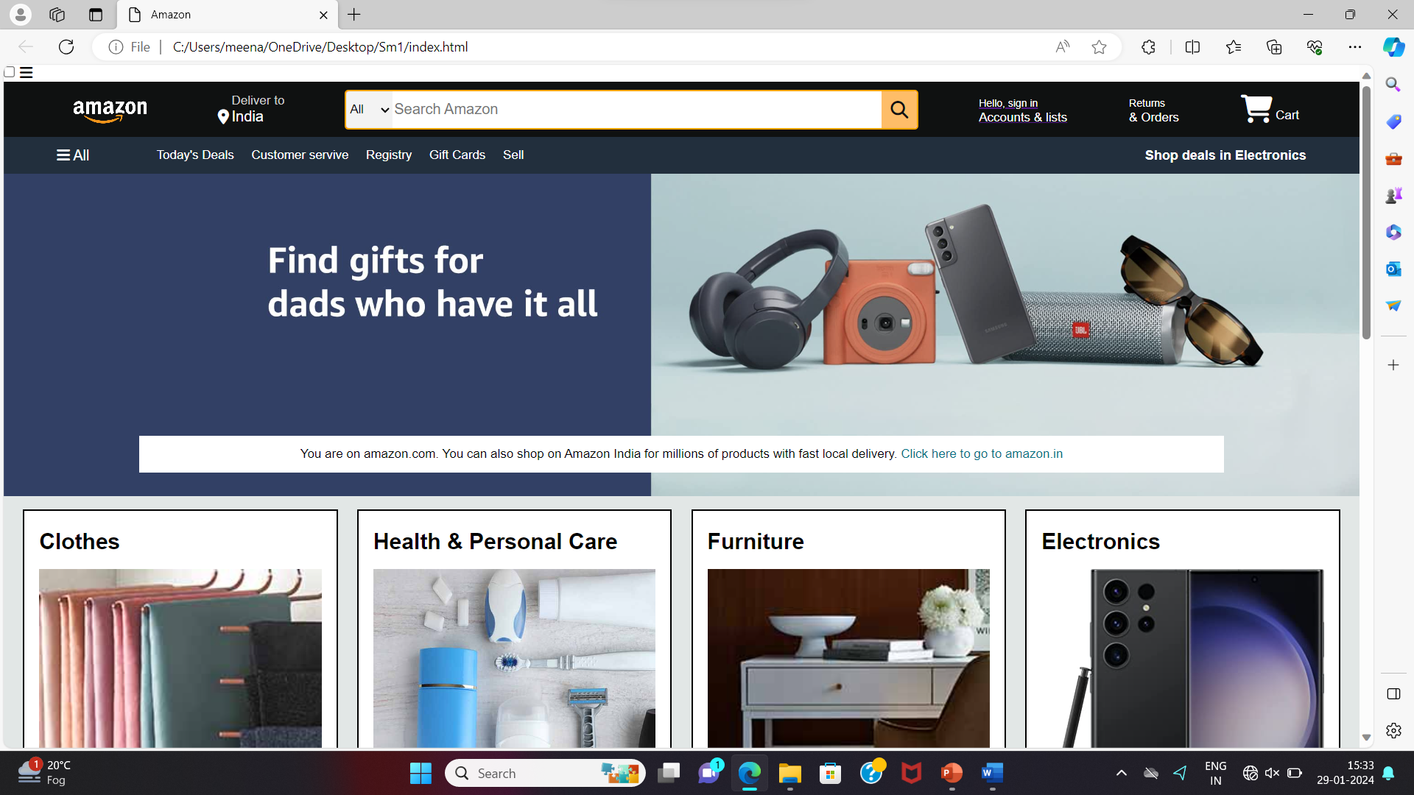
rESULT

Slide 13
Methods used:-
HTML
CSS
JAVASCRIPT

Slide 14
bibliography
We frequently visited Stack Overflow to find solutions to coding challenges and troubleshoot issues encountered during development.MDN Web Docs was a valuable resource for detailed documentation on web technologies, APIs, and best practices.
The platform also served as a source of open-source code libraries and inspiration for our project. We integrated font awesome into our project for responsive icons and UI components.
Font awesome provided a wide selection of web fonts that we used to enhance the visual appeal of our website.

Slide 15
THANK YOU
“
”

