Slide 1








DHANALAKSHMI SRINIVASAN INSTITUTE OF RESEARCH & TECHNOLOGY × DONGGUK UNIVERSITY, SOUTH KOREA
J O I N T L Y O R G A N I Z E D I N T E R N A T I O N A L H A C K A T H O N
INTELLATHON -26
Ask Smarter. Prioritize Faster. Route Better.
Smart Ambulance Priority, Duplicate Detection & Routing
TEAM NAME
JARVIS
TEAM ID
HCINTL033
FOCUS AREA
Healthcare
PROBLEM STATEMENT TITLE
AI-Based Smart Ambulance Priority, Duplicate Incident Detection & Shortest-Route Dispatch System
Perambalur, Tamil Nadu, India • 14–15 October 2026

Slide 2




0 2 · P R O B L E M & S O L U T I O N
Problem Statement & Proposed Solution
×
DGU
Logo
The Challenge
Simultaneous calls, limited ambulances, repeated questions, hard-to-spot urgent patients, duplicate calls for one accident, and inefficient ambulance allocation & hospital routing.
P R O P O S E D S O L U T I O N
Priority 108 helps control centres ask smarter, prioritize faster, link duplicate calls and route better.
What It Does
1
Target Users
Emergency control-centre dispatchers and ambulance teams
Adaptive questions, priority levels, duplicate linking
Current Gaps
Duplicate calls, repetitive questions, unclear urgency, manual allocation
How It Works
2
Rules + Dijkstra routing; dispatcher approves
What Makes It Different
3
Links duplicate calls to one incident, not patients
3 → 1
Example: 3 callers report one accident → 1 incident record; other urgent patients are still prioritized and injured counts kept.

Slide 3
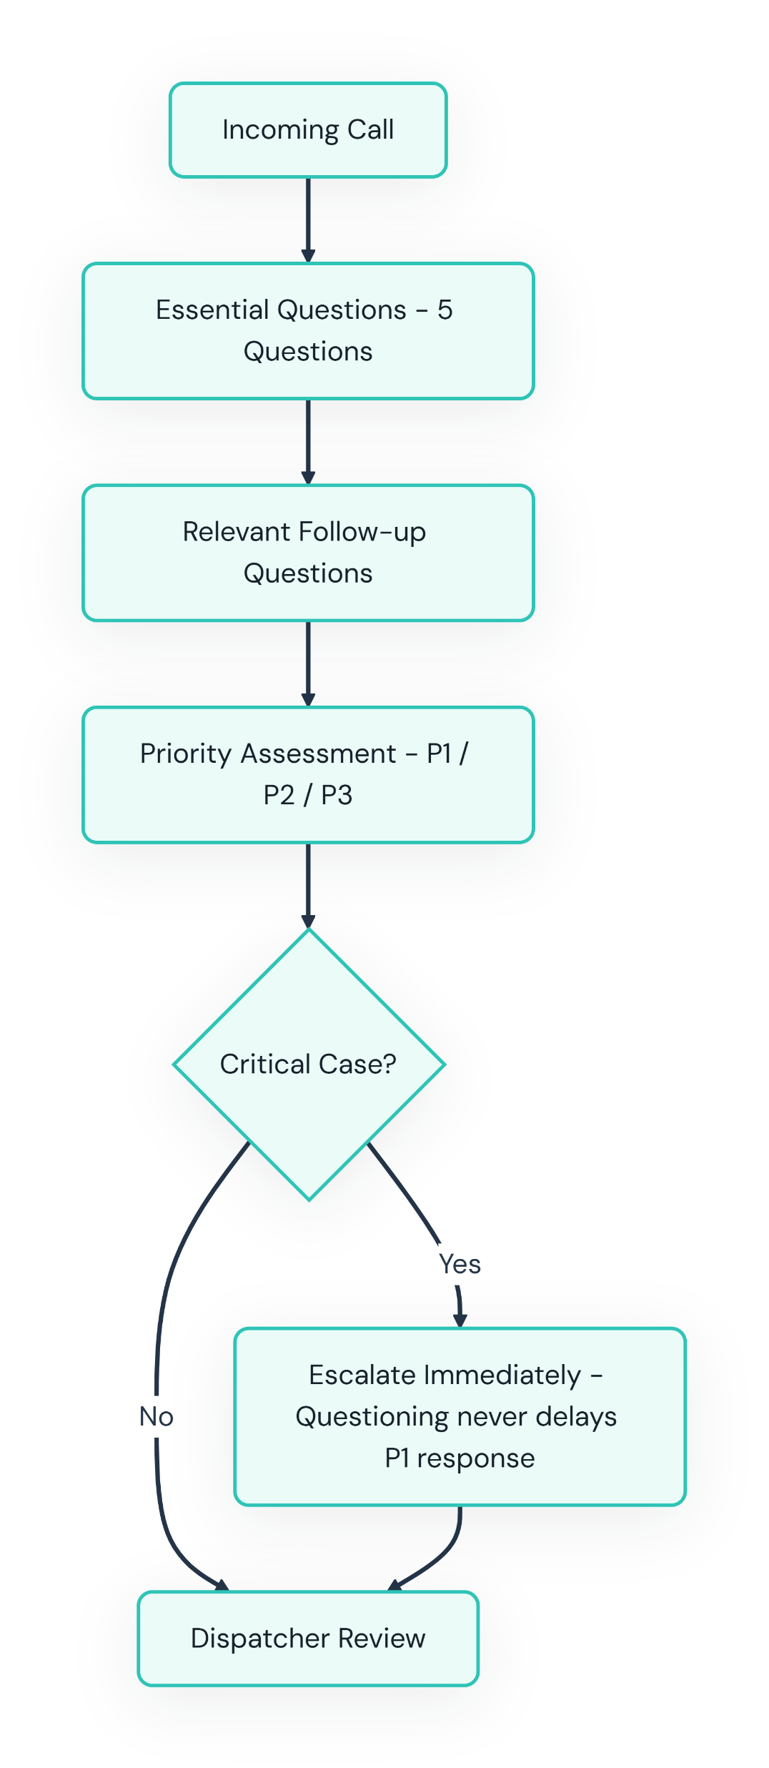
Adaptive Questioning & Priority
0 3 · A D A P T I V E Q U E S T I O N S
DSIRT
Logo
×
DGU
Logo
Questions & Priority
Essential Questions
Event, consciousness, breathing, bleeding, location
1
Road Accident
Injured count, hazards, trapped patients, injuries
2
Chest Pain / Unconscious
Onset & breathing; last-responsive time
Incoming Call
↓ Essential Questions (5)
↓ Relevant Follow-up Questions
↓ Priority Assessment (P1 / P2 / P3)
↓ Dispatcher Review
Critical cases escalate immediately; questioning never delays P1 response.
3
P1 — Critical
Immediate escalation & emergency response
4
P2 — High Urgency
Urgent assessment & appropriate response
5
P3 — Lower Urgency
Follow approved triage & response protocol
6

Slide 4
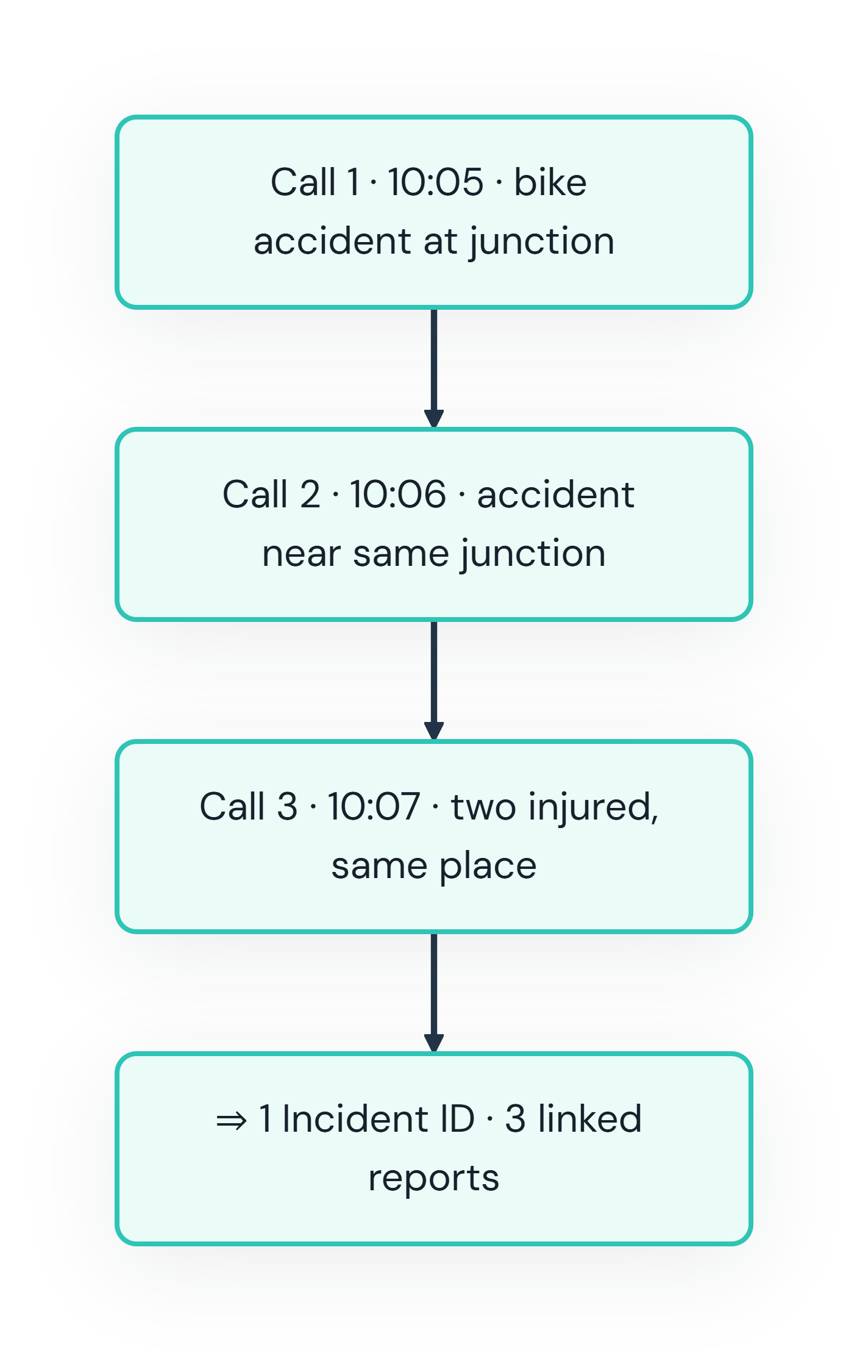
Duplicate Emergency Call Detection
0 4 · D U P L I C A T E D E T E C T I O N
DSIRT
Logo
×
DGU
Logo
Matching Information
1
GPS / reported location
2
Distance between locations
Call 1 · 10:05 · bike accident at junction
Call 2 · 10:06 · accident near same junction
Call 3 · 10:07 · two injured, same place
⇒ 1 Incident ID · 3 linked reports
3
Time gap between calls
4
Incident type, landmarks, details
Safety rule: Deduplicate incident records, not patients — keep injured count & conditions
Algorithm
Receive & Search
Extract location, time, type; search active incidents in radius & time window
Compare
Strong match: link to incident. Uncertain: dispatcher review
Create New
No suitable match: create a new incident

Slide 5





Allocation & Hospital Routing
0 5 · A L L O C A T I O N & R O U T I N G
DSIRT
Logo
×
DGU
Logo
A. Priority-Based Allocation
B. Hospital Routing
1 Priority
Assessed priority
2 Ambulances
Identify available units
₄ Staff & Kit
Equipment, personnel
₅ Recommend
Suggest a suitable ambulance
₇ Hospital
Travel time, suitability, availability
Hospital A: 12 min, lacks needed facility (illustrative)
Hospital B: 15 min, suitable & available (illustrative)
Result: B suggested despite longer time
Illustrative times, not real data
3 ETA
Location & travel time
6 Confirm
Dispatcher confirms
Graph Model
Nodes
Junctions & hospital entrances
1
8 Dijkstra's Algorithm
Junctions & hospital entrances = nodes; road segments = edges with travel-time weights. Finds minimum total time when weights are non-negative.
9 Recommendation
Suggest a suitable hospital & route for dispatcher confirmation. Nearest hospital is not always the most appropriate.
Edges
Road segments with travel-time weights
2
Output
Minimum total-time route to hospital
3

Slide 6



0 6 · A R C H I T E C T U R E & I M P A C T
Architecture & Impact
×
DSIRT
Logo
DGU
Logo
1
2
3
Architecture
Call → Questions → Duplicate Check → Priority → Allocation → Routing → Approval → Dashboard
Stack & Benefits
React, FastAPI, PostgreSQL, OpenStreetMap; focused questions, fewer duplicates
Evaluation Metrics
Duplicate accuracy, false merges, dispatch time, route accuracy
Thank You
JARVIS • Adaptive Questioning · Duplicate Detection · Priority Allocation & Routing
Prototype needs clinical validation, privacy safeguards & authorization before 108 integration

